Slide 1
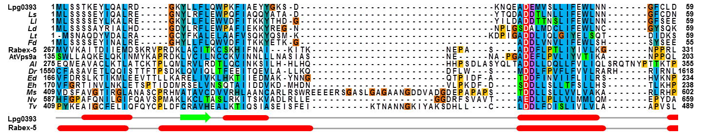
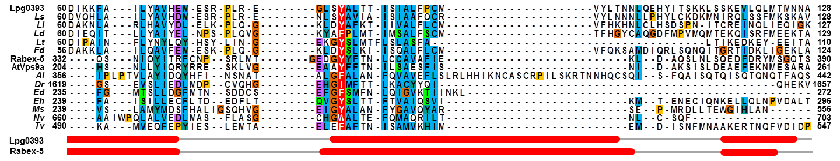
Figure 1

Slide 2
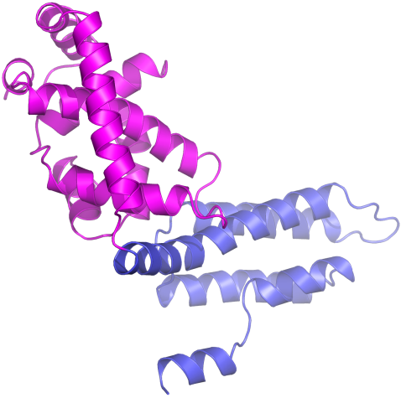
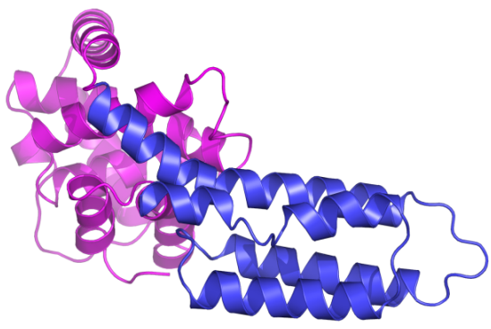
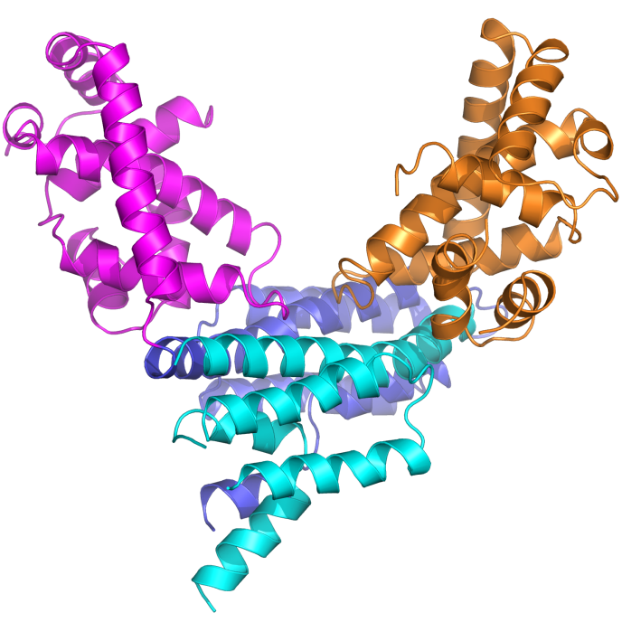
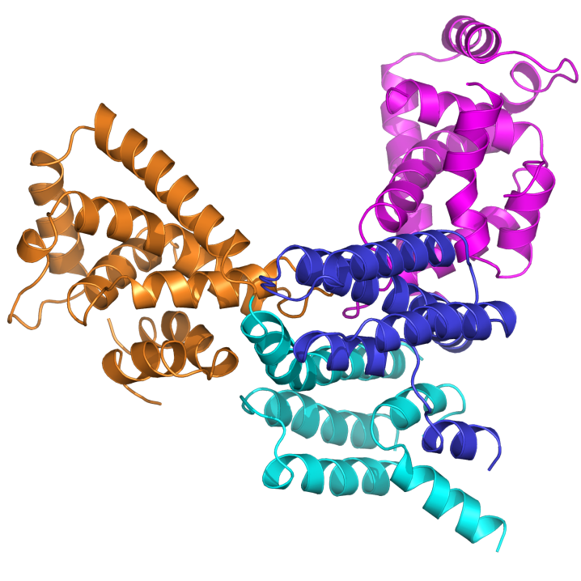
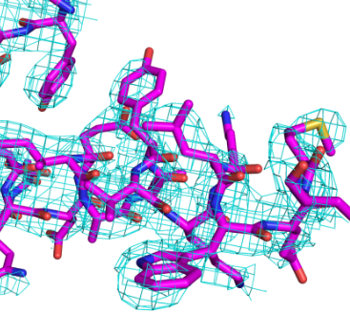
A
α6
Vps9-like domain
α3
α7
α5
90°
N
α4
α8
α1
α9
C
α2
α12
α11
α9
α8
α11
N
Helical bundle
α10
α10
C
α12
B
Chain A
Chain B
N
180°
N’
α11
α11'
C
α12
70°
C’
α12’
C
100 kDa
Lpg0393
(35 kDa)
Y206
Y224
M231
64 kDa
X
43 kDa
27 kDa
25 kDa
W229
10 kDa
Figure 2

Slide 3
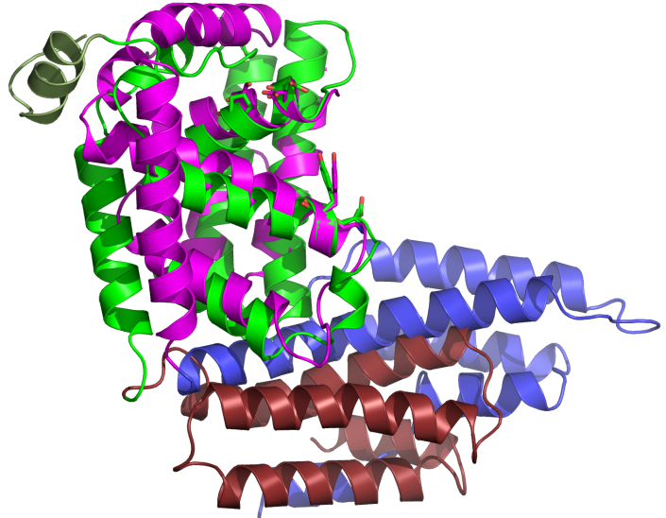
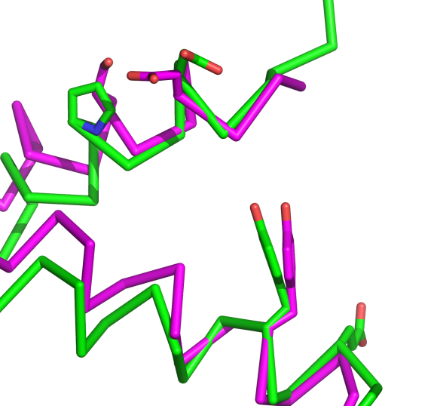
A
C
Ser45
Asp41
Asp313
α3
Pro317
αV4
αV4
α3
N
αV6
α5
α5
Tyr84
Lpg0393Δ17
+
Rabex-5
(132-397)
Tyr354
Glu351
N
αV6
Gly81
C
B
α6
αV4
α3
αV3
Asp313
N
Asp41
αC
αV6
Tyr354
α7
α2
α5
Tyr84
C
αV1
αV2
α1
Lpg0393 Vps9-like domain
α4
αV5
Lpg0393 Helical bundle
α9
HB3
Rabex-5 Vps9 domain
α8
HB4
Rabex-5 Helical bundle
α10
HB2
C
α12
α11
N
HB1
Rabex-5 C-terminal helix
Lpg0393Δ17
Rabex-5(132-397)
C
α1
α2
Lpg0393
AtVps9a
Rabex-5
1
100
232
- | - | - | - | - | - | - | - | - | - | - | - | - | - | - | - | - | - | - | - | M | L | S | S | - | - | - | - | - | - | - | - | - | - | - | - | - | - | - | T | K | E | Y | L | Q | A | L | R | D | - | - | - | - | - | G | K | Y | - | L | L | F | L | Q | W | P | K | F | I | A | E | Y | Y | G | K | S | D | K | N | Q | E
E | E | V | I | A | D | E | K | L | F | Q | K | M | S | L | V | Q | Q | F | I | S | P | E | N | L | D | I | Q | P | T | F | Q | N | E | S | S | W | L | L | A | Q | K | E | L | Q | K | I | N | M | Y | K | A | P | R | D | K | L | V | C | I | L | N | C | C | K | V | I | N | N | L | L | L | N | A | S | I | A | S | N | E
E | K | K | D | L | A | I | Q | K | R | I | R | A | L | R | W | V | T | P | Q | M | L | C | V | P | V | N | E | D | I | P | E | V | S | D | M | V | V | K | A | I | T | D | I | I | E | M | D | S | K | R | V | P | R | D | K | L | A | C | I | T | K | C | S | K | H | I | F | N | A | I | K | I | T | - | - | K | N | - | E
αV1
αV2
αV3
α3
α4
α5
Lpg0393
AtVps9a
Rabex-5
40
180
309
- | - | - | - | A | D | E | M | V | S | L | L | I | F | E | W | L | N | N | G | F | C | L | D | D | I | K | K | F | A | I | L | Y | A | V | H | E | M | E | S | R | P | L | R | E | - | G | L | S | Y | A | L | T | T | I | S | I | A | L | F | P | C | M | V | Y | L | T | N | N | L | Q | E | H | Y | I | T | S | K | K | L | S
N | A | P | G | A | D | E | F | L | P | V | L | I | Y | V | T | I | K | - | A | N | P | P | Q | L | - | H | S | N | L | L | Y | I | Q | R | Y | R | R | E | S | K | L | V | - | - | G | E | A | A | Y | F | F | T | N | I | L | S | A | E | S | F | I | S | N | - | - | - | - | - | I | - | D | - | - | A | K | S | - | - | I | S
- | P | A | S | A | D | D | F | L | P | T | L | I | Y | I | V | L | K | - | G | N | P | P | R | L | - | Q | S | N | I | Q | Y | I | T | R | F | C | N | P | S | R | L | M | - | T | G | E | D | G | Y | Y | F | T | N | L | C | C | A | V | A | F | I | E | K | - | - | - | - | - | L | - | D | - | - | A | Q | S | - | - | L | N
αV4
αV5
αV6
α6
α7
Lpg0393
AtVps9a
Rabex-5
116
248
376
S | S | K | E | V | L | Q | L | M | T | M | N | N | A | Y | L | E | K | Q | R | F | V | E | F | L | G | Q | E | Q | D | K | F | F | T | W | V | K | E | A | D
L | D | E | A | E | F | E | K | N | M | E | S | A | R | A | - | - | - | - | - | - | - | - | - | - | - | - | - | - | - | - | - | - | - | - | - | - | - | - | -
L | S | Q | E | D | F | D | R | Y | M | S | G | Q | T | S | - | - | - | - | - | - | - | - | - | - | - | - | - | - | - | - | - | - | - | - | - | - | - | - | -
αC
Figure 3

Slide 4
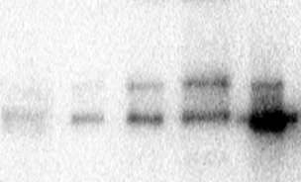
A
Rab5b(1-190)
Rab21(15-200)
Rab22(1-175)
Rab1a(1-182)
Rab6a(1-200)
4.0
3.4
2.8
2.2
1.6
1.0
0.4
K_{obs} (s⁻¹) X 10⁻³
0 | 0.5 | 1 | 1.5 | 2
[Lpg0393] (μM)
0.01 μM
Substrate | k_{cat}/K_{m} (M⁻¹s⁻¹) | k_{int} (s⁻¹)
Rab5 | 5.4 X 10² | 9.4 X 10⁻⁵
Rab21 | 1.1 X 10³ | 2.9 X 10⁻⁴
Rab22 | 1.6 X 10³ | 2.9 X 10⁻⁴
0.1 μM
Lpg0393
0.5 μM
Intrinsic
1.0 μM
5 mM EDTA
2.0 μM
B
Rab5b(1-190)
C
Rab5b(1-190)
D
Glutathione agarose Input
Lpg0393
GST-Rab5b(1-190)
GST-Rab6a(1-200)
EDTA
+ | + | + | + | +
- | - | + | + | -
- | + | - | - | -
- | + | - | + | -
kDa
40
Lpg0393
35
25
Western blot
1 μM Lpg0393
1 μM Lpg0393
1 μM Lpg0393(D41A)
1 μM Rabex-5(132-397)
1 μM Lpg0393(Y84F)
Intrinsic
Intrinsic
5 mM EDTA
Figure 4

Slide 5
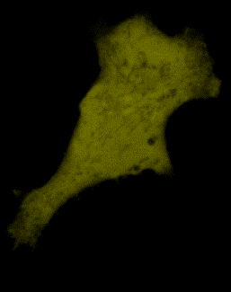
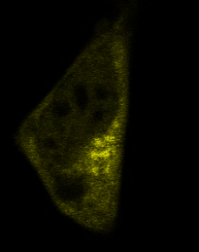
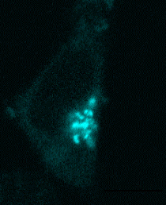
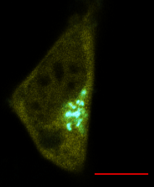
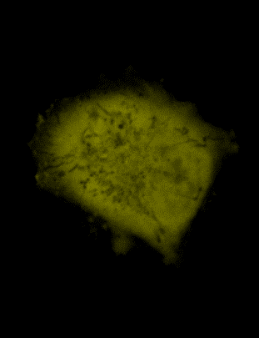
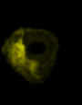
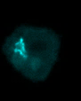
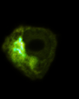
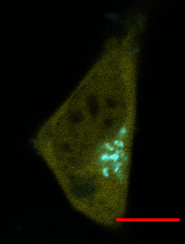
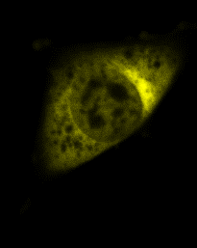
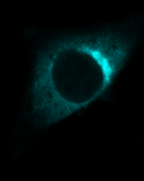
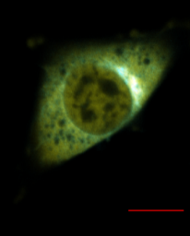
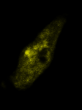
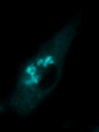
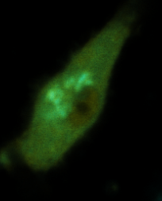
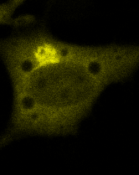
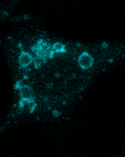
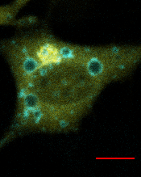
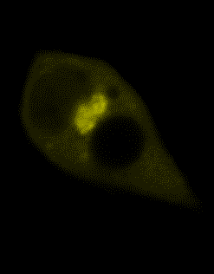
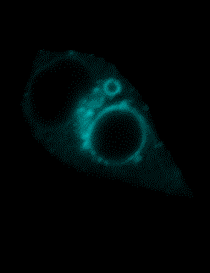
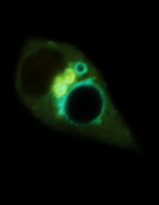
A
YFP alone
Lpg0393
Golgi marker
Merge
Intensity
HeLa cells
2 4 6 8 10 12 14 [μm]
RAW264.7
2 4 6 8 10 12 14 [μm]
B
Lpg0393
Rab5b(S34N)
Merge
Intensity
HeLa cells
2 4 6 8 10 12 14 [μm]
RAW264.7
2 4 6 8 10 12 14 [μm]
C
Lpg0393
Rab5b(Q79L)
Merge
Intensity
HeLa cells
2 4 6 8 10 12 14 [μm]
RAW264.7
Figure 5

