Slide 1
A MEMBER OF THE RUSSELL GROUP

Slide 2
Denis Duret d.duret@liverpool.ac.uk School of Veterinary Science University of Liverpool
Is PeerMark a useful tool for formative assessment of literature review?
A trial in the School of Veterinary Science
Zeeshan Durrani Z.durrani@liverpool.ac.uk
Lecturer
School of Veterinary Science
University of Liverpool

Slide 3
“Feedback is a troublesome issue in higher education”
Nicol et al., 2014
Nicol, D., Thomson, A. and Breslin, C. 2014. Rethinking feedback practices in higher education: a peer review perspective. Assessment & Evaluation in Higher Education, 39, 102-122.

Slide 4
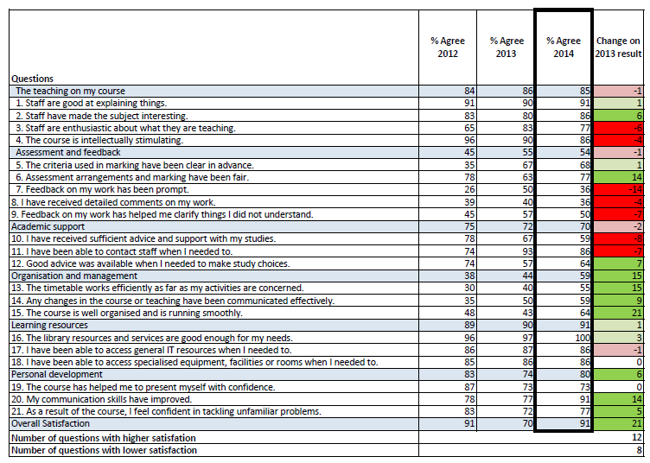
NSS 2014 JACS Subject Level 3 – Veterinary Science

Slide 5
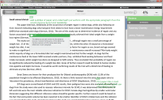
What is PeerMark?
Turnitin, Grademark, & Peermark are a suite of tools
PeerMark facilitates peer review so that students can evaluate each other’s work and learn from their classmates.

Slide 6
Why PeerMark?
Undergraduate Research Skills
Aims
Provide students with research learning experience and bring them as close as possible to the experience of academic staff carrying out their disciplinary research

Slide 7
Research Skills Theme
BVSc, Second year component
Literature review writing
(2500 words)
Generation of references
Effective literature searching
Use of core IT programmes (reference management softwares)
Writing research proposal
Notes:
The research skills theme in the second year seeks to achieve effective literature searching, scientific writing, generation of references, use of core IT programmes such as reference management software (e.g. RefWorks, EndNote and Mendeley), and to develop critical independent thinking.

Slide 8
PeerMark©, peer review process
Students submit their literature review via Turnitin GradeMark©
The instructor creates a PeerMark© assignment and sets two reviews for each student to be reviewed.
The student writes a review anonymously for each assigned paper by responding to the open ended (written) and/or scale (ranked) questions selected by the instructor
Once the PeerMark© assignment due date passes, the instructor reviews all comments and adds feedback
On the PeerMark© assignment post date, reviews of the students’ papers become available for the papers’ authors to view

Slide 9
Show one quick example of the students’ submission

Slide 10
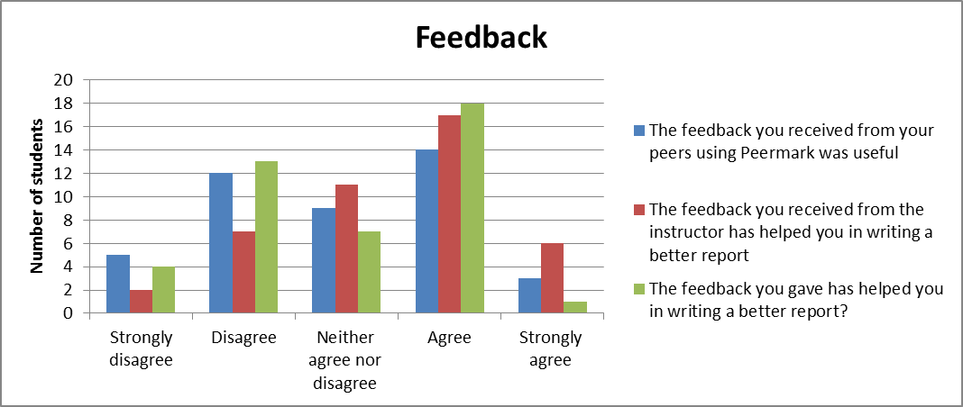
The results show that the feedback received from the peers was “useful” and the feedback received from the instructor has greatly “helped” them in writing a better report.
Also, the feedback that they gave help in the PeerMark process has helped them to produce a better report (green).

Slide 11
Student Comments
“I actually thought it was good. It was very personal, not something like group feedback. My style of writing and ability to reference has changed significantly”
“I was given conflicting feedback by the peers, one person said my referencing was good whilst another said it was wrong”. The instructor’s feedback helped me in identifying the correct feedback”.
“One thing I must admit about the PeerMark
is it does allow you to look at other students work,
so you can pick up on things that they
are going well”

Slide 12
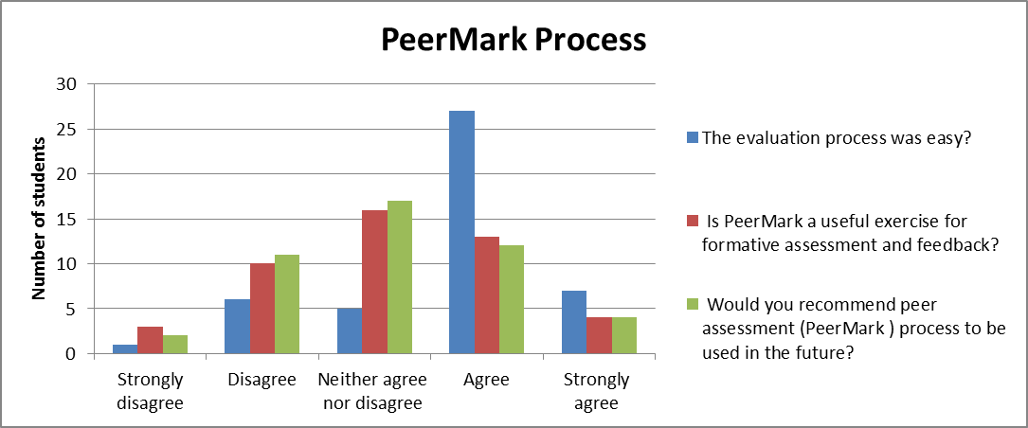
The PeerMark © process was easy but students are equally divided on the usefulness of the exercise

Slide 13
Student Comments
“Hard to tell as its usefulness is based on the knowledge of the person giving you a review. ”
“I would recommend the use of PeerMark for formative assessment but not for summative exam”
“If it’s intended to involve students and engage them in a productive way, then it’s a good system. Quite simple to use”

Slide 14
Conclusions
Students responded very positively for the use of PeerMark
Tool still underdevelopment (but not priority for Turnitin – see RoadMap)
Unforgiving if you get the dates wrong when you set it up.
Lack of group functionality

Slide 15
Conclusions
A useful tool for a peer-based approach to feedback
A useful tool for students engagement
However,
Students need support and guidance on what to look for and an understanding of how examining other students’ work will improve their own writing process.
Risk of variability in student’s feedback
Training is required on how should they
write constructive feedback?
Some students didn’t put enough effort
and may prove to be disadvantageous
Notes:
If students are unable to be critical and evaluative about the stuff they produce themselves it will be even more challenging for them to construct sensible feedback on something unfamiliar

Slide 16
Thank you!
Zeeshan Durrani & Denis Duret
School of Veterinary Science
Email: z.durrani@liverpool.ac.uk & dduret@liverpool.ac.uk

Slide 17
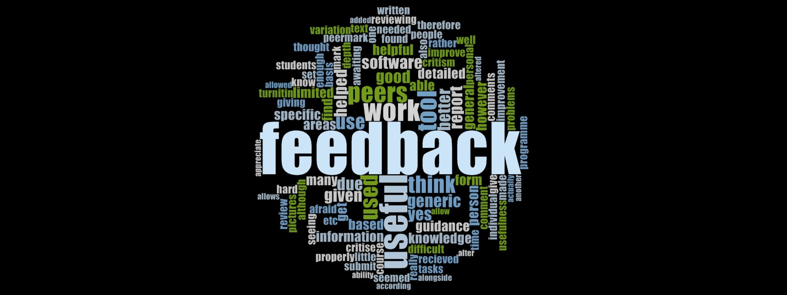
Word Cloud
Research Skills Theme

