Slide 1
1. Young/Adult
Physiological redox signaling
NADH oxidase(s)
(activated by contractile
activity)
O₂.
Local
thiol
oxidation
Activation of
multiple regulatory
signaling pathways
Specific adaptations
to contractile activity
H₂O₂
2. Old
Oxidative damage
Increased mitochondrial
generation of ROS
Increased
H₂O₂ and
other ROS
Oxidative damage to lipids, proteins, DNA
Dysregulated redox signaling
NADH oxidase(s)
(? activated by contractile
activity)
O₂.
Local
thiol over-
oxidation
Chronic activation of
multiple regulatory
signaling pathways,
with lack of response
to stimuli
Lack of adaptations
to contractile activity
Elevated
H₂O₂
Figure 1

Slide 2
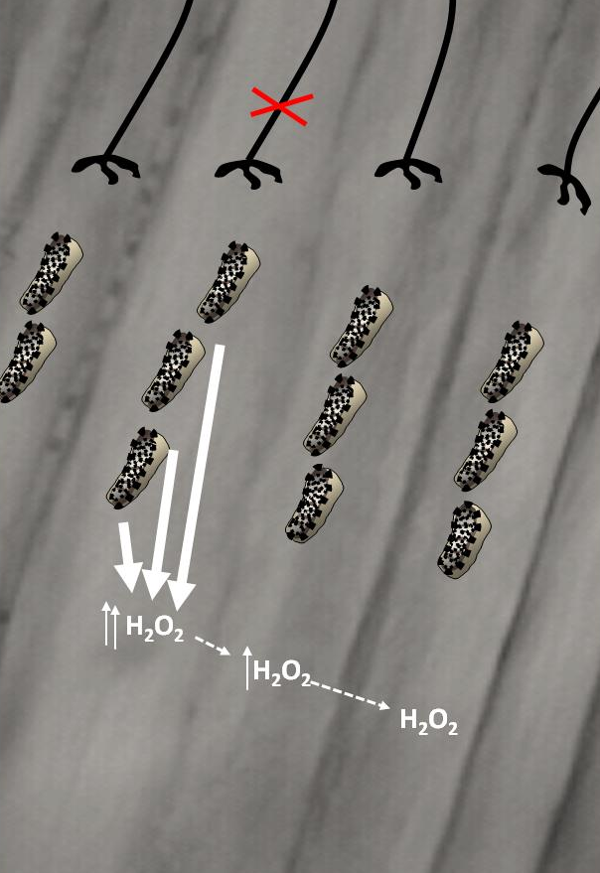
H₂O₂ diffuses from mitochondria in denervated fiber to promote axonal
regeneration in damaged axon
and sprouting of neighbouring axons
Only single fibers become denervated leading to very high mitochondrial ROS generation in the denervated fibre
H₂O₂
High local H₂O₂ causes local oxidative damage, chronically activates redox
pathways and attenuates redox-regulated responses to contractions
in the denervated fiber
H₂O₂ diffuses from denervated fiber to chronically activate redox
pathways and attenuate redox-regulated responses to contractions
in neighbouring innervated fibers
Figure 2

