Slide 1

Progress in Stochastic Model Updating
3rd International Symposium on Uncertainty Quantification and Stochastic Modelling
UNCERTAINTIES 2016
Maresias, São Paulo, Brazil
15-19 February 2016
John E Mottershead^{1,2}
j.e.mottershead@liv.ac.uk
with contributions from:
Matteo Broggi², Herbert Martins Gomes³, Yves Govers⁴, Hamed Haddad Khodaparast⁵, Michael Link⁶, Edoardo Patelli² and Tiago Silva⁷
¹Centre for Engineering Dynamics, University of Liverpool, UK.
²Institute for Risk and Uncertainty, University of Liverpool, UK.
³Department of Mechanical Engineering, UFRGS, Brazil.
⁴Institute of Aeroelasticity, German Aerospace Centre (DLR), Göttingen, Germany.
⁵College of Engineering, Swansea University, UK.
⁶Institute for Statics and Dynamics, University of Kassel, Germany.
⁷Instituto Superior de Engenharia de Lisboa, Portugal.

Slide 2



University of Liverpool
Institute for Risk and Uncertainty
Multidisciplinary problems
Quantification, Communication, Decision Making.
Engineering, Mathematics, Finance & Economics, Environmental Sciences, Public Health, Social Sciences.
40 Institute members
Industrial focus
EPSRC and ESRC Centre for Doctoral Training (CDT) in Risk & Uncertainty
EPSRC & ESRC funding of £4M.
Industrial partners’ contribution £20M.
Cohort training of PhDs.
1-year MRes taught modules & project
3-year PhD
Easter and Summer Schools
6-month industrial placement.

Slide 3
Outline
Deterministic Model Updating
Lynx Helicopter
Variability and Uncertainty
Covariance, Interval and Bayesian Model Updating
Parameter Selection in Stochastic Model Updating
Stochastic Model Updating - DLR AIRMOD Structure
Covariance, Interval and Bayesian Model Updating Results
Conclusions

Slide 4
Deterministic Model Updating by the
Sensitivity Method
Sensitivity - in the sense of the local derivative of an output with respect to a parameter – iterative solution
Output – typically a natural frequency, mode shape, vibration response, FRF.
Parameters – (1) Physical, such as a lumped mass, stiffness of a boundary condition, elastic modulus, mass density; (2) Geometric, such as a dimension of a beam cross section, an offset parameter.
A nonlinear inverse problem.
J.E. Mottershead, M. Link and M.I. Friswell,
The sensitivity method in finite element model updating: a tutorial,
Mechanical Systems and Signal Processing, 25(7), 2011, 2275–2296.

Slide 5
Deterministic Model Updating by the
Sensitivity Method
  Model Updating problems are usually ill-conditioned - require regularisation, weighting, side constraints to enforce physical understanding.
  The choice of Updating Parameters is not straightforward
    parameters should be sensitive ( but sensitive parameters are not always the right ones);
    select parameters with columns that most closely represent the measured outputs (subset selection);
    select stiffness parameters that have high strains in the mode shapes.
Updated model should be fit for purpose – requires physical understanding of the problem and of the model.

Slide 6
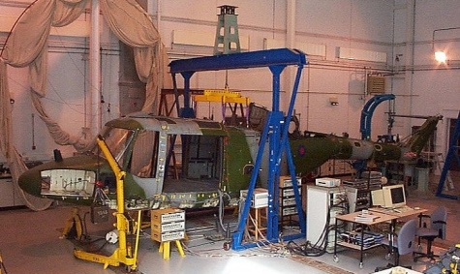
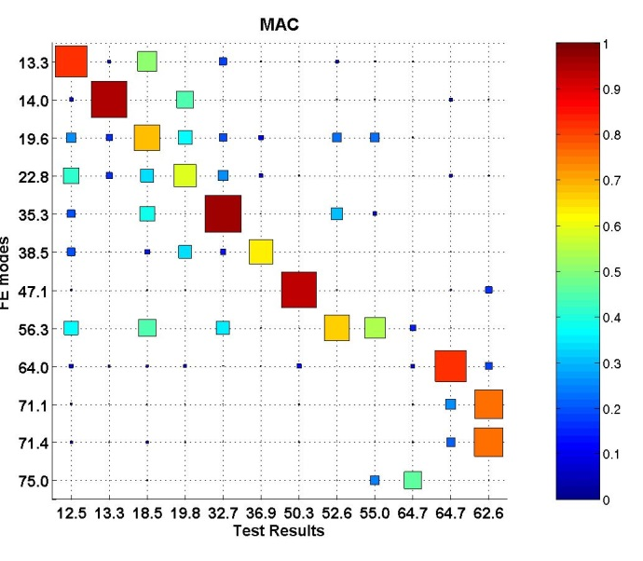
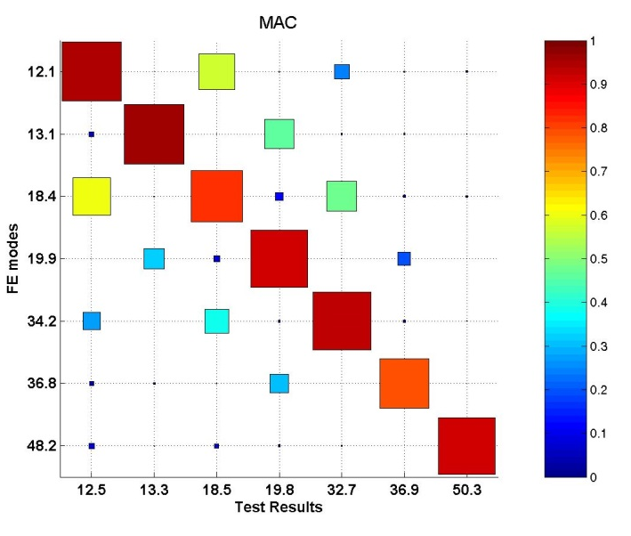
QinetiQ Lynx Helicopter
Mode No. | Mode description | Updated FEM (Hz) | Test (Hz) | Error (%)
1 | 1st vertical bending | 12.06 | 12.45 | -3.12
2 | 1st lateral bending | 13.14 | 13.29 | -1.08
3 | Tail plane fore/aft bending | 18.41 | 18.52 | -0.61
4 | Tail plane vertical bending | 19.94 | 19.85 | 0.47
5 | 2nd vertical Bending | 34.15 | 32.67 | 4.55
6 | 2nd lateral Bending | 36.83 | 36.91 | -0.20
7 | Fuselage torsion | 48.25 | 50.34 | -4.16
8 | 3rd vertical bending | 54.33 | 52.57 | 3.36
9 updating parameters
3 having similar effects are linked together
Finally 6 updating parameters
Average natural frequency
error reduced from 6.6%
to 2%
Max initial error of 15.1%
reduced to 4.55%.

Slide 7
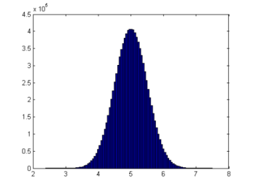
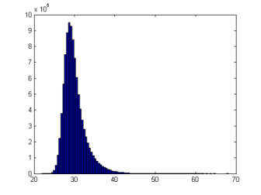

Uncertainty and Variability
System
Input
Output
System parameters
Output: Measured variability
Input: Uncertain
System Parameters: Uncertain

Slide 8
Stochastic Model Updating
An uncertainty quantification (UQ) problem:
  Variability in measured natural frequencies, mode shapes, etc.
  Selection of Updating Parameters (to be randomised).
  Correction of the FE model so the distribution of predicted natural frequencies converges upon the measured distribution.
Probabilistic Model Updating
Interval (& Fuzzy) Methods
Bayesian Model Updating
Problem of variability in nominally identical test structures:
  effect of accumulated manufacturing tolerances.
  environmental effects and wear.
  effect of disassembly and reassembly of joints.

Slide 9
Brief Review
E. Simoen, G. De Roeck and G. Lombaert, Dealing with uncertainty in model updating for damage assessment: a review, Mechanical Systems and Signal Processing, 56-56, 2015, 123-149
J.L. Beck and L. Katafygiotis, Updating models and their uncertainties. I: Bayesian statistical framework, Journal of Engineering Mechanics, 124(4), 1998, 445-461.
L. Katafygiotis and J.L. Beck, Updating models and their uncertainties. II: model identifiability, Journal of Engineering Mechanics, 124(4), 1998, 463-467.
K.-V. Yuen, Bayesian Methods for Structural Dynamics and Civil Engineering, John Wiley and Sons, Singapore, 2010.
S.-E. Fang and R. Perera, Damage identification by response surface based model updating using D-optimal design, Mechanical Systems and Signal Processing,25(2), 2011,717-733.
S.-E. Fang, W.-X. Ren and R. Perera, A stochastic model updating method for parameter variability quantification based on response surface models and Monte-Carlo simulation, Mechanical Systems and Signal Processing, 33, 2012, 83-96.
E.L. Zhang, P. Feissel and J. Antoni, A comprehensive Bayesian approach for model updating and quantification of modelling errors, Probabilistic Engineering Mechanics, 26, 2011, 550-560.
M. Muto and J.L. Beck, Bayesian updating and model class selection for hysteretic structural models using stochastic simulation, Journal of Vibration and Control, 14(1-2), 2008, 7-34.
L. Mthembu, T. Marwala, M.I. Friswell and S. Adhikari, Model selection in finite element model updating using the Bayesian evidence statistic, Mechanical Systems and Signal Processing, 25, 2011, 2399-2412.
S.K. Au and J.L. Beck, Estimation of small failure probabilities in high dimensions by subset simulation, Probabilistic Engineering Mechanics, 16(4), 2001, 263-277.

Slide 10
Efficiency
Stochastic Model Updating – often requires large numbers of deterministic computations. Therefore efficient methods are needed.
Use of meta-models, surrogates, emulators
  Response surfaces
  Polynomial Chaos Expansion
  Gaussian Process Emulation (Kriging)
  Artificial Neural Networks (ANN)
How closely does the meta-model reproduce FE results?
Meta-model introduces more uncertainty
A sufficiently accurate meta-model might be very expensive to produce.

Slide 11
The Transformation Matrix
The generalised pseudo inverse of the Sensitivity matrix.
Includes weighting and regularising side constraints.
Weighted system with classical Tikhonov
regularisation:

Slide 12
Updating the Mean
A deterministic model updating problem using the
mean values of the data and the mean sensitivity
matrix,
Can be shown to be unbiased when

Slide 13
Determining the Covariances
Haddad Khodaparast et al. – perturbation method:
Govers and Link – minimising a covariance residual using the Frobenius norm:
Covariances
are determined by propagation of step-by-step through the FE model starting from an initially chosen distribution.
H. Haddad Khodaparast, J.E. Mottershead and M.I. Friswell, Perturbation methods for the estimation of parameter variability in stochastic model updating, Mechanical Systems and Signal Processing, 22(8), 2008, 1751-1773.
Y. Govers and M. Link, Stochastic model updating - covariance matrix adjustment from uncertain experimental modal data. Mechanical Systems and Signal Processing, 24(3):696–706, 2010.

Slide 14
Determining the Covariances
Assuming small parameter variability:
Both expressions from the previous slide reduce to:
Requires only the transformation matrix at last iteration when updating the
mean.
Independent of an assumed initial distribution (except for the parameter mean ).
Very dependent upon choice of parameters.

Slide 15
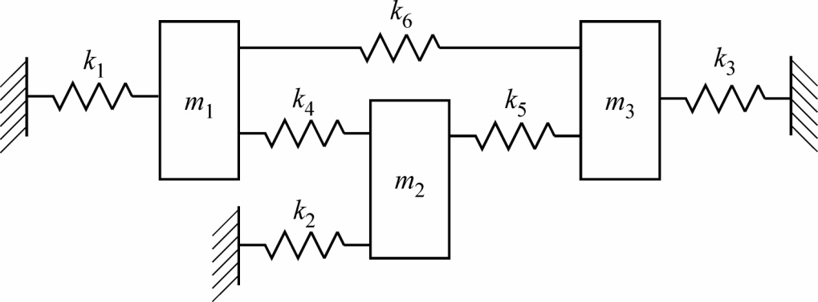
Example: 3 DOF m-k System.
Known deterministic parameters:
Randomised parameters (used to produce test data):
Initial model:

Slide 16
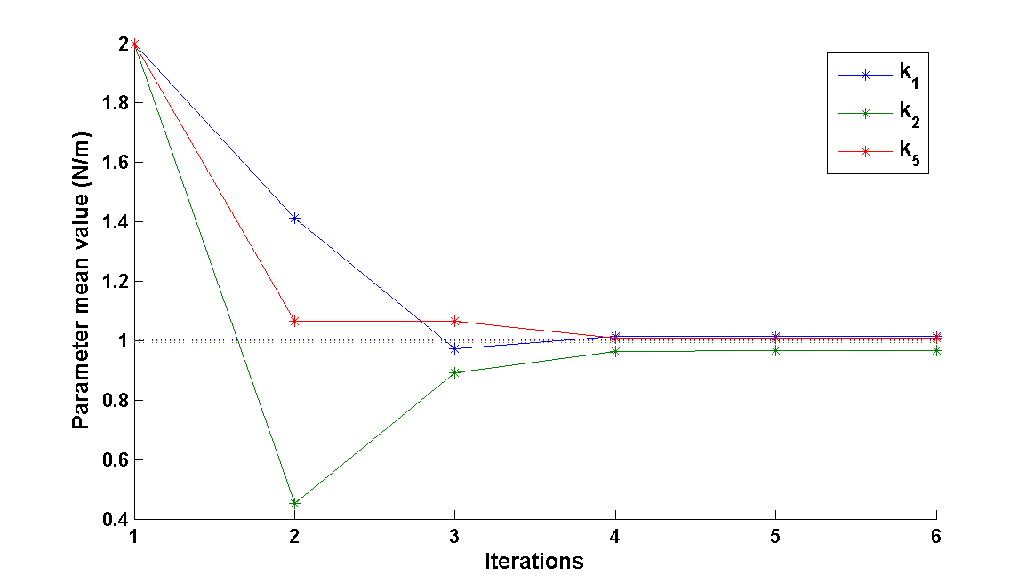
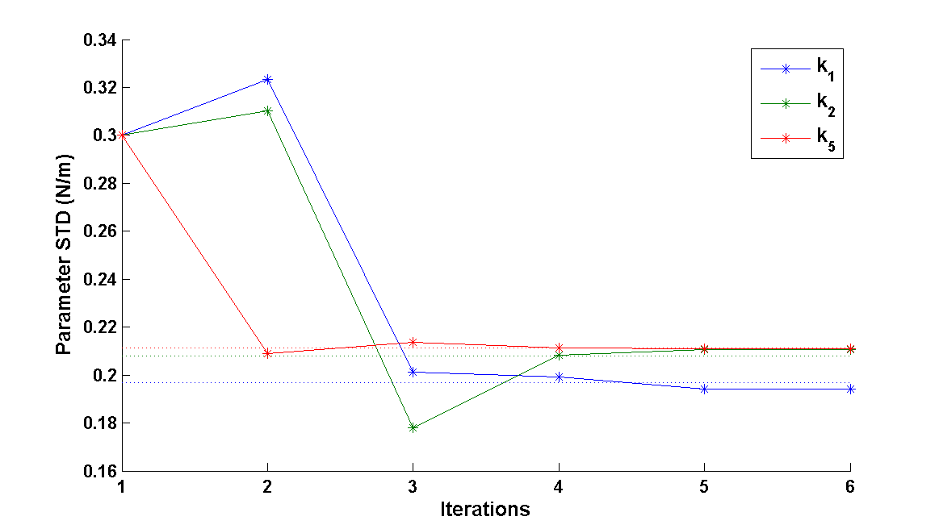
Example: 3 DOF m-k System.
Consistently Chosen Parameters
Measured data: 30 points in the 3D space of the natural frequencies.

Slide 17
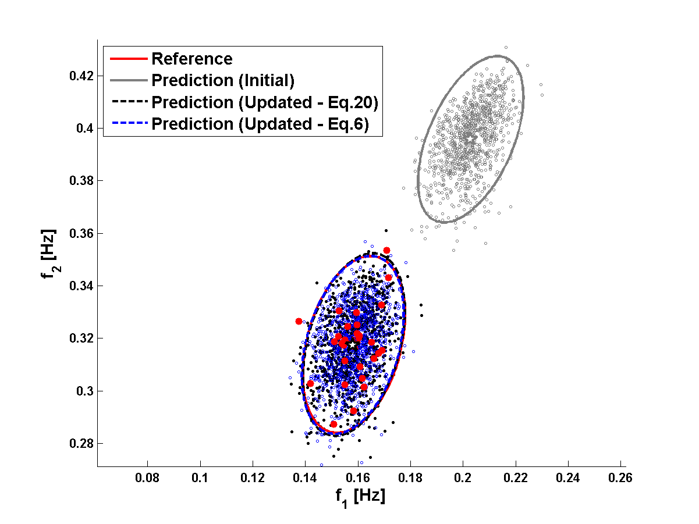
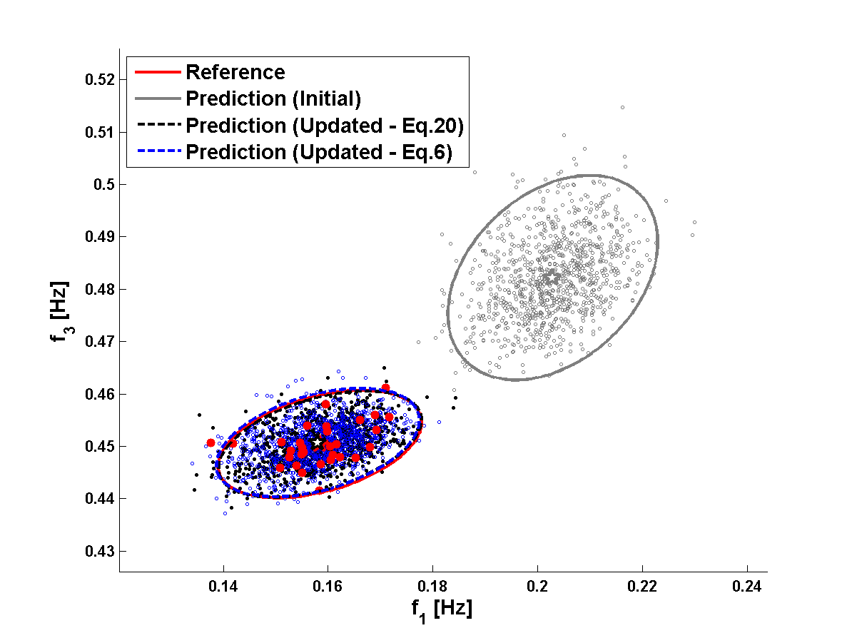
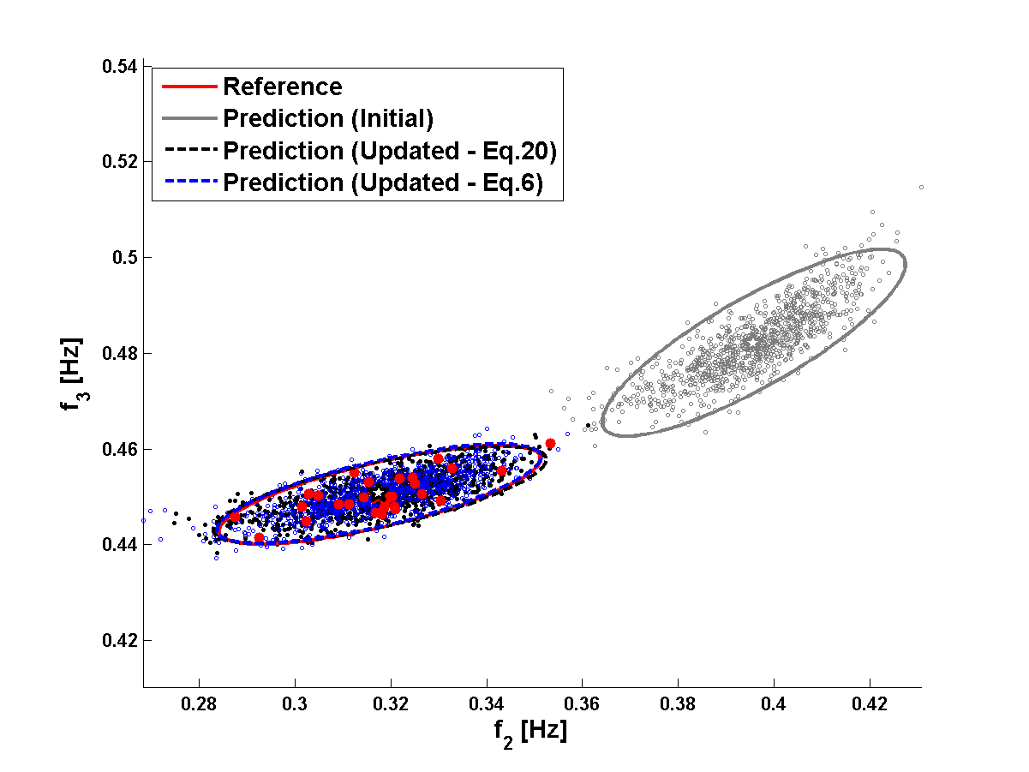
Example: 3 DOF m-k System.
Scatter Diagrams – Covariance Ellipses
Updated model: 1000 data points generated from identified distribution

Slide 18
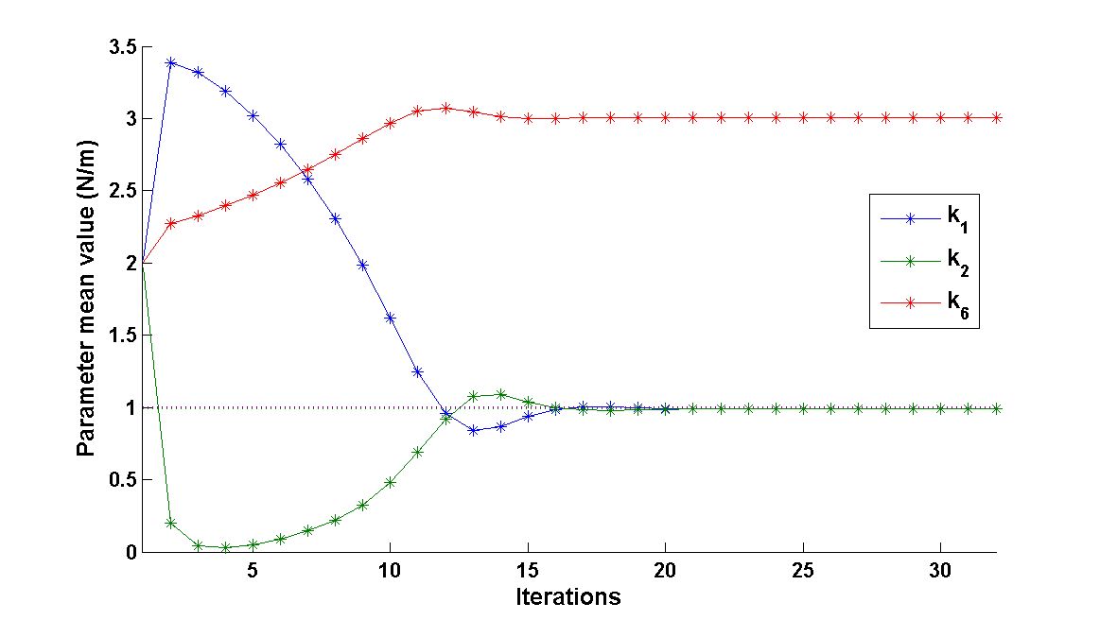
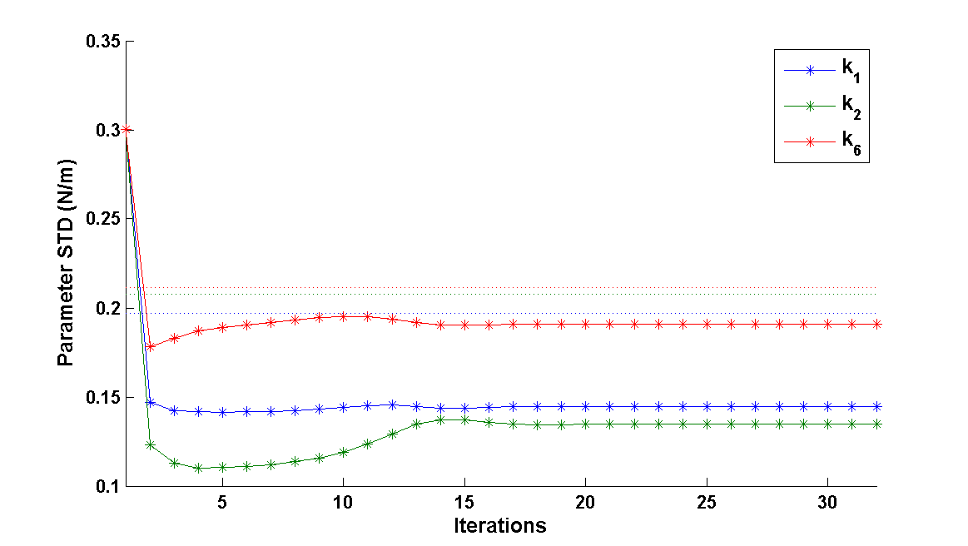
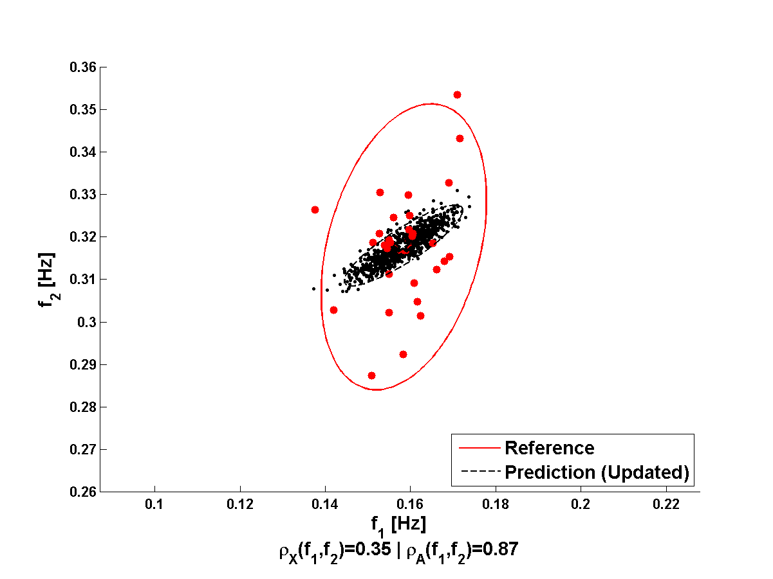
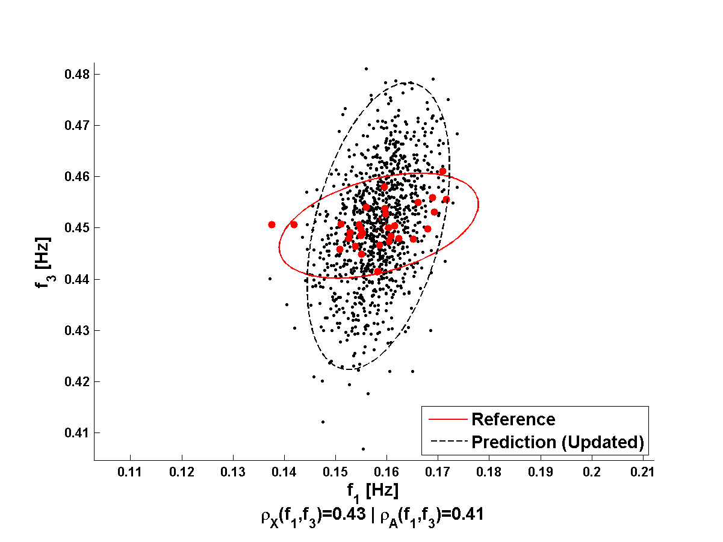
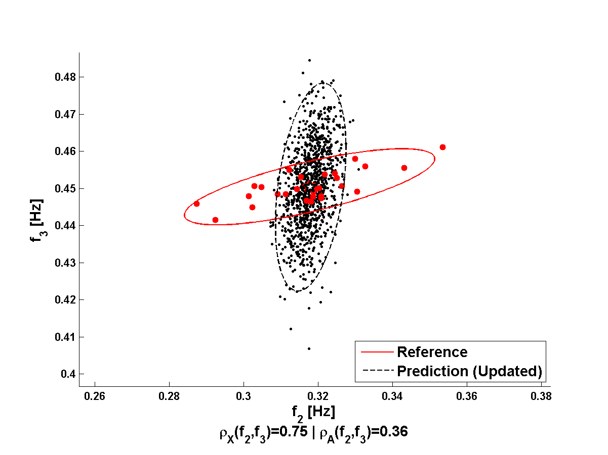
Example: 3 DOF m-k System.
Inconsistent Parameters
Randomised parameters (used to produce test data):
Initial model:
Means are updated almost perfectly, but not the covariances – this is because the wrong
updating parameters were chosen.

Slide 19
Parameter Selection for Covariance Updating
Scaled sensitivity matrix:
Assumption: parameters are independent of each other and of the error
T.A.N. Silva, N.M.M. Maia, M. Link and J.E. Mottershead,
Parameter selection and covariance updating, Mechanical Systems and Signal Processing, 70-71,2016, 334-344.

Slide 20
Parameter Selection for Covariance Updating

Slide 21
Pin-Jointed Truss
4
8
12
16
20
1
3
5
7
11
15
19
9
13
17
21
2
6
10
14
18
5 diagonal bars: nominal stiffness
True values (used to produce data):
Initial estimates:

Slide 22
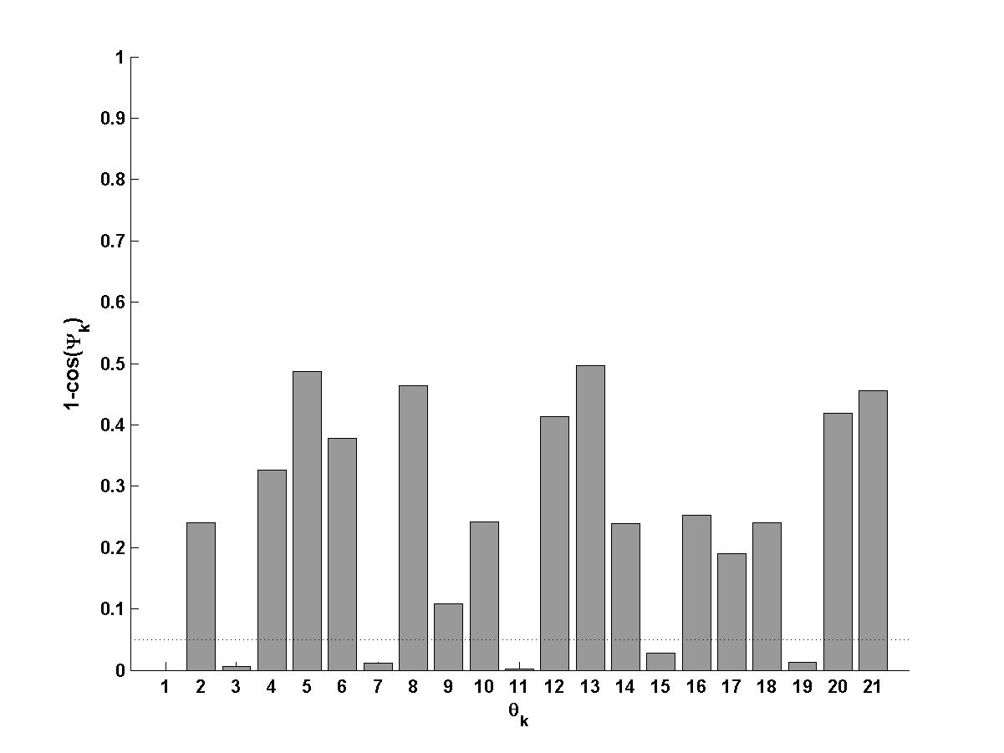
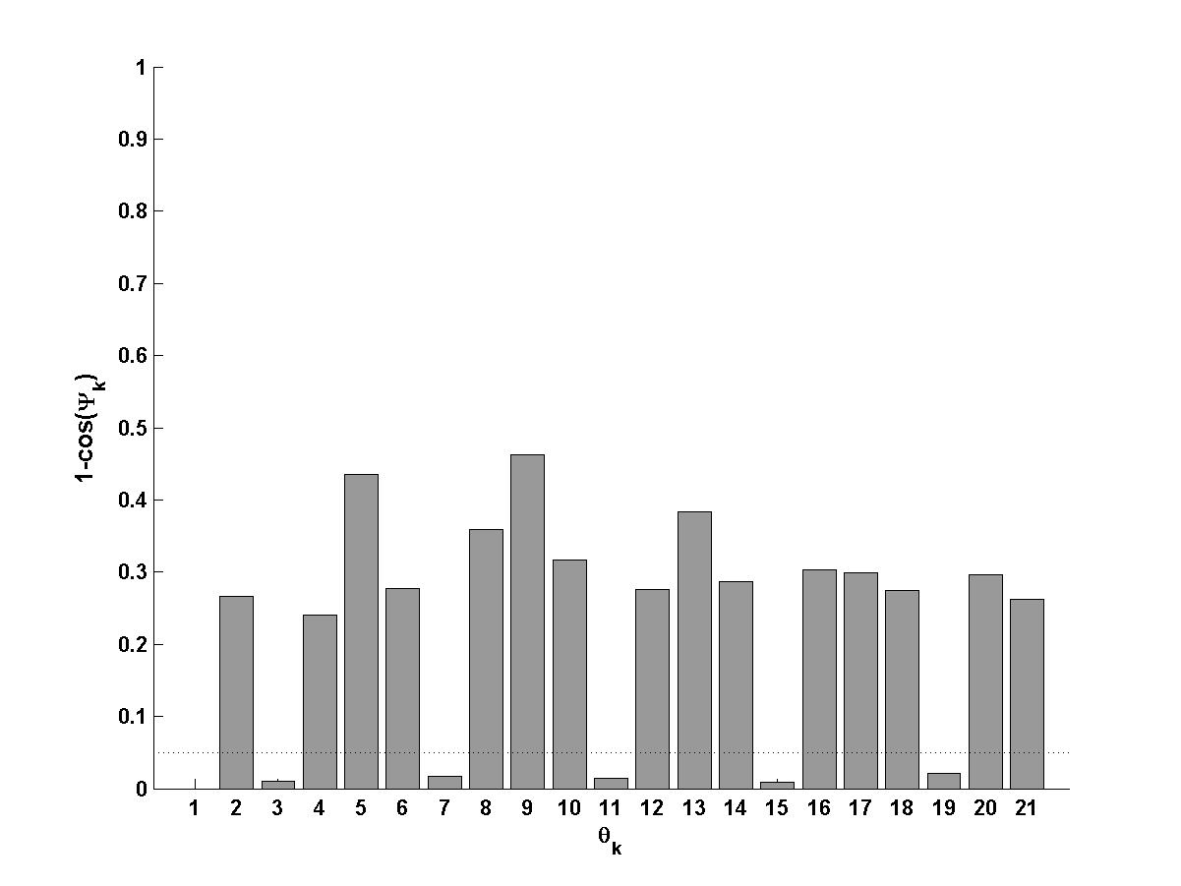
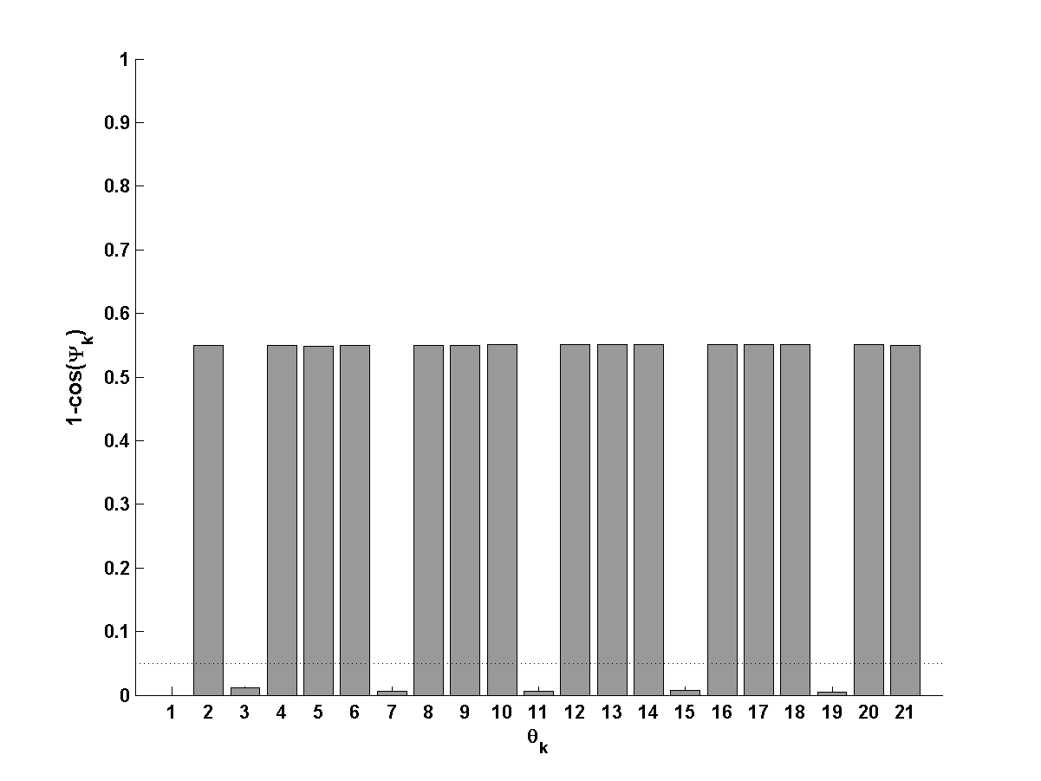
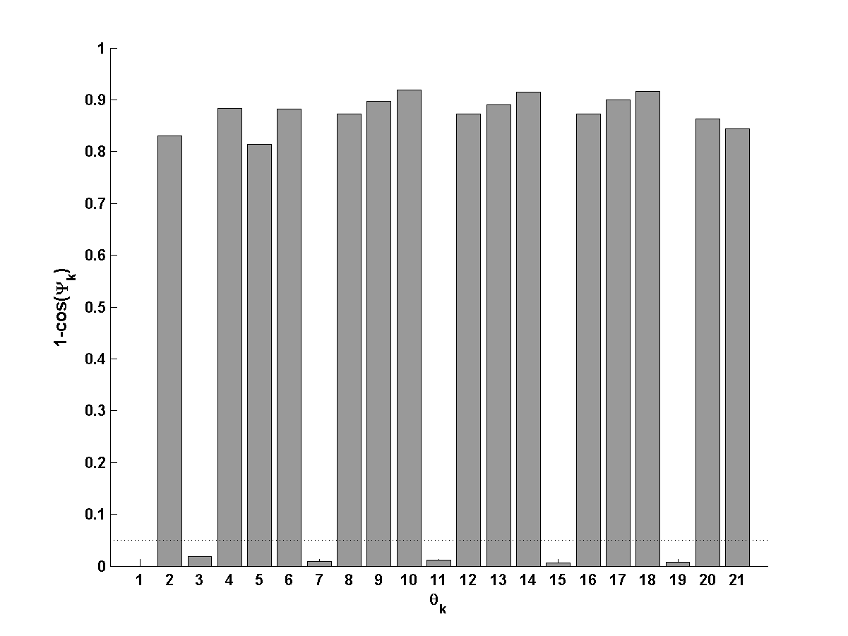
Pin-Jointed Truss – Cosine Distances
1st 10 eigenvalues
1st 15 eigenvalues
All eigenvalues
All eigenvalues & eigenvectors

Slide 23
Interval Model Updating
Makes no assumption on the distribution of the updating parameters, only that they are confined between the upper and lower limits of an interval.
Interval arithmetic – known to be very conservative - is avoided.
A Kriging meta-model is used.
Reproduces the FE predictions exactly at the training points.
A curve is fitted through the training points which is the most probable (rather than the smoothest).
The mean square error is used as a measure of accuracy between the training points.
H. Haddad Khodaparast, J.E. Mottershead and K.J. Badcock, Interval model updating with irreducible uncertainty using the Kriging predictor, Mechanical Systems and Signal Processing, 25(4), 2011, 1204-1226.

Slide 24
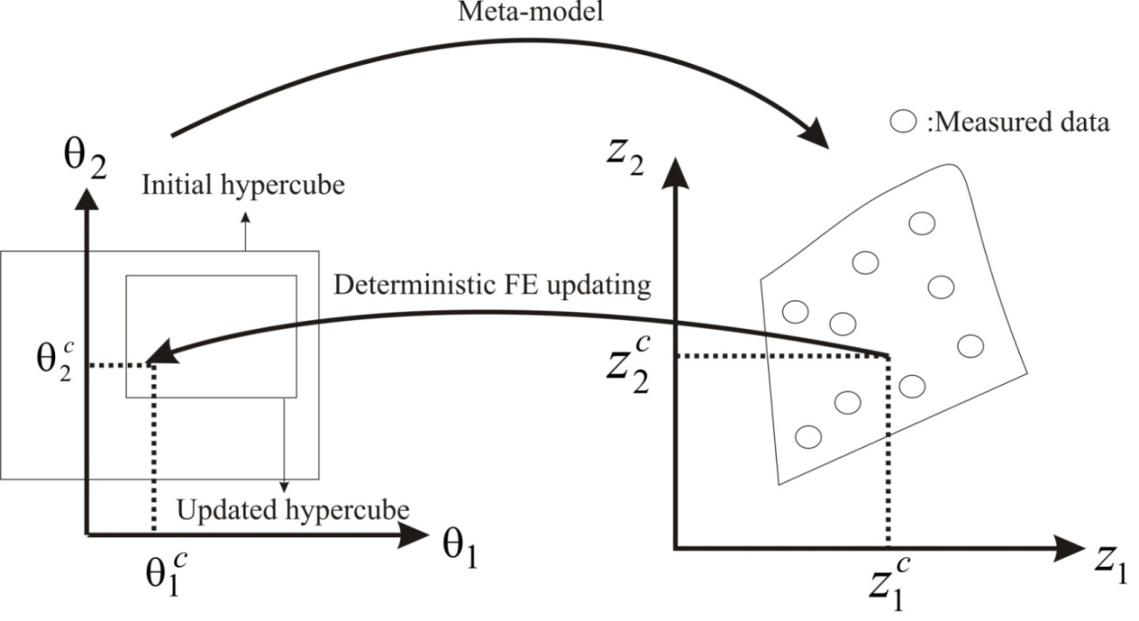
Interval Model Updating
Procedure:
Deterministic model updating of the mean values of the parameters.
Create a meta-model based on an initial hypercube around the updated means of the parameters determined in (1) above.
Carry out deterministic model updating for every data point (using the meta-model for efficiency).
Construct a new hypercube covering the region of the updated parameters.
Increase the size of the hypercube if updated parameters fall outside the initial hypercube.
Generate output data using the meta-model from a uniform distribution of parameters selected from the updated hypercube.

Slide 25
Bayesian Model Updating
Formerly very expensive, but now tractable using modern algorithms such as Transitional Markov chain Monte Carlo TMCMC and subset simulation together with surrogate models and parallelised code.

Slide 26
Example: 3 DOF m-k System.
Parameter pdfs, cdfs and Metropolis Hastings history (TMCMC).

Slide 27
Example: 3 DOF m-k System.
Initial model
Sensitivity Method
Bayesian Model Updating

Slide 28
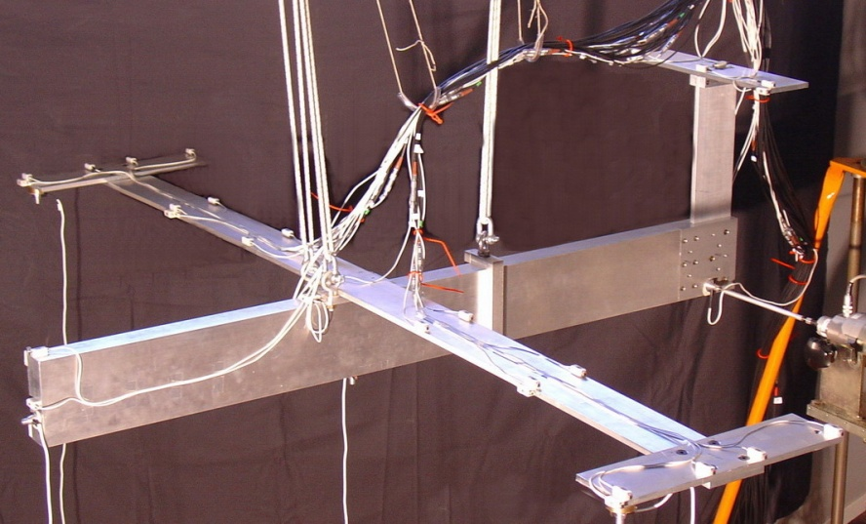
DLR AIRMOD Structure
Replica of the GARTEUR SM-AG19 benchmark structure.
Built at DLR Göttingen
Made of aluminium
6 beam-like components connected by 5 bolted joints
Wingspan – 2 m, fuselage length - 1.5 m, height - 0.46 m
Weight 44 kg
Two additional masses of 167 g at the forward tips of the winglets
Y. Govers, Y., and M. Link, Stochastic model updating of an aircraft like structure by parameter covariance matrix adjustment, Proc., International Conference on Noise and Vibration Engineering, Leuven, Belgium, 2010, 2639-2656.
Y. Govers and M. Link, Using stochastic experimental modal data for identifying stochastic finite element parameters of the AIRMOD benchmark structure, Proceedings of the International Conference on Noise and Vibration Engineering, USD2012, Leuven, Belgium, 2012, 4697-4715.

Slide 29
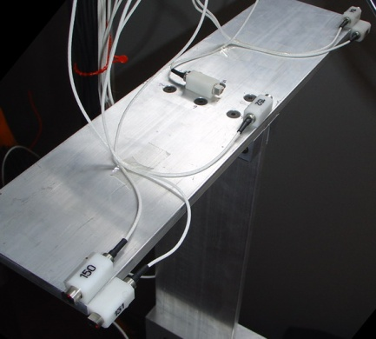
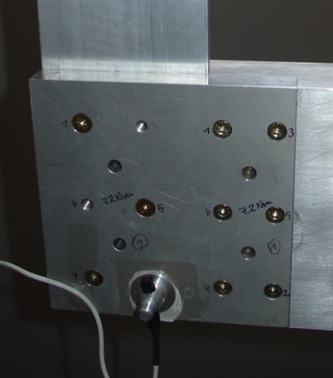
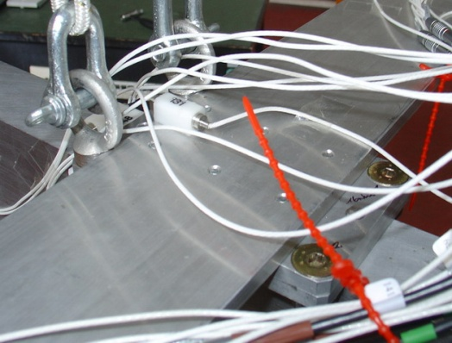
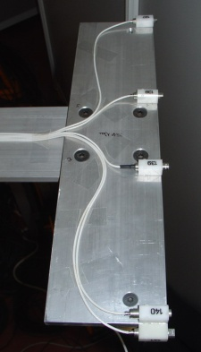
AIRMOD – Joints & Variability
VTP/HTP VTP/Fuselage Wing/Fuselage Winglet
Previous study compared different sources of variability: excitation (hammer, sweep etc.), different modal analysis methods, operator variability, phase resonance vs. phase separation methods, disassembly and reassembly.
Joint stiffness variability due to disassembly and reassembly is the most important factor.
AIRMOD was disassembled, reassembled and re-tested 130 times.
Automated modal parameter estimation was applied after data acquisition.
Bolts were tightened using a calibrated torque wrench in a pre-defined sequence.
Mass of cables may be distributed differently between tests.

Slide 30
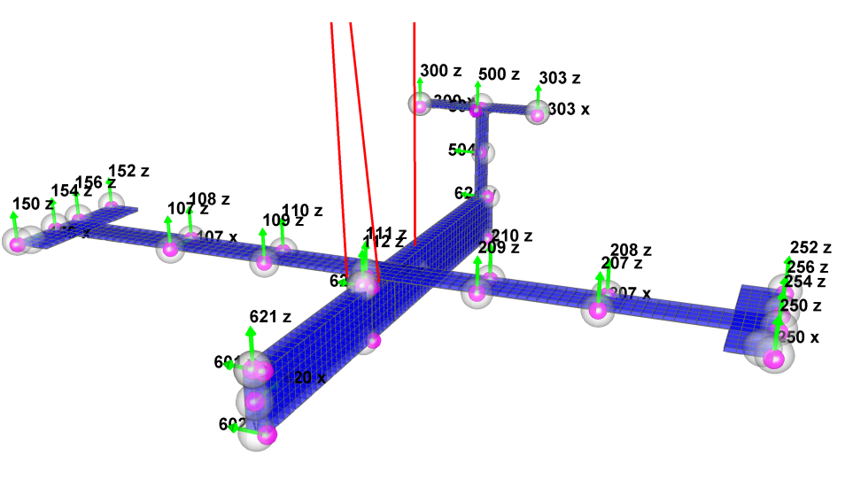
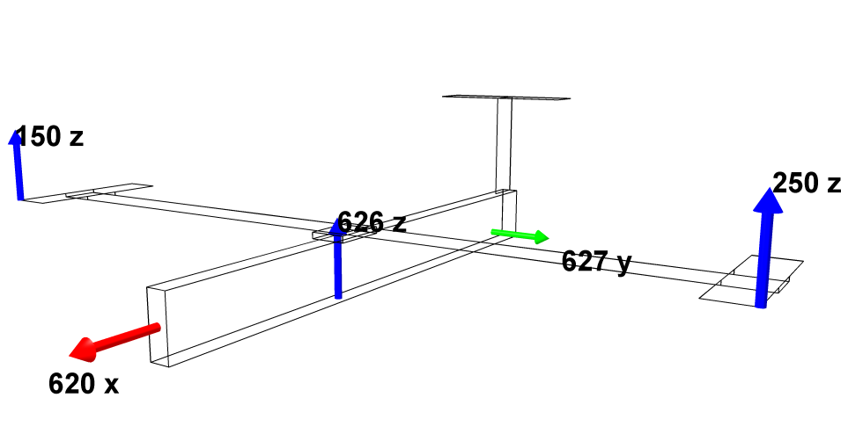
AIRMOD – Test Configuration
Sensor Locations
38 acceleration sensors (0-400Hz)
8 in x-direction
8 in y-direction
22 in z-direction
soft suspension:
bungee cords to achieve simple boundary conditions
Exciter Locations
Two exciter locations, 626z and 627y
Random excitation in the frequency band 0-400 Hz

Slide 31
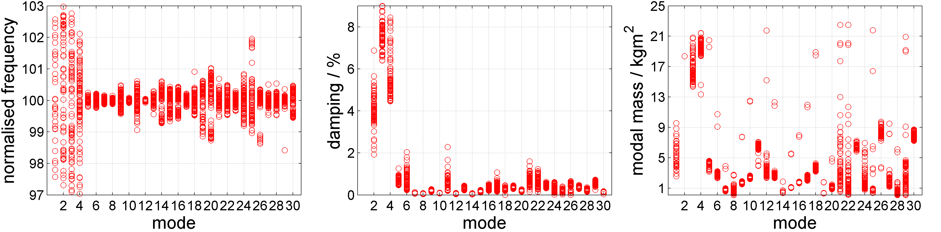
AIRMOD – Observed Variability
Natural Frequency Damping Modal Mass

Slide 32
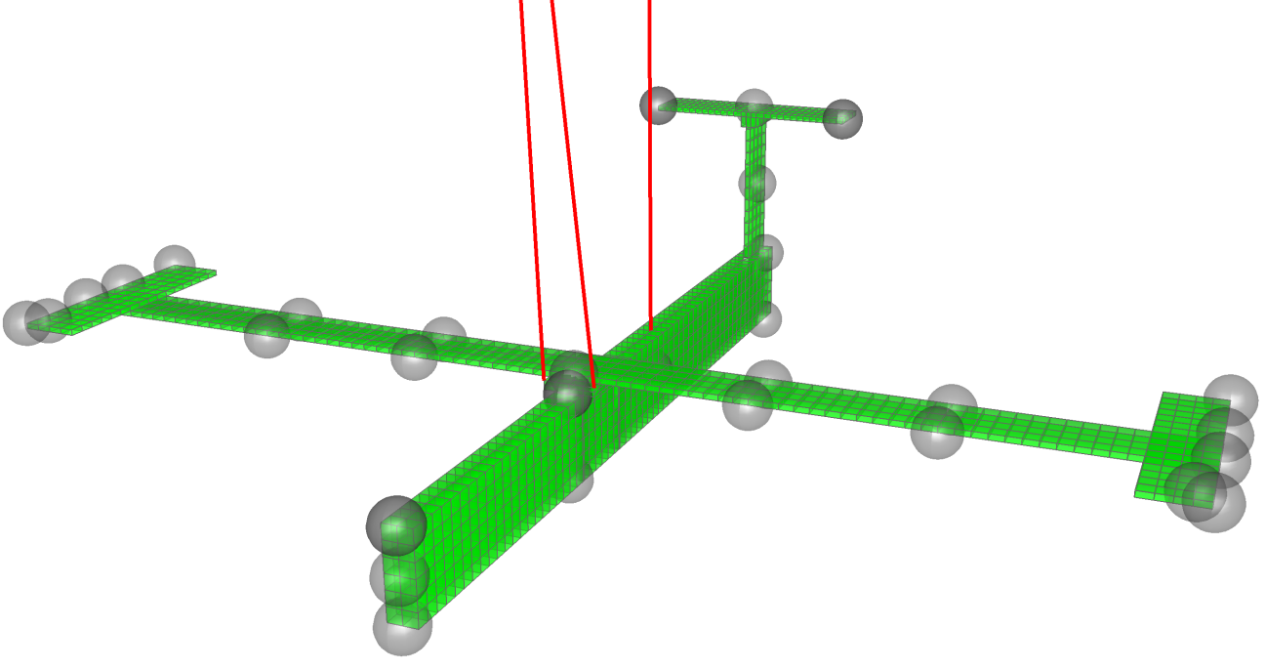
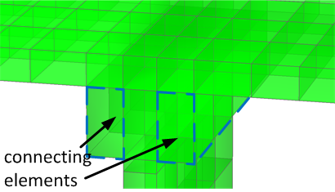
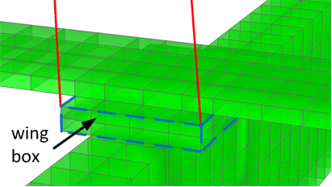
AIRMOD – FE Model
MSC.NASTRAN solid model with ~3000 grid points
Non structural masses such as cables and sensors modelled as point masses
Elastic support of the structure is modeled for identification of rigid body modes
Exact geometrical representation of joints with elastic spring connections (x,y,z) at equivalent nodal points

Slide 33
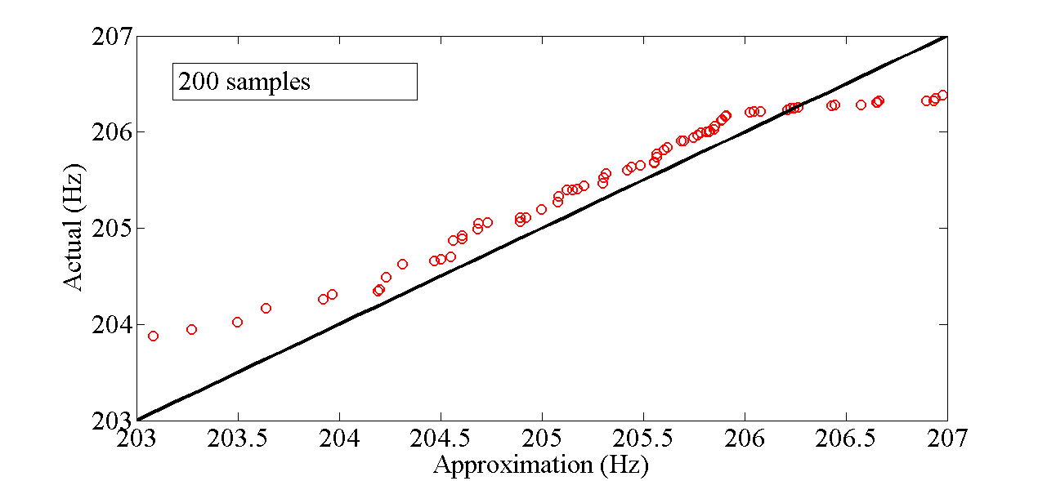
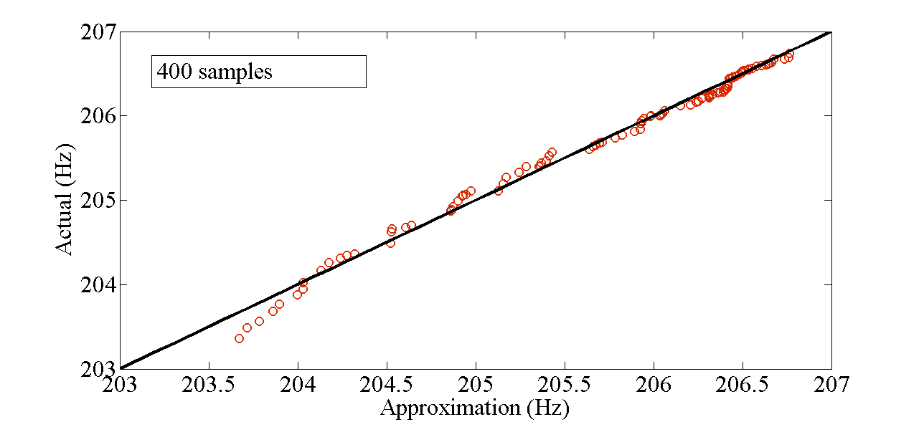
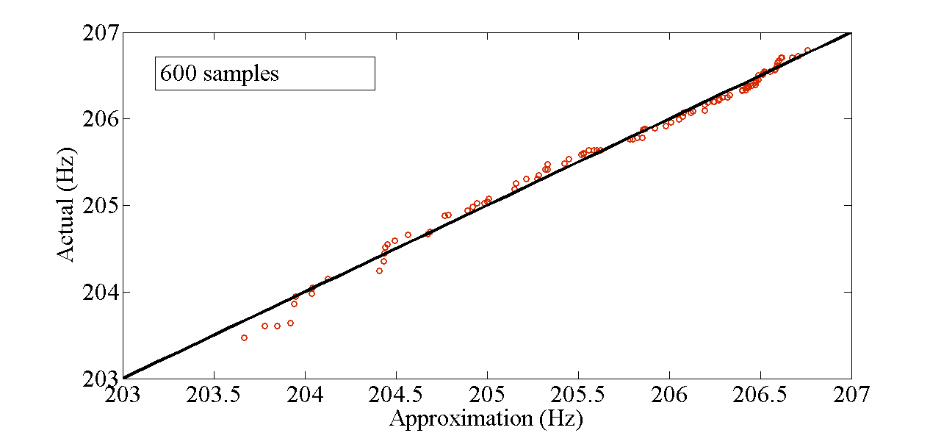


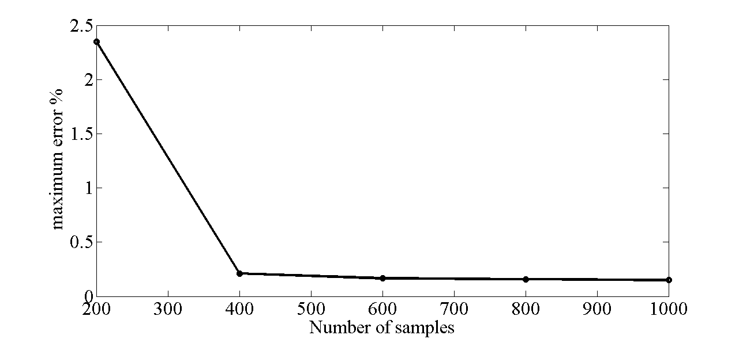
AIRMOD – Training the Kriging Meta-Model
f₁₉ – most erroneous output, 100 points

Slide 34
AIRMOD Updating Parameters
 | Type | Location | Description | Init. Val. | Unit
θ₀₁ | stiffness | front bungee cord | support stiffness | 1.80E+03 | N/m²
θ ₀₂ | stiffness | rear bungee cord | support stiffness | 7.50E+03 | N/m²
θ ₀₃ | stiffness | VTP/HTP joint | sensor cable – y dir^{n} | 1.30E+02 | N/m
θ ₀₄ | stiffness | wing/fuselage joint | sensor cable – y dir^{n} (top) | 7.00E+01 | N/m
θ ₀₅ | stiffness | wing/fuselage joint | sensor cable – y dir^{n} (bott^{m}) | 7.00E+01 | N/m
θ ₀₆ | stiffness | VTP/HTP joint | joint stiffness – x, y dir^{ns} | 1.00E+07 | N/m
θ ₀₇ | stiffness | VTP/HTP joint | joint stiffness – z dir^{n} | 1.00E+09 | N/m
θ ₀₈ | mass | VTP/HTP joint | sensor cables | 2.00E-01 | kg
θ ₀₉ | mass | wingtip right wing | screws and glue | 1.86E-01 | kg
θ ₁₀ | mass | wingtip left wing | screws and glue | 1.86E-01 | kg
θ ₁₁ | mass | wingtip left/right | sensor cables on wings | 1.50E-02 | kg
θ ₁₂ | mass | out^{r} wing left/right | sensor cables on wings | 1.50E-02 | kg
θ ₁₃ | mass | inn^{r} wing left/right | sensor cables on wings | 1.50E-02 | kg
θ ₁₄ | stiffness | wing/fuselage joint | joint stiffness – x dir^{n} | 2.00E+07 | N/m
θ ₁₅ | stiffness | wing/fuselage joint | joint stiffness – y dir^{n} | 2.00E+07 | N/m
θ ₁₆ | stiffness | wing/fuselage joint | joint stiffness – z dir^{n} | 7.00E+06 | N/m
θ ₁₇ | stiffness | VTP/fuselage joint | joint stiffness – x dir^{n} | 5.00E+07 | N/m
θ ₁₈ | stiffness | VTP/fuselage joint | joint stiffness – y dir^{n} | 1.00E+07 | N/m
18 Updating Parameters
θ₁ - θ₅ – Support stiffnesses
θ₆ - θ₈ – Joint stiffness/mass at VTP/HTP
θ₉ - θ₁₃ – Non-structural masses
θ₁₄ - θ₁₆ – Joint stiffnesses wing/fuselage
θ₁₇ - θ₁₈ – Joint stiffnesses VTP/fuselage

Slide 35
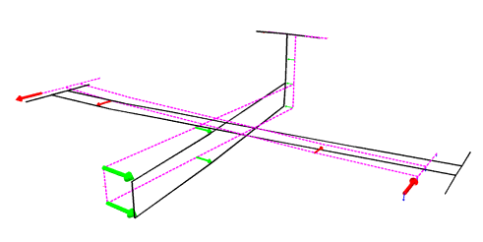
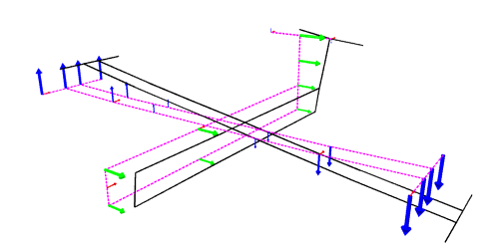
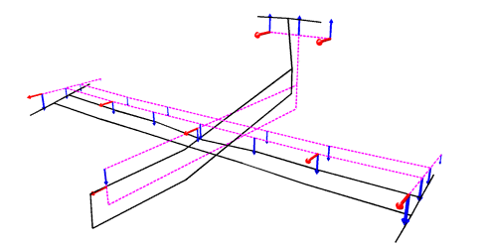
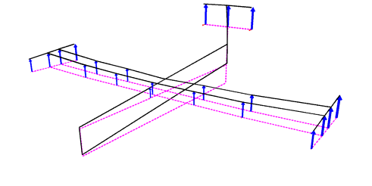
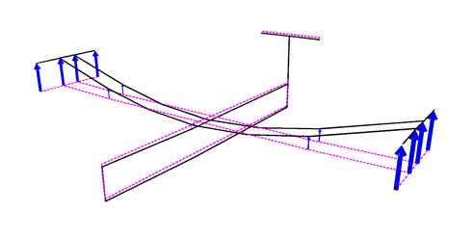
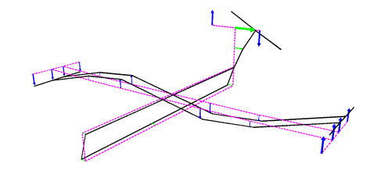
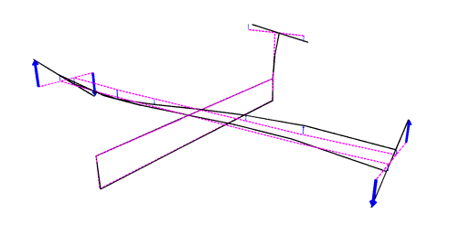
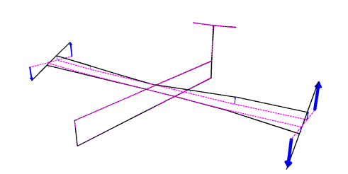
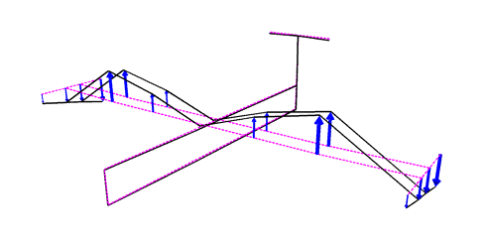
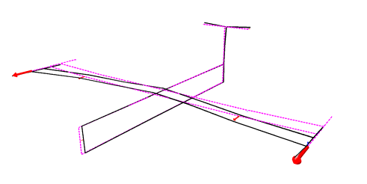
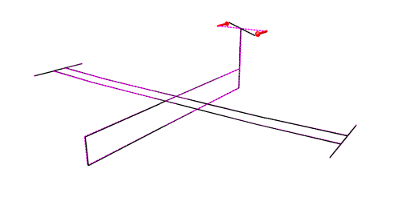
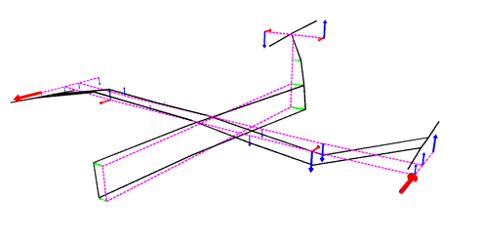
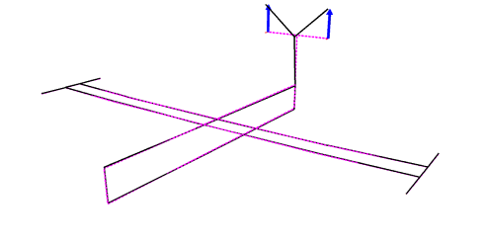
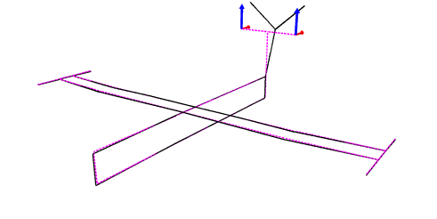
AIRMOD – Updating Residuals
  1
  2
  3
  4
  5
  6
  7
  8
  10
  11
  12
  14
  19
  20
Residual:
14 modes chosen for updating
Eigenfrequency residual + mode-shape residual for means only

Slide 36
AIRMOD – Frequency Prediction from Updated Means
# | Mode | f_{test} Hz | f_{fe} _{(init)} Hz | Δf_{fe} _{(init)} % | Δf_{fe} _{(upd)} %
1 | RBM Yaw | 0.23 | 0.17 | -26.52 | 0.01
2 | RBM Roll | 0.65 | 0.56 | -14.59 | -0.01
3 | RBM Pitch | 0.83 | 0.82 | -1.0 | 0
4 | RBM Heave | 2.17 | 2.14 | -1.62 | -0.02
5 | 2n Wing Bending | 5.5 | 5.65 | 2.78 | 0.4
6 | 3n Wing Bending | 14.91 | 15.11 | 1.35 | -0.01
7 | Wing Torsion Anti | 31.96 | 33.31 | 4.25 | 0.25
8 | Wing Torsion Sym | 32.33 | 33.62 | 3.98 | -0.42
10 | 4n Wing Bending | 43.89 | 44.66 | 1.77 | -0.08
11 | 1n Wing Fore-Aft | 46.71 | 47.21 | 1.08 | 0.02
12 | 2n Wing Fore-Aft | 51.88 | 52.91 | 1.99 | 0.05
14 | VPT Torsion | 65.93 | 67.69 | 2.67 | -0.05
19 | 2n HTP Bending | 205.5 | 206.73 | 0.56 | -0.04
20 | HTP Fore-Aft | 219 | 225.73 | 3.04 | 0.11

Slide 37

AIRMOD – Probabilistic and Interval Updating Results
Black bars represent 3 standard deviations
Y. Govers, H. Haddad Khodaparast, M. Link and J.E. Mottershead, A comparison of two stochastic model updating methods using the DLR AIRMOD test structure, Mechanical Systems and Signal Processing, 52-53, 2015, 105-114.

Slide 38
AIRMOD – Probabilistic and Interval Updating Results

Slide 39
AIRMOD – Bayesian Model Updating Results

Slide 40
Full FE and Surrogate ANN Model

Slide 41
Covariance and Bayesian Model Updating Results

Slide 42
AIRMOD - Comments on Updating Results
Results of similar quality are produced by covariance and Bayesian updating methods - generally both enclose the measured data.
Bayesian updating was carried out on a parallelised system using 20 cores of a multi AMD Opteron processor 6168 system. The wall-clock time was approx. 8 hours.
A surrogate model needs to be created and this also requires some computational effort (2000 FE model executions)
Bayesian updating results are preliminary – ANN model to be improved and present results based on diagonal data-covariance matrix in the likelihood function.
Interval method is generally the more conservative of the 3 methods. This is to be expected since the output variability can only be defined within the constraints of a box defined by upper and lower bounds – of greater sample space than the true distribution.
Covariance updating can be carried out on a standard desktop computer in a few minutes – it does not require the use of a meta-model.

Slide 43
Conclusions
The problem of variability in nominally identical test structures is considered (effect of accumulated manufacturing tolerances, wear, disassembly and reassembly etc.).
The choice of updating parameters is even more important in stochastic model updating than in deterministic updating.
Covariance updating is generally ill-conditioned and requires regularisation.
Regularisation is done automatically in Bayesian updating – by use of the output and parameter covariance matrices (present in the likelihood function and the prior distribution).
The use of a meta-model enables efficient stochastic model updating, but at the same time introduces additional uncertainty.
Constructing the meta-model can be expensive.
Covariance updating assumes a Gaussian distribution on the parameters which in general cannot be justified.
The interval methods makes no assumptions regarding the distribution of parameters.
Bayesian updating gives a measure of the most probable model - in principle it is capable of identifying the true parameter distribution.
The interval method is conservative, when compared to covariance and Bayesian methods.

Slide 44
Chair in Uncertainty in Engineering
Institute for Risk and Uncertainty
Closing Date: 2 March 2016
https://www.liverpool.ac.uk/working/jobvacancies/currentvacancies/professiorial/

