Slide 1
Figure 1. Age Standardized Rate of Oropharyngeal Squamous Cell Carcinoma (OPSCC) in the UK, 2002-2011.
Data courtesy of the UK HPV Prevalence Study (1) [A. Schache/N.Powell].

Slide 2
Figure 2. Estimated Age Standardized Incidence Rate of HPV-positive and HPV-negative OPSCC in the UK, 2002-2011.
Data courtesy of the UK HPV Prevalence study (1) [A.Schache/N.Powell]. For each year, the gender-specific proportion of HPV-positive and HPV-negative samples was multiplied by the UK gender-specific incidence rates to estimate Age Standardised Rates (ASR) for HPV-positive and HPV-negative OPSCC.

Slide 3
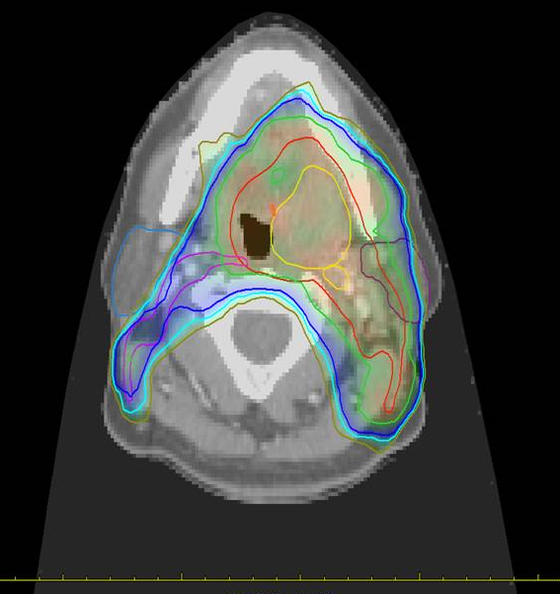

Slide 4
Figure 3. Intensity Modulated Radiotherapy (IMRT) plan for left tonsillar carcinoma
Gross Tumour Volumes (GTV) for left tonsillar primary and retropharyngeal node (yellow); Clinical Target Volume (CTV1) for radical dose RT (red); CTV2 for prophylactic dose RT (purple); 62.7Gy, 54Gy, 51.3Gy and 48 Gy isodose lines (shown in green, blue and mustard respectively).

Slide 5
PATHOS Trial schema
Pathology
assessment
A
Low risk
No adjuvant treatment
HPV positive
OPSCC
T1-3
N0-N2b
Randomise
Transoral
surgery
+neck
dissection
Intermediate
risk
B1 60Gy in 30# (control)
B
B2 50Gy in 25# (test)
Randomise
C1 60Gy in 30#+Cisplatin
(control)
High
risk
C
C2 60Gy in 30# (test)

Slide 6
Figure 4. PATHOS (Post-operative adjuvant treatment for HPV-positive tumours)- study schema.
Patients with T1-T2 N0-N2b HPV-positive OPSCC undergo transoral surgery and neck dissection before being stratified into groups (A, B, C) based on pathological risk factors. Group A (no risk factors) have no adjuvant treatment. Group B (N2, close margins, perineural/vascular invasion) are randomised to 60Gy (control arm) or 50Gy (test arm) of RT. Group C (extracapsular spread and/or positive margins) are randomised to POCRT (control arm) or PORT (test arm). The primary endpoint is patient-reported swallowing function (MDADI score) 12 months after treatment. Secondary outputs include overall survival, loco-regional control and quality of life. The aim is to determine if TOS followed by reduced intensity adjuvant treatment can improve long-term function, whilst maintaining high survival rates.

