Slide 1
Learning Analytics: An Overview
By Alex Wainwright, Maria Limniou, and John J Downes
Notes:
For this workshop I am aiming to provide a brief overview of learning analytics, in particular what have become the main applications of this process and where the field is now progressing into.

Slide 2
Outline
Big Data
Big Data and Education
Learning Analytics
Definition
Dashboard Analytics
Predictive Analytics
Social Learning Analytics
Ethical Issues
Notes:
What I want to do is start with a quick introduction on big data, then move onto the concept of big data in education, and then how this relates to learning analytics.
I will end the workshop on a brief discussion about ethical issues.

Slide 3
“Every day, we create 2.5 quintillion bytes of data” – IBM
Notes:
According to IBM, we are now generating 2.5 quintillion bytes of data per day through the use of social media websites, watching videos, making purchases online, or even from our mobile phones.

Slide 4
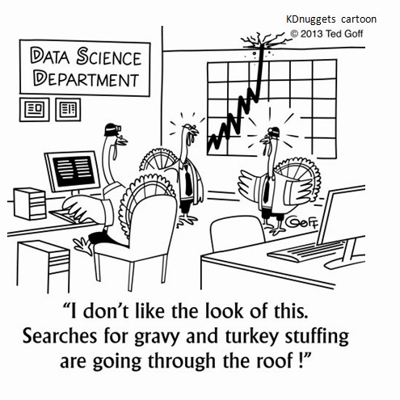
Big Data
Increased daily usage of web services (e.g., Amazon, Google).
With each interaction our behaviour is stored.
Analysis of this data can provide insights into behaviour.
Notes:
One of the main ways we are contributing to big data is due to our daily lives being centred around accessing particular web services, such as Google and Amazon, through our phones or computers.
Consequently, this means that we are providing a significant amount of data to these companies, which theoretically allows them to make insights into our behaviour using analytics.
In turn, it is anticipated that by having a greater insight into our behaviours, companies can improve their services to keep us returning.

Slide 5
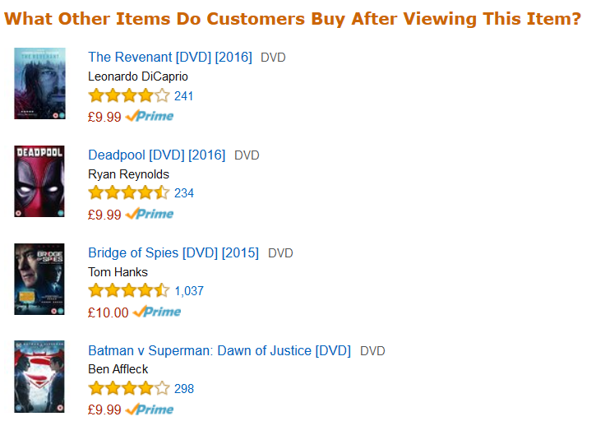
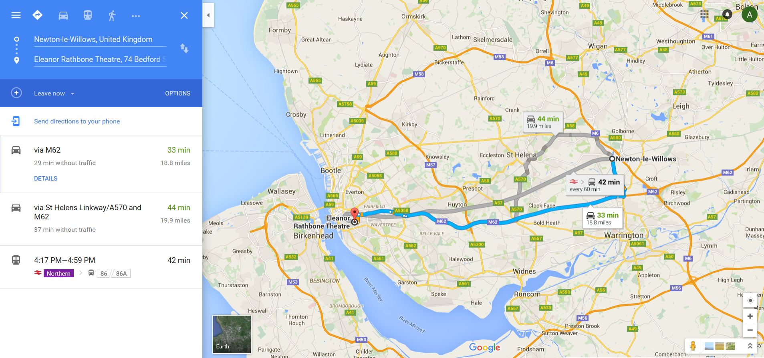
Big Data Examples
Amazon
Google
Notes:
Here are two examples of big data analytics in action.
For amazon, this typically entails a flood of emails following every purchase with the aim of recommending similar products or products that other people with similar interests have bought.
For Google maps, on the other hand, the determination of a route to take relies on a continuous stream of information from phones to determine how many cars are on the road and how fast they are going. Also, the amount of data they have collected over many years can allow for predictions of how traffic levels will vary throughout the day.
These are examples of big data use in companies, but what about big data in education?

Slide 6
Big Data and Education
Higher Education collects a voluminous amount of student data.
“Inefficient in its data use” – Long and Siemens (2011).
Universities are now beginning to utilise such data, but the UK is lagging behind (Sclater, Peasgood, & Mullan, 2016).
Student Data
Attendance
Virtual Learning Environment
Admissions
Library Accesses
Grades
Demographics
Notes:
Higher education institutes possess a large amount of data relating to students, which includes: demographics, grades, attendance, library accesses, and virtual learning environment behaviour, to name a few.
Despite the potential insights this data offers, educational institutes have been slow in making use out of it in order to enhance the educational experience of students.
Even now, with a gradually increasing use of educational big data, UK universities are still lagging behind the US and Australia.
What is therefore required is a greater promotion of the utility that this data offers in promoting effective educational reforms. This could involve the introductions of early interventions to reduce drop-outs or the re-design of a course based upon what tools students prefer to use.

Slide 7
Learning Analytics
“The measure, collection, analysis and reporting of data about learners and their contexts, for purposes of understanding and optimising learning and the environments in which it occurs.”
Siemens & Gasevic (2012)
Notes:
What has emerged from the increased interest in educational big data has been the use of learning analytics.
Learning analytics is defined as…
And essentially this means that it focuses upon analysing student data in order to improve the learning environment.

Slide 8
VLEs: The Main Data Source
Virtual learning environments (VLES; i.e., VITAL) have become an essential tool for teaching and learning.
Collects traces of student behaviour:
Hours spent online
Total hits to folders
Number of discussion posts made
Notes:
Virtual learning environments like VITAL are becoming an essential tool for teaching and learning.
They offer an environment to store additional learning materials, allow students to discuss topics with their peers, access lecture capture, or engage in various learning activities such as formative online assessments.
For teaching purposes, allows for student trace data to be downloaded.
This data covers the hours spent online, the total number of hits to folders, the number of activities participated in, formative assessment marks, and the percentage of word changes made to a Wiki activity.

Slide 9
Dashboard Analytics
A visualisation of VLE behaviour for students or teaching staff.
Purdue University’s Course Signals (Campbell, DeBlois, & Oblinger, 2007).
Only low level, summative feedback (Tanes, Arnold, King, & Remnet, 2011).
At-Risk
Room for Improvement
On-Track
Notes:
What has emerged from the ability to recorded student behaviour from VLEs, or any other platform, has been the development of dashboards.
Dashboards can be designed with either students or teaching staff in mind.
For students, they will be presented with graphical representations of their behaviour on a VLE during a specific period of time. In some situations, the average behaviour of all students within the course is also presented.
Whereas, teachers will be presented with an overview of each student’s behaviour and in some cases an indicator of whether this student is at-risk of dropping out or failing.
A notable example of a dashboard has been Purdue University’s course signal, which presents students with a different colour light depending on how well they are doing in a course. For example, the provision of a red-light indicates that they are at-risk of not performing well on a course; thus, as an intervention strategy the student is offered an array of learning resources to help them improve their performance.
In other words, the dashboard aims to provide a simplistic visualisation of performance with the anticipation that it will motivate behavioural change.
From the work of Tanes and colleagues, an important shortcoming of course signals was identified. This related to the students’ needs of wanting detailed instructive feedback; whereas, all course signals is providing is low-level in that it informs of whether they are on track or not.
Therefore, you cannot solely rely upon a computer generated response to provide the necessary details to address the particular problems a student is experiencing.

Slide 10
Dashboard Limitations: The Average
Notes:
Although dashboards can have utility, it is important to recognise their limitations, one of which is the idea of comparing a student’s performance to the class average.
For visualisation purposes I have created this line graph that plots simulated VLE access data from one student (in green) and what would be the class average.
In this case, the student is below average throughout the module, which is the most you can infer from such a visualisation.
What happens if you present this data to a student?
Corrin and de Barba (2014) found that such visualisations provide no opportunity for students to self-reflect as they are not considering how their performance compares to their own learning goals.
Gasevic, Dawson, and Siemens (2015) – comparison to the average may have a negative effect on those students with low self-efficacy. In this case, the knowledge that they are below average may lead the student to dropping out.
Or, in the event a student was just above average it may dissuade them from pushing themselves and achieving even higher.

Slide 11
Dashboard Limitations: Solutions
Students prefer to see their own analytics, as opposed to knowing the progress of their peers (Tabuenca, Kalz, Drachsler, & Specht, 2015).
Prompts at regular intervals (Sonnenberg & Bannert, 2015).
There is a clear need to investigate what makes for an effective dashboard.
Notes:
Although they have their limitations, dashboards can be effectively implemented into a course to aid effective learning strategies, such as the ability to meta-cognitively regulate their learning.
As Tabuenca showed, providing students with both learning analytics outputs and tips on how to self-regulate their learning led to improvements in their time management skills. Moreover, receiving analytics relating to their own behaviour was preferred over and above knowing how they were performing in comparison to their peers.
In a similar manner, Sonnenberg found metacognitive prompts to improve learning outcomes.
So, what should be taken away from this section on dashboards is an appreciation of their utility, but more fundamentally what are their limitations. And it is these limitations that can pave the way for research to understand what students want from visualisations and they can also lead to effective interventions that promote effective skill develop (e.g., students being able to regulate their learning to meet set goals).

Slide 12
Predictive Analytics
Prevailing view of learning analytics being able to predict student success and retention (Siemens & Long, 2011).
VLE Engagement
Student Achievement
Notes:
Linked with dashboard analytics is the concept of predictive modelling, which is based upon predicting student outcomes using the data that is available, be that VLE data, library accesses, or demographics.
It is anticipated that by using predictive analytics it would detect at-risk students early on in their academic career so interventions can be introduced to prevent them from dropping out.

Slide 13
Predictive Analytics: Limitations
Research findings do not provide much support for prediction of student outcomes based on VLE interactions:
Some support for online learning but not face-to-face (Agudo-Peregrina, Iglesia-Pradas, Conde-Gonzalez, & Hernandez-Garcia, 2014).
More recent evidence does not support the use of VLE data to predict achievement in online settings (Strang, 2016).
VLE trace data accounted for 21% of variance in academic performance (Gasevic, Dawson, Rogers, & Gasevic, 2016).
Notes:
Despite the potential that predictive analytics offers in the way of presenting an opportunity to predict student success, the evidence suggests that this is very unlikely.
Instead, it appears that for both online and face-to-face settings, the use of VLE trace data to predict success is superfluous.
According to Gasevic and colleagues, VLE trace data accounts for 21% of variance in academic performance, but this was only with a general model that included 9 different courses.
These authors then ran separate models for each course, using only those VLE variables that were relevant. The outcome of this was that course specific VLE variables led to a variation in how much variance was accounted for in student grades. Ranging from 5% in one course to 70% in another.
What can be taken away from this overview on predictive analytics is that general models of student success cannot be applied across courses as you may over or underestimate certain predictors. Instead, models should consider the relevant course specific variables as there is a high degree of variability across each course in how well used a VLE is.

Slide 14
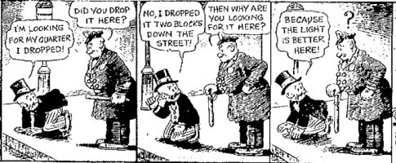
Predictive Analytics: Other Factors
Not all blended learning courses make full use out of the VLE (Limniou, Downes, & Maskell, 2015; Limniou, Downes, Tsivilis, & Whitelock-Wainwright, 2016).
Front- and Back-stage behaviours (Gilmore, 2014).
Notes:
In other words, a student using a VLE does not mean that they are more likely to do well, as there are other factors that need to be considered.
As illustrated in this cartoon, just because the VLE offers an efficient way to collect student data, it is only a small proportion of the learning process.
For example, an important factor that determines whether students will use a VLE is the instructional conditions themselves, as teaching staff have considerable influence over promoting student engagement with these online environments through the design of their course.
Furthermore, we must consider what students typically use a VLE for in a blended learning environment, and that is to access reading materials.
The extent a student will access these resources will also vary in accordance to their levels of prior knowledge but also the extent to which they consider themselves as self-directed learners.
So in some cases it may appear that a student is disengaged due to having a low level of VLE activity, but in reality they may not need to utilise the environment as a consequence of accessing material from other sources.
This leads on to consideration of student behaviour through the perspective of Goffman’s front and back stage behaviour.
This initially related to a restaurant employee, where they displayed front-stage behaviour in the restaurant itself, but also backstage behaviour where they worked within the kitchen, so the parts of the whole individual were separated by a kitchen door.
Gilmore recently applied this analogy to student behaviour – the VLE constitutes the frontstage, whilst the backstage consists of any online or offline behaviour not captured by the VLE. So the parts of the whole student are separated by a login page.
Again, this relates back to the cartoon by acknowledging the limitation of solely using VLE trace data as student learning is not contained solely within this environment, as they use a variety of tools, including social media, to interact with peers, write essays, and read articles.
Therefore, by incorporating more details relating to the students themselves, it is anticipated that a greater understanding of the learning process will follow.

Slide 15
Social Learning Analytics
Students can communicate with their peers at any time of the day, regardless of context.
VLE trace data fails to capture the granulate details of the learning process (Ellis, 2013).
Combining trace data with an analysis of social discourse (Buckingham Shum & Ferguson, 2012).
Notes:
With the ubiquity of VLEs now on offer in majority of courses, students have the potential to communicate with their peers, or instructors, at any time of the day regardless of the context through either discussion boards or chatrooms.
If we turn to constructivism and the work of Vygotsky, the ability to work collaboratively with more capable peers is fundamental in moving from an actual to a potential development level.
So, learning is not an isolated process, we need to interact with others in order to gain new perspectives and provide a greater understanding of a topic or concept.
Even in the context of group learning, a more knowledgeable peer can negotiate meaning through elaboration and explanation, which is doing so can allow other group members to grasp the concept.
As previously discussed, reliance upon trace data ignores a large amount of the learning process, especially the cognitive and social processes that students engage in.
This is where Ferguson’s notion of social analytics can be of considerable value, in that it outlines a method through which trace data can be combined with an analysis of social discourse to provide a more complete picture of student learning.
Through this process, we are ignoring any consideration on predicting how well a student will do or whether they are at-risk of dropping out of the course.
Instead, we are seeking to understand how the benefits of collaboration and socialisation help develop a student’s academic skills.

Slide 16
Social Network Analysis of the EU Referendum Hashtags
Purple indicates hashtags relating to the leave campaign.
Blue relates to the vote remain campaign.
Orange is to do with the NHS.
Gephi: https://gephi.org/
Notes:
A main approach in social learning analytics is to create social network diagrams.
I have created an example diagram here using Gephi, which is a open software package. What I have done is linked the software to the twitter API using a plugin and downloaded data that shows the relationship between different hashtags.
What you can see from the diagram is the formation of different groups within the network based upon the community it falls into, for example the vote remain campaign are the blue nodes; whereas, issues relating to the NHS are captured by the orange nodes.
As a process to analyse data I believe social network analysis is very useful as it provide a good visualisation of the different communities that emerge and could possibly suggest reasons for why certain people are drawn to one another.

Slide 17
Social Learning Analytics: Research Findings
Discussion board participation accounted for more than 30% of the variance in student grades (Macfadyen & Dawson, 2010).
Instructor engagement in discussion boards cannot be overlooked (Hernandez-Garcia, Gonzalez-Gonzalez, Jimenez-Zarco, & Chaparro-Pelaez, 2015).
Group leader assignment greatly determines discussion board dynamics (Xie, Yu, & Bradshaw, 2014).
Notes:
In the study by Macfadyen and Dawson, it was found that discussion board participation and formative assessment tasks accounted for more than 30% of the variance in student grades.
What was more important about this study was its application of social network analysis, which allowed the researchers to identify the relative engagement levels of students.
This assessment of engagement levels is important as you can easily visualise those students well integrated within a group, but also those who do not, which could signify a student who is disengaged with the learning process; thus, it adds a further dimension to the trace data measures.
More recent research has shown that the role of an instructor is an important factor to consider when setting up a discussion board.
In this study, they did find highly active students on a discussion board to achieve better grades overall. However, if the instructor was highly engaged with the discussion board then students would perform badly; whereas, if they were inactive then students were more likely to drop-out.
What this shows is that even though discussion boards may facilitate student achievement through the exchanges of ideas and the refinement of knowledge, but also that the instructor has a fundamental role in how effective a discussion board can be.
More importantly, it highlights how trace data alone cannot determine whether a student is at-risk of dropping out; rather other influencing variables need to be considered.
A further example I would like to discuss is by Xie and colleagues. This study involved assigning students to be leaders of a discussion board for a week, this meant that at the start of each week the leader would outline guidelines relating to what the group should do in the forthcoming week.
For example, how many posts should each person make and within what timeframe, and a reminder of what activities each student should do.
What was found, was that the group leader’s directions had a profound effect on the amount of interaction occurring between group members.
As in the case where the leader set out clear instructions and prompted students to respond to questions posted, the number of posts was high (319)
Whereas, if this process was not followed then the number of posts by group members were substantially lower (66)
In other words, without an outline that advocates students to interact with one another it is unlikely that students will use the discussion board or for spontaneous interactions to take place.
We need to assess learning tools in order to create instructions for best practice.

Slide 18
Social Learning Analytics: Alternative Ideas
Learners whose discourse was more narrative, with deeper cohesion interacted more with peers and instructors (Joksimovic et al., 2015).
Student sense of belonging (Dawson, 2008).
Notes:
There are other ways in which data from a discussion board can be exploited.
As in the case of this first study, they sought to examine the relationship between centrality scores and coh-metrix components. To clarify, coh-metrix allows you to analyses the higher level features of language and discourse in text.
Some of the outputs relate to the narrativity of the text, the syntactic simplicity, and deep cohesion (ideas cohesively connected?).
It was found that those who use discourse that is more narrative, with deeper cohesion had higher centrality scores overall. In other words, these students were able to connect with others more easily and so would potentially have access to more resources.
For instance, by developing a stronger tie with a peer the student would be at an advantage in that they have someone to assist them in reaching particular goals, such as providing clarification of a topic.
When coming to university, it is important for students to be integrated into a community as without this they are more inclined to drop out or become disengaged with a course.
According to Dawson, we could effectively use SNA to determine how well integrated a student is within a course. As they found a higher level of centrality to be predictive of student retention.
So this suggests the possibility that by introducing discussion boards within VLEs where students can communicate with their peers in a relaxed manner could be particularly beneficial in increasing retentions.
However, the problem is that students rarely make use out of discussion forums in face-to-face settings beyond simply asking for help on certain topics.
Therefore, an exploration of those factors that deter students from discussion board use could be of value, such as the effect of social presence.

Slide 19
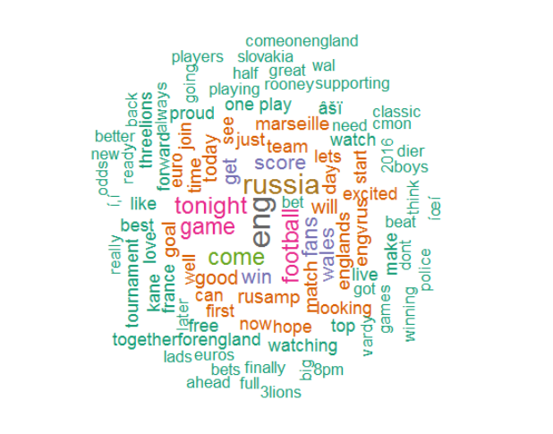
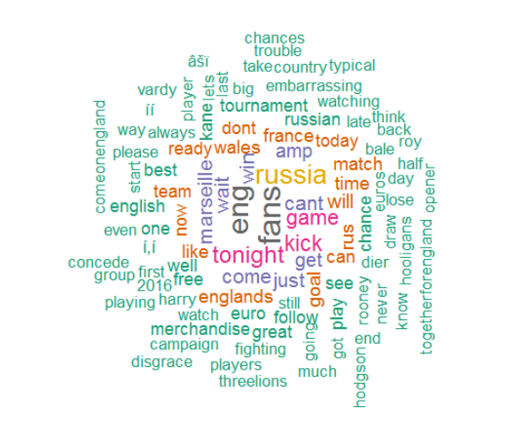
Extending a Social Network Analysis
Positive Tweets
Negative Tweets
Notes:
Even though who students communicate with should be considered, as more knowledgeable peers should support individuals to gain a better understanding of the topic.
The problem is, however, the analysis not taking into consideration what the students are actually saying.
This is where sentiment analysis can be of considerable use in understanding the emotion conveyed by students in their discussions, and I will illustrate this using an analysis of tweets related to the England vs Russia football game.
So what I did was collect twenty thousand tweets during throughout the day, with the intention that it would allow me to see fluctuations in emotion.
Once collected, I analysed these tweets using sentiment analysis, which led to them being categorised as either positive or negative.
The word clouds show frequently associated words with both positive and negative tweets.
This is quite good as in the context of student learning you could identify particular aspects of the course that students hold negative views towards, such as workloads.
You could even take this further, and assess the change in student emotions over the course of a module.

Slide 20
Notes:
As you can see here, this is the change in the mean positive and negative sentiment conveyed in tweets over the time leading up to and after the football match.
What it shows is that majority of tweets were positive prior to the game, but during the game and once it was over there was a surge in negative tweets.

Slide 21
Notes:
This further shows the change in emotion over the football game, but when tweets are categorised as having sentiment related to joy or sadness.
For education purposes, this type of analysis could be useful in identify the change in student attitudes towards your module over time or from a singular lesson.
With this data you could gain greater clarity over what particular topics or activities students preferred in their learning process

Slide 22
Learning Analytics: What’s Missing?
Notes:
There has not been a consistent use of theoretical constructs, so there are not many opportunities to make comparisons of findings across time.
What is needed, is a greater appreciation of learning theories – trace data will only give you a small proportion of the learning process.
We need to understand what are the cognitive, affective, and motivational states that factor into the learning process – this can lead to models that illuminate greatly upon how particular student behaviour, but also we can understand how analytics

Slide 23
Ethical Issues
What are the ethical issues?
Code of Practice (Sclater, 2016).
Notes:
There are many research opportunities that can make use of learning analytics, especially when the connection to learning theory has not been adequately addressed.
Before considering research, however, we must turn towards the numerous ethical issues related to the use of learning analytics.
As it currently stands, it is readily assumed that our actions online are constantly monitored, recorded, or even analysed with the anticipation that it can lead to improvements in services.
For example, Amazon can recommend me more products to buy that I do not need.
Despite this, it cannot be assumed that in the context of education that students would readily accept that their data will be stored and analysed for the purposes of learning analytics.
At our University, students do consent to VITAL storing their behaviour as this forms part of the computer services policy they need to sign when becoming a student.
The issue here is how many students actually realise that this occurs, but then if you inform them does this lead to gaming the system?

Slide 24
Code of Practice – Sclater (2016)
Areas | Meaning
Responsibility | Who will carry out the analytics?
Transparency and Consent | Is the process clear to students?
Privacy | Will data remain anonymous?
Validity | Is the algorithm valid?
Access | Can students access the information?
Positive Interventions | What intervention will be carried out?
Minimise Adverse Impacts | Are you categorising students?
Stewardship of Data | How long will the data be kept for?
Notes:
Here are eight ethical areas that have been outlined in the Jisc code of practice – I’m only going to go through a couple of them just to provide some extra details, but they are quite self-explanatory.
So, the first area concerns who in the institution has responsibility for learning analytics to be used in an ethical and effective manner? This could be either teaching staff, heads of schools, or a specific department.
This responsibility also covers what parts of the data will be anonymised, what analytics will be carried out and with what purpose, how the output will be used to guide interventions, and what we do with the data.
Now, moving to the area of transparency and consent is more difficult.
This is because recording of student behaviour within a virtual learning environment is automatic and there is no method to prevent this collection from occurring.
In the case of using this data for the creation of dashboards or interventions, consent should be obtained.
Also, before obtaining consent the process should be as transparent as possible for students – they should be aware of what data is being used and what is off limits, who has access to the analytics, and how the data will be interpreted.
In the event a student does opt-in, they should be allowed to opt-out at any time without any repercussions.
Relating to the idea of transparency is the issue of privacy, as any student data collected should maintain anonymity and every attempt should be made to prevent the loss of anonymity through the use of multiple datasets.
Now this data that is used should be accurate and if you were to make predictions of student success or retention then you need to make sure that the algorithm is valid.
This is because the outcome of these analytics could affect a student’s wellbeing or career, so if you are basing a decision on a model that is 60% accurate in identifying at-risk students then you could be putting students under a considerable amount of distress.
You are accountable for the student’s wellbeing and you should not be putting them in a situation that could jeopardise their future.

Slide 26
Questions?

