Slide 1
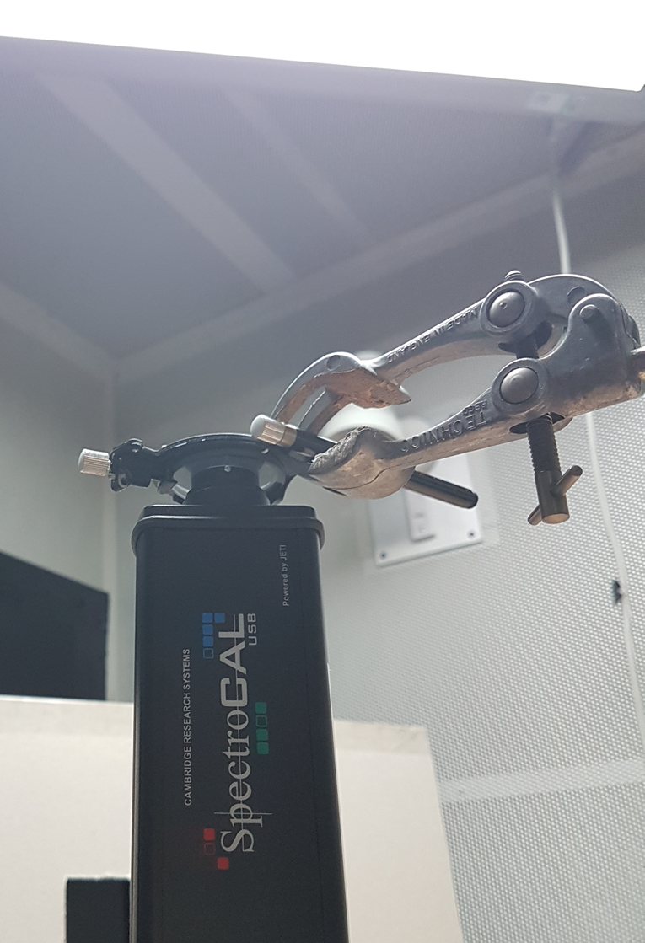
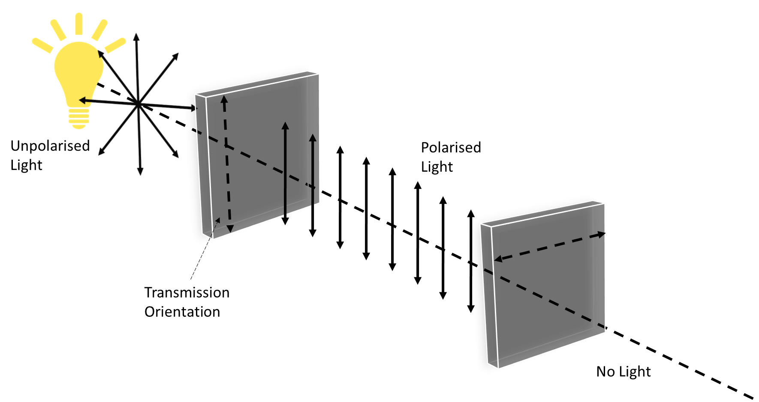
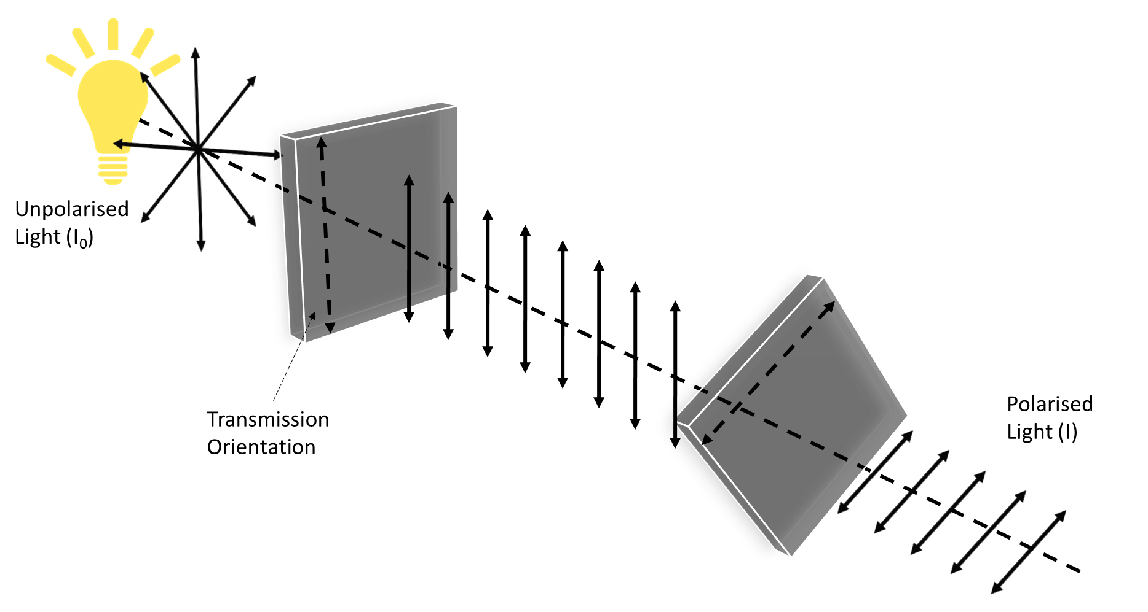
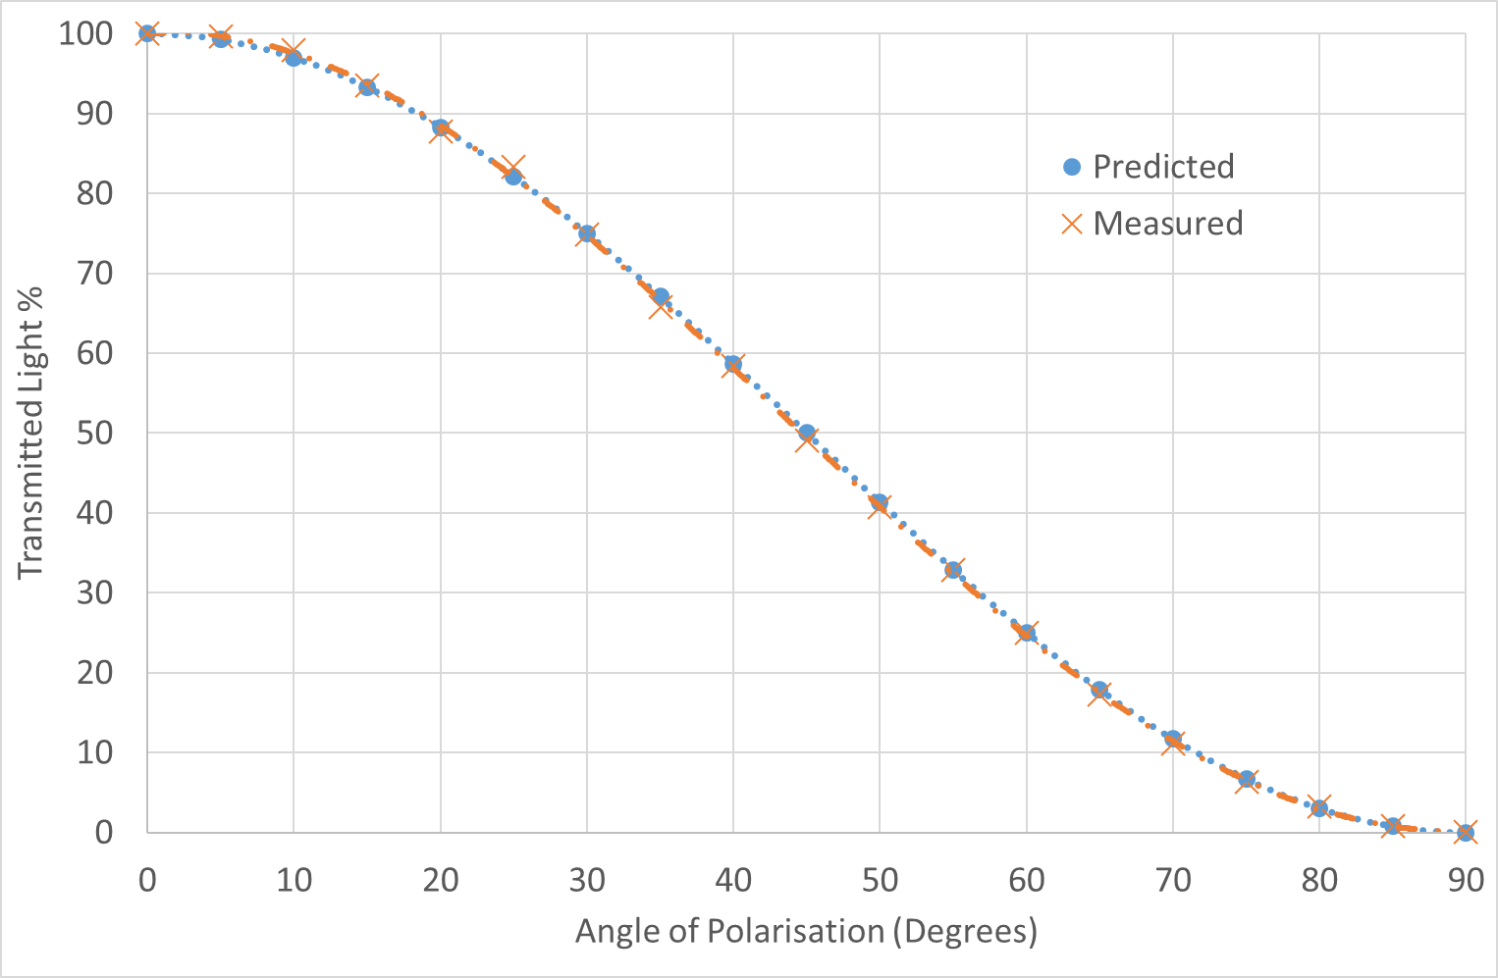
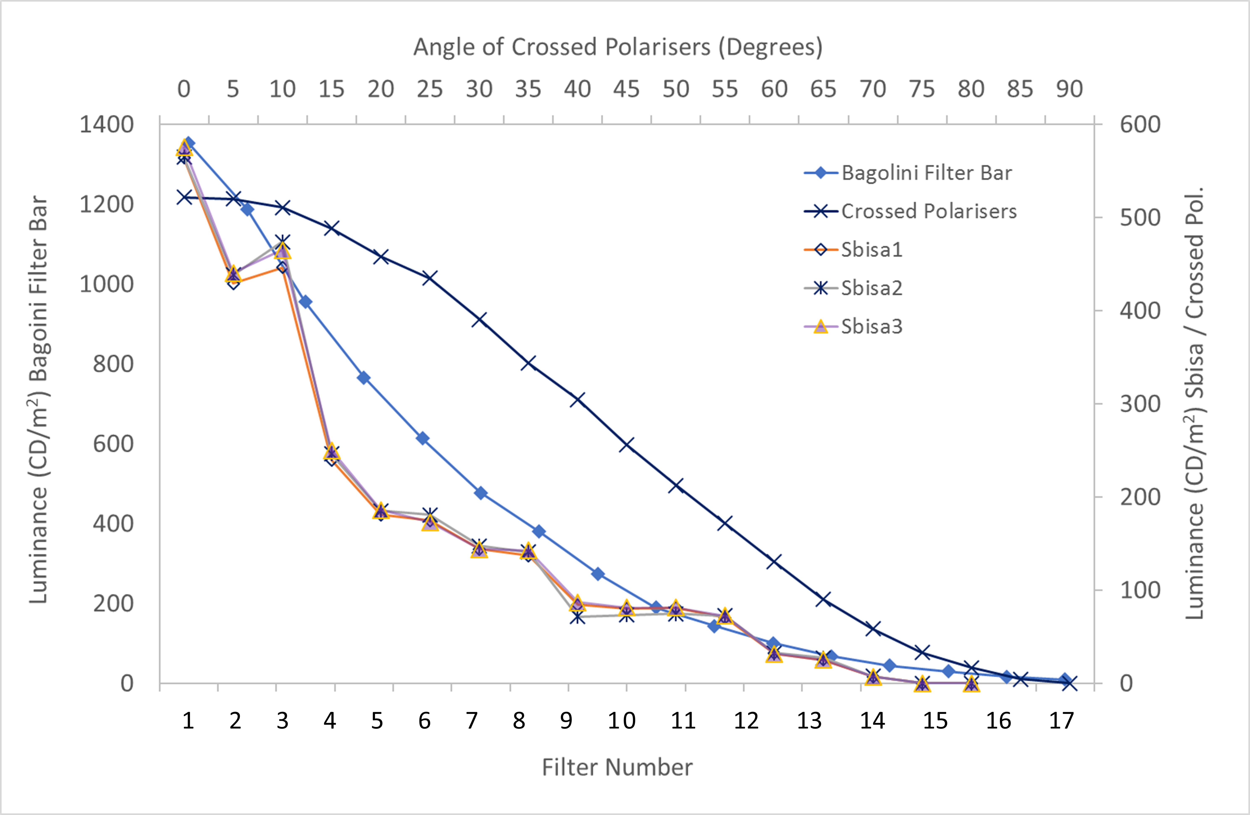
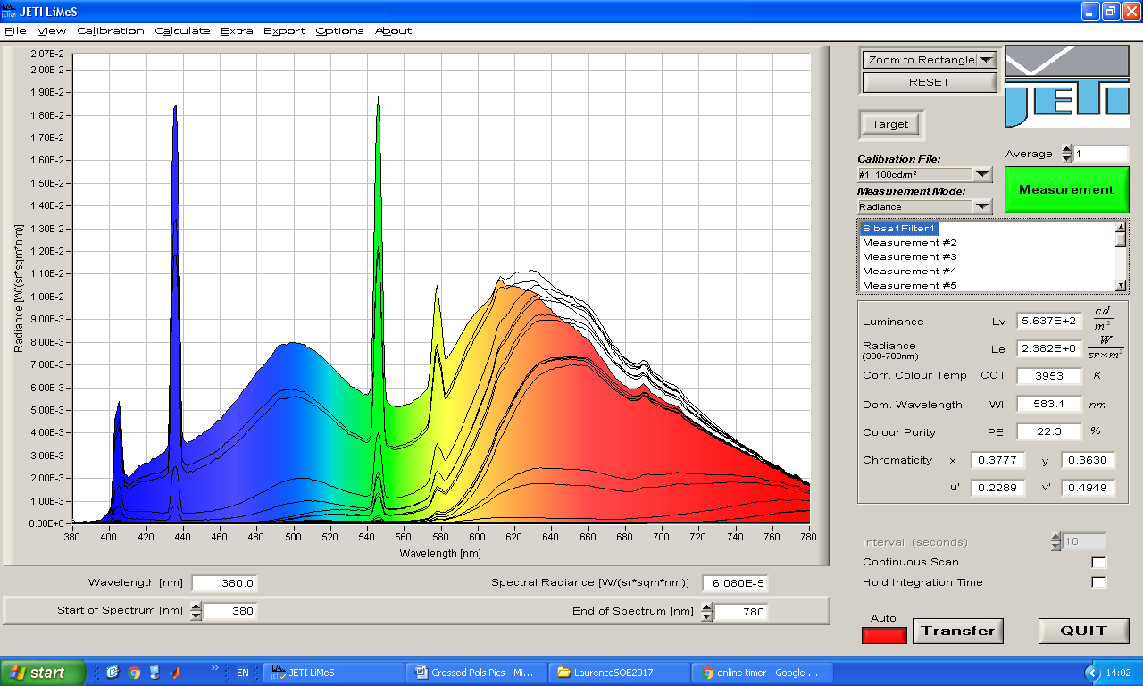
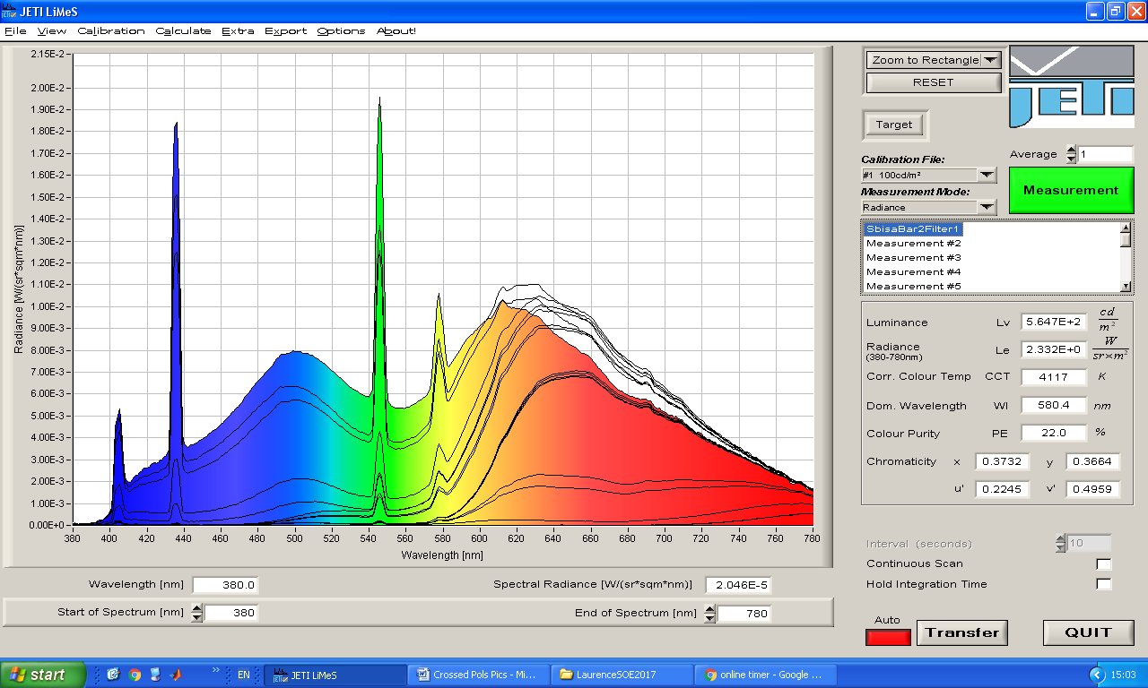
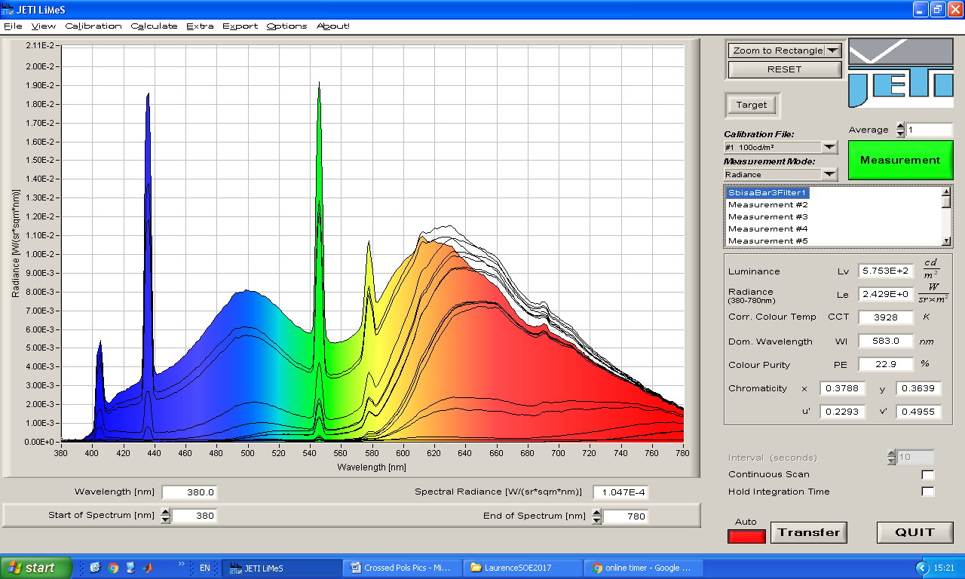
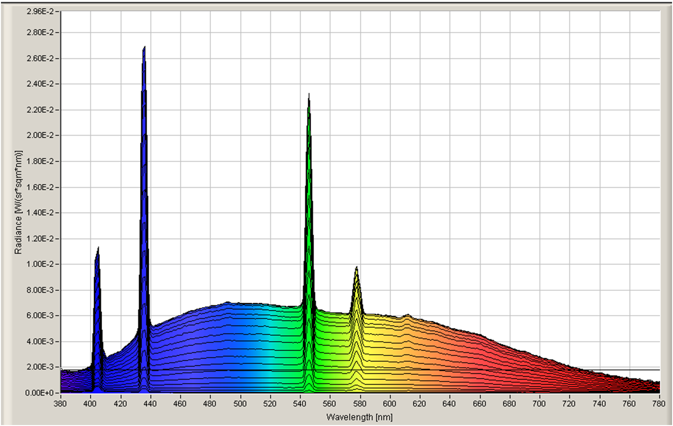
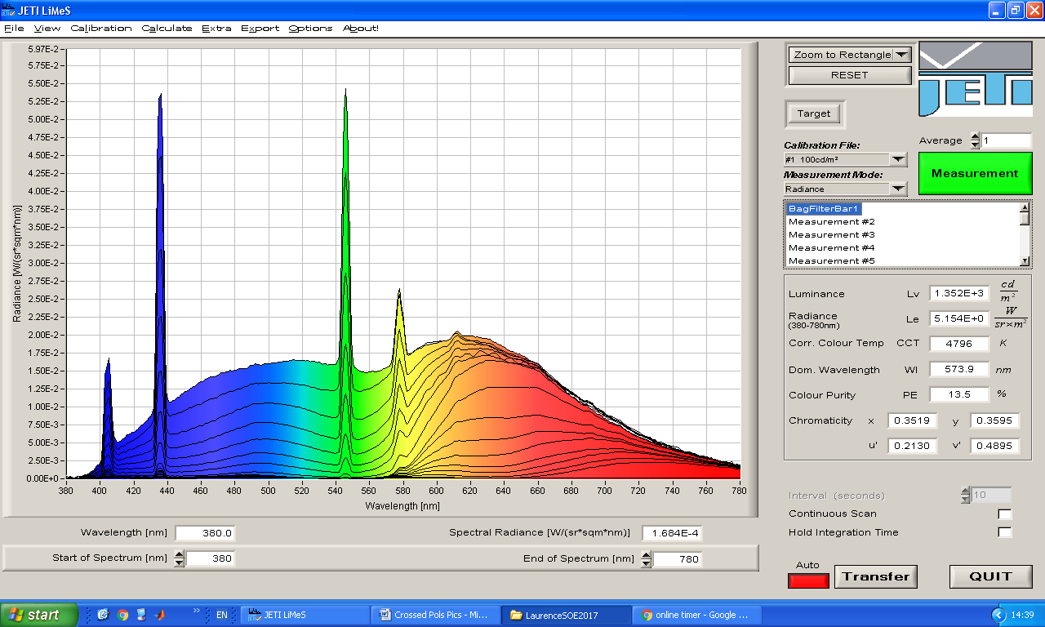
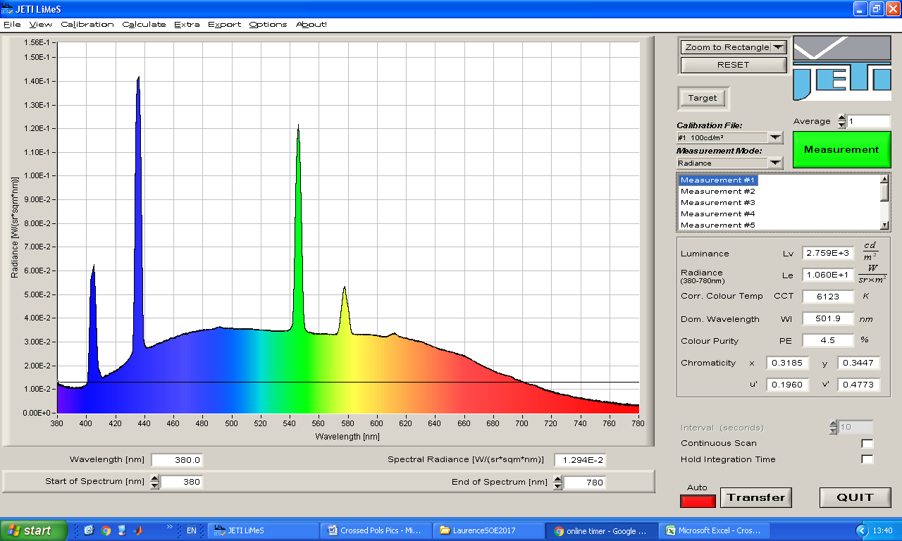
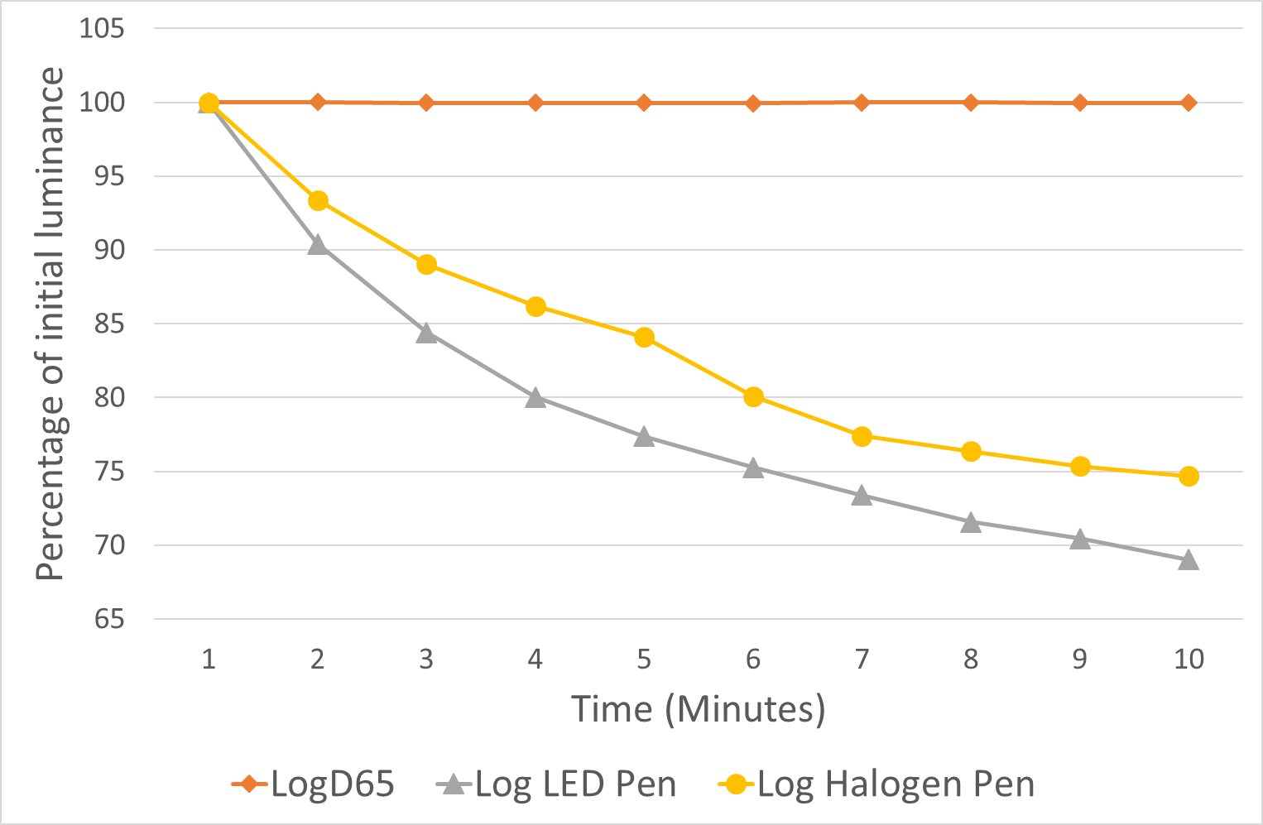
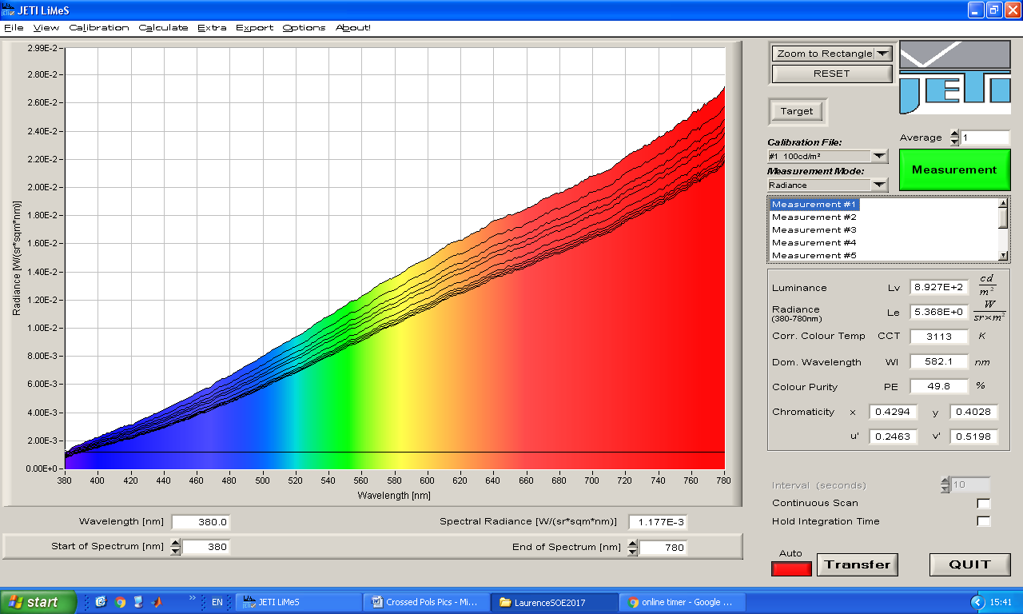
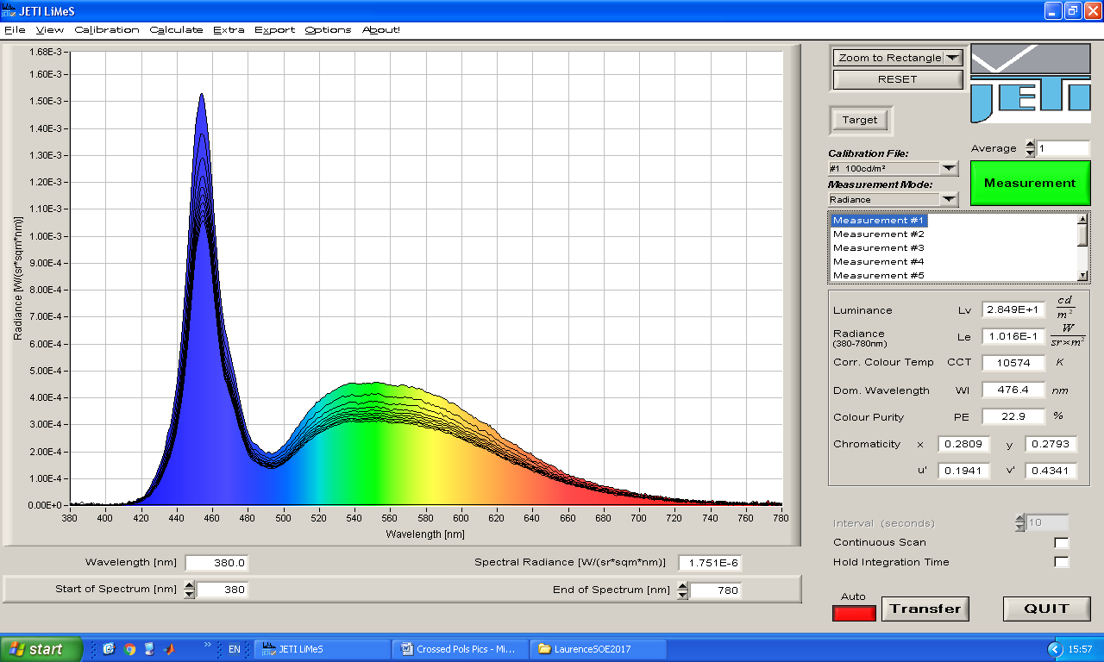
Evaluation of a new method of assessing suppression in amblyopia and the effect of light source variability.
L Tidbury^{1,2}, A O’Connor¹ & D Newsham¹
1) Directorate of Orthoptics & Vision Science, University of Liverpool, Liverpool 2) Psychological Science, University of Liverpool, Liverpool
Introduction
The risk of intractable diplopia is a concern during the treatment of strabismic amblyopia.
The use of any neutral density filter (such as the Sbisa bar, NDF and Bagolini filter bar) placed in front of the healthy eye, will mimic certain aspects of amblyopia,^{1,2} allowing the level of suppression to be monitored.
When the appropriate filter is positioned over the healthy eye, the input to the two eyes is balanced, which can restore binocular function of at least simultaneous perception.³
The most commonly used filter bar in the UK is the Sbisa bar,⁴ however visual inspection alone, shows marked differences between filter gradations, with evidence of large jumps in light transmitted between some lower filters and small jumps between higher filters.⁵
Aim: To investigate the use of crossed polarisers to reduce light transmission, in comparison with the Sbisa and Bagolini bars.
Methods
The Law of Malus states that when a second polariser is rotated towards 90º from the first polariser’s transmission orientation, the change in light intensity is proportional to the angle of crossing (Fig. 1 & 3). This predictability suggests a good method to control the amount of light entering the eye, and suitable for trial frame mounting.
A spectroradiometer (SpectroCAL MKII) was used to measure the intensity of light from a stable light source (D65 GTI GLE-m5/32 (Fig. 2)), repeated through each filter of three separate Sbisa bars , Bagolini bar and at 5º intervals of a pair of crossed polarisers. Common light sources (An LED and ophthalmoscope bulb) were also measured for comparison.
Figure 1: Demonstration of polarisation through two filters. One orientation of unpolarised light is ‘filtered’ through the first polariser. Rotation of the transmission orientations of the second polariser towards 90º from the first, reduces the transmission of light.
Figure 2: Equipment set up, filter method (in this example the crossed polarisers) is placed between spectrometer and light source.
Results
a.
b.
c.
Figure 5 (a-e): The total colour spectra of each filter for each bar. The colours represent the spectra at filter 1 / 0º using the D65 light source. a-c are for the 3 Sbisa bars. d for the crossed polarisers and e, the Bagolini filter bar. Note the large variation in luminance reduction across the spectra (a-c), the improved but still variable changes in e, and the proportional and even changes in d.
d.
e.
Figure 3: Plot of the predicted light transmission (%) according to the law of Malus, and the actual measured value, showing the applicability of the crossed polariser method.
Figure 4: Luminance levels measured through each filter/5º of crossed polarisation. The top x-axis if for the Crossed Polarisers only, and the left y-axis is for the Bagolini filter bar only.
a.
Light Source Stability
Discussion
Crossed polarisers, even with relatively large changes used here of 5º, provide a predictable, consistent reduction in luminance across the entire spectrum of light.
The Sbisa bars show very little change between some filters (e.g. 9-12 are identical), and variability across the spectra, e.g. a change from 12 to 9 would be less alarming than a change from 9 to 8. These bars have been in the clinic for some time, which could suggest a degradation in the filters.
The Bagolini bar shows a consistent change in luminance across filters, but some variability across spectra. This is a newly ordered bar, with some colour variability.
There have been approaches to measuring interocular suppression that do not rely on filter bars, such as the use of a 3DTV to show varying contrast letters to each eye,⁶ and dichoptic head mounted displays displaying motion coherence stimuli.⁷ Whilst the latter two approaches are robust and designed for clinical use, they are limited to use in the clinic, and restricted by departmental budgets.
Whilst the inter-ocular luminance ratio remains constant, based on the filter placed before each eye, it has been suggested that the absolute luminance seen by the eye behind the filter, may have a marked effect on the balance of ocular dominance.⁸ Simply put, variations in the light source will result in a difference in contrast ratio required to elicit a diplopic response: A pen torch isn’t a suitable light to assess facultative suppression.
The method of crossed polarisers introduced here is a cheap and simple solution (in association with a suitable light source), but further validation is needed to establish test/re-test variability.
The use of crossed polarisers offer:
A cheap and portable method
A near continuous scale, offering more “filters” than traditional bars
A consistent decrease in luminance across the entire colour spectrum
b.
d.
Figure 6 (a-d): a-c: show the colour spectra (at first measurement), with the black lines showing each measurement at 1 min intervals up to 10 minutes. a: D65 b: Halogen c:LED.
The plot in ‘d ‘shows the percentage of initial luminance over time. The D65 luminant (daylight spectra) shows perfect stability over ten minutes, however, the LED pen touch and Halogen (ophthalmoscope bulb) show a reduction in luminance over this time – this variability would be greater across different appointments.
c.
1 Zhou J, Jia W, Huang C-, Hess RF. The effect of unilateral mean luminance on binocular combination in normal and amblyopic vision. Sci Rep 2013; .
2 Baker DH, Meese TS, Hess RF. Contrast masking in strabismic amblyopia: Attenuation, noise, interocular suppression and binocular summation. Vis Res 2008; 15 :1625-1640.
3 Hess RF, Mansouri B, Thompson B, Gheorghiu E. Latent stereopsis for motion in depth in Strabismic Amblyopia. Invest Ophthalmol Visual Sci 2009; 10 :5006-5016.
4 Newsham D, O’Connor AR. Assessment of the density of suppression to identify risk of intractable diplopia in the United Kingdom. Strabismus 2016; 2 :45-50.
5 Piano M, Newsham D. A pilot study examining density of suppression measurement in strabismus. Strabismus 2015; 1 :14-21.
6 Birch EE, Morale SE, Jost RM, De La Cruz A, Kelly KR, Wang Y-, et al. Assessing suppression in amblyopic children with a dichoptic eye chart. Invest Ophthalmol Vis Sci 2016; 13 :5649-5654.
7 Black JM, Thompson B, Maehara G, Hess RF. A compact clinical instrument for quantifying suppression. Optom Vis Sci 2011; 2 .
8 Zhou J, Hess RF. Neutral-density filters are not a patch on occlusion. Invest Ophthalmol Vis Sci 2016; 10 :4450-4451.
EP-PED-483
Mr Laurence Tidbury L.Tidbury@Liverpool.ac.uk

