Slide 1
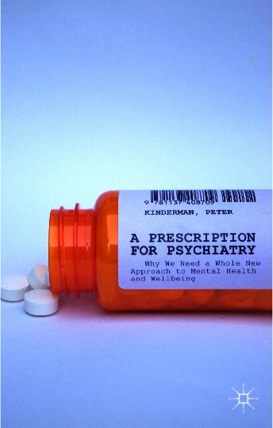
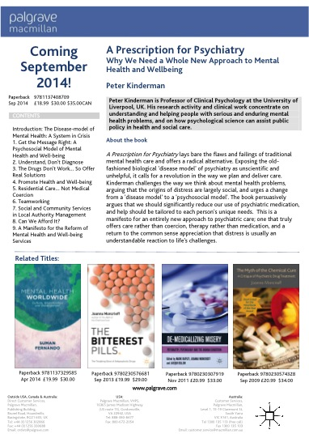



A manifesto for mental health:
why we need a whole new approach to mental health and wellbeing
Peter Kinderman
Professor of Clinical Psychology
University of Liverpool, UK

Slide 2
“… the message that comes through loud and clear is that people are being badly let down by the system in every area of their lives.”
The
Schizophrenia
Commission
Notes:
The system is broken…

Slide 3
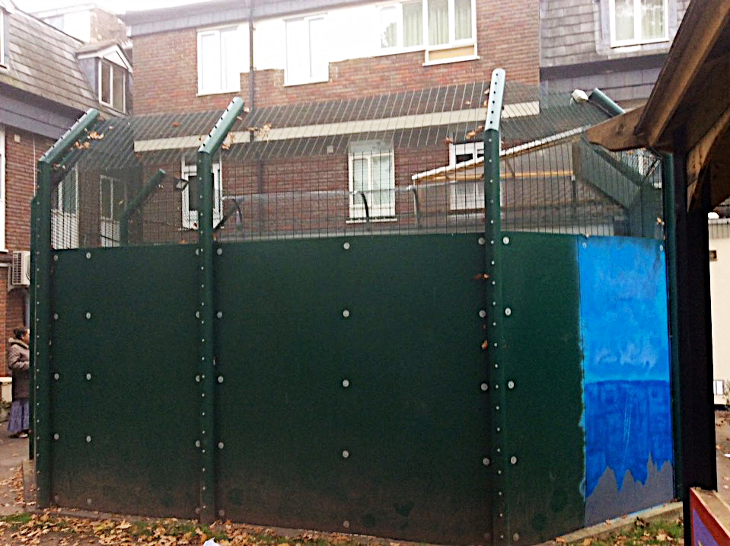
Notes:
And violates our fundamental rights

Slide 4
Notes:
It’s not a guild dispute – psychiatry is in “dissent”… although I’m clearly on one side

Slide 5
A manifesto
for mental health & wellbeing
Mental health problems are fundamentally social and psychological issues.
We should therefore replace ‘diagnoses’ with straightforward descriptions of our problems, radically reduce use of medication, and use it pragmatically rather than presenting it as a ‘cure’.
Instead, we need to understand how each one of us has learned to make sense of the world, and tailor help to our unique and complex needs.
We need to offer care rather than coercion, to fight for social justice, equity and fundamental human rights, and to establish the social prerequisites for genuine mental health and wellbeing.
Notes:
My manifesto

Slide 6
A manifesto
for mental health & wellbeing
Mental health problems are fundamentally social and psychological issues.
“All mental processes, even the most complex psychological processes, derive from operations of the brain”. Eric Kandel (1989)
“No one doubts that the brain is the organ of affect and behavior...”
Tom Insel (2015)

Slide 7
Ψ = ∫ (g,e)
ΔΨ = ∫ (Δg,Δe)
Δg >Δe

Slide 8
“… The study provides evidence linking the recent increase in suicides in England with the financial crisis that began in 2008. English regions with the largest rises in unemployment have had the largest increases in suicides, particularly among men…
We estimated that each 10% increase in the number of unemployed men was significantly associated with a 1.4% increase in male suicides. These findings suggest that about two fifths of the recent increase in suicides among men during the 2008-10 recession can be attributed to rising unemployment…”
Notes:
http://www.bmj.com/content/345/bmj.e5142

Slide 9
“… the number of stressful life events was significantly associated with depression …
No association was found between 5-HTTLPR genotype and depression … and no interaction effect between genotype and stressful life events on depression was observed … no evidence that the serotonin transporter genotype alone or in interaction with stressful life events is associated with an elevated risk of depression…”
Notes:
Risch (2009) doi: 10.1001/jama.2009.878

Slide 10
“…There were significant associations between adversity and psychosis ... with an overall effect of [an odds ratio of ] = 2.78 … These findings indicate that childhood adversity is strongly associated with increased risk for psychosis…”
Notes:
http://schizophreniabulletin.oxfordjournals.org/content/early/2012/03/28/schbul.sbs050.full.pdf+html
Varese et al - In the National Comorbidity Survey (Shevlin et al. 2007), which examined cumulative trauma, the odds ratios increased dramatically - from 2.53 for 1 type of trauma to 53.26 for 5 types of trauma.

Slide 11
A manifesto
for mental health & wellbeing
Mental health problems are fundamentally social and psychological issues.

Slide 12
A manifesto
for mental health & wellbeing
Mental health problems are fundamentally social and psychological issues.
We should therefore replace ‘diagnoses’ with straightforward descriptions of our problems, radically reduce use of medication, and use it pragmatically rather than presenting it as a ‘cure’.

Slide 13
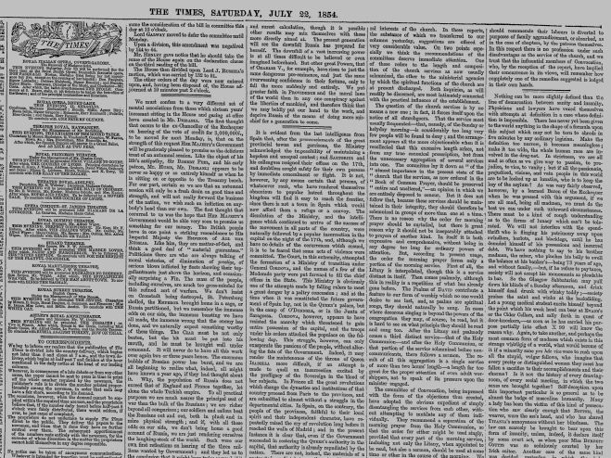
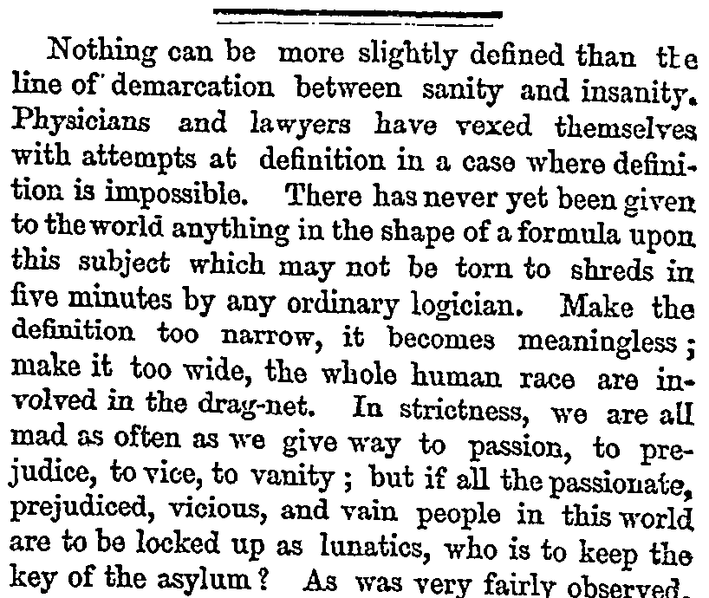

Slide 14
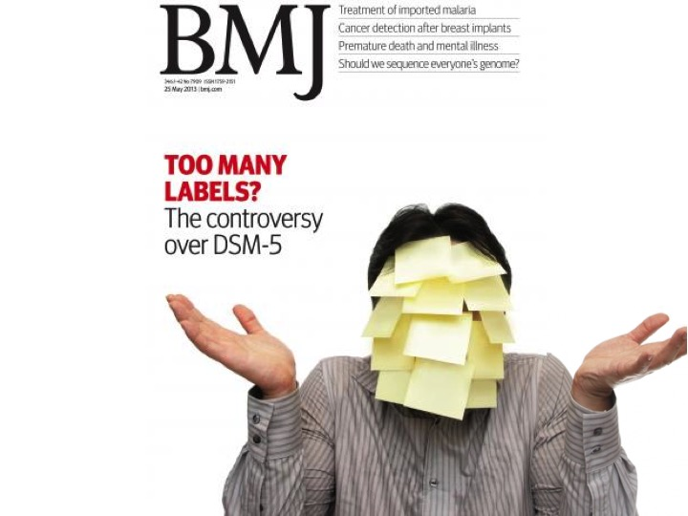

Slide 15
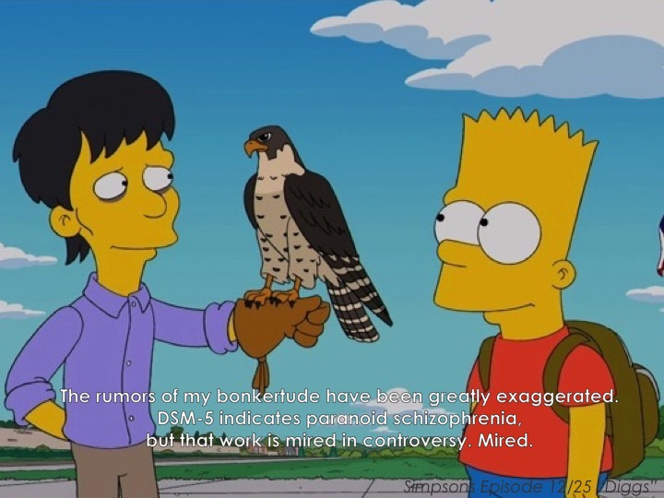

Slide 16
A manifesto
for mental health & wellbeing
Mental health problems are fundamentally social and psychological issues.
We should therefore replace ‘diagnoses’ with straightforward descriptions of our problems, radically reduce use of medication, and use it pragmatically rather than presenting it as a ‘cure’.
Instead, we need to understand how each one of us has learned to make sense of the world, and tailor help to our unique and complex needs.

Slide 17
Biological factors
Mediating psychological processes
Psychological and social problems
Social factors
Circumstantial factors
Kinderman, P. (2005) A psychological model of mental disorder. Harvard Review of Psychiatry. 13: 206–217.

Slide 20
A manifesto
for mental health & wellbeing
Mental health problems are fundamentally social and psychological issues.
We should therefore replace ‘diagnoses’ with straightforward descriptions of our problems, radically reduce use of medication, and use it pragmatically rather than presenting it as a ‘cure’.
Instead, we need to understand how each one of us has learned to make sense of the world, and tailor help to our unique and complex needs.
We need to offer care rather than coercion, to fight for social justice, equity and fundamental human rights, and to establish the social prerequisites for genuine mental health and wellbeing.

Slide 21

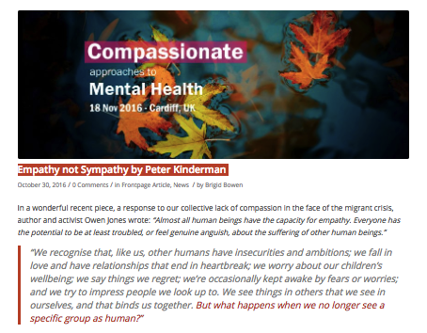

Slide 22
1 : 4
4 : 4

Slide 23



Slide 24

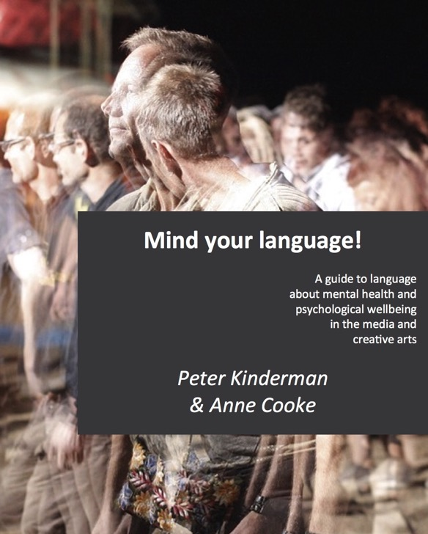
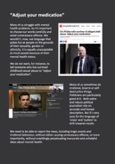
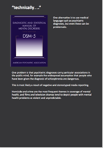

Slide 25
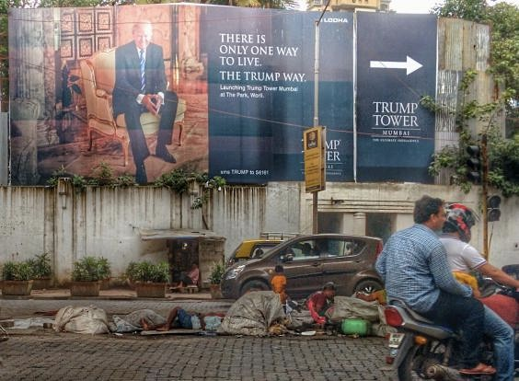

Slide 27
The crisis in mental health should be managed not as a crisis of individual conditions, but as a crisis of social obstacles which hinders individual rights. Mental health policies should address the “power imbalance” rather than “chemical imbalance”.
The urgent need for a shift in approach should prioritize policy innovation at the population level, targeting social determinants and abandon the predominant medical model that seeks to cure individuals by targeting “disorders”.

Slide 28
“…To promote genuine mental health and wellbeing we need to protect and promote universal human rights, as enshrined in the United Nations’ Universal Declaration of Human Rights. Because experiences of neglect, rejection and abuse are hugely important in the genesis of many problems, we need to redouble our efforts to protect children from emotional, physical or sexual abuse and neglect...
More generally, if we are serious about preventing mental health problems from developing, and about promoting genuine psychological well-being, we must work collectively to create a more humane society: to reduce or eliminate poverty, especially childhood poverty, and to reduce financial and social inequalities...”

Slide 29


Slide 30
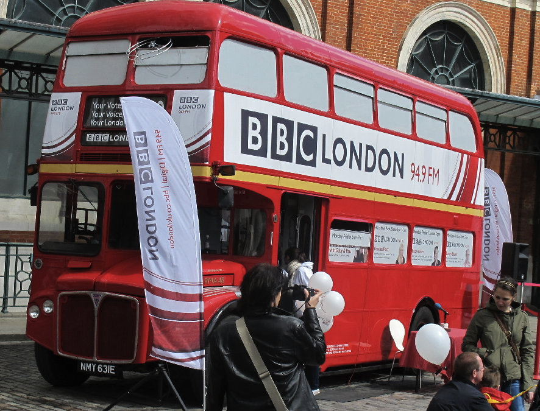
Don’t ask what’s wrong with me,
ask what’s happened to me

Slide 31
Peter Kinderman
Professor of Clinical Psychology
University of Liverpool, UK
p.kinderman@liverpool.ac.uk
@peterkinderman
www.peterkinderman.com

Slide 32
Citations, credits and image sources:
All images © Palgrave Macmillan and http://www.amazon.com/dp/1137408707/
https://www.rethink.org/about-us/the-schizophrenia-commission
© Alison Cameron https://twitter.com/allyc375
http://bjp.rcpsych.org/content/193/1/6 and http://bjp.rcpsych.org/content/201/6/430
All images © Palgrave Macmillan, text http://www.amazon.com/dp/1137408707/
All images © Palgrave Macmillan, text http://www.amazon.com/dp/1137408707/, http://ajp.psychiatryonline.org/article.aspx?articleid=172780 and www.nimh.gov/about/director/2013/transforming-diagnosis.shtml
-
http://www.bmj.com/content/345/bmj.e5142
Risch (2009) doi:10.1001/jama.2009.878
http://schizophreniabulletin.oxfordjournals.org/content/early/2012/03/28/schbul.sbs050.full.pdf+html
All images © Palgrave Macmillan, text http://www.amazon.com/dp/1137408707/
All images © Palgrave Macmillan, text http://www.amazon.com/dp/1137408707/
The Times Editorial Saturday, 22 July 1854, p. 8.
http://www.bmj.com/content/346/bmj.f3352
https://en.wikipedia.org/wiki/Diggs_(The_Simpsons)
All images © Palgrave Macmillan, text http://www.amazon.com/dp/1137408707/
© Peter Kinderman
doi: 10.1192/bjp.bp.114.147553
doi: 10.1192/bjp.bp.114.147553
All images © Palgrave Macmillan, text http://www.amazon.com/dp/1137408707/
http://compassionatementalhealth.co.uk/empathy-not-sympathy-peter-kinderman
© Peter Kinderman
http://www.all-about-psychology.com/peter-kinderman.html
© Peter Kinderman
https://www.indy100.com/article/trump-mumbai-homeless-slum-children-photograph-reddit-photoshop-fake-7503251
http://ap.ohchr.org/documents/dpage_e.aspx?si=A/HRC/35/21
http://ap.ohchr.org/documents/dpage_e.aspx?si=A/HRC/35/21
All images © Palgrave Macmillan, text http://www.amazon.com/dp/1137408707/
https://twitter.com/OnlyUsCampaign
Image © Peter Kinderman, text http://www.jacquidillon.org/
All images © Palgrave Macmillan
© Peter Kinderman

