Slide 1
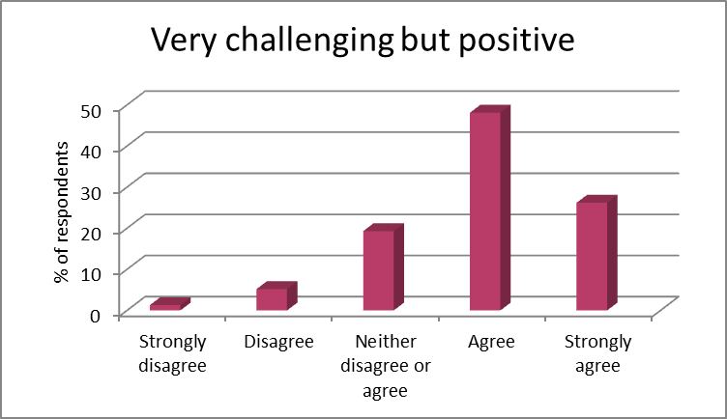
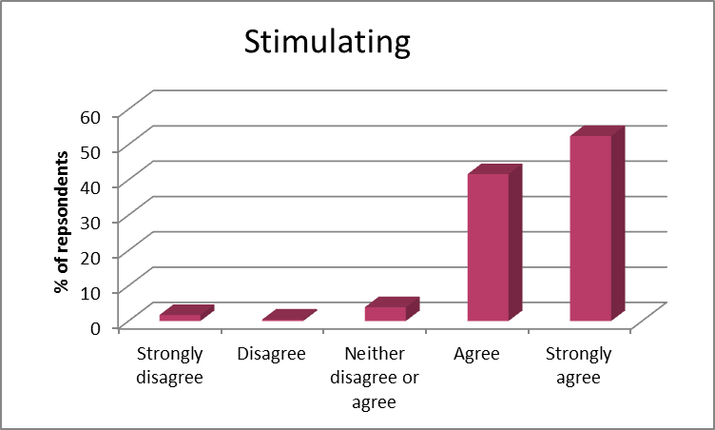
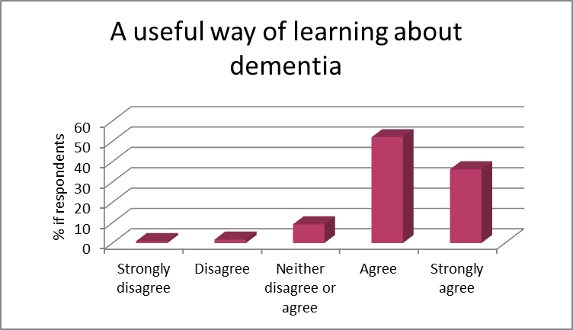
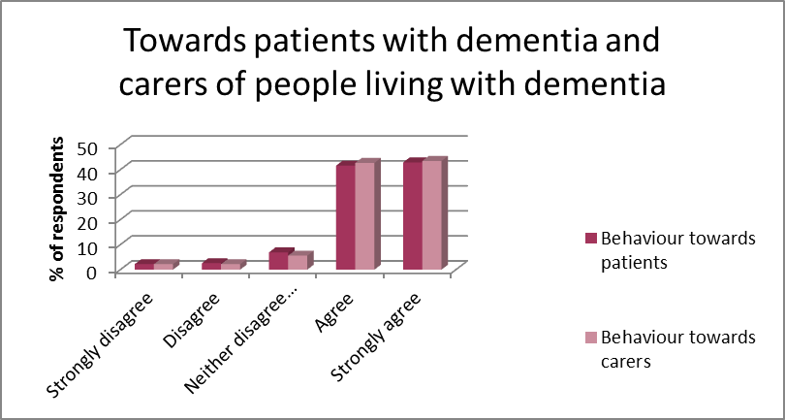
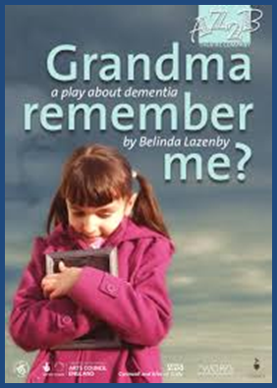
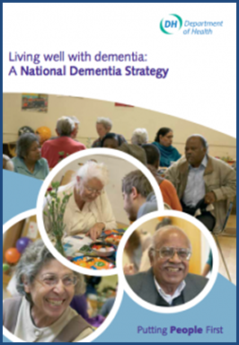
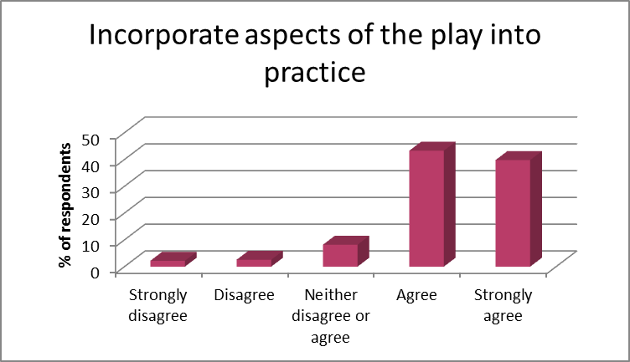
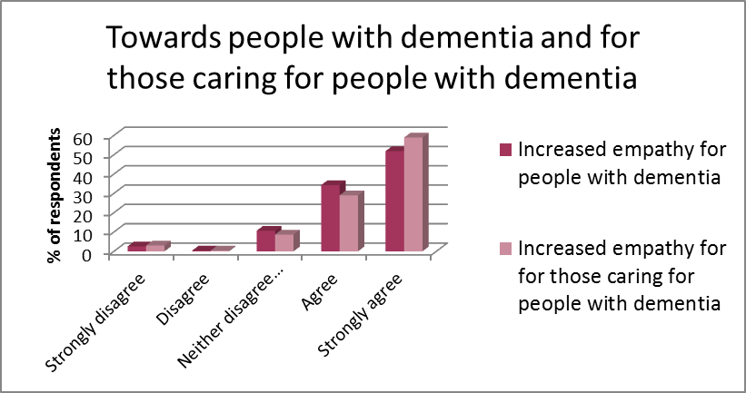
An arts-based pedagogic approach for dementia awareness and training for health care professional students
Helen Orton - Academic Lead for Continuing Professional Development and Inter-Professional Education and Learning (h.p.orton@liverpool.ac.uk)
School of Health Sciences, Institute of Clinical Sciences
Introduction and background
Recent demographics show that 850,000 people have a form of dementia in the UK. If age-specific prevalence remains stable, this will increase to 1 million and 2 million by 2025 and 2050 respectively¹. Globally, the number of people living with dementia will increase from 46.8 million (2015) to 130 million to 131.5 million by 2030 and 2050 respectively². It is thus important that health and social care professionals are equipped with the correct knowledge and skills to care for people with dementia³.
Whilst much of what is learned about dementia in a professional context is through formal teaching and learning, it is often the least effective. The use of theatre in training interventions is more engaging and contextualises the complex and emotive issues that are encompassed⁴. Arts-based learning in medical education to facilitate non-scientific elements of medicine issues⁵ has been well received but illness-related theatrical performances in the context of health care education is offers an innovative and emerging pedagogy modality⁶⁻⁷. Ethnodramas enable health care professionals to immerse themselves in the lives of persons with dementia and their families which have a subsequent positive impact in responding to the needs and concerns of persons with dementia⁸.
Results
The performance was:
The impact of the play:
The play has made me think how I need to change my behaviour……
The play: “Grandma, remember me”
The play is underpinned by research identifying that dementia can be “lived well” where grandchildren are particularly helpful to grandparents with dementia as they cope with the continued repetition and is consistent with the term “living well with dementia” as part of the UK’s National Dementia Strategy⁹. It is based on a true experience, from the perspective of a young child whose grandmother develops Alzheimer’s disease.
The play has made me realise I need to………
The play has made me realise I need to demonstrate greater empathy
Aims of the study
To establish the perception of health care students of using theatre to examine their comprehension of dementia and the impact of the play on their beliefs around changing attitudes towards people living with dementia.
Conclusions
Arts-based learning provides an effective way for health care students to explore those aspects of health care that cannot be reduced to scientific phenomena. It facilitates an understanding of the emotional factors that impact upon the human experience (families and carers) and the understanding of illness and suffering and will continue to be part of the curriculum. However, the longer term impact needs to be considered in future research.
Design of study
The study consisted of pre-performance questionnaires to collect demographic data and phrases associated with dementia and an immediate post-questionnaire based on the value of the performance, theatre as an educational tool and impact of the play on practice.
References
1. Alzheimer’s Research UK (2016) https://www.dementiastatistics.org/statistics-about-dementia/prevalence/
2. Prince M, Wimo A, Guerchet M et al. World Alzheimer Report 2015. The Global Impact of Dementia:
An analysis of prevalence, incidence, costs and trends.
3. Health Education England https://hee.nhs.uk/our-work/person-centred-care/dementia
4. Rossiter K, Kontos P, Calantonio A, Gilbert J, Gray J and Keighley M. Staging data: theatre as a tool
for analysis and knowledge transfer in health research. Social Science and Medicine 2008; 66(1): 130-46.
5. De la Croix A, Rose C, Wildig E and Wilson S. Arts-based learning in medical education:
the students’ perspective. Medical Education 2011; 45: 1090-1100.
6. Shapiro J and Hunt L. All the world’s a stage: the use of theatrical performance in medical education.
Medical Education 2003; 37: 922-927.
7. O’Connor A, Abbott J-A, Recoche K. Getting the message across: does the use of drama aid education in
palliative care? Advance in Health Science Education 2012; 17: 195-201.
8. Kontos P, Naglie G. Expressions of personhood in Alzheimer’s: moving from ethnographic text to performing
ethnography. Qualitative Research 2006; 6:301-317.
9.https://www.gov.uk/government/uploads/system/uploads/attachment_data/file/168221/dh_094052.pdf

