Slide 1
Ovarian cancer update for GPs
Dr Jane Wilcock
BScFRCGPPGCertMedEd.MAHEd.SFHEA
https://www.nice.org.uk/guidance/cg122/evidence/full-guideline-pdf-181688799
http://www.cancerresearchuk.org/health-professional
https://emedicine.medscape.com/article/255771-overview

Slide 2
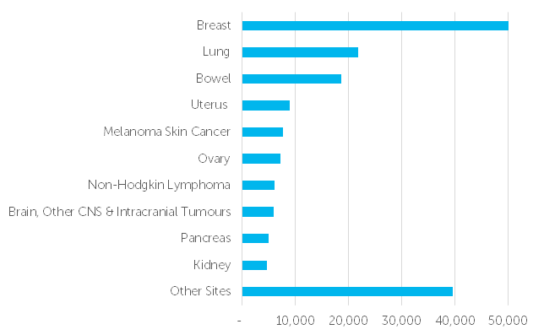
The Ten Most Common Cancers in Females, Numbers of New Cases, UK, 2015 This chart excludes non-melanoma skin cancer because of known under-reporting http://www.cancerresearchuk.org/health-professional/cancer-statistics/incidence/common-cancers-compared#heading-Two

Slide 3
Ovarian cancer (OC) stats (cancer researchUK and NICE)
7,270 cases pa ( 20 women a day) are diagnosed with ovarian cancer (OC)
4,277 die pa
Most women are diagnosed with advanced stage disease and this contributes to ovarian cancer having the lowest relative five year survival rate of all gynaecological cancers (2007).
The five year survival rates for patients with ovarian cancer have increased dramatically from 20% in 1975 to 38.9% in 2006
Overall survival is 35% over 5 years+
6th most common cancer in F and 4% of F cancers
In the last 10 years mortality has dropped 16%
Incidence is highest in F 60-64yrs according NICE guidance
F aged 15-39yrs: 90% survive 5+yrs
Newer drugs being added on, not replacing treatment like bevacizumab (Avastin)
If BRACA1 or 2 +ve: olparib and niraparib recently recommended in recurrence

Slide 4
Risk factors for OC
Age over 65yrs ( >50%cases)
BRACA 1 and 2 5-15% cases
Breast cancer increases the risk by two, more if occurs<40yrs old
HRT (1% cases in UK)
Endometriosis
Cigs (3%cases)
Talc
Protective factors
COC/CHC
Having children
Breastfeeding
Tubal sterilisation

Slide 5
Screening for OC: not recommended Lancet vol 387; No.10022;, p945–956, 5 March 2016 UKCTOCS. United Kingdom Collaborative Trial of Ovarian Cancer Screening. The final analysis of the impact of ovarian cancer screening on the mortality from the disease
202,638 postmenopausal women; 50–74 years from 13 centres in NHS Trusts in England, Wales, and N. Ireland. Excluded if BSO or known OC, FH OC, active non-OC malignancy.
Random allocation to annual
multimodal screening (MMS) with serum CA125 interpreted with ovarian cancer algorithm
transvaginal ultrasound screening (USS)
no screening, in a 1:1:2 ratio.
The primary outcome was death due to ovarian cancer, comparing MMS and USS separately, with no screening. Median follow-up of 11·1 years. There were new OC diagnosis in 1,282 (0·6%) women:
338 (0·7%) in the MMS group
314 (0·6%) in the USS group
630 (0·6%) in the no screening group.
BUT when prevalent cases were removed screening showed significantly different death rates with an overall average mortality reduction of 20%; reduction of 8% in years 0–7; reduction of 28% in years 7–14 in favour of MMS
This is undergoing further follow up

Slide 6
Symptoms OC
F especially ≥50yrs with persistent or frequent (esp. > x12 times/month)
• persistent abdominal distension (bloating)
• feeling full and/or loss of appetite
• pelvic or abdominal pain
• increased urinary urgency and/or frequency
New onset symptoms in last 12months of IBS as rarely presents for the first time at this age.
In addition to NICE I would highlight PMB
BrJGenPract 2013 Jan; 63(606): e11–e21. Symptoms and risk factors to identify women with suspected cancer in primary care: derivation and validation of an algorithm Hippisley-Cox J and Coupland C.
PMB which gives a 88-fold increase in uterine cancer
29-fold increase in cervical cancer
a 5-fold increase in ovarian cancer
4-fold increased risk of bladder cancer; 2-fold increase in breast cancer, blood cancer and ‘other cancers’

Slide 7
bloating
feeling full and/or loss of appetite
pelvic or abdominal pain
increased urinary urgency and/or frequency
New onset symptoms in last 12months of IBS
PMB
Constipation
Indigestion/reflux
SOB
Tired
Weight loss
examination:
abdo and PV for mass, ascites, bowel obstruction
chest for pleural effusion

Slide 8
Investigations OC
GP suspects OC refers 2WW
GP cant detect obvious mass etc but patient has symptoms then undertake CA125
if<35iu reconsider diagnosis
if>35iu undertake USS
any abnormality on USS refer 2WW

Slide 9
Evidence for investigations in OC
Assume prevalence of OC with symptoms presenting to primary care of 0.23%
If all women with symptoms were referred to secondary care around 1 in 500 referred would turn out to have ovarian cancer SO…..
PPV of serum CA125 is 0.81%
PPV USS 1.14%
This means that around 1 in every 100 women referred to secondary care with positive serum CA125 or ultrasound would have ovarian cancer.
NPV of CA125 is 99.94%
NPV for USS is 99.96%
This means 1 in every 2,000 women with negative tests would turn out to have ovarian cancer
If women were only referred when both CA125 test and USS were positive,
3.67% would have OC = 1 in 26 referred would have ovarian cancer

Slide 10
Types of ovarian cancer
90% are epithelial cell OC and probably arise from end fallopian tubes
5% granulosa cell tumour (sex chord stromal tumour) can be non functioning or can produce oestrogen with irregular menses, PMB, breast tenderness
1% fallopian tube ca
Teratoma ovary (germ cell ca of F in their 20s, dermoid tumour) Usually immature and benign esp. in younger ages
Primary peritoneal ca PPC
Borderline ovarian tumours (not cancer)

Slide 11
Treatments OC
If v early stage1A may manage with ovary and fallopian tube removal
Usually though TAH BSO with omentectomy and retroperitoneal LN sampling
ollowed by CT using carboplatin and paclitaxel (Taxol)
If advanced then bevacizumab is used usually
CA125 can be used to follow up for recurrence with scans
Thankyou for listening

