Slide 1
Re-thinking professional identity:
Introducing Interprofessional Responsibility as a lever for IPE
Dr Viktoria Joynes

Slide 2
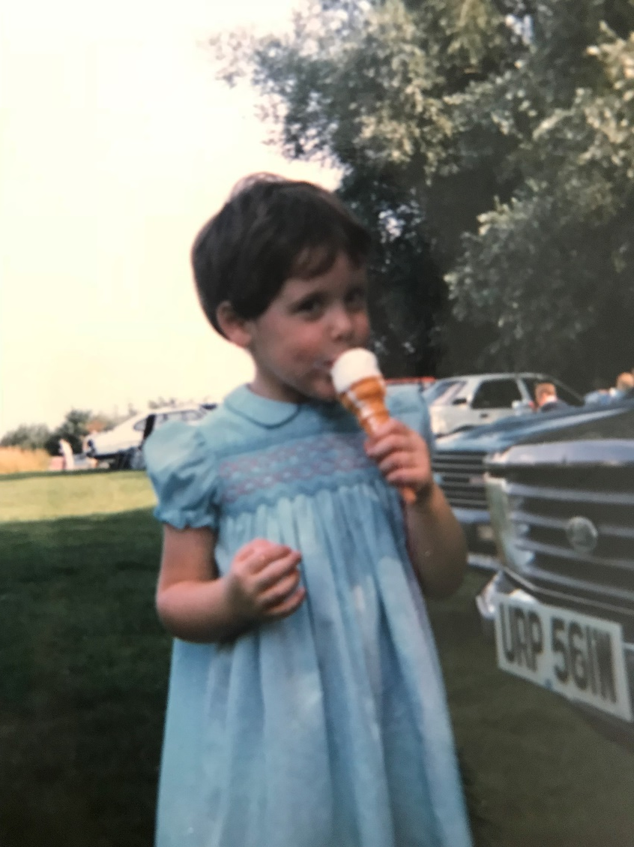

Identity matters: Who am I?

Slide 3
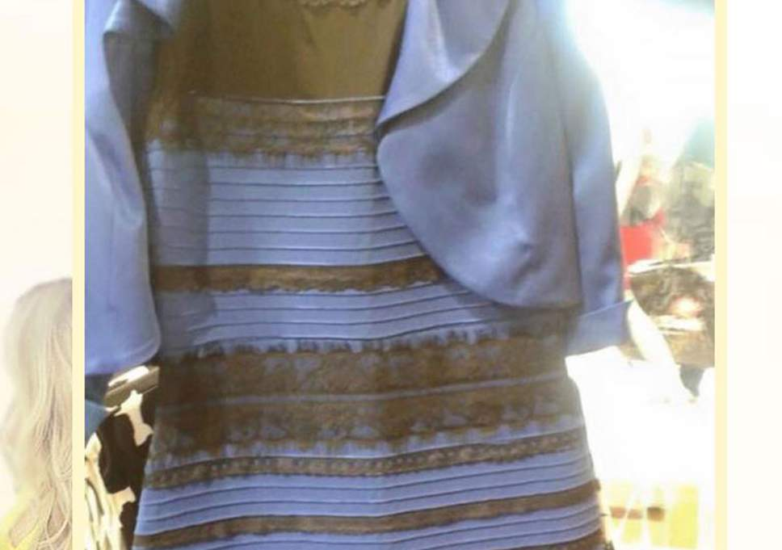
Background to the study
ALPS – one programme, two realities?
Image:
The notorious dress ( Swiked/Tumblr )

Slide 4
Research Questions
How do H&SC staff conceptualise their professional identity, and the professional identity of other professions with whom they work or learn?
Do H&SC staff perceive that professional identities are reinforced, challenged or changed by interprofessional education and / or collaborative practice?
What implications do conceptualisations of professional identities and IPE have for the implementation of educational initiatives aimed at improving teamwork between professions for the ultimate aim of improving service user care?

Slide 5
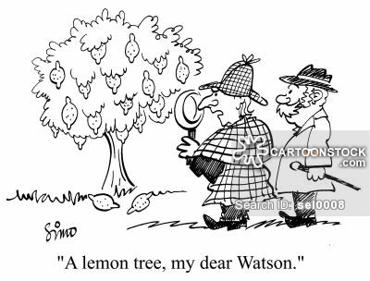
Approach
Qualitative (part of wider mixed-methods study)
“Full time practitioners” or “Academics”?
Phenomenological – what was important to respondents?
Interpretivist – process of enquiry
Image: cartoonstock.com

Slide 6
Headline finding 1: One identity / Many identities?
...a big part of the professional identity for me has been a learning disability nurse and I think that is quite unique within the family of nursing and also within the family of health and social care and I’m quite happy to describe myself as a learning disability nurse…I think that it brings with it um, a certain set of values and attitudes that I’d like other people to think I would have as a nurse and personally as well. (HEI03)
I see myself more as an academic than a social work identity, and I struggle with that because I remain proud to say I am a social worker and a registered social worker and a qualified social worker, but the reality of my current role is that I no longer practice…I think my identity is vague and mixed (HEI14)
It depends who I’m talking to, um, well as a group we call ourselves specialist midwives so I suppose that’s how I think of myself. I still think of myself as a midwife but that I specialised in a slightly different role to most other midwives. (NHS09)

Slide 7
Headline finding 2: IPE in universities ≠ collaborative practice
The first thing to understand is that things go in a circular, so we had IPW [interprofessional working] as a module, the evaluation would always then show that it would be better if it was threaded through the whole curriculum, so the next time we revalidate we spread it through the whole curriculum, somebody will come up with the bright idea that it would be better if you can consolidate it…I think the whole issue about being seen to do it rather than being trusted to do it drives us towards a more reductionist approach. (HEI04)
We had one day where we mixed…there was probably like a token dietician who said ‘this is our role’ that was it, there was nothing about how do we work together.
(NHS01 – speech and language therapist)
Some of the things at university did seem really false and just exercises, more tick-box, you know? (NHS12)

Slide 8

Headline finding 3: Negative talking
I don’t think physios have ever struggled [with their professional identity] I think physios just fix bones and muscles don’t they? I think nurses have become confused, she says in an opinionated way, I think the role of nursing has really really changed um and are they now pseudo-doctors? Are they, I mean in some settings certainly medical health they are trying to be OTs as well, they are running the groups, they are doing the occupational therapy bits without the training or understanding how to do that…and then social workers sort of know what they do. They’re just bank managers aren’t they?
(HEI08 – occupational therapist)
Social workers were the ones I found very difficult to work with…that’s probably my prejudices, I found the ‘how is this for you?’ round the houses approach very difficult to cope with
(NHS07 – nurse)
I’ve always found health visitors a bit odd but er that’s just me, I don’t know whether health visitors are picked from the cradle, that’s just a joke aside.
(HEI02 – nurse / midwife)
Image: Pinterest / Cloudy With a Chance of Meatballs 2

Slide 9
What if we thought about and taught about interprofessional responsibility?
All professionals have a responsibility to work across professional boundaries in order to ensure the best patient care is provided, and need to understand these responsibilities in the context of their job roles (Cameron, 2011). This can be conceptualised as ‘interprofessional responsibility’, that can and should be incorporated into each individual professions’ identity, and introduced to student professionals as early as possible.
Cameron, A. (2011). Impermeable boundaries? Developments in professional and inter-professional practice. Journal for Interprofessional Care, 25, 53–58.

Slide 10
Implications for Practice
-All H&SC staff need to be mindful of opinions they express regarding all professions, particularly in front of students
-IPE should be delivered across or between professional boundaries that are seen as most relevant to practice experiences
-Educators need to prepare students for collaborative working, but should recognise that alongside professional identity, the ability to do this effectively is something that develops with experience
-Educators should seek to move away from IPE as a box-ticking exercise, and seek out examples of good collaborative practice and placement learning opportunities
All professions need to understand their interprofessional responsibilities in order to ensure the best possible patient care

Slide 11
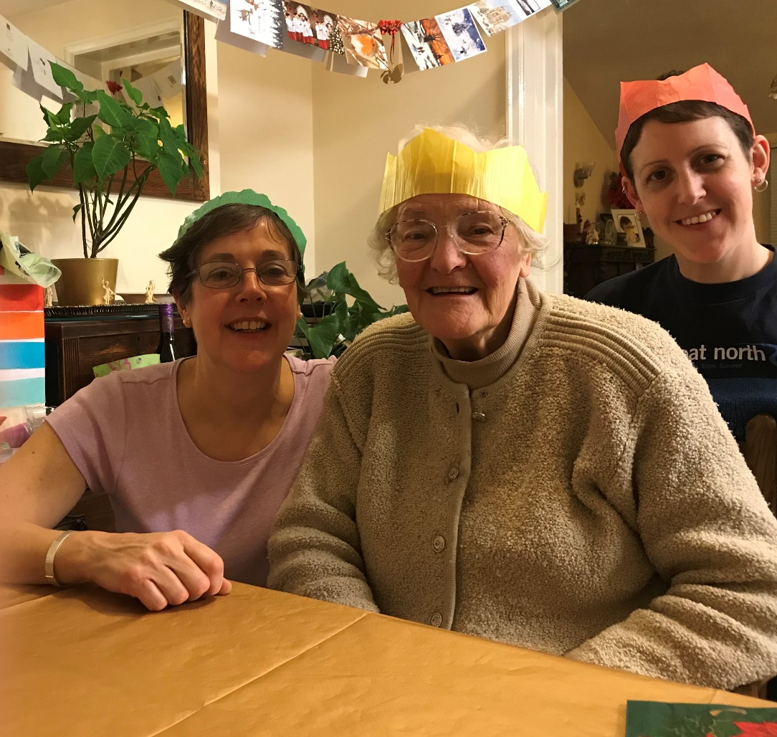
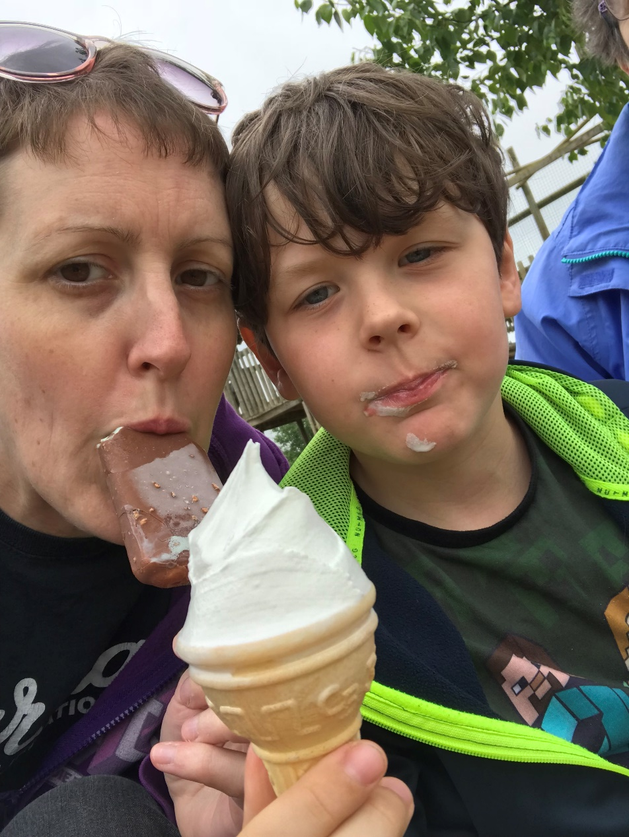
Acknowledgements
Research conducted at: University of Leeds
Thinking time: University of Liverpool
Professor Trudie Roberts (PhD Supervision)
Professor Richard Fuller (collegial advice)
Mrs Shelley Fielden (PhD recruiter!)
Professor Hazel Scott (encouragement to apply)
My wonderful and forthcoming research participants

