Slide 1
Dr Margaret Procter
“Accounts with Interest”: promoting academic/professional collaboration
Senior Lecturer,
Record & Archive Studies
University of Liverpool, UK

Slide 2
Today’s presentation
an overview of an ongoing academic/professional collaborative project: “Accounts with Interest: opening up the Archives of Barclays Bank ”
reflecting core conference themes
making collections available … by considering ‘collaboration’ as a ‘professional tool’ in its own right
‘innovation’ in terms of the research framework and design

Slide 3
‘Innovative’ project features
framed within archival studies as a discipline (NOT history)
makes the archive an object of study in its own right
embeds the researchers in the corporate environment and NOT in the searchroom
explicitly aims at knowledge transfer to the professional community – looks to the “future archive”
purposefully interdisciplinary: archive studies/business history/digital humanities

Slide 4
“… a transatlantic consumer, corporate & investment bank offering products and services across personal, corporate & investment banking, credit cards & wealth management, with a strong presence in our two home markets of the UK & the US.
With over 325 years of history and expertise in banking, Barclays operates in over 40 countries and employs approximately 120,000 people. Barclays moves, lends, invests and protects money for customers and clients worldwide.”

Slide 5
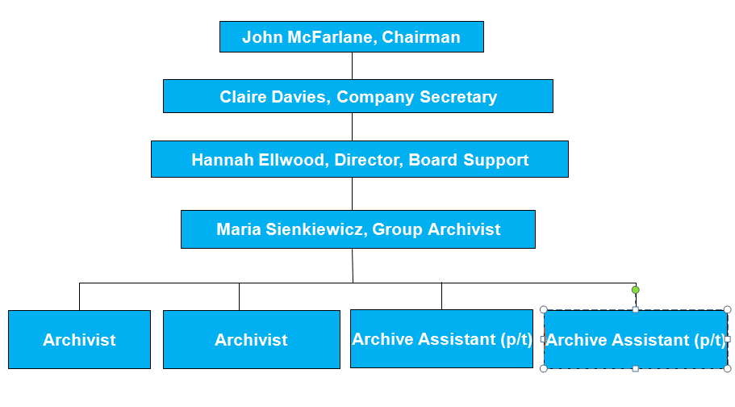
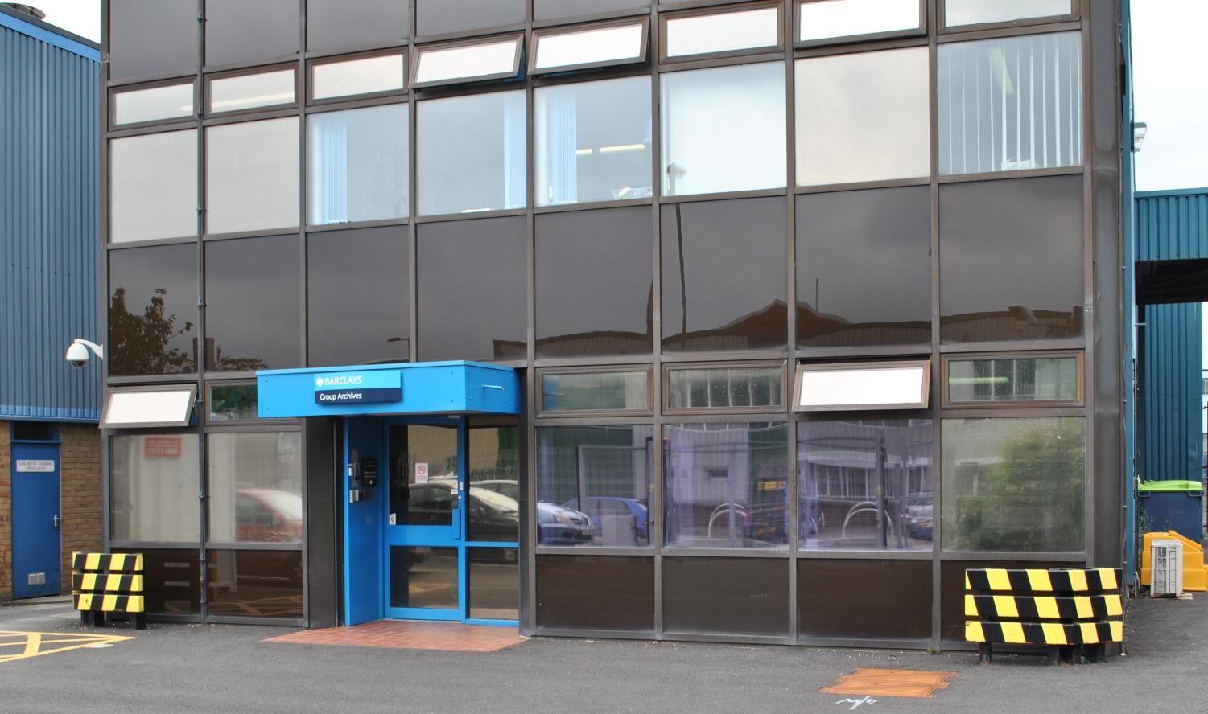
Barclays Group Archives (BGA)
“To preserve, manage and provide access to Barclays' historical records in support of the Group's business needs and to fulfill our commitment to the wider community.”
1.5 miles of shelving
12,719 volumes
7,792 photographs
1,196 films
609 parchments
18 sets of scales
12 firearms
10 gramophone records
1 lock of hair
oldest document: 1567
newest document: 2017

Slide 6
Academic research at BGA
www.archive.barclays.com

Slide 7
“Accounts with Interest ” : specific research aims
Thesis: corporate environment in which records are created impacts the possibilities for their subsequent archival management & exploitation
R1 : “systems analysis”:
how did data reached archives in the past – scoped to nominal data/customer records
how do current systems result (or not) in transfer of similar data i.e. characteristics/constraints of present systems for the ‘future archive’
what are implications for research e.g. will digital practices result in a digital black hole in the future archive?
R2: digital exploitation of data for audience development
develop a model for exploiting historical customer information within the Barclays context
consider wider applicability: developing cross-bank archive functionality for historic customer information/delivering to local authority record offices holding local banking records
Notes:
banking and financial records held by majority of English local ROs - probably over 600/700 separate fonds in multiple ROs

Slide 8
Why is this a ‘useful tool’ for BGA?
allows BGA to improve its stakeholder engagement
“in support of the Group's business needs …
enhances in-house service (enquiry response/service development)
extra body (!) - no in-house possibility of developing identified potential of nominal data: embedded researcher is a clear win
.. and to fulfill our commitment to the wider community”.
evidences local engagement (geographically/R&D/professional community)
positions BGA as site of professional expertise/best practice
Notes:
academic discipline : archival science – a ‘new’ academic discipline from 1990s – object of study – is recorded information created as part of a transaction; research includes study of its accessibility, acquisition, use, preservation … within the context of its creation, and its wider societal context or any given institutional or toerh context
response to social, cultural, business changes to recording practice, and the role of records/archives brought about by technology ;
response to hijacking of archives (the archival turn) by scholars in other disciplines!

Slide 9
Why is this a ‘useful tool’ for UoL?
grows archival science as a research discipline
creates and extends links with practitioners (employers)
benefits: clear in terms of UoL’s corporate objectives
promotes ‘knowledge transfer’ providing tools for customer engagement/audience development
impact
extends links with professional communities
ticks Arts & Humanities Research Council boxes
interdisciplinary
collaborative … with a commercial, rather than a cultural, partner

Slide 10
Conclusions (1)
collaboration: positive
collaboration: not so positive
aligns with strategic objectives of multiple stakeholders
practical outcomes : for partners/ profession/for research councils
builds on existing personal relationships
archival
academic
interdisciplinarity is problematic!
aims and objectives
research team assumptions
research training
methodologies … archival science
recruitment difficult

Slide 11
Conclusions (2)
innovative interdisciplinary work is challenging
the rewards of this project will be over the long term
we are confident that our project will have substantial impact that benefits the private-sector partner
… and the professional archival community
… in addition to the (historical) research community

Slide 12
Thank you
Margaret Procter, UoL
mprocter@liv.ac.uk
Maria Sienkiewicz, Group Archivist, Barclays
Dr Andrew Smith, Senior Lecturer in International Business, UoL
Dr Zoe Alker, Lecturer in Criminology (digital humanities), UoL
Ian Jones, CDA studentship holder, UoL

