Slide 1


Twitter – is it an educational tool?
@livuniphysio
Amanda Deaves
Emily Grant
Kate Trainor
Notes:
Introduction of people Physio directorate
Twitter handle – if you wish to have review the account / feed.
Why did this project start:
Personal and team interest in Twitter,
starting using, linked to a variety of people and health care organisations, researchers, clinicians felt connected,
saw it in use during conferences,
liked the brevity aspect.,
Strong sense of awareness of local and wider aspects of health and research issues
Potentially Within Healthcare there is a strong message regarding caution within the use of social media and being very mindful of a professional profile became interested in demonstrating good practice.
Wonder if it could be used to enhance teaching? And if the students might experience the same positive response to this platform as I have.
Felt that it was important to create a positive environment and experience for the students prior to graduation

Slide 2
Research Title
  A mixed method investigation; do final year undergraduate physiotherapy students value Twitter as an educational tool?
Research Question:
  Can Twitter be used as a teaching tool to enhance the educational experience of undergraduate physiotherapy students?
Research Aim:
  to explore the potential for using Twitter as an educational tool within physiotherapy education
Notes:
So from that initial interest the following project was developed to answer this research question:
And we had these wider objectives:
Research objectives
To identify how physiotherapy students are currently using social media (both professionally and personally)
To share information and model professional behaviours using a targeted Twitter feed
To enable students to evaluate the use of Twitter to support their learning experience
To assess the potential value of Twitter as an educational tool in undergraduate physiotherapy education

Slide 3
Enhanced Education
Take home messages
Timely information
Networking links
Assignment support via Tweet chat
Links to additional resource
Pedagogy Principles
Student – tutor interaction
Conciseness
Principles for Student Engagement
Support learning
Connectivism
Constructivism
Awareness of the world
Collaboration
Social Interaction
Resource sharing
Active learning
Dhir, Buragga & Boreqqah, 2013; Osgerby & Rush, 2015; Ruckert et al., 2014; Flynn, Jalali & Mreau, 2015
Notes:
On reviewing the literature regarding Twitter it is apparent that it has the potential to enhance learning and student experience
1)Several learning theories have been identified in relation to social media and twitter
the learning theories that have been identified are connectivism and constructivism.
Both of these consider the technological context, it involves an active process, reflection and social interaction, it encompasses the transmision of knowledge, the process of learning and the learner taking responsibility for their learning via a reflective stance
2)The literature also highlights hat twitter has several pedagogical benefits:
they encourage the active engagement, conciseness, awareness of the world
With the functionality of the platform clearly related to the overall aim of enhancing student experience and education
3)Twitter is also has a positive relationship with the 7 principles of student engagement; active learning, interaction, prompt feedback, timely responses, communication and diversity, student –tutor interaction.
From these learning theories, pedagogy and student engagement principles there is a strong suggestion that twitter has the capacity to enhance education and student experience

Slide 4


Mixed Method Design
Ethical approval
Year 3 cohort undergraduate physiotherapy students
Quantitative and Qualitative questionnaire
  Initial questionnaire – Semester 1 Week 1
  Scoping Questionnaire mid semester 1
  Final questionnaire – May Semester 2
Focus Groups – Mid Semester 2
  Sampling questionnaire regarding habits
  ‘Super Users’ & ‘Novice users’
Notes:
Single cohort of students
Validation of the question
Initial set up from quote author and credit work
Baseline – pre exposure to the twitter feed preferences and initial views
Post questionnaire towards the end of the academic year evaluation
Scoping questionnaire to determine focus group questions and to provide a snap shot view regarding the account and also the potential to alter our approach to the account
Focus group decided to explore their view and to try to determine the value of this platform as an educational tool,
This was to provide rich data regarding there experiences

Slide 5
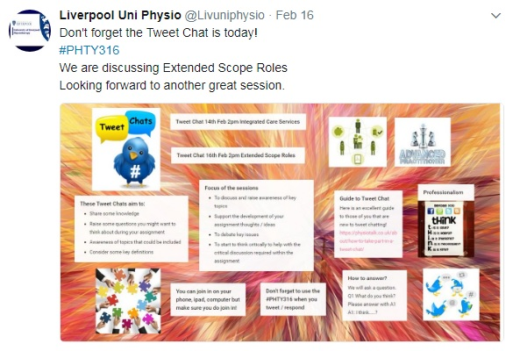
One Module in Year 3 – Context of Physiotherapy
Notes:
One module over the whole year – runs over both semesters.
PHTY 316 context of physiotherapy – module aims to critically discuss the wider issues of health care and the contempary issues of physiotherapy. This relates to service delivery and links to wider agencies involved with health care, include policy makers, the changing role of the therapist and inter-professional working
Specifically targeted tweet activity
The topics and content of the module, structured around the teaching syllabus and the teaching content / topics each week
Range of different tweets reflecting principles of student engagement
Within the context of the learning objectives for PHTY 316 a range of tweets.
Background information – structure of the NHS
Quoting retweets – so the original information is there, we are adding comment and curating this information – modelling professional behaviour and adding the application of the information to the module
Asking questions – we where hoping would not be rhetorical and giving a weekly focus as the semester progressed – designed to instigate debate or at least stimulate thought.
Using pictures and links to useful resources via tiny urls.
Promotion of the tweet chat and outlining the process of this activity.
We made a deliberate decision not to overload the feed and ensure we were on topic at all times as well as trying to demonstrate the full functionality of twitter.

Slide 6
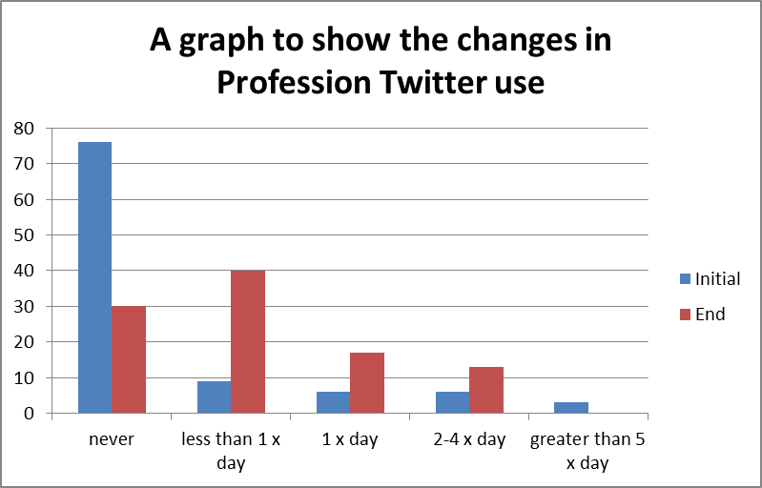
Results
N=33
  10 males : 23 Females
Age: 18-23 years = 31 24-29 years = 2
Initial usage
  Facebook 100%
  Twitter 39%
End of year usage
  Facebook 100%
  Twitter 70%
Notes:
N=33
10 males : 23 females
Age: 18-23 years = 31 24-29 years = 2
Facebook 100%
Snapchat 94%
Whatsapp 91%
Instagram 82%
Twitter 39% (n=13)
Indication regarding changes in behaviour in their usage
Whilst these figures skewed towards females and the younger students this does reflect our intakes.

Slide 7
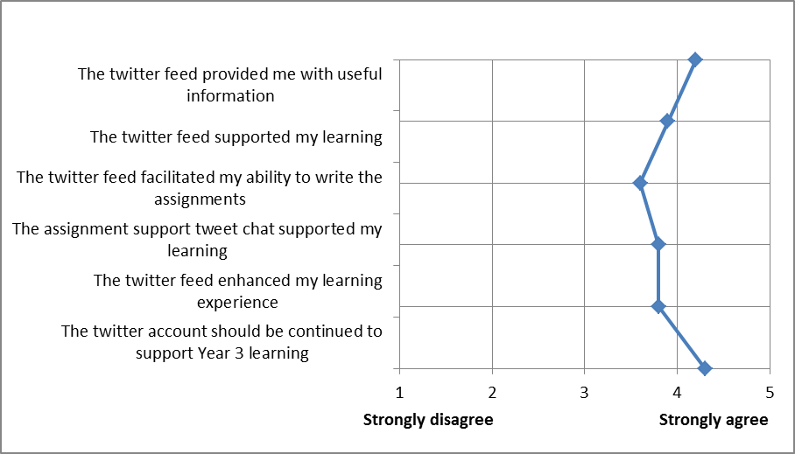
Evaluation of Twitter feed post module using a Likert scale N= 30
Notes:
These are the responses from the post exposure questionnaire at the end of semester 2
Using a likert scale
positive responses given the emphasis was on receiving the whole cohort evaluation of the twitter feed in relation to their learning and learning experience.
The student provided the strongest response regarding the continuation of the account

Slide 8
Qualitative Method
2 focus groups;
  Super Users (n=7)
  Novice Users (n=8)
Question schedule developed from scoping questionnaire
Conversations were recorded and transcribed verbatim
A thematic analysis approach was adopted (Vaismoradi, Turunen & Bondas, 2013)
Data was independently reviewed by 2 researchers, codes refined and defined, then themes identified
The key themes that emerged will be presented
Notes:
3 males in each group

Slide 9
Thematic map
Digital Literacy
Familiarity with Twitter
Limitations of platform
Educational Experience
Professional and social separation
Continued Professional Development
Training requirements
Self confidence
Passive voice
Professional Identity
Assignment support
Reassurance
Thought stimulation
Peer assisted learning
Professional awareness
Notes:
Briefly outline the main themes that have imerged.

Slide 10
Digital Literacy
Confidence and Passive Voice
“Having the confidence to actually be an active part of it and not just passively just clicking on that” NU3
“I don’t feel that I have made the most of it…….I am not familiar with it so I don’t feel as confident or comfortable” NU2
“I think the main negative for me…was the assumption that we would all know how Twitter works and how it is used and how much of a powerful tool it is” NU1
“It’s dead easy isn’t. It’s accessible on everything isn’t. Your phone...we’ve got our iPads so we’ve got it on that. It’s everywhere isn’t it? “ SU2
“I think it’s good. I like it, but I have used it for quite a while……it’s good to follow a range of different people” SU1
Digital literacy encompasses digital behaviours, practices and identities Jisc 2014
‘Training’ is an essential requirement Legaree, 2015
Students may have limited understanding of how technology can support learning Margaryan, Littlejohn & Vojt, 2011
Notes:
Lack of digital literacy
surprised – new users – very unsure
super users – very specific details regarding training requirements
potential slightly different attitude regarding approach to the new experience
Passive voice – related to confidence and resource sharing
JISC Developing digital literacies march 2014 https://www.jisc.ac.uk/full-guide/developing-digital-literacies

Slide 11
Educational Experience
Peer Assisted Learning / Thought stimulation / Reassurance
“I think one of the motivations for me to use it is the contributions from all of the peers and lectures as well”
“It was things that you might not have even thought to look at so it was quite helpful to see what other people had been using in their assignment …”
Active engagement is essential Ruckert et al., 2014
“I think sometimes it can stimulate some thoughts as well. When you are just a bit lost and think what direction can I look in ……It still might make you think about an area that may not have been considered…”
“You sort of ask the question, which prompted you to either think about an answer or further search that area whereas without that question you might not have even thought to include that….”
Cognitive engagement is essential to achieve a greater sense and depth of learning Wang, Chen & Anderson, 2014
“I find it really useful the lecturers posting stuff because you know it is relevant and up to date “
“…so we take your word for it when you post something”
Students perceive themselves as ‘subordinate’ within this professional domain Lackovic et al., 2017

Slide 12
Professional Identity
Professional and Social Separation
“for me its good to be able to separate my social from you my friends and know looking at stuff that might seem relevant and on Twitter ....I like being able to go on Twitter against the mind set of ok I am going to be able to find the relevant stuff now is more useful to me than putting on Facebook”
“I was surprised how big it was within Physiotherapy I didn’t know that Twitter was used that much professionally….it seems our profession has really embraced it”
“I had a previous twitter account, which I have deactivated and made a new professional one. Not because there is anything… but just because I think like if you are going down that angle, it’s for networking then it’s more professional isn’t?“
Separating personal and professional use can support a health work life balance Maloney, Moss & Ilic, 2014
By developing a professional identity, individuals can operate within the professional community Gagnon & Sabus, 2015
Notes:
Wishing to keep separate profiles concerns re negative impact
Kacmarczyk 2013

Slide 13

Twitter – is it an educational tool?
Positively received by physiotherapy students
Students demonstrated an increase in professional use of Twitter
Encourages active engagement
  Resource sharing
  Collaboration / peer assisted learning
Has the potential to impact on digital literacy
Supports the development of Professionalism

Slide 14

The Future
Keep the account active
Consider widening scope of feed to include broader networking aspects
Increase the ‘active’ requirements within the module to increase active engagement from the students
Ensure Twitter training is included early within the module

Slide 15
Amanda Deaves
Lecturer
Directorate of Physiotherapy
a.deaves@Liverpool.ac.uk
@LivUniPhysio
UoLiverpool Physio

Slide 16
References
Dhir A, Buragga K, Boreqqah A (2013) Tweeters on Campus; Twitter a Learning Tool in Classroom? Journal of Universal Computer Science 19,5, 672-691
Flynn L, Jalali A, Moreau K (2015) Learning theory and its application to the use of social media in medical education. Postgraduate Medical Journal 91, 556-560
Gagnon K, Sabus C (2015) Professionalism in a digital age: opportunities and considerations for using social media in health care. Physical Therapy 95,3,406-414
JISC (2014) Developing Digital Literacies https://www.jisc.ac.uk/full-guide/developing-digital-literacies
Lackovic N, Kerry R, Lowe R, Lowe T (2017) Being knowledge, power and profession subordinates: Students’ perceptions of Twitter for learning. Internet and Higher Education 33, 41-48
Legaree BA (2015) Considering the changing face of Social Media in Higher Education. FEMS Journals 363, 16, 1-3
Maloney S, Moss A, Ilic D (2014) Social Media in Health Professional Education: a Student perspective on User Levels and Prospective Applications. Advances in Health Science Education 19, 687-697
Margaryan A, Littlejohn A, Vojt G (2011) Are digital natives a myth or reality? University students' use of digital technologies. Computers & Education 56,429-440
Osgerby J, Rush D (2015) An Exploratory case study examining undergraduate accounting students’ perceptions of using Twitter as a learning support tool. The International Journal of Management Education 13, 337-348
Ruckert E, McDonald PL, Birkmeier M, Walker B, Cotton L, Lyons LB, Straker HO, Plack MM (2014) Using Technology to Promote Active and Social Learning Experiences in Health Professions Education. Online Learning, [S.l.], v. 18, n. 4, Oct. 2014
Vaismoradi, Turunen, Bondas (2013) Content analysis and thematic analysis: Implications for conducting a qualitative descriptive study. Nursing & Health Sciences 15 (3) 398-405
Wang Z, Chen L, Anderson T. (2014) A framework for interaction and cognitive engagement in connectivity learning contexts. The international Review of Research in Open and Distributed learning; Vol 15, No 2

