Slide 1
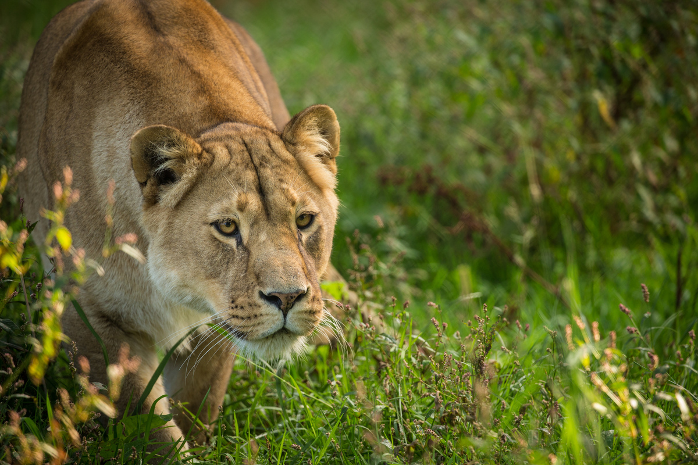
Achieving Zero Carbon at Zero Cost: A case study of a UK Safari Park
Tom Johnston
t.johnston@liverpool.ac.uk
Supervisor:
Dr Stephen Finnegan

Slide 2
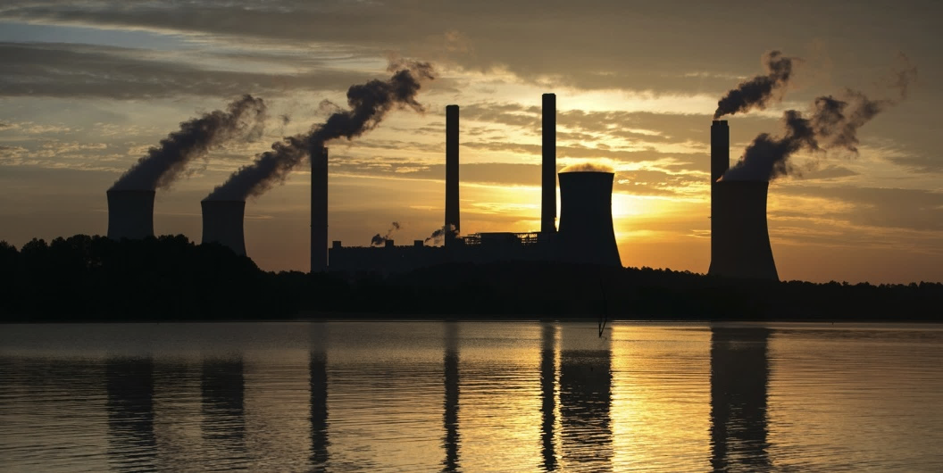
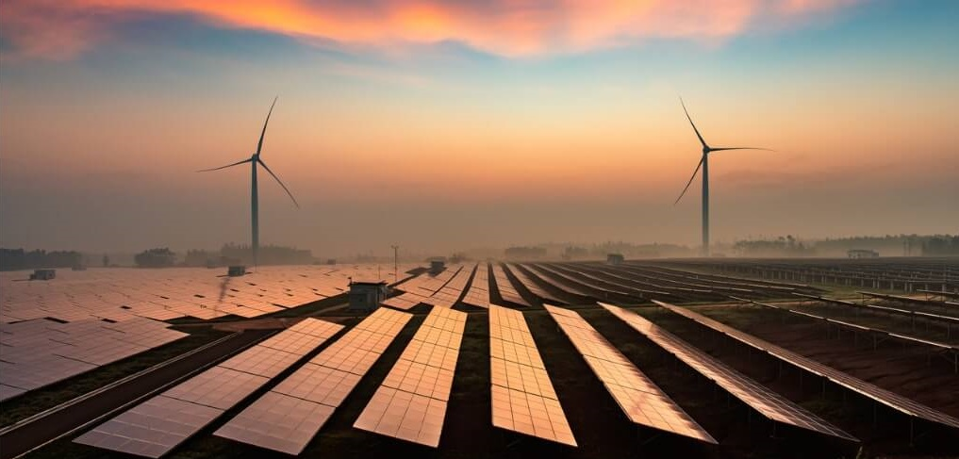
Introduction
Research Background
Significant increase in global public awareness on climate issues, sustainability, air pollution, and the impact on biodiversity & the ecosystem.
Countries, cities, and businesses are beginning to take steps in order to mitigate and abate anthropogenic GHG emissions – HOWEVER we need to act sooner.
A number of frameworks, guidance tools, models, and research papers on improving energy efficiency and reducing GHG emissions are widely available in the UK.

Slide 3
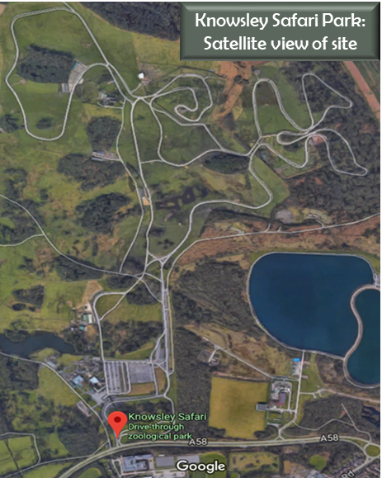
Case Study
Industrial Partner: Knowsley Safari
Commercial activity spans across many sectors including hospitality, conservation, research, education, amusements, and tourism.
The diversity of business activities provides this case study with an inherent generality which can easily be applied to similar businesses.
The rural setting in which the site is located provides its own challenges which are directly transferrable to other rural bases businesses.

Slide 4
Zero Carbon Framework
Methodology
Data Collection Procedure & Challenges
Forecasting
Financial Strategies
CO₂ Reduction Scenarios
Strategic Implementation
Continuous Improvement Plan (CIP)
Framework Structure

Slide 5
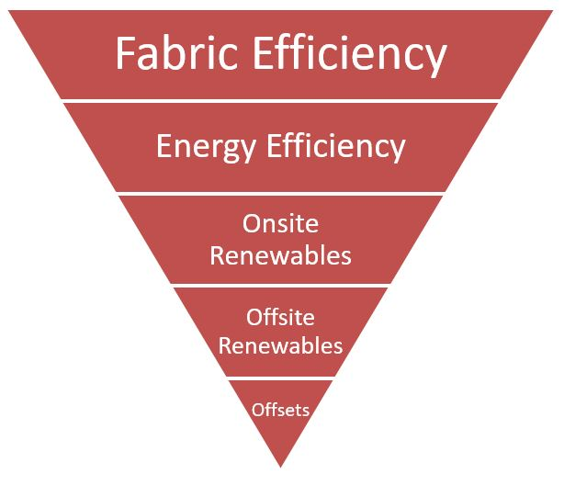
Methodology
Primary Aim: To assist businesses based in rural settings to achieve zero CO2 emissions at net zero cost
Targets - baseline emissions & target year
Monitor & Measure – current energy demand
Gather Historical Data – energy consumption, visitor numbers, climate data
Analyse & Forecast – future demands of the site, inflation, policy changes
Develop ‘Energy Efficiency & CO₂ Reduction’ Scenarios
Establish Financial Strategy - to guarantee a cost neutral approach
Implementation – strategic changes, zero carbon master plan, carbon reduction projects
CO₂ Reduction Hierarchy [Source: UKGBC]

Slide 6
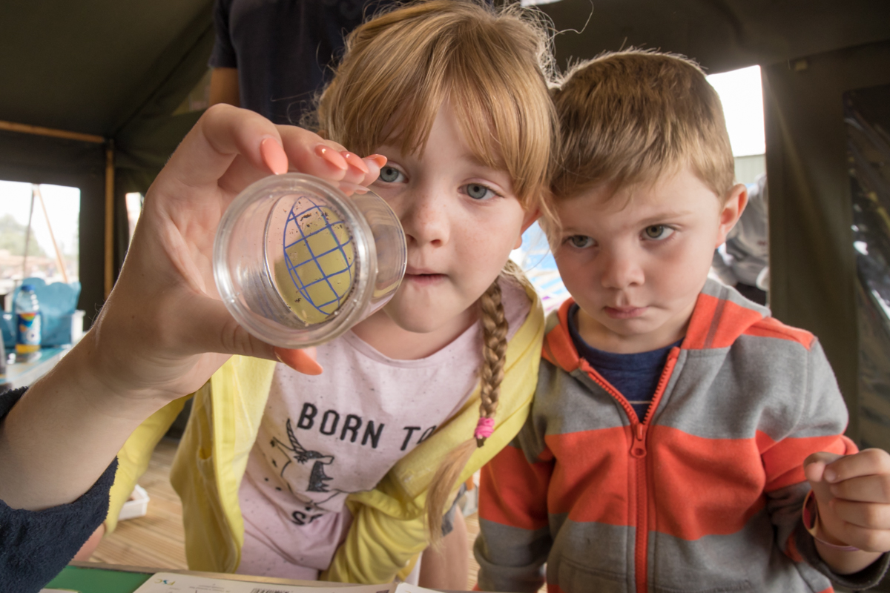
Future Research
Public Engagement
Zoological collections have a fantastic opportunity to educate the public on climate change issues.
Lead by example
Be more conscious
Consider alternative ways to travel
Reduce your CO2 footprint

Slide 7
Thanks for Listening!

