Slide 1
Figure 1
A
B
C017
C086
C110
G012
C098
G034
C
D
Figure 1 Characterisation of immune responses of EVD survivors and close contacts
A) EBOV-specific antibody titre using arbitrary ELISA units (AEU) against whole virus preparation as measured by ELISA in plasma samples collected from survivors (n=117), contacts (n=66) and negative controls (n=23). (B) Geometric mean neutralising antibody titre (GMT) against live EBOV (strain Mayinga) using plasma samples collected from survivors (n=117), contacts (n=66) and negative controls (n=23). Results displayed using a Log2 scale (C) ELISpot to detect IFNγ secretion using an EBOV GP peptide library and PBMC samples from survivors (n=116), contacts (n=42) and negative controls (n=21). (D) Quantified results from health questionnaire given to all survivors and contacts with a maximum score of 13 representing severe symptoms and 0 representing no symptoms experienced during the 2013-16 outbreak. Bars represent Geometric Mean ± SEM. Dashed lines represent the mean plus five standard deviations. SFU: Spot Forming Units. Mann-Whitney test were performed for all statistical analysis. Blue dots represent sero negative survivors.

Slide 2
Figure 2
A
B
C
D
Figure 2: Longitudinal response following EBOV infection
(A) EBOV-specific antibody titre against whole virus preparation as measured by ELISA in plasma samples collected from matched survivors (n=96) between 2015 - 2017. (B) Neutralising antibody titre against live virus preparation (Mayinga) using plasma samples collected from matched survivors (n=96) between 2015 -2017. (C) ELISpot to detect IFNγ secretion using an EBOV-GP peptide library and PBMC samples from matched survivors (n=63) between 2015 - 2017. (D) Time in months, from when each volunteer was confirmed EBOV-negative following second negative PCR and so were discharged from the Ebola treatment centre (ETC). Data include antibody titre to whole EBOV as determined by ELISA, antibody activity as determined by neutralisation assay and T-cell responses as determined by ELISpot. A-C show the geometric mean with 95% CI.

Slide 3
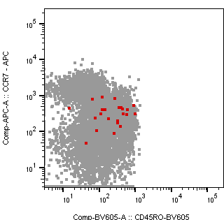
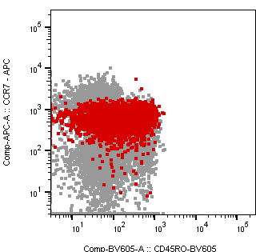
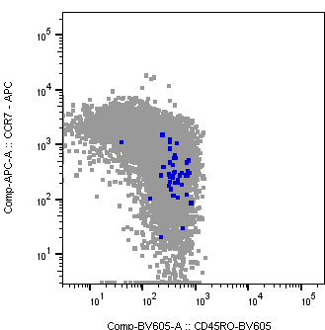
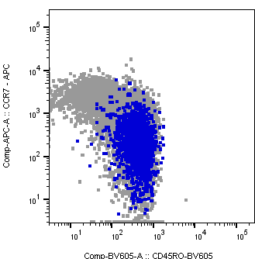
Figure 3
A
B
NT
Peptide
SEB
C
D
NT
Peptide
SEB
Figure 3: T cell activation in response to EBOV GP peptide
Samples collected from 2016 were used to analyse the T cell response to EVD (A) The Sum of CD8⁺ T cells producing IFNγ in response to overnight stimulation with GP peptides (2.5 µg/peptide). CD8⁺ T cells originating from EVD survivors (n=51) produce significantly (Mann-Whitney test) more IFNγ than PBMCs originating from ELISpot negative controls (n=26) (p=>0.0001). (B) Representative dot plot highlighting where IFNγ producing cells fall with respect to the CD8⁺ T cell phenotype. (C) The sum of CD4⁺ T cells producing IFNγ in response to overnight stimulation with GP peptides (2.5 µg/peptide). (D) Representative dot plot highlighting where IFNγ producing cells fall with respect to the CD4⁺ T cell phenotype. Panels A and C: bars represent Geometric Mean ± SEM.

Slide 4
Figure 4
A
B
C
Figure 4: Polyfunctional CD8⁺ T cell analysis
Samples collected from 2016 were used to analyse the T cell response to EVD (A) Using FlowJo™ Boolean gating and Spice software (NIH) the combination of cytokine secreting CD8⁺ T cells were identified and it was found that there is a significant population of IFNγ⁺ (p=0.018) only and IFNγ⁺/ TNFα⁺ (p=0.0075) CD8⁺ T cells amongst the survivor (red dots) PBMCs compared to ELISpot negative controls (grey dots). Samples that returned a negative result during analysis were assigned a value of 0.001, Mann-Whitney test were performed for all statistical analysis. (B) CD8⁺ T cell activation as measured by intracellular staining for the degranulation marker CD107a. CD8⁺ T cells originating from EVD survivors showed significantly greater CD107a levels than negative controls (p=0.032). (C) Representative dot plot from survivor PBMCs stimulated with EBOV GP peptide, the number of CD107a⁺ events have been overplayed in red to show their level of expression.

