Slide 1
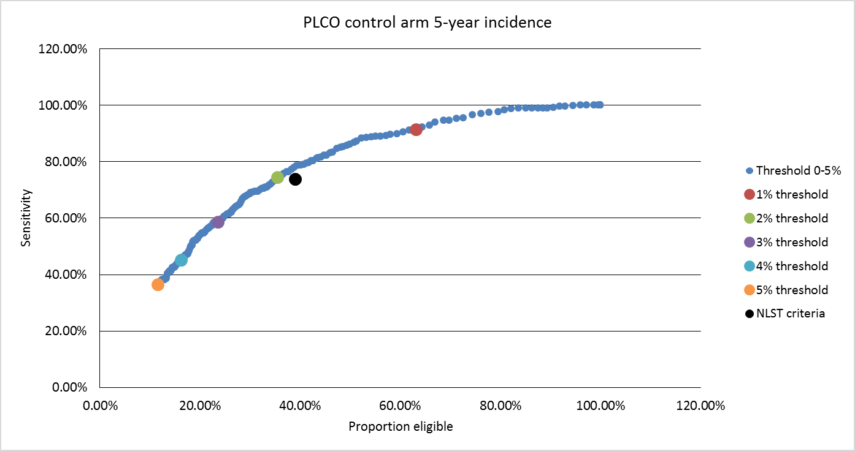
Selecting the risk cut off for the LLP_{v2} model
Kevin de Haaf¹, Harry de Koning¹, John K. Field²
¹Erasmus MC, Rotterdam, The Netherlands. ²University of Liverpool, Liverpool ,UK.
ABSTRACT
RESULTS
The application of risk prediction models for the selection of individuals for lung cancer (LC) screening requires risk thresholds to distinguish between individuals eligible and ineligible for screening. However, little is known about the performance of risk prediction models across different risk thresholds. The UKLS trial utilised the Liverpool Lung Project risk model (LLP_{v2}) with a risk threshold of 5% for 5-year LC incidence as the selection criteria in the trial. The UKLS yielded a 1.7% LC detection rate at baseline, which was higher than the NLST or NELSON trials.
PLCO control arm 5-year incidence: Performance across different risk thresholds
A LLP_{v2} risk threshold of 2.03% yielded a similar sensitivity, but higher specificity and a more favourable ratio of eligible individuals per LC compared to the NLST criteria.
Applying low risk thresholds yielded high sensitivities, at the cost of low specificities and higher ratios of persons eligible per LC included within the eligible population.
A LLP_{v2} risk threshold of 1.0% would yield a sensitivity of 91.5% at the cost of a specificity of 37.2% and a ratio of 39 eligible individuals per LC. In contrast, a LLP_{v2} risk threshold of 5.0% would only yield a sensitivity of 36.5%, but had a specificity of 88.8% and a ratio of 18 eligible individuals per LC.
LLP_{v2} risk thresholds between 2.0-3.0% may provide an advantageous balance between sensitivity and the ratio of eligible individuals per LC.
Selection criteria | Sensitivity | Specificity | Proportion eligible | Persons selected percancer
NLST criteria | 73.76% | 61.47% | 39.04% | 29.92
LLP: 2.03% | 73.42% | 65.54% | 35.03% | 26.97
LLP: 2.00% | 74.45% | 65.06% | 35.52% | 26.97
LLP: 2.25% | 70.19% | 68.50% | 32.06% | 25.82
LLP: 2.50% | 65.93% | 72.26% | 28.30% | 24.26
LLP: 2.75% | 61.50% | 74.70% | 25.83% | 23.73
LLP: 3.00% | 58.60% | 76.93% | 23.59% | 22.75
OBJECTIVES
This study evaluates the performance of different risk thresholds for the selection of individuals for lung cancer screening utilising the LLP_{v2} model which was used in the UKLS trial ¹.
METHOD
The performance of the LLP_{v2} risk model to predict 5-year LC incidence was evaluated in ever-smokers from the PLCO ². The sensitivity (the proportion of LC in the total population that occur within those selected for screening), specificity (the proportion of individuals excluded from screening which do not develop LC), and proportion of individuals eligible for screening was assessed across a wide range of risk thresholds. In addition, the trade-off between the sensitivity and the proportion of individuals eligible for screening was assessed.
Sensitivity/Eligibility PLCO control incidence graph for the LLP_{v2}model
CONCLUSIONS
Applying the LLP model with a 2.03% threshold identifies a similar number of LC while selecting a lower number of individuals for screening compared to the NLST criteria (ie 10% less individuals required).
The level of the risk threshold applied to select individuals for screening has an inverse relationship between the efficacy and efficiency of LC screening.
Implementing LC screening programs which use risk prediction models to determine screening eligibility require further assessment of the trade-off between these aspects with regards to the long-term benefits, harms and cost-effectiveness to ascertain the optimal risk threshold.
.
REFERENCES
1.The UK lung Cancer Screening trial: a pilot randomised controlled trial of low dose computed tomography screening for the early detection of lung cancer. Field JK, Duffy SW, Baldwin DR, Brain KE, Devaraj A, Eisen T, Green BA, Holemans JA, Kavanagh T, Kerr KM, Ledson M, Lifford KJ, McRonald FE, Nair A, Page RD, Parmar MK, Rintoul RC, Screaton N, Wald NJ, Weller D, Whynes DK, Williamson PR, Yadegarfar G, Hansell DM. Health Technol Assess. 2016 May;20(40):1-146.
2. Screening by chest radiograph and lung cancer mortality: the Prostate, Lung,
Colorectal, and Ovarian (PLCO) randomized trial.Oken MM, Hocking WG, Kvale PA, Andriole GL, Buys SS, Church TR, Crawford ED, Fouad MN, Isaacs C, Reding DJ, Weissfeld JL, Yokochi LA, O'Brien B, Ragard LR, Rathmell JM, Riley TL, Wright P, Caparaso N, Hu P, Izmirlian G, Pinsky PF, Prorok PC, Kramer BS, Miller AB, Gohagan JK, Berg CD; PLCO Project Team.JAMA. 2011 Nov 2;306(17):1865-73.
Printed by

