Slide 1
A year of COVID-19: the impact on radiographer education
Dr Pete Bridge,
University of Liverpool, UK.

Slide 2
The Silver Linings
COVID-19 has ruined and ended lives.
Our students have certainly not been exempt from this
This presentation, though, will focus on the positive impact on the learner experience and future pedagogical development that has arisen from the experiences of the last 12 months

Slide 3
Impact of COVID-19 on Education
Clinical placement restrictions
Increased use of simulation
Effective remote clinical skills training
Cessation of on-campus lectures
Increased use of distance learning
Impact on student logistics and finance
Cessation of face-to-face support
Innovation in student support
Impact for ongoing clinical placement support

Slide 4
Clinical Placement Restrictions
Clinical placement for our therapeutic radiography students ceased for the summer of 2020 and have only recently resumed but with reduced capacity
Year 1: Delayed start
Year 2: Missed opportunities
Year 3: Accelerated sign-off
This has been common across the world

Slide 5
Use of Simulation for Skills Training
To help address the placement issues, an international online conference was facilitated. This aimed to explore the use of simulation solutions to help with placement capacity reduction.
Video-based simulation
Remote access to software resources
“Zoom” interpersonal skills simulations
Use of out-of-hours / equine facilities
This event highlighted a shared enthusiasm for collaboration and resource sharing amongst the MRS simulation community

Slide 6
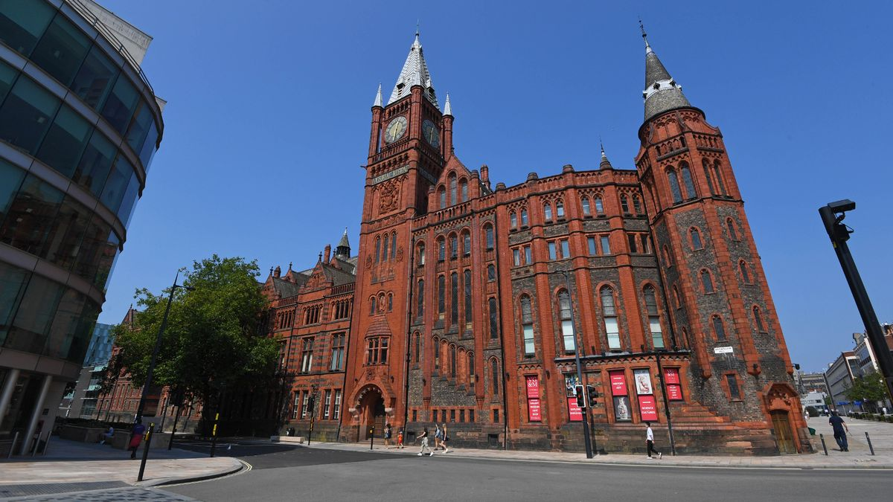
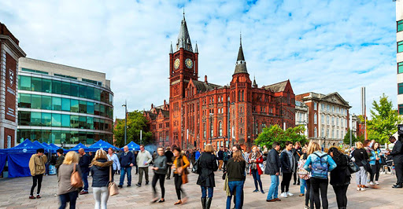
Campus Closure

Slide 7
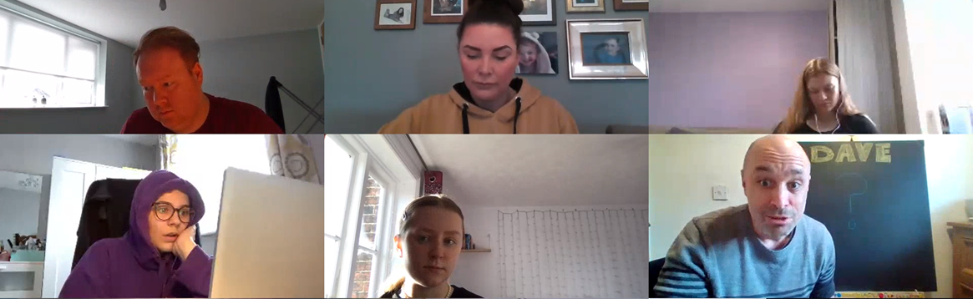
Remote Learning Solutions
Complete reliance on video conferencing tools
Development of new guidance
Student feedback
Some value the logistical and financial gains
All wish for face-to-face contact

Slide 8
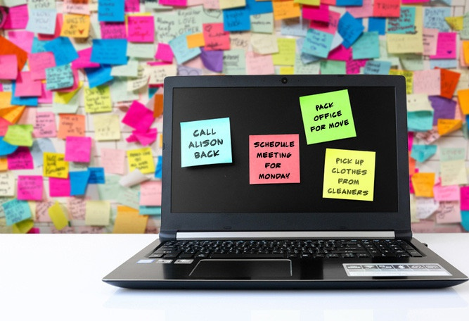
Remote Assessment
Challenging
Question styles
Dependence on online environment stability
Invigilation / plagiarism checking
Benefits
Reduced stress?
Increased use of auto-marking
Room and staffing costs

Slide 9
Student Support
Challenge
One of the most challenging aspects of the last year has been supporting students and their isolation, anxiety and disillusionment
Solution
Regular remote catch-ups
Signposting to University mental wellbeing resources
Calendar of wellbeing activities
Weekly informal quiz to provide social bonding

Slide 10
Pedagogical Impact
It is hard to imagine placing our newly found remote simulation, learning and assessment resources back into a box when life returns to normal.
Conference feedback demonstrated a genuine desire for a community of practice and collaboration post COVID-19. Will this continue?
Will we continue to reap the benefits of these techniques post-COVID-19.
How will they integrate into the evolved curriculum?

Slide 11
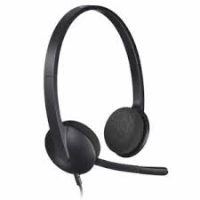
Ongoing Support
The isolation and anxiety associated with COVID-19 social distancing is, to a lesser extent, experienced by students out on clinical placement
Can the techniques and technology used over the last year help to improve support for these students in the future?

Slide 12
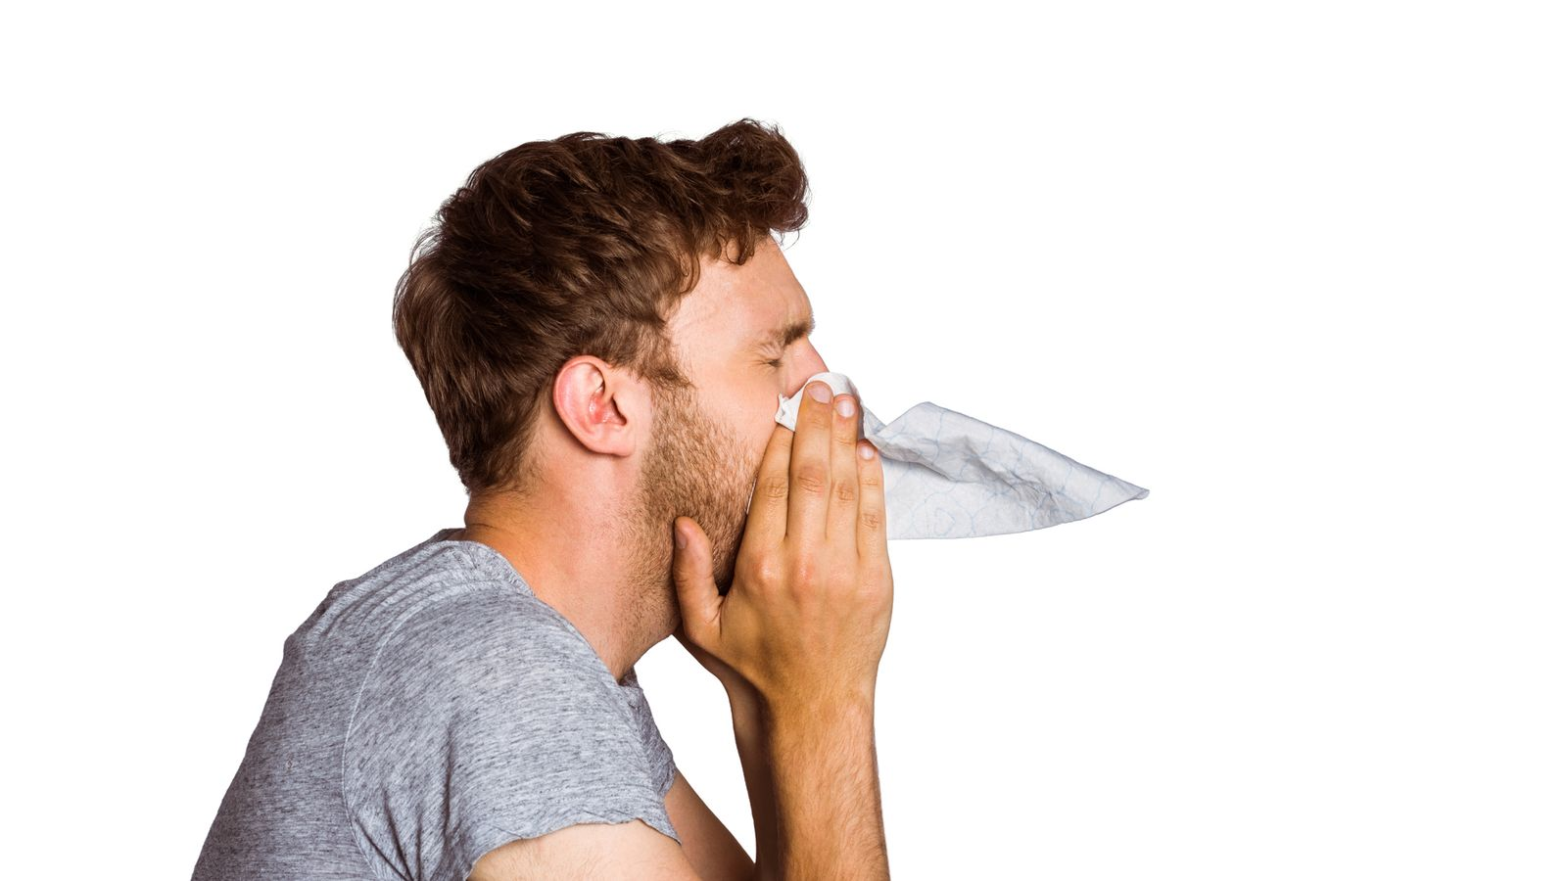
Conclusion
COVID-19 led to rapid uptake of simulation, remote teaching, online assessment and innovative remote support solutions
Online or virtual activities should continue to play an important role
Work is needed to identify the optimal blend
Sharing of resources and ideas was adopted enthusiastically
The international collaborative approach should hopefully continue throughout the pandemic and beyond
Are we ready for the next pandemic??

