Slide 1
Setting SAiL:
An inter-disciplinary approach to supporting second attempts in learning
Dr Viktoria Goddard (they / she)
Senior Lecturer in Medical Education
Director of Studies, MBChB Programme, School of Medicine, University of Liverpool

Slide 2
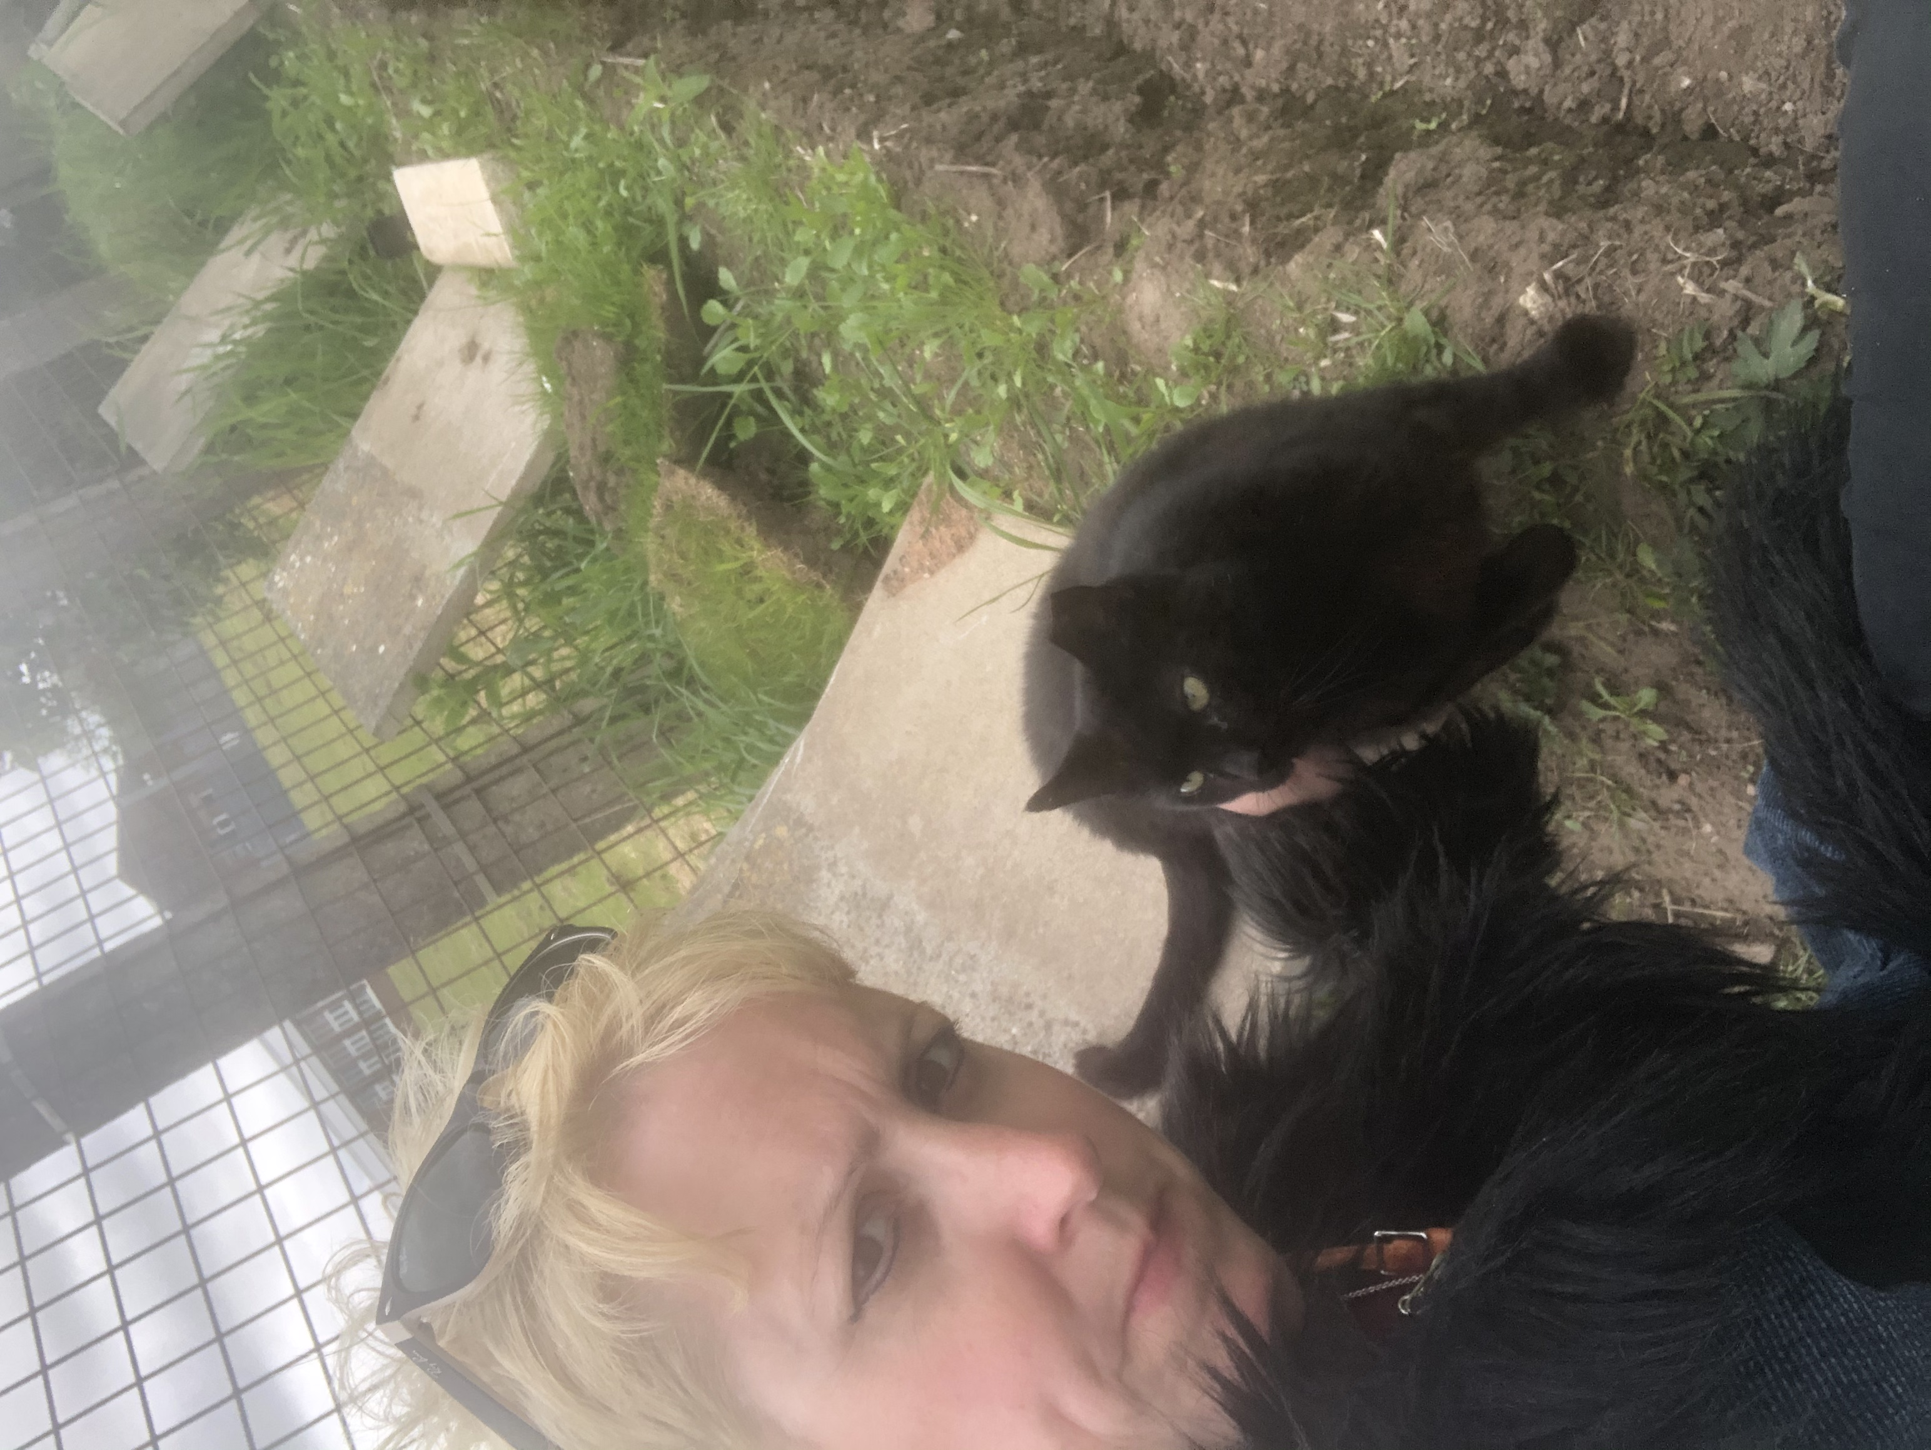
A bit about me…
Director of Studies on large (intake 330 / year) MBChB Programme
Worked in Medical Education since 2007 (Leeds and then Liverpool)
Sociologist (PhD Medical Education)

Slide 3
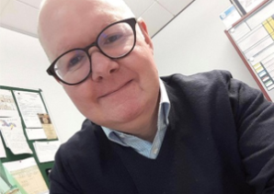
Acknowledgements
Professor Richard Fuller, University of Liverpool, UK
Professor Vishna Nadarajah, International Medical University, Kuala Lumpur, Malaysia

Slide 4
Supporting students: SAiL
Built on principle that we all struggle with the same challenges, and best-practice developing within schools not at cross-institutional level
Initiative aimed at sharing best practice – cross-faculty (Medicine, Healthcare, Vets & Dentistry) in supporting students “at risk of future failure”
Students – re-sitting; struggling for academic, professional or health / wellbeing reasons; often known to many members of staff who do not know what to ‘do’ to support them

Slide 5
SAiL Year 1: A new concept in IPE
Shared how, when we identified students in our ‘at risk’ groups
Shared case-studies of supporting students
Exploring opportunities for cross-professional peer-mentor systems and alignment of mentor / buddy systems across faculty
Started sharing educational best practice through shared team space (Sharepoint for official documents, Padlet for articles and talks)
Trialled bespoke support for students re-sitting year (medicine pilot) through one-to-one meetings – awaiting results!

Slide 6
Self-Regulated Learning models ‘on track’ learners
Metacognitive skills
Thinking about learning
Strategic action
Planning and self monitoring
Self efficacy
Motivation to learn
Challenge and practice
In control of own learning
Resources for learning + visualisation of data to help self monitoring
Artino et al. Researching Medical Education (2015):155-166

Slide 7
Self-Regulated Learning models – underperforming learners
Low effort & engagement
Minimal effort; late submissions
Little internal ownership ‘ tell me what to do’
Poor self control / responsibility
Little self awareness, self efficacy or self monitoring
Less academic success and ownership ‘not my fault’
Link with ability mindset
Resources for learning and data for external monitoring of students
Artino et al. Researching Medical Education (2015):155-166

Slide 8
Developing a conceptual model of learner profiles…
Tier 3
Tier 2
Tier 1
Students in difficulty (have come to our attention)
?????????
Students ‘on track’ – students ‘excelling’

Slide 9
Group Exercise: At risk students
Which students might be more at risk of future (academic) failure?
Why?

Slide 10
Making the leap into HPE
Personal
Social disruption
Adolescence
Cultural
Norms
Language
Educational
Enculturation
Expectations and behaviours

Slide 11
Clinical
Many of these challenges are amplified in high pressure, often unpredictable clinical settings
Healthcare systems and processes
Expectations and behaviours of patients
Hierarchies and roles – clinical staff
Expectations of learners – and understanding of responsibility
Establishing relationships – and appropriateness of seeking support/help

Slide 12
Introducing the amber ‘at risk of failure’ learner
A shared responsibility – learners, teachers, Universities:
Students from non-traditional backgrounds/first to University
Programmes that require multiple transitions – e.g. international
Failure may not just be traditional academic scores
disengagement, professionalism concerns, poor attendance, health & wellbeing all potential ‘failure paths’
Opportunity to help ‘diagnose’ these learners, provide resources and help with behavioural interventions to improve self regulation

Slide 13
Group Exercise 2
Pick one of these three cases:
International student entry into Year 1 of programme
Collaborative provision programme: transfer into Year 3 from another University
Senior (year 4 – 5) student with caring responsibilities (two young children)
What data could you gather to decide if these students were at risk of an unsuccessful transfer/transition?
Notes:
No additional materials here other than the above

Slide 14
Discussion
International entry into Year 1
Struggling with (clinical practice) & choice of course -‘course is not for me’; possible language skills concern
Managing student and parental expectations
Collaborative provision programme: transfer into Year 3
‘In at the deep end’ – risk of social isolation and poor engagement with educational model
Senior (year 4 – 5) student with caring responsibilities (two young children)
Social isolation, needs on transfer to working life (location / continued support), financial concerns (working / studying)
Notes:
Discussion then click through cases;
For data, stratify the white board as ‘pre transfer’, monitoring ‘during transfer’ and consider personalised longitudinal monitoring beyond if the transfer experience has been very challenging (e.g. awful elective)

Slide 15
Performance at Workplace related to | Challenges for Transition
 | Into Clinical Environment | + Across Borders
Academic Integration | Theory practice-gap, apprehensive about assessments | + varying levels of competencies
Social Adjustment | Increase workload | + Socio cultural/economic adaption
Personal and emotional adjustment | Authenticity, fear of mistakes | + Values, homesickness
Workplace Adaptation | Work based assessments, ambiguity of roles, interprofessional relationships | + Different healthcare systems, patient expectations
Notes:
Vishna’s slide

Slide 16
What does the literature say about transitions?
Transition Shock (Kramer, Duchscher)
Well established emotional, intellectual, physical and socio-cultural changes resulting from move into new (graduate) practice
Tacit knowledge in professional workplaces (Eraut)
Tacit understanding of people/situations, routines, decision making
Expert/established teams are often poor at sharing with new starters
Bridging and induction programmes typically don’t engage this tacit, essential knowledge
Almost certainly magnified for international students/graduates
Duchscher J Adv Nursing 2009
Eraut Br J Educ Psychol 2010

Slide 17
Am I ready to progress…?
(Portfolio) Visualisation of achievement, feedback and learning activities for learners and faculty
How am I doing? Where do I need to go next?
Helping users visualise both the ‘journey’ and ‘destination’ (Kimber et al 2006)
Recording goals and ‘anticipated’ feedback
Allow personalisation depending on learner ability (and self-regulation) (Leenknecht et al, 2019)
Simple tools – MS Word, email to tutors
Notes:
Leenknecht, Asst and Eval in HE

Slide 18
Preparedness is not enough...
Reconceptualising transitions as ‘critically intensive learning periods’ (Kilminster)
Transitions often associated with safety concerns and adverse outcomes
Performance strongly associated with intense periods of learning/adapting to teams and learning cultures
Nursing responses to transition shock (Clipper)
Focus on more longitudinal preceptor type models – positive impact on perceptions of care and safe practice
Kilminster Med Educ 2011
Clipper J Contin Educ Nurse 2015

Slide 19
Group Discussion 3
Building on these theoretical perspectives:
Understanding and employing tacit knowledge
Critically intensive learning periods
How can we better support students and graduates in practice who are ‘at risk’, particularly during transition periods?
Are you aware of what your own institutions currently doing well, and what could be improved, in this area?
Are you working in a silo in this area when you could be sharing practice across the institution?

Slide 20
Interventions… behaviour change
Focus on developing self regulation skills
Suite of behavioural change approaches;
Incentives and rewards (e.g. unlocking opportunities/game-based learning)
Socialisation (focus on peer support and teams, +/- ‘self’)
Encouragement desirable behaviour – nudges (Thaler & Sunstein)
Coaching and direction (case management approaches)

Slide 21
Future solutions?
Using routinely collected data – e.g. WBA, skills practice, task completion
Monitoring (dis)engagement – develop highly predictive models of learners ‘at risk of future failure’ (Fuller & Hallam 2017,2018)
Nudges
Non-directive interventions to influence motives and decisions
Simple, SMS texts - Reducing drop out for ‘at risk’ students newly entering higher education (Castleman & Page 2014)
Smartphone nudges for medical students at risk of failure – improved engagement, reduced high stakes failure (Hallam & Fuller 2018)
Can be coupled with ‘live’ preceptor models

Slide 22
Reflections on supporting students collaboratively
Shares best practice / sense that “risk” is also shared (appeals harder when decision making is consistent)
Inventive / innovative solutions borne of discussion
Outside of comfort zone but more rewarding relationships
Expanded opportunities for students to learn from other professions
Needed now more than ever (‘pandemic generation of learners’)

Slide 23
THANK YOU FOR LISTENING
Contact:
Dr Viktoria Goddard
Viktoria.Goddard@Liverpool.ac.uk
@viktoriactg

