Slide 1
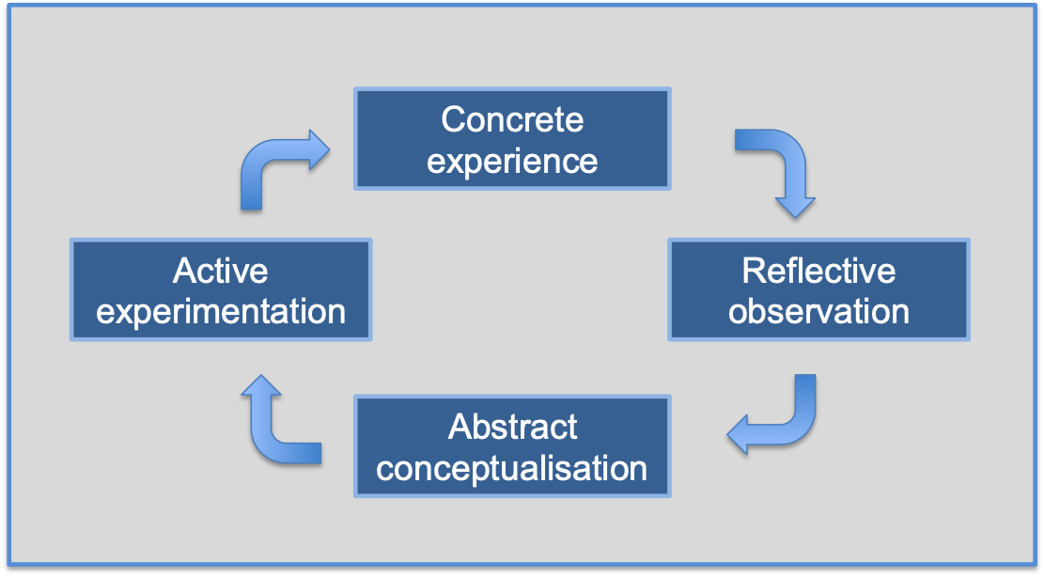
Simulation based learning is a teaching method that employed to produce a real-life clinical experience without going through the real event.(3, 4)
A literature review to inform the introduction of psychiatric simulation to the University of Liverpool Medical School
Dr Alexander Challinor^{1, 2}, Dr Declan Hyland^{1,} ²
^{1.} School of Medicine, Institute of Life Course and Medical Sciences, Faculty of Health and Life Sciences, University of Liverpool
^{2.} Mersey Care NHS Foundation Trust
Corresponding author: alex.challinor1@nhs.net
INTRODUCTION
RESULTS
Psychiatry draws on multiple skills and attitudes which must be developed experientially, in clinical practice, or within medical education. Transformations in the structure of psychiatric delivery and reductions in funding to mental health care have limited the availability of direct patient contact for medical students.⁽¹⁾ This highlights the importance of undergraduate education in ensuring adequate training which provides exposure to psychopathology.
Simulation-based learning is a teaching method that is employed to produce a real-life clinical experience without going through the real event. It is possible that simulation can be utilised as a powerful pedagogical tool for teaching understanding, knowledge and skills required for psychiatry.
The literature search identified 671 papers. Of these, 70 papers met the inclusion criteria and were included in the review. 601 papers were excluded due to them being duplicate papers, or not meeting the inclusion criteria; or not within undergraduate education, or not focussed on psychiatry, or not evaluating simulation as an intervention.
The review found that simulation in psychiatry has been introduced to undergraduate teaching in many different forms. This includes more traditional forms of simulation, such as role-play and simulated patients, to more modern approaches, such as virtual reality and high-fidelity mannequins.
Simulated patients and role-play are forms of simulation that build on the social context of learning, exploring values, attitudes and behaviours, as well as drawing on a range of educational theories, including experiential learning. Kolb and Fry⁽²⁾ describe four learning environments in their theory of experiential learning. Despite its simplicity and ease of delivery, simple role-play teaching, which was found to only use stage 1 or 2 of Kolb’s learning cycle⁽³⁾, has limitations for learning, experience, and engagement over other simulation pedagogy. Studies show that well-designed, multi-faceted simulated patients, using an experienced and authentic actor, yielded greater educational benefit to students. One study by Khal et al.⁽⁴⁾ used iterative hypothesis testing via small group teaching, case analysis, simulated patient use and reflective feedback, demonstrating significant educational gain.
aim
Reviews of simulation in psychiatry have been predominantly performed on subsets of this topic, with a focus on one intervention or a singular outcome of effectiveness and / or limitations.
The aim of this review was to investigate different ways in which simulation has been introduced and used in psychiatric teaching within the undergraduate curriculum.
This review will enable the appropriate evidence-based introduction and development of psychiatry simulation in the medical undergraduate curriculum at the University of Liverpool. Psychiatry’s use of advancements and modernisation of simulation pedagogy was also evaluated.
With other specialities moving forward and implementing innovative and modern simulation practice, it raises the question of whether the focus in psychiatry should still be on developing high quality simulated patient teaching, or shifted to novel teaching methods. Our review found limited studies using virtual and / or augmented reality and high-fidelity simulation.
METHOD
CONCLUSIONS
REFERENCES
The authors searched MEDLINE, EMBASE and PsycINFO databases for studies that met the inclusion criteria. Search terms included ‘simulation’ (‘psychiatry’ or ‘mental health’), ‘undergraduate medical education’ and ‘psychiatry’. The authors searched the literature from inception to December 2019. The research papers were also searched using snowballing via citation tracking within the databases.
The inclusion criteria included studies involving a simulation methodology that was utilised within the field of psychiatric teaching and if the study was completed within undergraduate education. Only those studies that utilised simulation as a form of teaching, rather than as a form of assessment, were included. Foreign language studies and abstracts for which full papers could not be obtained were excluded.
Whilst there are multiple difficulties to overcome in simulation training, these barriers are primarily logistical and clearly outweighed by the educational gain demonstrated by our review. Psychiatric education would benefit from ensuring implementation of well-designed authentic traditional simulation teaching, alongside developing its evidence base for use of more immersive technological advances in mental health pedagogy.
The University of Liverpool Medical School is developing multi-faceted psychiatric teaching embedded within the communication skills curriculum. Augmented reality is also being explored, with the aim to introduce medical students to their mental health placement. This can educate students on risks and personal safety on mental health wards.
Thomson LDS, Brown T, et al. The organisation of undergraduate teaching. Teaching Psychiatry to Undergraduates. London: RCPsych; 2011. p.38-51.
Kolb DA. Experiential learning: experience as the source of learning and development. 2nd ed. Upper Saddle River, NJ: Pearson; 2015.
Abdool PS, Nirula L, et al. Simulation in Undergraduate Psychiatry: Exploring the Depth of Learner Engagement. Acad Psychiatry. 2017;41(2): 251-61.
Kahl KG, Alte C, et al. A randomized study of iterative hypothesis testing in undergraduate psychiatric education. Acta Psychiatr Scand. 2010;122(4): 334-8.

