Slide 1


Liverpool City Region Households into Work: Overcoming Complex Barriers to the Labour Market
Presentation to
DWP Areas of Research Interest Teams Event
22nd November 2021

Slide 2
What we are going to talk about
Liverpool City Region context
A place based approach to welfare interventions
Households into Work programme
Findings from the interim evaluation
Concluding thoughts

Slide 3
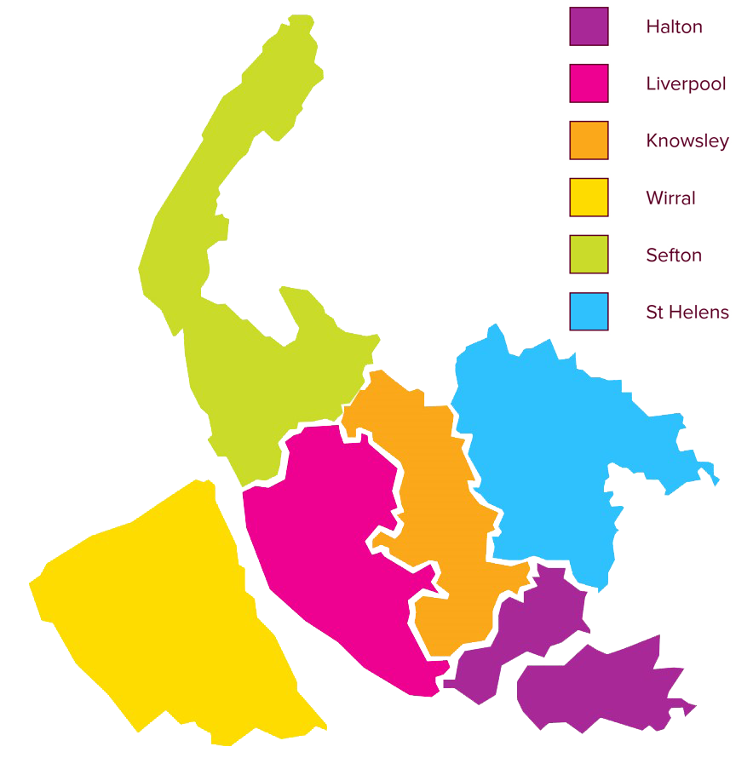
Liverpool City Region
2.0m residents
£32bn economy
49,000 businesses, of which 99% are SMEs
969,000 working age population
691,000 residents in employment
c.130,000 residents claiming out of work benefits

Slide 4
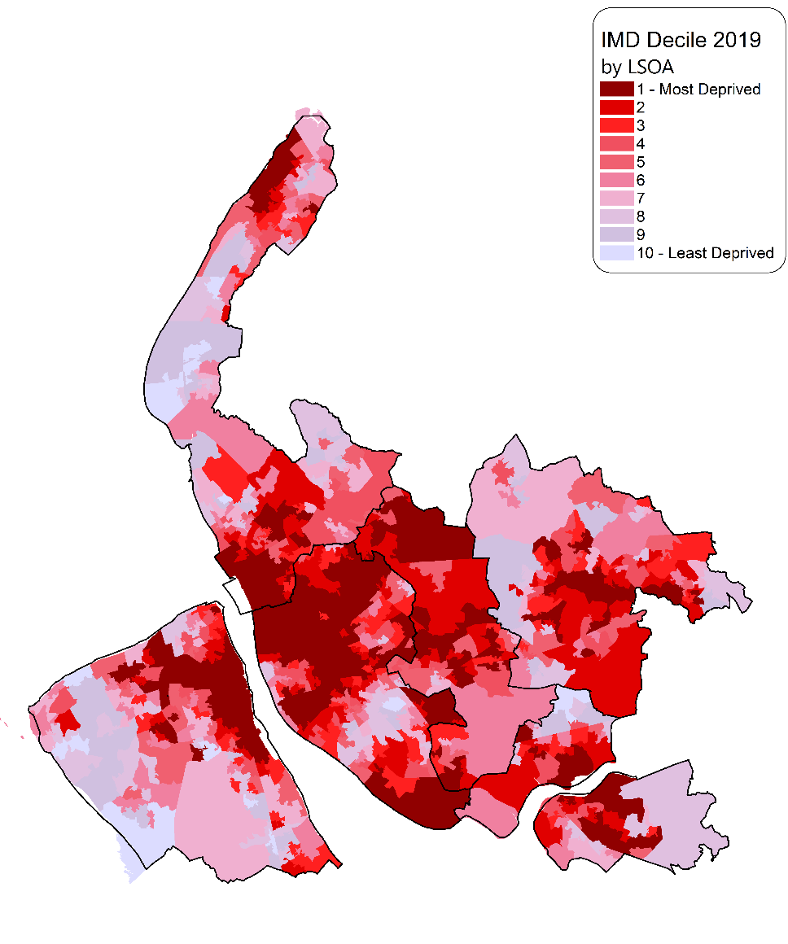
Index of Multiple Deprivation (2019)
Liverpool City Region ranked as the most deprived of 38 LEP areas on the Income, Employment and Health Deprivation and Disability domains
Ranked 1st on Employment deprivation domain
Knowsley (3) and Liverpool (4) ranked in the top 10 most deprived Council areas

Slide 5


A Place Based Approach to Reform
History of collaborative working across the 6 Local Authority areas in the design and delivery of programmes for people facing multiple employability barriers
Our devolution agreement recognised effective public service reform is critical in developing the systems needed to deliver a step change
Strong focus on inclusive economy in post covid recovery plan

Slide 6
Achieving System Change
Start with a coalition of the willing
Involve service users
Constancy of purpose …
… but with a degree of flexibility
Stability of leadership

Slide 7
HiW Case Study
Drivers: Mainstream interventions had not tackled the multiple causes of welfare dependency
Stakeholders: Combined Authority, 6 Local Authorities and DWP
Inputs: 800 households, £1,000 personal budget, 26 Employment Advocates
Outcomes/Targets: 600 positive outcomes, 500 significant improvements/moving closer to work and 20% of Households where an individual has moved into work
Funding: £4.6m over 2 years
Household approach
(Troubled Families)
Personal budgets
(Youth Employment Gateway)
Keyworker support
(Working Well)

Slide 8
HiW Approach
Launched in February 2018, HiW is delivered by a team of 26 Employment Advocates locally based across the City Region
Aims to identify and work with Households where two or more adults are out of work
Unlike more traditional programmes which focus on developing an individual’s progress through skills based interventions to ensure they are work ready, HIW embodies a holistic approach to intervention based on Household issues, providing 1:1 tailored support over a 12 month period
Engagement on the programme is focussed on the Pathways Star and action plans set around 8 themed Star points (on a scale of 1 to 5)
This team build upon existing relationships with service providers including Jobcentre Plus, NHS and third sector organisations, to deliver outcomes for those involved on the programme

Slide 9
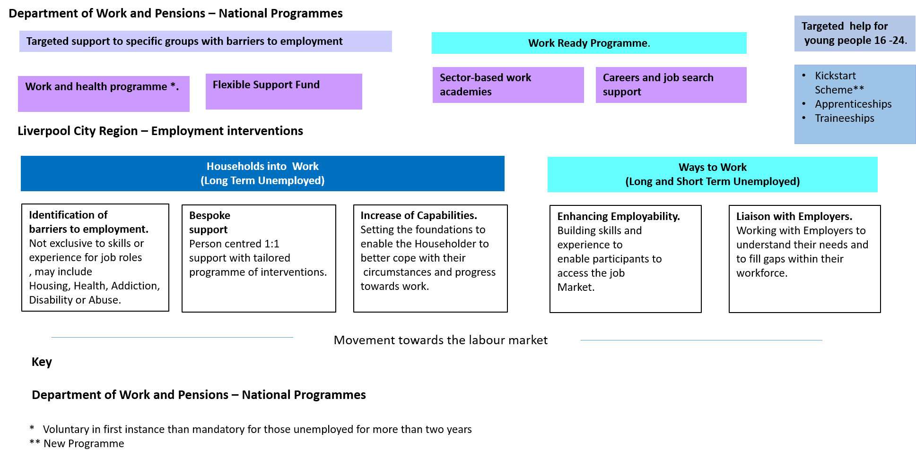
HiW in context with other provision
Labour Activation Programmes in Liverpool City Region (August 2020)

Slide 10
HiW Client Group Charactistics
Self-reported support needs of Clients
Time Spent out of Employment
Support Need | % | Support Need | %
Mental health issues | 65% | Drug misuse | 10%
Parent (with children under 18) | 32% | Problem drinking | 6%
Has care responsibilities | 26% | Sensory impairment | 4%
Lone parent | 23% | English is not first language | 4%
Chronic health condition | 23% | Care leaver | 4%
Victim of domestic abuse | 16% | On community sentence | 4%
Homeless/temporarily housed | 16% | Teenage parent | 1%
Learning disability | 15% | Refugee | 1%
Physical disability | 13% | Ex-armed forces | 1%
Ex-offender | 12% | Asylum seeker | 1%
Not in education, training or work (NEET) | 12%
Time band | Percentage
0-6 months | 17%
6-12 months | 8%
12-18 months | 6%
18-24 months | 5%
24-36 months | 10%
More than 36 months | 38%
Never employed | 15%
Unknown | 1%
Figures provided from whole programme CRM. N=1,606 at 31st March 2020

Slide 11
HiW Pilot Programme Performance
Performance Summary at conclusion of the pilot March 2020
 | Year 2 Target (March 2020) | Actual (March 2020)
Number of Households who have started on the programme | 800 | 1,062
Number of Households where individuals have completed at least one agreed activity | 600 | 851
Number making significant improvements / moving close to work | 500 | 722
Moved into employment (16 hours per week for 4 weeks) | 20% | 28%

Slide 12
Relational Welfare
Core Principles of a Relational Welfare State
From needs to capabilities
From means testing to open to all
From a financial to a resource focus
From centralised institutions to distributed networks
From individual to social networks
Hilary Cottam – Radical Help
Households into Work Programme embodies at least four of these core principles

Slide 13
Households Journey
Household Profile
Two People in Household
Annual income less than £5,999
Household Level of debt £500-£900 (At risk of eviction)
Primary Householder
Female
Aged 45
Previous employment >36 months
Not worked continuously for >20 years
In receipt of Universal Credit
Highest Level of Qualification: Level 1
Joined HiW: April 2018

Slide 14
HIW Interventions: Worked Example
Client circumstances Prior
to joining programme
Household into Work
Interventions
Outcomes
HiW Client
Long Term Unemployed = 19 years
Poor physical and emotional health
Socially Isolated
Multiple debts & risk of eviction
Secured tenancy
Improved confidence
Reduced dependence upon statutory services
Improved physical and emotional health
Enhanced knowledge and skills
Gained employment
1:1 Employment Advocate Support
Rent arrears payment plan
Debt Relief Order
Established routine
Connected client to services and community organisations
Accredited training
Secured voluntary work placement

Slide 15
Findings from Interim Evaluation
HiW offers a whole system approach that puts outcomes at the centre instead of a focus on specific organisations.
Wrap around support which responds to individuals needs, is required to enable progression and transition into the labour market
HiW combines practical application with a systemic perspective to provide bespoke packages for residents as part of a pathway towards employment
Offering tailored person centred support gave individuals an opportunity to reflect upon and enhance their capabilities. Supporting the embedding of outcomes and improving personal resilience

Slide 16
Concluding Thoughts
Devolution of DWP budget to the City Region helped to unlock innovation
Being non sanction lead enabled clients to over come anxiety associated with trying to enter the labour market
Place matters – knowledge and experience of working in a particular locality is a key determinant of what works when dealing with complexity
Investment in locally tailored solutions can make a vital contribution towards levelling up

Slide 17

Further Information
Belinda Tyrrell, Research Associate
tyrrellb@liverpool.ac.uk

