Slide 1
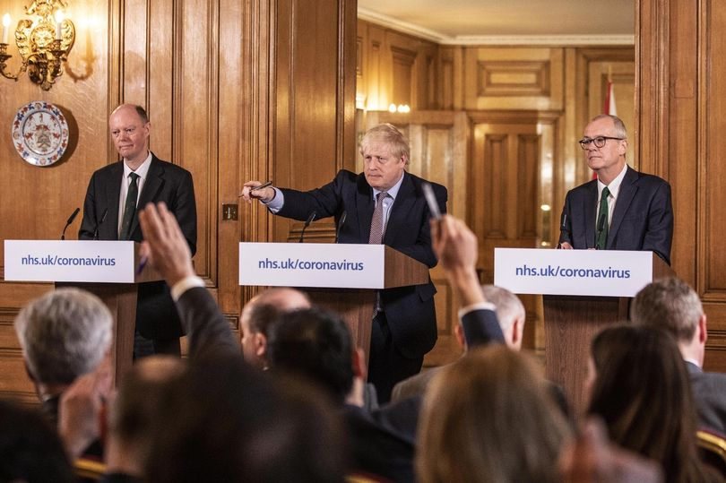
Scientific advice and COVID-19 policy making in the UK: an oral history study
Lancet Public Health Science, 26 November 2021
Paul Atkinson, Hayley Mableson, Sally Sheard
Notes:
Image: CW (CMO), BJ (PM), PV (GCSA)
UK good at science, thinks itself good at using science in policy-making. So why didn’t it do better against Covid-19?

Slide 2
Seeking a policy goal
‘policy makers would ‘say, “what should we do?” And [scientists] say “well what do you want to achieve?” And we just go round and round in circles’
‘we can’t advise what the best next step is, because that is contingent on what the overall plan is, and there isn’t one. So it makes it quite hard for us to do our job in terms of scientific advice.’
[Scientific adviser 4]

Slide 3
Scientists don’t want to set policy
‘nervous that … these are policy decisions and we are not taking them as scientists
‘it would be unfair if we were blamed for policies that didn’t follow the science, or based on scientific uncertainty were implemented and didn’t have the desired effect.
‘we are giving the scientific advice but we are not making policy and sometimes that is a little bit blurred’
[Scientific adviser 3]
Notes:
#2 Using scientific advisers as a shield, and as a scapegoat for unpopular political decisions

Slide 4
Levels of scientific advice
Minimal guidance
Maximal guidance
Deal with uncertainty
eg use surveillance to estimate infection rate, what are likely impacts of different interventions?
(Cairney 2021)
Deal with ambiguity
eg how to define and try to solve the problem: how urgent, what is the role of the state, who should state intervention benefit most?

Slide 5
Scientific evidence is combined with other policy inputs
(Face masks for the public)
‘we can say what the evidence is, … but then we are pushed to give recommendations, … we have to push back … try to avoid giving a recommendation … that is … a political choice, because there are much wider concerns, like diverting masks from healthcare workers, or risk compensation. … many of these are not scientific, but they are important considerations
‘we should interpret the science and give the best estimates of what the science is telling us, but the decision and all of the other evidence is a policy decision’
[Scientific adviser 3]
Notes:
#3 pressing scientists to back political choices that their knowledge didn’t justify

Slide 6
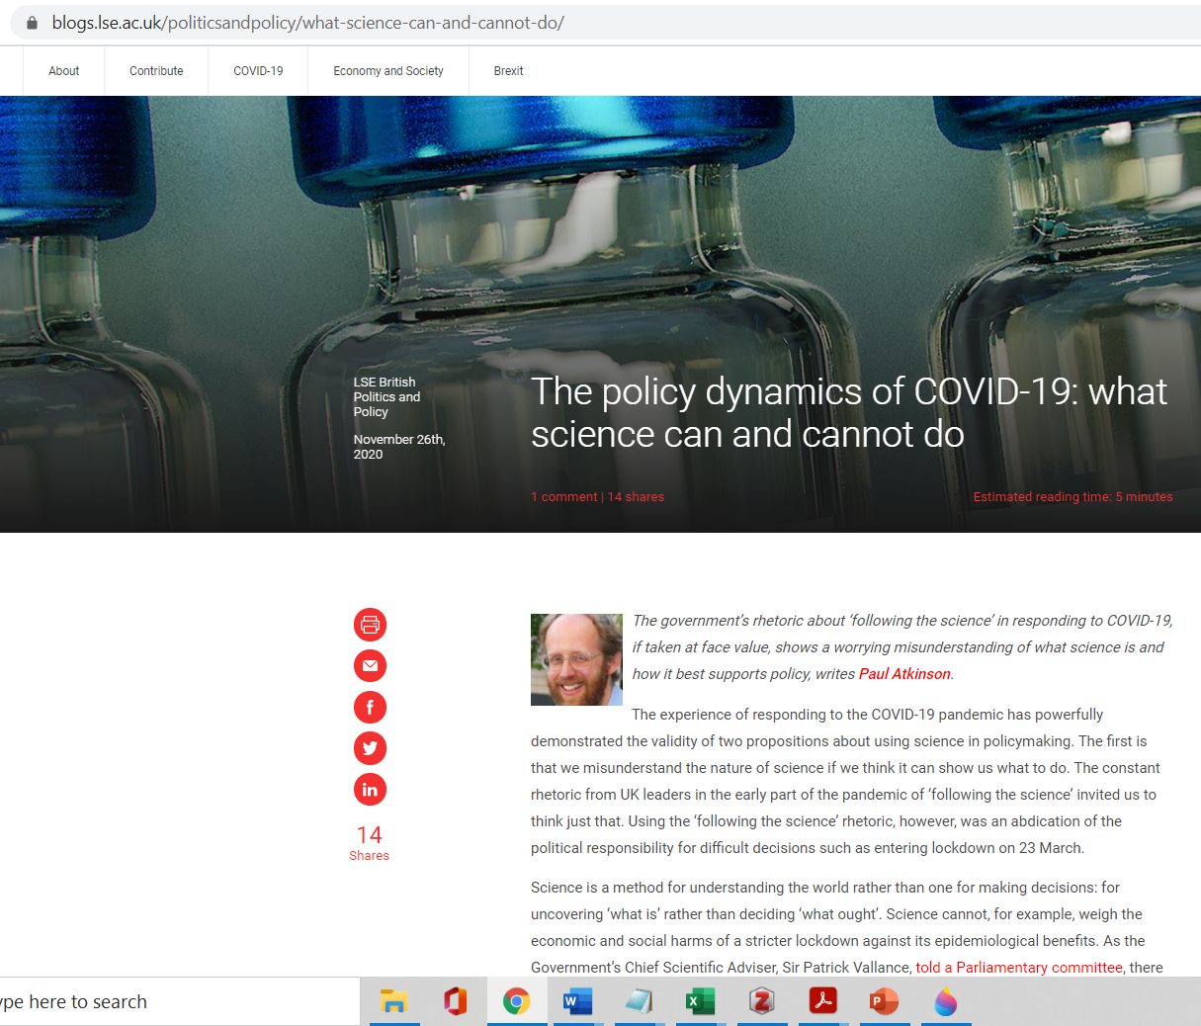
‘Following the Science’?
No:
Not providing a policy goal in good time
Trying to get reluctant scientists to decide policy
Using science as one input to a confidential policy process

Slide 7
References
Atkinson (2020) blogs.lse.ac.uk/politicsandpolicy/what-science-can-and-cannot-do/
Atkinson et al (2020) Understanding the policy dynamics of COVID-19 in the UK, Social Science and Medicine
Berridge (2010) Hidden from history?: Oral history and the history of health policy, Oral History
Cairney (2021) The UK Government’s COVID-19 Policy: What Does “Guided by the Science” Mean in Practice? Frontiers in Political Science
Haddon, C., Sasse, T., Nice, A. (2020) ‘Science advice in a crisis’, London: Institute for Government
Smith (2021) Open Letter: Top five ethical lessons of COVID-19 that the world must learn, Wellcome Open Research
Weible et al (2020) COVID-19 and the policy sciences: initial reactions and perspectives, Policy Sciences

