Slide 1
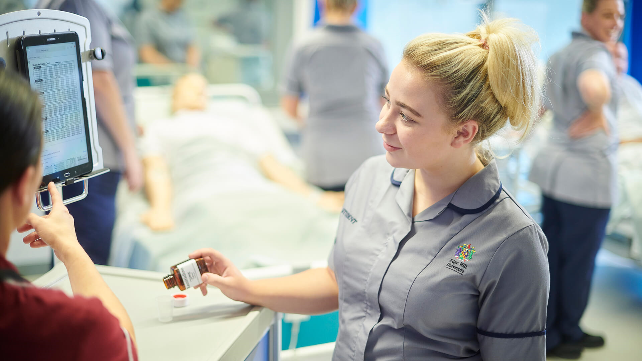
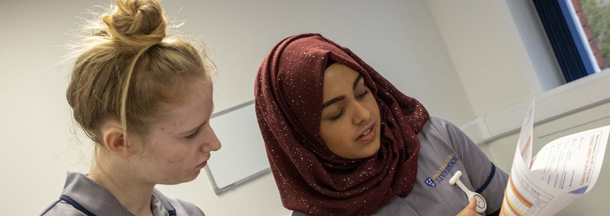
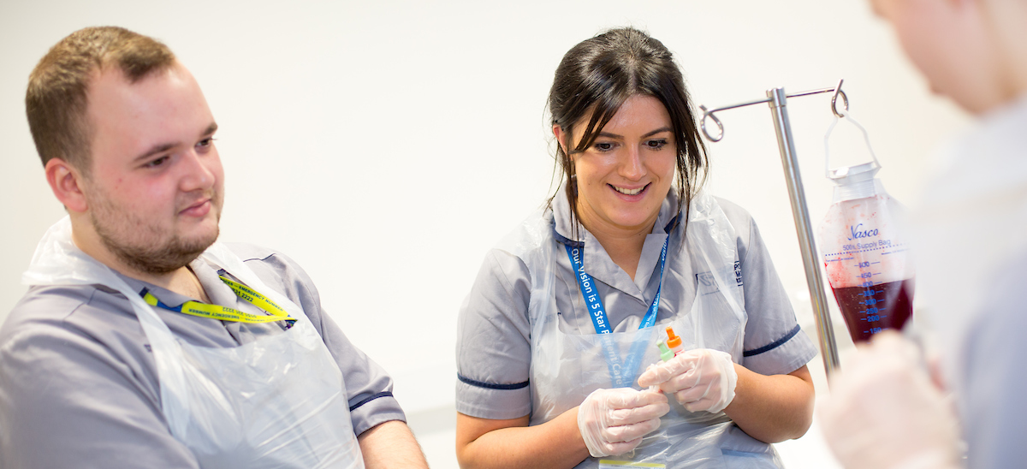
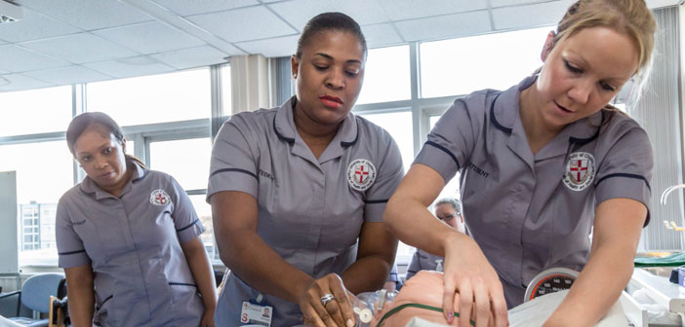
Cheshire and Merseyside Higher Education Institutions Collaborating Throughout the Pandemic
Claire Walker, Dr Kate H. Knight, Richie Williams, Trudy Hutchison, Mark Arnold, Lou Shorney, & Jonathan Hay
Background
By joining together and focusing on supporting our deployed students throughout the COVID-19 pandemic, the Cheshire and Merseyside Higher Education Institutions and Practice Education Facilitator (PEF) collaborative has navigated the storm together, coming to a joint consensus on how best to support, guide, and advise our learners together with our practice partners and staff. Innovative ideas, joint guidance, learning strategies and much more have meant that every student in our region has received consistent messages and support. Our practice staff were able to feedback to us through our PEF links, enabling prompt decisions and actions - ensuring safety and quality for all.
The North West
England’s North West has a challenging public health landscape — a combination of social deprivation, health inequalities and social care issues result in our population experiencing considerable challenges and losses all too frequently. According to official government figures, the North West saw the second highest cumulative number of COVID-19 cases, and also the second highest numbers of death per region (behind only the South East and London). As such, our learners and the staff who support them were facing unprecedented clinical, professional and emotional pressures.
Steering
By the end of April 2020, the HEI practice leads across our area of the North West (alongside two representatives from our PEF network) were meeting weekly to support, navigate and collaborate on decisions and guidance, masterminding how we supported our learners and those that support them during these challenging times. Innovative ideas included: online simulated learning for those students isolating; guidance for practice assessors and supervisors; reflective learning for protected learning times; guidance and advice on infection control; testing and isolation along with risk assessment and managing adverse events.
Collaboration
The unprecedented intensity and frequency of the meetings where all four HEIs came together provided the basis for cementing this valuable partnership. In the early days of the pandemic, the partnership consisted of weekly collaboration meetings in addition to online offshoots. Commitment to this collaborative ethic enabled processes and procedures to be aligned across Cheshire & Merseyside. The partnership continues to date, ensuring our learners have a consistent approach to practice learning, and our scope and vision continue to grow. We continue to make joint decisions and issue shared guidance to support our students and practice staff so they can better care for our community and patients, further growing our vital profession.
Mobilisation
During March 2020, the clinical placement landscape changed drastically. By mid-April, almost 15,000 healthcare learners were working on the frontline in the midst of a global pandemic. Over 2000 learners were deployed from our region, a large proportion of these being student nurses. This unprecedented mobilisation of thousands of healthcare learners proved vital to supporting the NHS during the most significant emergency in its history, and was achieved as a result of our teamwork.

