Slide 1
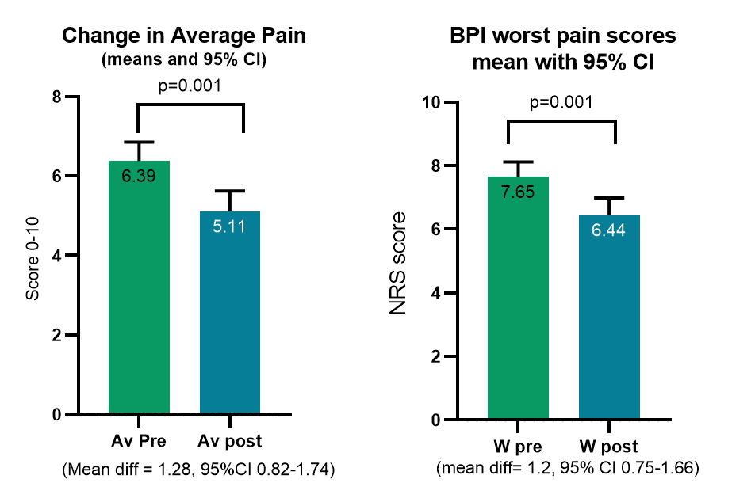
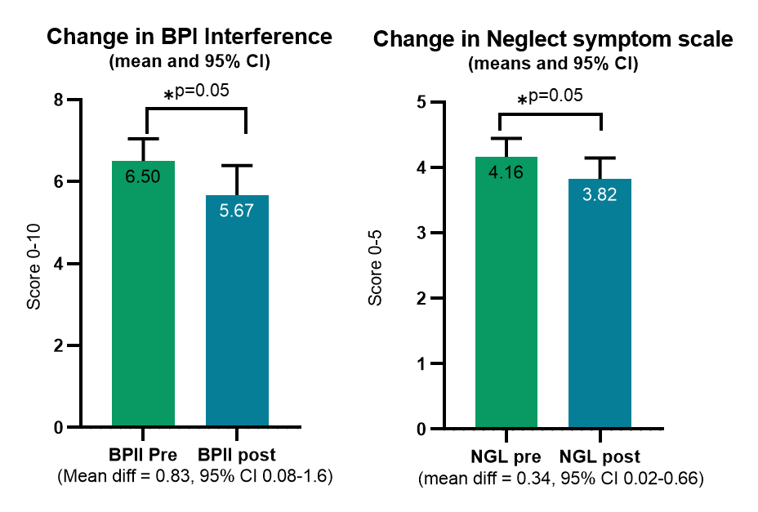
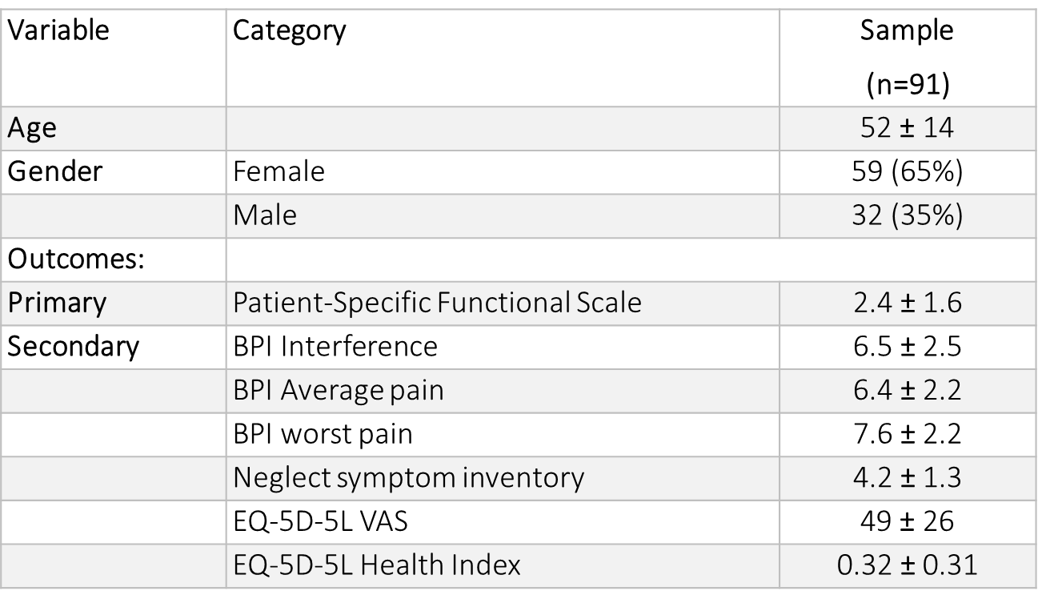
THERAPY TREATMENT FOR CHRONIC COMPLEX REGIONAL PAIN SYNDROME WITHIN A CLINICAL SETTING
Abstract ID: 1040
Selina Johnson 1,2*; Louise Haynes 1, Andreas Goebel 1,2.
Walton Centre NHS Foundation Trust; Liverpool, UK, 2. Pain Research Institute, Faculty of health and life Sciences, University of Liverpool; Liverpool, UK,
Background :
Guidelines support the inclusion of a variety of physiotherapy interventions for CRPS management, but do not describe how treatments can be integrated as part of clinical pathways (1,2). Evidence of current practice and treatment pathways, therefore, is needed to inform future best practice guidelines (3,4).
AIMS:
To describe and evaluate a clinical pathway for patients with longstanding CRPS in a tertiary pain clinic.
Results 2:
Methods:
Patient referred to Pain Clinic
Current tertiary CRPS pathway
Confirmation of CRPS
by Pain Consultant, information and Medication review
Assessment for
SCS/DRG
Assessment for PMP
Specialised PT therapy, if not suitably trialled before
6-8 x Rx sessions
Discharge
Retrospective case series review
Of patients completing a chronic CRPS physiotherapy pathway
OUTCOMES
PRE CRPS PHYSIO RX
PHYSIO
RX
OUTCOMES POST CRPS PHYSIO
RX
Results 1:
JAN 2016- JAN 2020
Clinically relevant changes
156 patients
Outcome | n= | Change | n (%) with change
PSFS | 85 | ≥30% improved | 49 (58%)
BPI interference | 88 | ≥2 point improved
BPI average pain | 87 | ≥2 points improved | 33 (38%)
BPI worse pain | 87 | ≥2 points improved | 33 (38%)
Neglect symptom scale | 85 | ≥1.2 points improved | 16 (19%)
EQ-5D-5L VAS | 80 | ≥ 11 points improved | 31 (21%)
91 complete datasets
Baselines outcomes:
Treatment type:
Desensitisation (84%) and treatments to address altered limb perception and neglect (89%) were most common.
Conclusions
Longstanding CRPS is often refractory to medications and interventional treatments. Physiotherapy treatment using a mechanism informed treatment pathway was associated with significant improvements in all outcome domains. Further work is needed to help inform and optimize clinical treatment algorithms..
REFERENCES:
1. Smart KM, Wand BM, O’Connell NE. Physiotherapy for pain and disability in adults with complex regional pain syndrome (CRPS) types I and II. Cochrane Database Syst Rev. 2016;(2).
2. Goebel A, Barker CH T-SL et al. Complex regional pain syndrome in adults 2nd edition [Internet]. 2nd editio. London; Royal college of Physcians; 2018. Available from: https://www.rcplondon.ac.uk/guidelines-policy/complex-regional-pain-syndrome-adults
3. Miller C, Williams M, Heine P, Williamson E, O’connell N. Current practice in the rehabilitation of complex regional pain syndrome: a survey of practitioners. Disabil Rehabil [Internet]. 2017 Dec 11 [cited 2019 Mar 3];1–7. Available from: https://www.tandfonline.com/doi/full/10.1080/09638288.2017.1407968
4. Packham T, Holly J. Mechanism-specific rehabilitation management of complex regional pain syndrome: Proposed recommendations from evidence synthesis. J Hand Ther. 2018;31(2):238–49.

