Slide 1
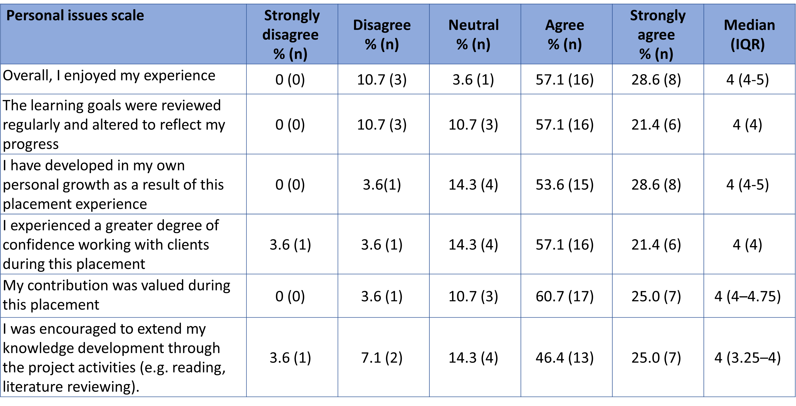
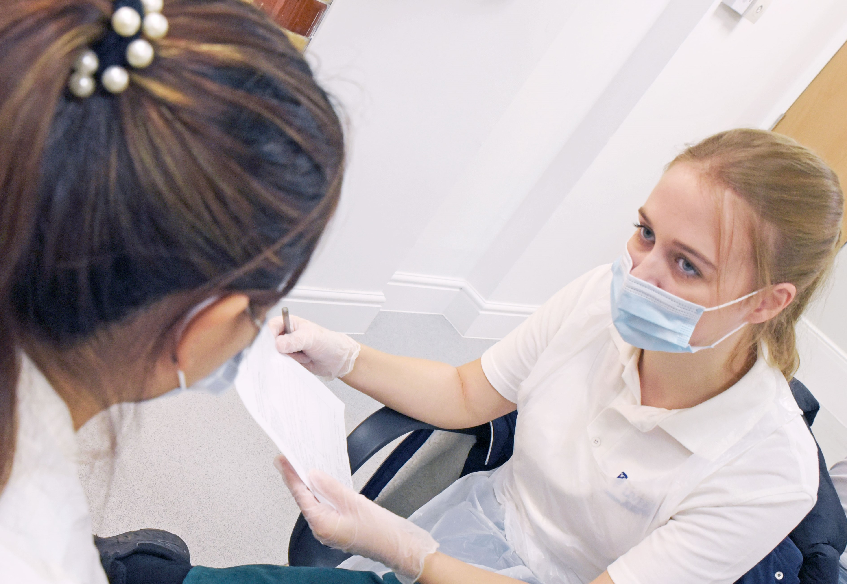
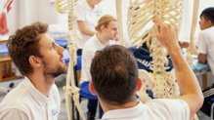
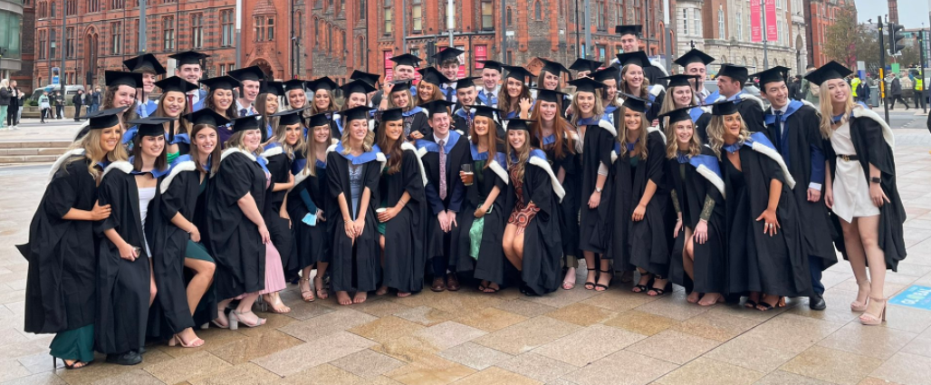
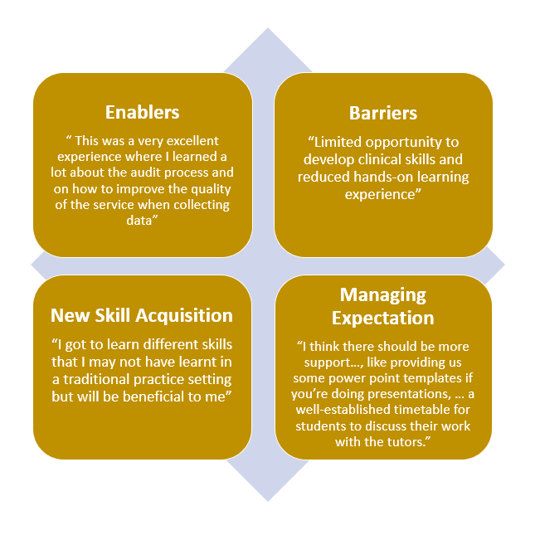
Experiences of Physiotherapy and Occupational Therapy Undergraduates of Blended Practice-based Learning.
Barnes-Brown, V; Edge, C; Deaves, A; Orton, H; Prescott, D; Sharp, J (2022)
www.liverpool.ac.uk/health-sciences vikkibb@liverpool.ac.uk
Context
Securing sufficient practice-based learning opportunities for health care students is long-standing, well documented and international issue (Martin et al 2004, Beveridge and Pentland 2020).
Increasing Allied Health Professional learners on healthcare programmes and the COVID-19 pandemic have highlighted the need for radical change and innovative ways of working to address placement capacity. This increase is in response to the requirement for health care provision closer to home (NHS England, 2020) and is accompanied by a shift in the provision of practice-based learning placements from acute NHS Trusts to community, domiciliary, primary and social care settings (HEE, 2020).
The blended practice-based placements (BLPs), were implemented in partnership with clinical collaboration across Cheshire and Merseyside region for physiotherapy (PT) and occupational therapy (OT) learners. Ethical approval was granted, by the University of Liverpool Research Ethics Committee, to pilot and fully evaluate this placement model.
​​
Discussion
Table 1 shows there was a majority of positive agreement with the statements within the questionnaire, indicating that the placement were well received by the participants and that generally the placement experience had a positive outcome.
Four themes were identified from the thematic analysis;
Enablers for learners included support (from educators and academic staff), the type of project and placement speciality.
Barriers for learners included the type and length of project not being
comparable to their peers, limited clinical time and continuity with patients.
New skill acquisition included adaptability and delegation skills, the ability to influence change in patient care and improved clinical reasoning.
Manage Expectations of learners, to prepare them for the experience,
enhance communication and provide more guidance on the types of projects they could complete.
Conclusion
Over 11,800 clinical hours have been saved by delivering BLPs, allowing learners to continue to progress on clinical programmes without having a gap in their studies. Without this innovation, Fifty-seven second- and third-year occupational therapy and physiotherapy students would have to extend their programmes of study to achieve the required 1000 clinical hours, to be registerable with their professional bodies.
Fifty-seven service improvement projects have been completed within partner organisations, to influence patient care and efficiency of staff working.
This placement model allows the development of abilities and skills as core competencies related to their role as a newly qualified AHP’s standards of proficiency (HCPC 2013).
Recommendations
Alternative placement models are required to meet ongoing capacity demands. This work adds to the growing body of placement related literature.
Projects based within the Quality Improvement Framework provide impact for both Learner, Educator and Healthcare Services.
Development of resources and guidance support documents for both educator and learner to ensure engagement and positive outcomes for all stake holders.
Results
Response Rate: 49% (n= 28; PT 78%; OT 22%)
Table 1: Sample of the percentage agreement with the quality of placement experience questionnaire
Thematic Analysis
Blended practice-based learning placement
=
Clinical Experience
+
Project Activity
Research Aim:
To ascertain the experiences of the newly introduced blended placement-based learning for second year occupational therapy and physiotherapy learners.
Method
A convenience sample was utilised: PT & OT learners who completed a blended practice-based learning placement were eligible to participate.
Both quantitative and qualitative methods were employed in the research. The questionnaires were devised from existing literature (Barrett, Belton and Alpine, 2019). Responses were scored on a Likert scale 1-5
The quantitative data were analysed using descriptive statistics (Statistical Package for the Social Sciences (SPSS) 27 software).
Profession specific focus groups also took place on-line and recordings were transcribed verbatim by an experienced qualitative research transcriber. Thematic analysis using NIVIVO 12 was used to analyse the qualitative data.
References
Barrett EM Belton A and Alpine LM (2019) Supervision models in physiotherapy practice education: student and practice educator evaluations. Physiotherapy Theory and Practice, 37(11), 1-14.; Beveridge J Pentland D (2020) A mapping review of models of practice education in allied health and social care professions. British Journal of Occupational Therapy, 83(8), 488-513. Accessed on 04.05.22; HCPC (2013) The standards of proficiency for occupational therapists. Available at: https://www.hcpc-uk.org/standards/standards-of-proficiency/occupational-therapists/..Accessed on 18.05.22; Health Education England (2020) Current placement expectations of AHP regulators and professional bodies. Available at: https://www.hee.nhs.uk/our-work/allied-health-professions/helping-ensure-essential-supply-ahps/placement-expansion-innovation/current-placement-expectations-ahp-regulators. Accessed on 04.05.22; Martin M Morris J Moore A Sadlo G Crouch V (2004) Evaluating Practice Education Models in Occupational Therapy: Comparing 1:1, 2:1 and 3:1 placements. British Journal of Occupational Therapy, 67(5), 192-200. Accessed on 04.05.22;NHS England (2020) We are the NHS: People Plan for 2020/21 – action for us all. Available at: https://www.england.nhs.uk/publication/we-are-the-nhs-people-plan-for-2020-21-action-for-us-all/ Accessed on 04.05.22.

