Slide 1
Ripple Effects: Disseminating Local Climate Action via TV
Elke Weissmann (Edge Hill University) and Belinda Tyrrell (University of Liverpool) in collaboration with Love Wavertree CIC

Slide 2
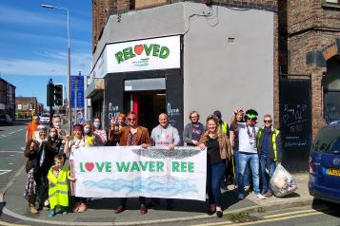
Aims of Project
Understand how local communities come to shared understanding on climate action
Understand if local television, if it were re-imagined as public service television in the UK, would be able to disseminate these understandings and motivate more people

Slide 3
Aims of presentation
Introduce project
Discuss theoretical background
Present some very early findings

Slide 4
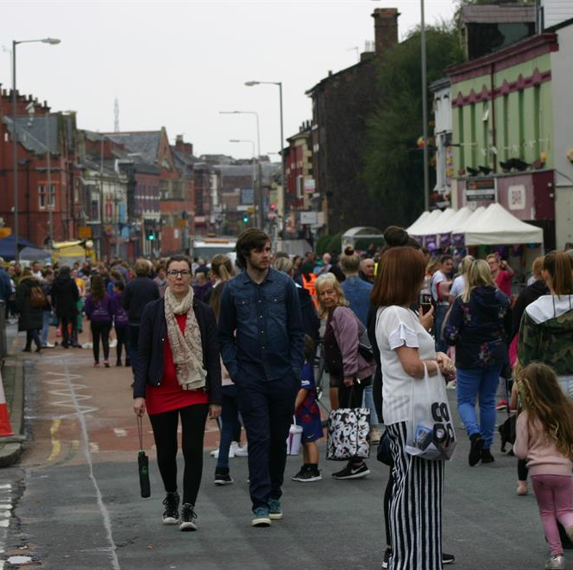
The Project
Collaboration between Edge Hill University, University of Liverpool, Love Wavertree CIC and the British Academy
Funded through stream on Shared Understandings of a Sustainable Future
Three key strands in this: community activism, policy and television

Slide 5
Community Activism
Role of local communities in post-national context (Sassen, 2003, 2004)
Community-based initiatives found to be helpful in addressing climate change to different levels (Celata and Sanna, 2018), though wider engagement is required (Martellozzo et al., 2019)
Community activism particularly important in under-resourced areas where climate change is not massively high amongst other priorities
Love Wavertree CIC already engaging with climate change initiatives via Car Free Sunday, food waste initiatives and measuring pollution levels

Slide 6
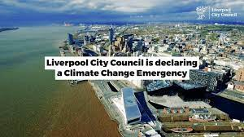
Policy
Local policy
Issues regarding what can be done locally on limited resources
Issues regarding communicating what is being done or what can be supported
Television
Increasing shift away from ideas of public service in the UK (Freedman, 2018), including active attempts to dismantle public service television under current government
Local television established in early 2010s under commercial licences

Slide 7
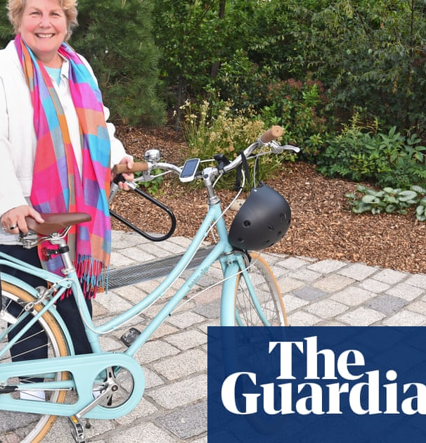
Television and Climate Change
Increasing attempts made to address issues of sustainability in production of television (see Lopera-Marmol and Jimenez-Morales, 2021)
Also attempts to address climate change as a topic in television, e.g. Norwegian TV (Furuseth et al, 2020)
Braasch (2015:33) points to need of specific imagery as not everything ‘encourage[es] civic action and involvement’.
‘Heeding the social scientists’ warnings about the helplessness-inducing effects of negative images means that more pictures are needed of specific solutions and adaptations that will shape the world of tomorrow.’ (ibid: 38)

Slide 8
Local TV and Climate Change
Local TV in the UK introduced under commercial licences
Local content is minimal (approx. 4 hours a day in Liverpool, only 1 of which is new content, everything else is repeated).
No evidence of engaging the community or speaking to community concerns, including climate change/action
Alternatives: community-led television in Canada, Germany, the USA, etc. (Higgings, 1999, King and Mele, 1999)

Slide 9
Creation of Local TV
Climate assemblies to gauge local community concerns and interest in climate action
Recording of these and creation of a documentary series and a lifestyle TV programme
Dissemination via newsletter, screening and website
Can local TV take community action beyond those who participate in it?

Slide 10
Early findings
Television not perceived to be massively helpful in informing citizens about climate action
Television perceived as too tame:
‘Ethical, green capitalism is impossible and TV isn't going to be a voice for deconstructing that. Attenborough etc just do low level gradual 'time is running out' messages. Time has run out and gradually making people aware is not a viable option.’ (participant 5)
‘Some adverts have started to incorporate climate messaging but suspect mostly greenwashing.’ (participant 6)

Slide 11
What Television has tackled climate change?
News
David Attenborough
Not just issues with negative images (Braasch, 2015) but also too distant from local experience

Slide 12
Local Knowledge and Climate Change
Local council experienced as not doing enough
Wish to see a host of changes (from planters, via low traffic neighbourhoods, to retrofitting housing)
Local media as not effective in communicating local action and initiatives

Slide 13
Local Action, Local Media
Demand for more local action exists
Requirement for local communities, including councils to do more
Local media need to become more effective in communicating local concerns
Elke Weissmann (weissmae@edgehill.ac.uk) Belina Tyrrell (Belinda.Tyrrell@liverpool.ac.uk)

