Slide 1
Striking the balance – tensions and double identity in operationalising professionalism assessments and Fitness to Practise.
Dr Dominic Johnson
Professor Viktoria Goddard (They / Them)

Slide 2
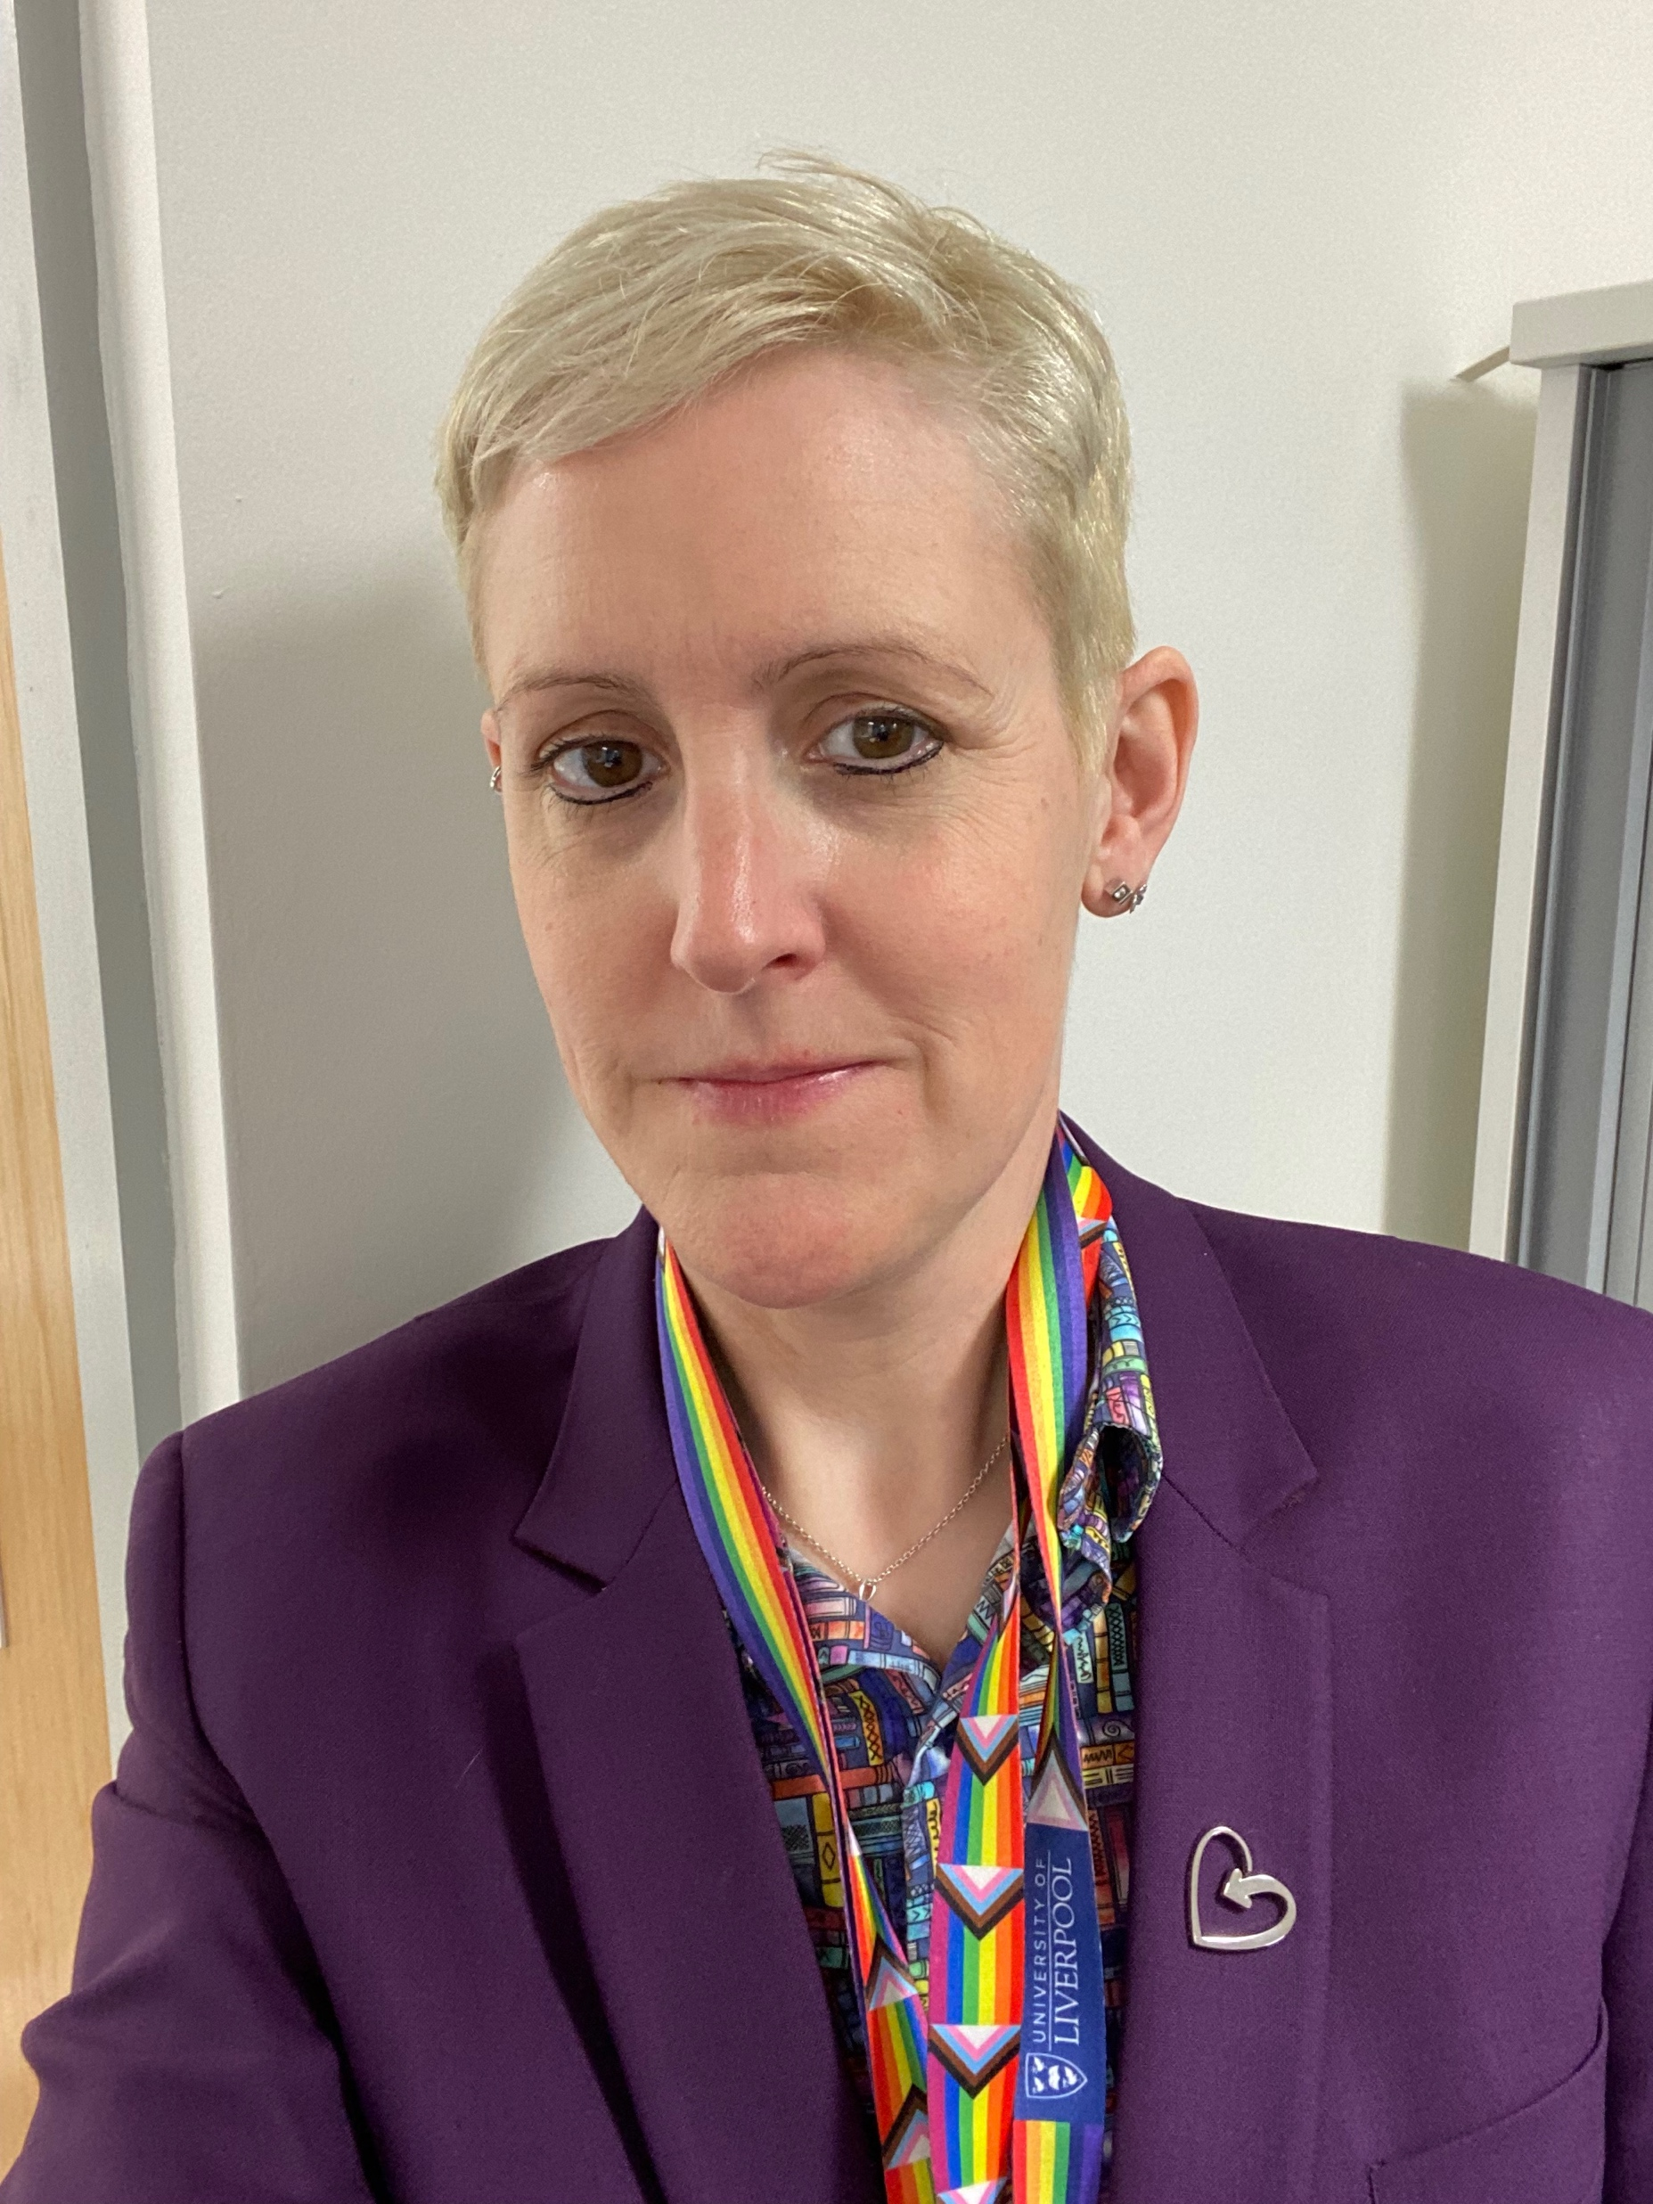
Introduction

Slide 3

Fitness to Practice: Different roles
Different roles:
-Medical school representative (as presenter of case)
-Investigator
-Academics
-Clinicians
-Clinical academics
-Clinical academics – specifically psychiatrists
-Psychiatrist as expert
-Lay person / patient
-PS / administrator

Slide 4

Why are you here?
Introductions – your roles!
What would you like to discuss today?
Any tensions you have identified in FtP roles?

Slide 5
What’s our role?
“Medical schools have a duty to graduate with a primary medical
qualification only those students who are fit to practise medicine. This
requirement is set by the GMC, which is responsible for the quality
assurance of all medical education and training in the UK. Because
of this requirement, your medical school will have ways to monitor
students’ behaviour and have a fitness to practise or professionalism
process to deal with students who display unprofessional behaviour.”
GMC, Achieving Good Medical Practice

Slide 6
What’s our role?
“Medical schools have a duty to graduate with a primary medical
qualification only those students who are fit to practise medicine. This
requirement is set by the GMC, which is responsible for the quality
assurance of all medical education and training in the UK. Because
of this requirement, your medical school will have ways to monitor
students’ behaviour and have a fitness to practise or professionalism
process to deal with students who display unprofessional behaviour.”
GMC, Achieving Good Medical Practice

Slide 7
How do we monitor students behaviour?
Engagement
Skill development
Meeting course requirements
Professionalism
Wellbeing
Health
Environment
Campus
Feedback
Attendance
Clinical
Self Directed Learning
Achievements
Scores & Grades
Prizes & commendation
Progression

Slide 8
Meet George
Penultimate year health professions student
Student disciplinary panel has found them to have committed misconduct in relation to stalking and harassment of another student. Not been prosecuted as accuser didn’t want to go down legal / police route
Studies suspended in October pending outcome of the investigation, which took 6 months
About to come back to the course…

Slide 9

What next for George in your institution?

Slide 10
Dual roles – lessons from assessment?
Boud (2000):
Whatever else we do in assessment we must
• Promote desirable learning by students now and into the future, and
• Assure the learning that occurs
Everything else is subordinate to this!

Slide 11
Dual roles – lessons from assessment
Whatever else we do in a medical schools we must
• Promote desirable behaviour by students now and into the future, and
• Assure that we graduate as many doctors as possible
Everything else is subordinate to this!

Slide 12




Notes:
Medical students: professional behaviour and fitness to practise
‘Medical students have certain privileges and responsibilities different from those of other students. Because of this , different standards of professional behaviour are expected of them. Medical schools are responsible for ensuring that medical students have opportunities to learn and practise the standards expected of them.’
(GMC, 2009)

Slide 13
GMC FTP guidance
116 Medical schools should also consider including on panels:*
someone from outside the medical school
someone with legal knowledge
a student representative who does not know the student being investigated
where the concerns are related to health, a relevant health specialist, for example a psychiatrist or occupational health physician. This person should not be involved in the treatment of the student.

Slide 14


Slide 15
The reality - balancing the roles?
Health- before, during and after
Diagnosis mode
Mens rea for medical students
Notes:
Mens rea- link between the mental state and actions not explored
Pt perspective- how would a patient feel if they knew a student who was assessing them had been in A and E the night before for an overdose?, How would the staff in A and E feel?
Enough is enough- use of FTP for health- underused?

Slide 16
What about George?
Has sought support and help while suspended from studies
Been diagnosed with Autistic Spectrum Disorder
Done a course on “How to Conduct Healthy” relationships in light of recent diagnosis
Letter of support from therapist to state they should be allowed to return to the course

Slide 17
Still happy with your decisions?

Slide 18
By the way…
Been diagnosed with Autistic Spectrum Disorder
Diagnosis is from a private provider who are often used in legal challenges to course concerns
Some mutterings within Institution over the reliability of their services

Slide 19
Does that change anything?

Slide 20
The reality - balancing the roles?
The rescue fantasy
Appeal aversion
GMC health assessor insights
The legal brain
The real world……….
Notes:
UNI FTP and health

Slide 21
George is back…
FtP panel find that George’s fitness to practise IS impaired
However
Significant mitigation has been accepted by the panel and consequently George was allowed to continue on the course with conditions
A concern is raised by a placement supervisor that in receiving some feedback George
became defensive and argumentative,
and George stormed off the placement site

Slide 22
What next for George?

Slide 23
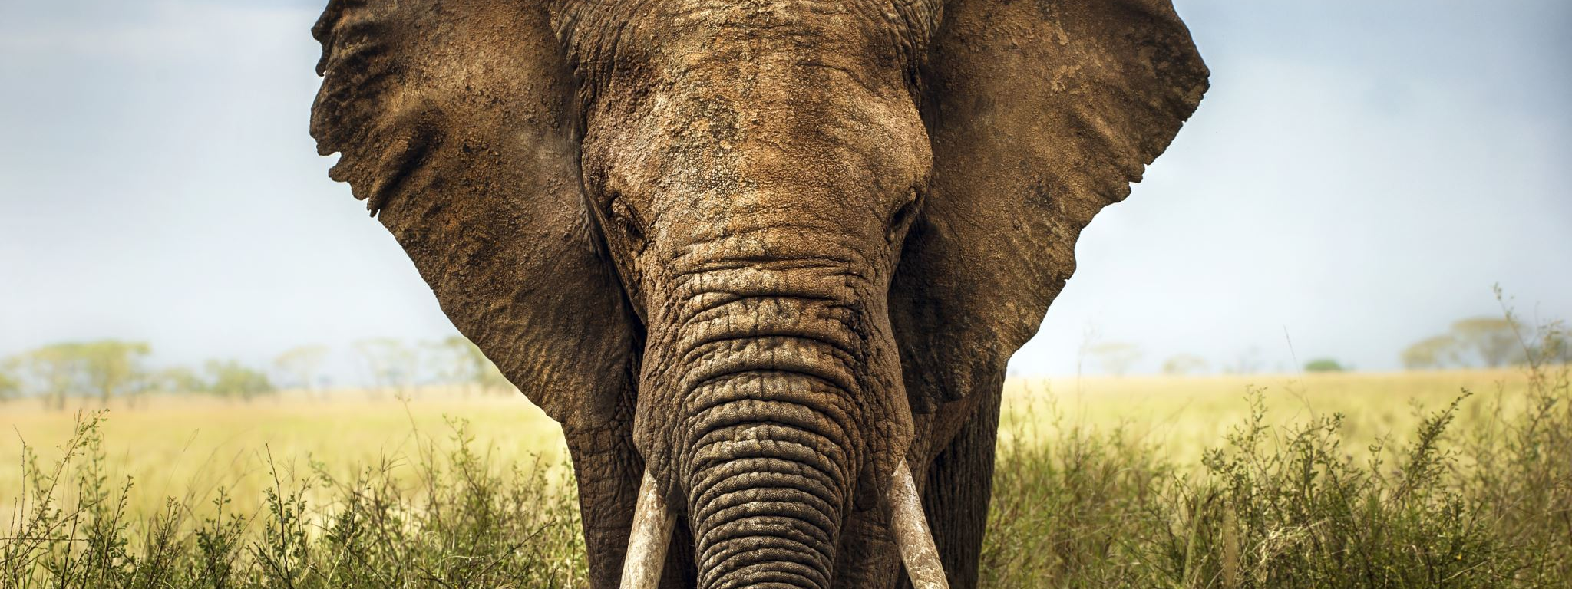
The proverbial elephant

Slide 24
George (again!)
George is referred back to Fitness to Practice
Viktoria / Dominic states that from their perspective, they are not sure that George is able to remediate aspects of their condition sufficiently that it raises questions about George’s suitability to join the profession
When George is questioned about this, George is defensive and states they have met all of the conditions imposed that were a requirement from their first FtP consideration

Slide 25
Group thoughts?

Slide 26
Lessons learned
Implications for practice
Anything you’d now do differently?
How would you like to build on this discussion?

Slide 27
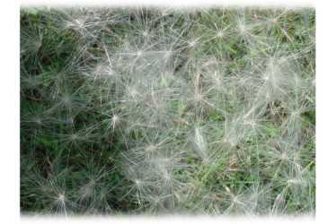
Contacts
Viktoria: Viktoria.Goddard@Liverpool.ac.uk
Dominic: Dominic.Johnson@Liverpool.ac.uk

