Slide 1
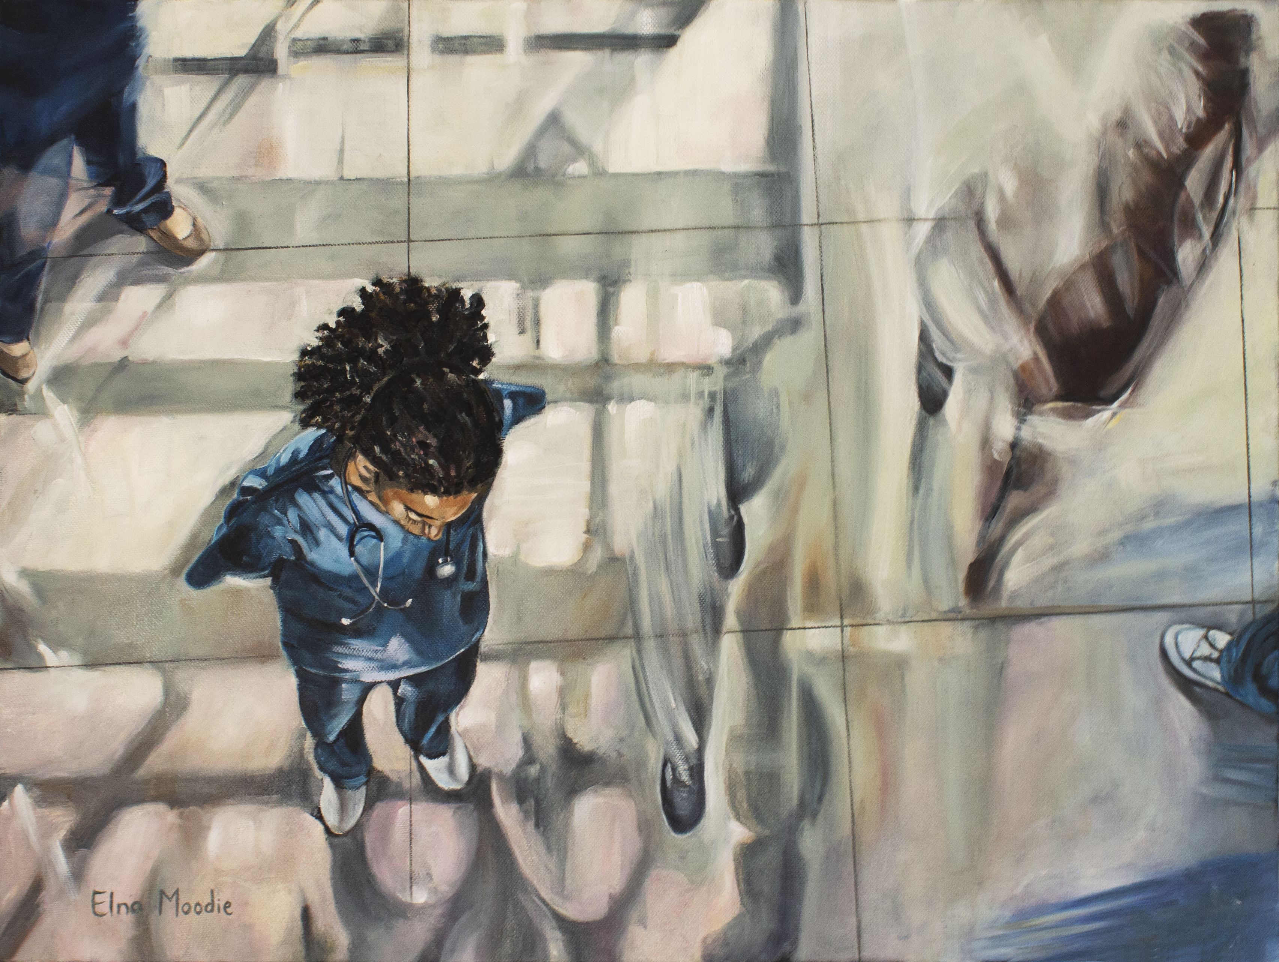



Reflecting on the emotional impact of working in healthcare: Student Schwartz Rounds and interprofessional education
Laura Golding, Viktoria Goddard & Victoria Grimbly

Slide 2
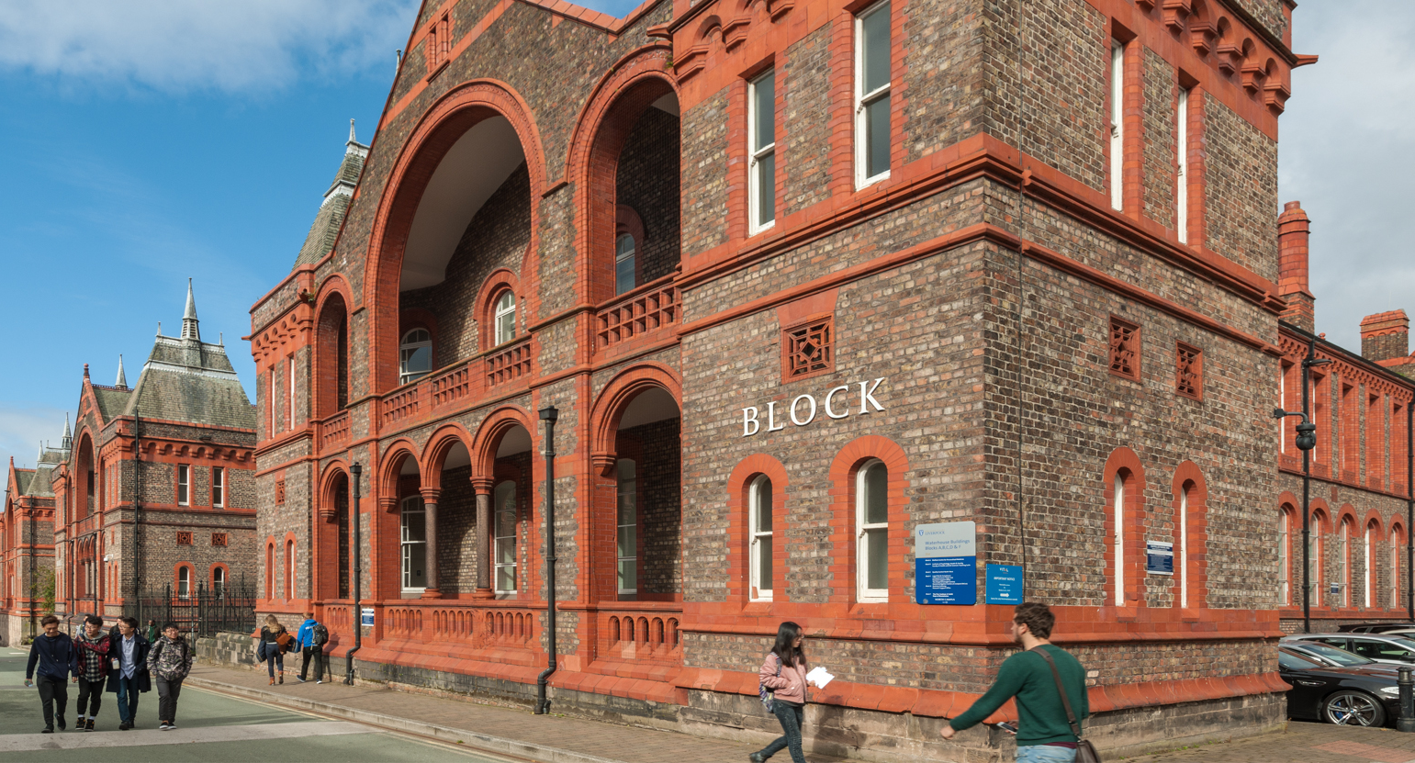

Dr Anthony Baynham, MBBS MRCPsych, Clinical Medical Education Fellow, School of Medicine
Professor Mark Gabbay, MD FRCGP, Prof of General Practice, HoD HSR, Director NIHR CLAHRC NWC
Professor Viktoria Goddard, Vice-Dean, Learning and Scholarship, School of Medicine and Director of Studies, MBChB Programme
Dr Laura Golding, Schwartz Round Project Lead and BPS/DCP/HCPC registered Clinical Psychologist
Mrs Victoria Grimbly, Schwartz Round Project Officer and Programme Manager, Infection Neuroscience Lab
Dr Gundi Kiemle, BPS/DCP/HCPC registered Clinical Psychologist & UKCP registered Psychotherapist, Academic Director & Admissions Tutor, Doctorate in Clinical Psychology
Ms Helen Orton, Academic Lead for Continuing Professional Development, School of Health Sciences
Dr Stuart Oultram, Lecturer in Bioethics, School of Medicine
Team

Slide 3
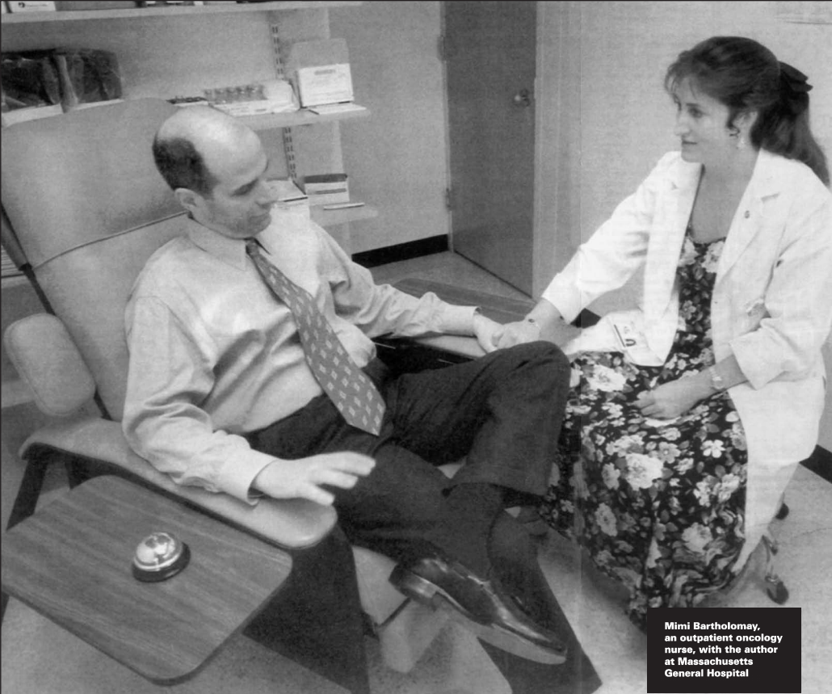
Kenneth Schwartz, a healthcare lawyer, died in 1995 from lung cancer at the age of 41. Before his death, he set up the Schwartz Center (Boston,USA).
The Schwartz Center for Compassionate
Healthcare is a not-for-profit organisation
designed to nurture compassion in healthcare, to encourage healthcare workers to make “the unbearable bearable” through “the smallest acts of kindness” and to strengthen the relationship between patients and their caregivers.
http://www.theschwartzcenter.org/

Slide 4

Schwartz Animation Explainer

Slide 5


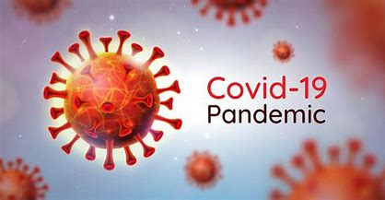


Learning from Success: Our Journey
£££
Schwartz
North: 10
National SR
Project
Schwartz South: 7
Schwartz Midlands: 14

Slide 6










Phase 1 HEIs
Phase 2 HEIs

Slide 7
Phase1 HEIs

Slide 8
Phase 2 HEIs

Slide 9
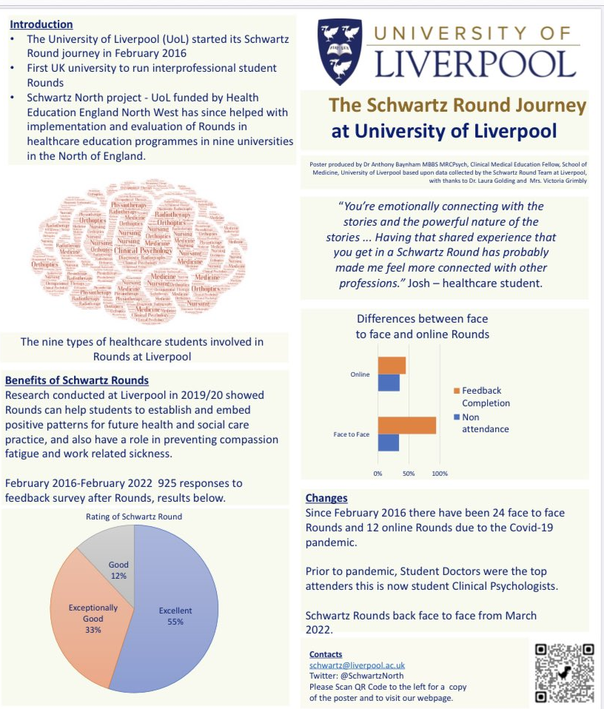
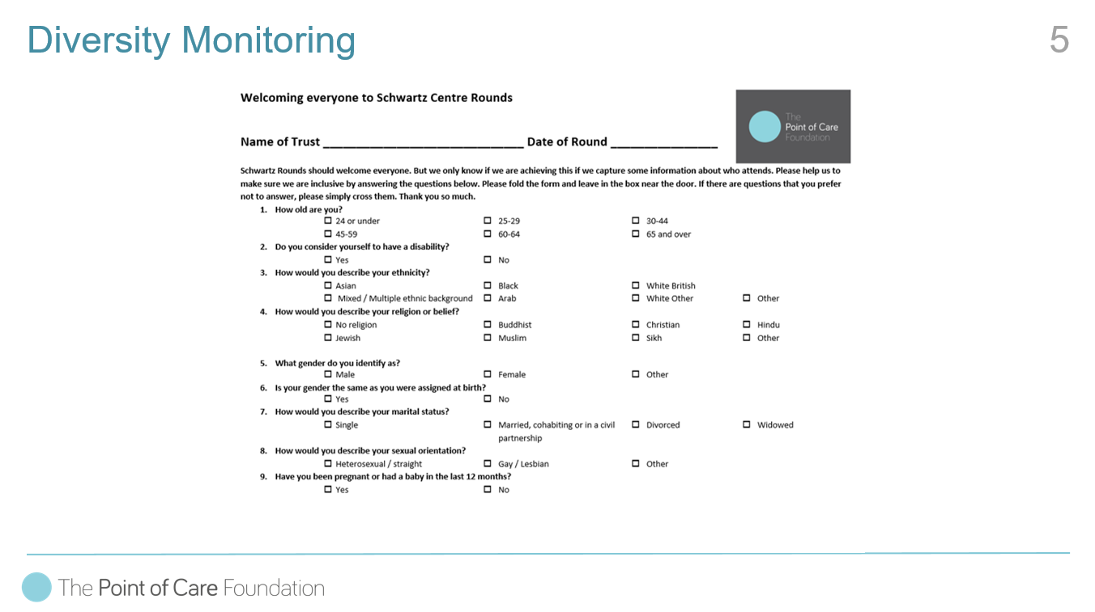
Compassion at the heart of health and social care education: running student Schwartz Rounds in HEIs – Conference March 2022
Schwartz Conference
Diversity Monitoring
https://www.liverpool.ac.uk/population-health/research/groups/schwartz/conference/

Slide 10
Running Student Schwartz Rounds in HEIs
The Point of Care Foundation has been active in supporting Schwartz Rounds in higher education settings since 2015, when University College London Medical School began running Rounds for medical students.
The University of Liverpool followed in 2016 by running interprofessional Rounds for students from nine different healthcare disciplines.
Currently there are 37 universities in the UK running student Schwartz Rounds – mainly for healthcare students, including those training in medicine, dentistry, nursing, occupational therapy, physiotherapy, diagnostic radiography, therapy radiography, clinical psychology, orthoptics, midwifery, social work, dietetics, paramedics and pharmacy.
Schwartz North; Schwartz South; Schwartz Midlands.

Slide 11
Interprofessional Opportunities
As the Rounds are offered across all our professional programmes, Schwartz Rounds are a beacon activity of interprofessional opportunity
Schwartz Rounds offer healthcare students new opportunities to meet with students and staff from other professional groups - important for socialisation and identity development. Example of a 'disorienting dilemma'? (Brown et al 2022)
Students hearing their feelings are 'normal' or 'usual' for members of all professions is incredibly powerful; a lot of discussion focuses on how that removes feelings of imposter syndrome
Ref: Brown, M.E.L., Lim, J.H., Horsburgh, J. et al. Identity Development in Disorientating Times: the Experiences of Medical Students During COVID-19. Med.Sci.Educ. 32, 995–1004 (2022). https://doi.org/10.1007/s40670-022-01592-z

Slide 12
“I found the Schwartz round really moving. It allowed me to reflect on things that I haven’t before, and think about how sometimes, patients don’t need you to have all the answers and tick all the boxes, they just need you to be human and there with them through their healthcare journey.”
“This was my first Schwartz round and although I didn't actively speak up, I feel like I have gained a lot through reflection.”
“Thank you for allowing such an emotional but insightful discussion. During the current climate, it has brought home how everything we do for patients is invaluable and how together, our multidisciplinary working helps patients.”

Slide 13
Used as an example of good practice in GMC Annual Monitoring return
Interprofessional nature led to recognition in terms of University awards
Ultimately a large part of the case for funding new Schwartz Rounds projects
Interprofessional Opportunities

Slide 14
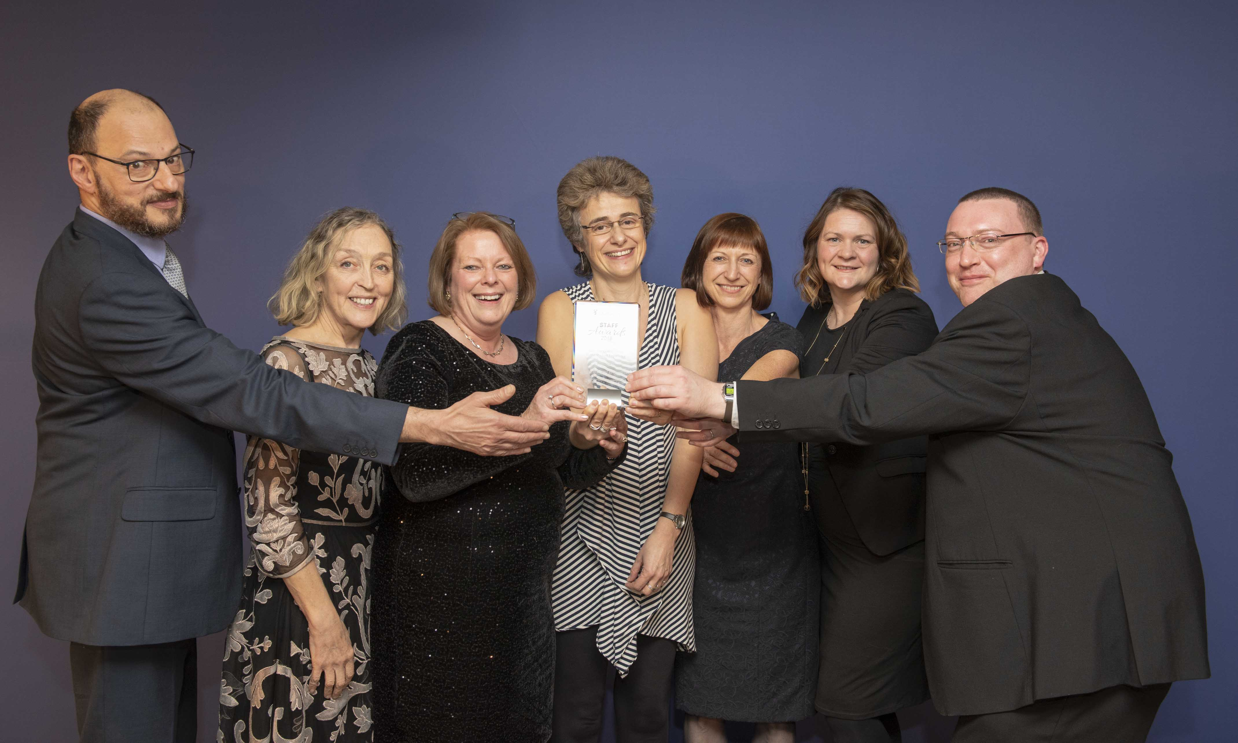
University of Liverpool Staff Team Award
Greatest Contribution to Student Experience 2018

Slide 15
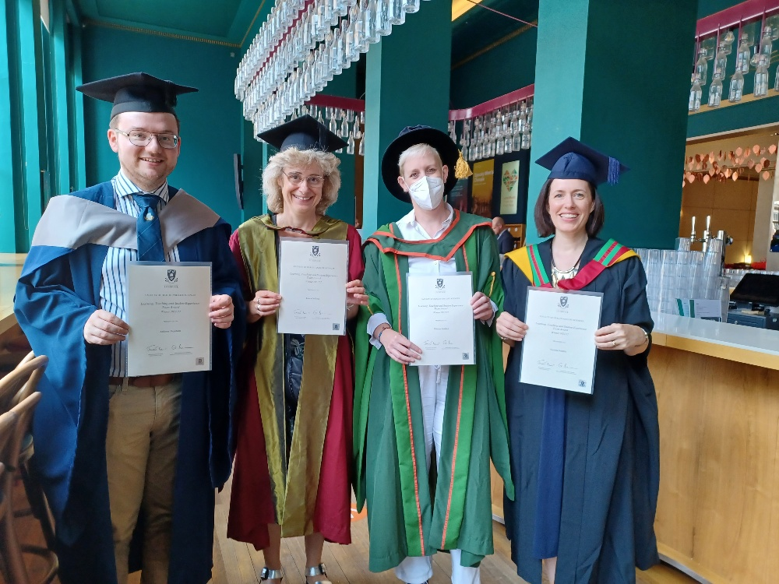
University of Liverpool Staff Team Award
Learning, Teaching & Student Experience 2022

Slide 16
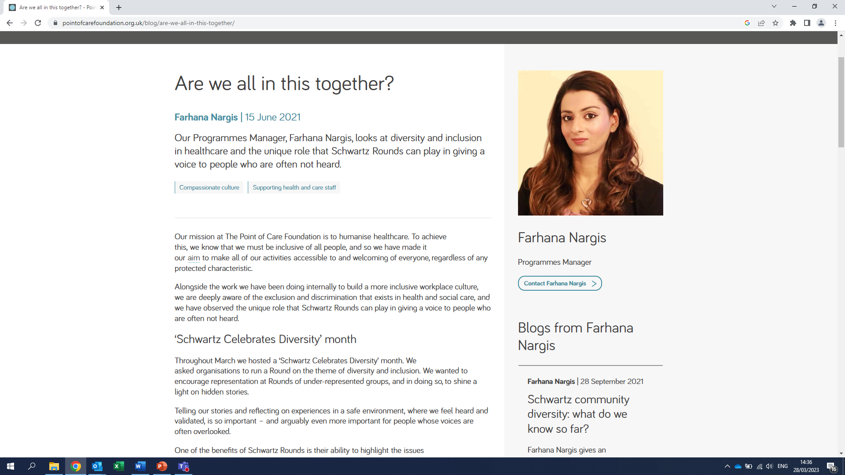
Equality, Diversity & Inclusion & Schwartz Rounds

Slide 17
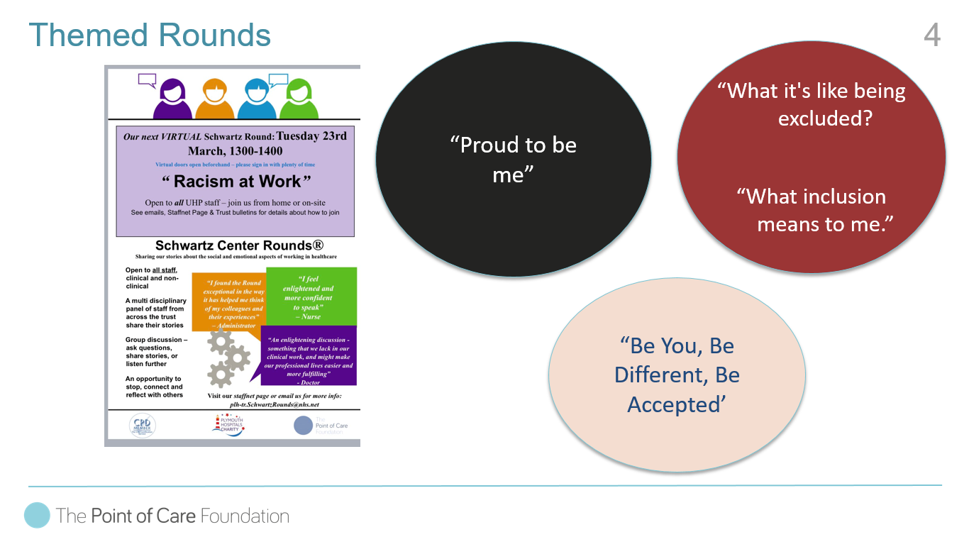
Themed Rounds

Slide 18
Diversity Monitoring

Slide 19

Thank You

Slide 20

Contact
Laura Golding
Viktoria Goddard
Victoria Grimbly
@SchwartzUoL
@goldingeagles
l.golding@liverpool.ac.uk
lauragolding@pointofcarefoundation.org.uk
Viktoria.Goddard@liverpool.ac.uk
grimblyv@liverpool.ac.uk

