Slide 1
Supporting student wellbeing and engagement through sensory modulation
Becky Matson and Jo Linforth
Occupational Therapy Lecturers
@OTLiverpool
#TLConf23
Notes:
Jo

Slide 2
How do you get yourself conference ready?
Notes:
Jo

Slide 3
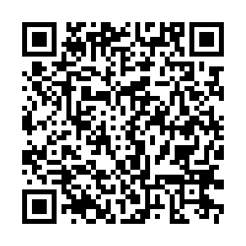
How are you doing?
Notes:
Jo

Slide 4
Take your pick…
Notes:
Jo

Slide 5
Occupational Therapy – focussing on doing
Notes:
Jo

Slide 6
Student Wellbeing and Engagement
When we are in too high or too low a state of arousal cognitive strategies become too difficult to initiate and are often ineffective
We need to first be able to manage our arousal levels so that we can think clearly and engage with those around us
(Collins, 2019; Porges, 2022)
Notes:
Me – when we are highly stressed or in a low state of arousal cognitive strategies become very difficult to access. Sensory approaches use what is known as a bottom up approach to support regulation and get us to the point where we can think more clearly and interact. Think about when you’re highly stressed and someone tries to reason with you or tells you to relax or calm down. And how often that can just make someone more agitated.

Slide 7
Sensory challenges and a HE environment
Notes:
Our students have moved to completely new environments at university where they are most likely living with a whole range of people with different habits and preferences to them, learning to navigate a new environment and become accustomed to new sounds, smells, sights and people. This video is focused on someone with autism but is helpful in considering the impact sensory stimulus that is outside of your control can have, especially if you are already feeling anxious or stressed.

Slide 8
Sensory modulation entails the use of sensory inputs provided through equipment, activities or the environment to regulate physiological responses in order to support self-management (Hollands et al 2015) and has been identified as foundational to a number of higher level processes including attention, regulation, affect and activity (Bundy & Lane, 2020).
Notes:
So what is sensory modulation? When referred to as a therapeutic approach it entails using equipment, activities or the environment to provide sensory inputs that support regulation. Achieving this is what enables us to better focus and engage.
When considering sensory modulation we are considering not just the five commonly acknowledged senses but also the movement senses or proprioception and vestibular input.

Slide 9
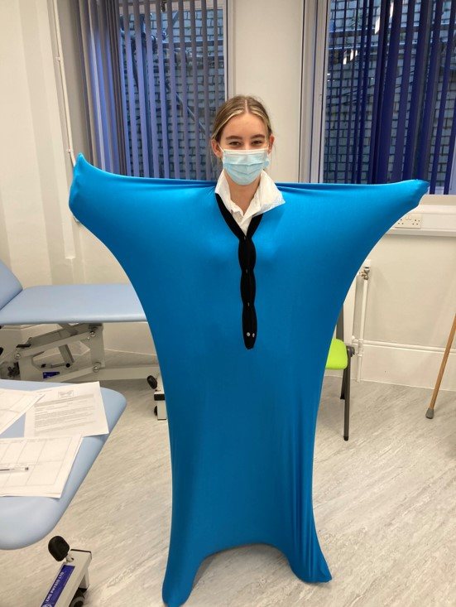
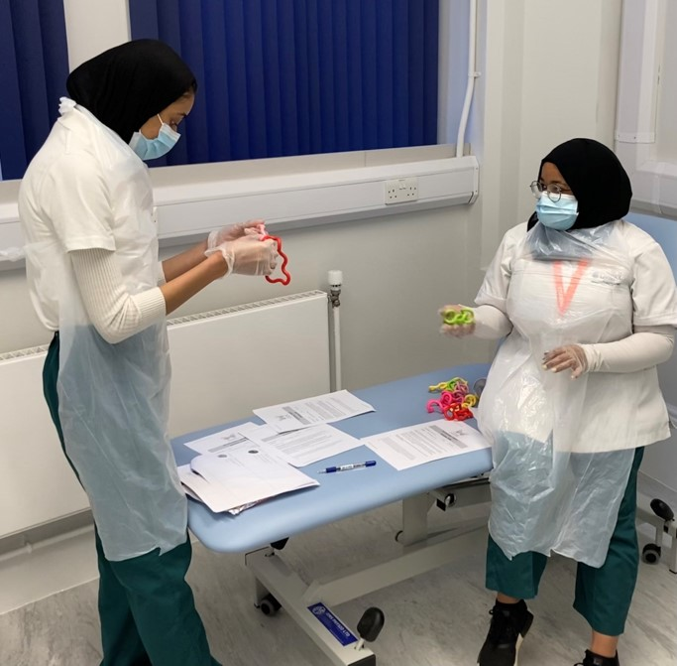
So what did we do?

Slide 10
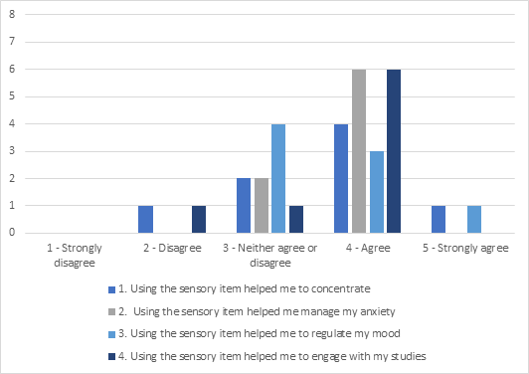
So what did we find?

Slide 11
Over to you…
On your tables, first share your areas of work
Then discuss the following questions:
What sensory challenges might your students face when coming to university?
What impacts might these have on your students?
How could you use sensory-based strategies in your areas of work?
What are you going to take away from this discussion?
Please add the outcomes of your discussion to the Padlet

Slide 12
rebecca.matson@liverpool.ac.uk j.Linforth@liverpool.ac.uk or on connect on twitter @OTLiverpool

