Slide 1
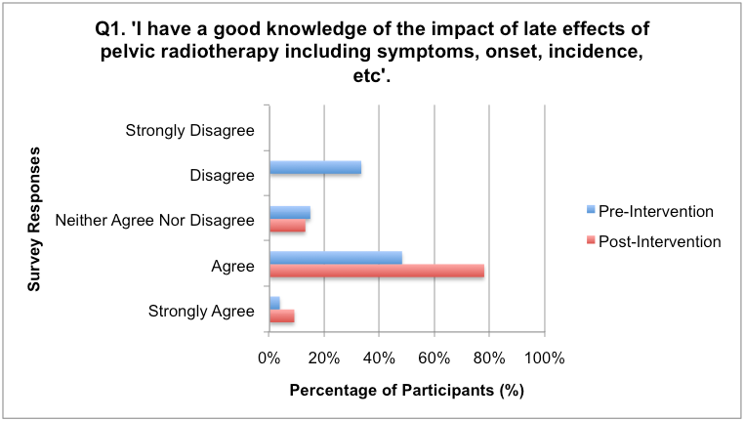
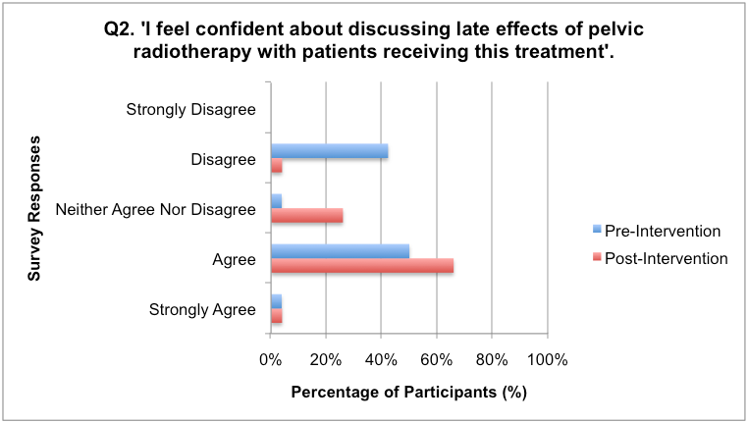
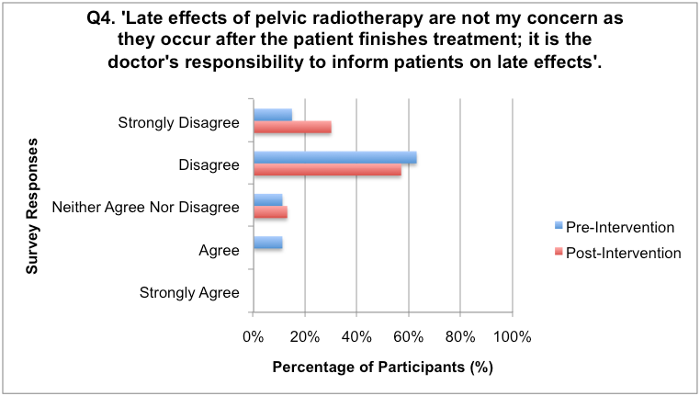
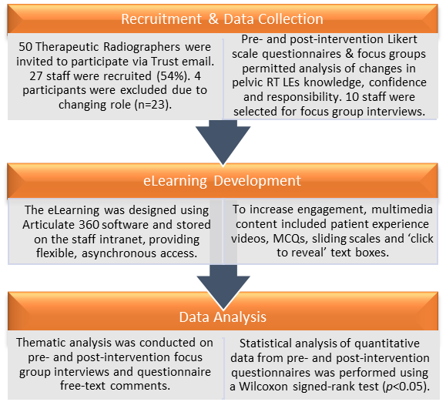
Development of a novel eLearning tool to improve Therapeutic Radiographers’ knowledge and awareness of pelvic radiotherapy late effects
Lauren Oliver MSc, Bridget Porritt MSc & Mike Kirby PhD School of Health Sciences, University of Liverpool
INTRODUCTION
RESULTS
CONCLUSIONS
The late effects (LEs) of pelvic radiotherapy (RT) significantly impact patient quality of life, with 50% of patients estimated to develop chronic gastrointestinal symptoms that present up to 30 years post-RT¹. Such LEs are frequently underreported and misdiagnosed due to a lack of patient/professional awareness¹.
A national drive aims to improve aftercare through enhanced RT LEs information². Despite this, many healthcare professionals including Therapeutic Radiographers refrain from providing LEs information due to a reported lack of knowledge and responsibility, highlighting a demand for further training³.
Therapeutic Radiographers hold a unique role for providing such information, due to the rapport built with patients during treatment. Barriers to training exist within busy RT centres, thus eLearning provides a flexible, robust training method⁴.
This study aimed to investigate the effectiveness of a novel eLearning tool to increase Therapeutic Radiographers’ knowledge, confidence and perceptions of responsibility surrounding pelvic RT LEs information provision.
Quantitative Results
The novel, interactive eLearning tool developed for this study proved successful in achieving the study aims: increasing Therapeutic Radiographers’ knowledge/awareness and professional responsibility in providing pelvic RT LEs information to patients. Whilst participants also reported increased confidence in discussing LEs after the eLearning, further training using ‘blended’ pedagogical approaches may be required to achieve longstanding improvements.
The eLearning developed here has since been disseminated to all NHS hospitals within the regional Cancer Alliance, including at a new specialist RT LEs clinic. This has enhanced pelvic RT LEs knowledge across the wider oncology multidisciplinary team (MDT), including consultants, nurses, physicists and dosimetrists. Our study also demonstrates the potential to develop similar robust, asynchronous eLearning tools across other healthcare disciplines within the wider MDT, overcoming barriers within busy clinical settings.
Limitations of the study included a small sample size within a single RT centre due to time constraints, lack of a control group and participant subjectivity. In future multi-centre audits, a larger sample size will increase study validity.
Statistically significant differences (p<0.05) were observed between pre- and post-intervention questionnaire responses for 8 out of 9 questions, demonstrating the effectiveness of the eLearning in changing staff perceptions around pelvic RT LEs.
Post-intervention, participants reported statistically significant increases in levels of LEs knowledge and confidence in discussing these with patients, and as a result had an increased perception of their professional responsibility to provide LEs information (figures 1-3).
Figure 1. Pre- and post-intervention responses relating to knowledge of RT LEs
Figure 2. Pre- and post-intervention responses relating to confidence in discussing RT LEs with patients
METHODS
This mixed-methods study was undertaken within a single RT institution over a 12-month period.
Future Development
Further dissemination of the eLearning across all UK Cancer Alliances is underway, to enhance RT LEs awareness for oncology professionals and to audit the tool nationally.
Work is currently underway to incorporate the tool onto the Health Education England eLearning for Health platform.
Figure 3. Pre- and post-intervention responses relating to perceived responsibility to provide LEs information
Outputs
Qualitative Results
The findings of this study have been disseminated through international conference and journal publications, including at ESTRO 2021⁵, the BIR Annual Radiotherapy & Oncology Conference and in the BJRO Journal⁶.
Five themes were derived from thematic analysis of pre- and post-intervention focus groups and free-text questionnaire responses. One response from each theme is provided below:
KNOWLEDGE/CONFIDENCE
“I mention it more at the end of treatment now. The eLearning has definitely made me more aware about telling patients”
CONSENT
“It should be part of a patient’s informed consent…we’ve got a duty to remind them, but they should get to us on day 1 and have had all of the information”
PROFESSIONAL RESPONSIBILITY
“I previously thought…’they should have been told by the Doctor’. Now, as I feel more confident, there’s no reason we can’t tell patients too”
GAPS WITHIN PRACTICE
“We focus on short-term side effects…no one ever talks about ‘actually, these side effects are a risk later down the line’”
TIME/SPACE
“If you had an official sit-down last day chat like you do on the first day, you’d have time to go through the late effects information with the summary too”
ACKNOWLEDGEMENTS
The authors wish to thank Liam Kind at Lancashire Teaching Hospitals NHS Foundation Trust (LTHTR) for his support and expertise in developing the eLearning tool.
We also extend many thanks and appreciation to LTHTR for funding towards this work, and to all staff within the Radiotherapy department for their participation in this study.
References
Dalsania RM, Shah KP, Stotsky-Himelfarb E, Hoffe S, Willingham FF. Am Soc Clin Oncol Educ Book. 2021; 41: 147-57.
National Cancer Survivorship Initiative (NCSI).Living with & beyond cancer: taking action to improve outcomes. 2013.
Griffiths D, Hodgson DA. J Radiother Pract 2011; 10: 215–27.
4. Childs S, Blenkinsopp E, Hall A, Walton G. Health Info Libr J 2005; 22 Suppl 2: 20–32
5. Kirby M, Oliver L, Kind L, Porritt B. Radiother Oncol 2021; 161 (S1):S227-S228
6. Oliver L, Porritt B, Kirby M. BJR Open. 2021; 3: 20210036
For any questions relating to this work please contact:
l.oliver@liverpool.ac.uk
@PRDResearch on Twitter
t

