Slide 1
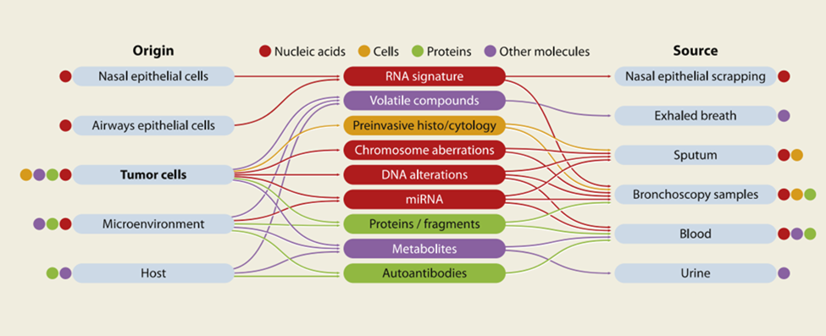
Notes:
Figure 1

Slide 2
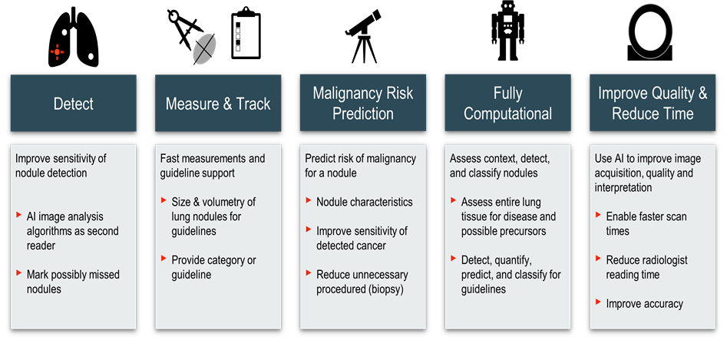
Notes:
Figure 2

Slide 3
Integration of artificial intelligence and biomarkers to increase the prediction of malignancy in suspicious CT screen-detected lesions
IASLC
CT Screening Five Year Road Map
2023
2027
Identify individuals who have never smoked but are at high risk of developing lung cancer
Standardised high-quality performance AI protocols, that leads to substantial reductions in costs and radiology reporting time.
Establish universal screening program quality indicators
Publicly accessible, easy to use, geospatial tool
Personalize CT screening interval, based on an individual’s CT lung cancer risk.
Recommendations for incidentally detected lung nodule tracking
Evidence to support clinical and cost effectiveness for the identification of additional findings on a lung cancer screening CT.
Establish a global shared education resource of lung cancer screening CT to ensure high quality reading and reporting
Establish universal screening program quality indicators

