Slide 1


PICTURE THIS: EVALUATING HEALTHCARE EDUCATION USING STUDENT GENERATED PICTORIAL DATA
Cath Gordon DCR(T) PgCert MA SFHEA
Cathy Fletcher RN MA (LTHE) SFHEA
Notes:
Good morning
Again, the short title and the full title ;
PICTURE THIS: EVALUATING HEALTHCARE EDUCATION USING STUDENT GENERATED PICTORIAL DATA

Slide 2
Background
Attrition rates for radiotherapy programmes has been historically higher than other healthcare programmes at 24.52%, (Society of Radiographers, 2020)
Nursing programmes historically have had attrition rates as low as 1.6% (Clover, 2011) however….
‘’Data collected by an independent charity, the Health Foundation, has highlighted that in 2018 the attrition rate for nursing students stood at a whopping 24%’’ (The Nursing Times,2023).
Notes:
To recap. This project came about by discussion of the potential reasons for attrition from both programmes.
Needed to explore why on radiotherapy programme 18 year olds come into contact with patients with life changing conditions (Cancer). Has this a bearing on their leaving the programme?
Their experiences are no different from other healthcare programmes such as diagnostic radiography and nursing. Both of these students come into contact with pts who are seriously ill.
We know that attrition is multifactorial- money, life, family- some that we can control or support but much we cannot do anything about. For both our programmes we wanted to know if our students come with realistic expectations as this is something we could do something about. (Recruitment and interview process)
Attrition rates for healthcare programmes coming under the microscope (Bowden, 2008; College of Radiographers, 2012; Beardmore, 2013)
Attrition can impact upon both workforce planning and ultimately patient care (Hamshire et al., 2012).
This is a further element of the same project…

Slide 3
Context
Questionnaires - have never given enough information to explain high attrition rates
  ‘there is much room for innovation and creativity in the research process’ (Deacon, 2006, p.97)
  Pictures - asking for a picture was a means of collecting students thoughts
  ‘the use of visual and creative methods can generally facilitate investigating layers of experience that cannot easily be put into words’ (Gauntlett, 2007, cited in Bagnoli, (2012,p. 210)
Notes:
In addition to the traditional questions asked on the questionnaires…
Why we asked for pictures?
Questions may be based on assumptions
Asking for a picture was a means of collecting any additional students thoughts
A blank page to give the opportunity to express thoughts and ideas not previously anticipated
Deacon (2000) then asserts that ‘researchers need to find methods that can encapsulate the multi-dimensionality of the human experience’ and quotes Piercy & Thomas (1999) noting the benefits of ‘attempting to reduce the level of the researcher-participant hierarchy and create partnerships between all those involved in the research’.
Deacon (2000) quotes Patton (1997) as stating that ‘In many cases and for many people, research has become routinized to the point that it involves "standard procedures" and believes that ‘there is much room for innovation and creativity in the research process.’

Slide 4
Themes from text (from thematic analysis)
Support
Supportive staff
Communication
Confidence
Greater confidence in clinical skills
Hands on care
They felt prepared for practice
Academic support vital
mentor/educator generally very supportive
Increased confidence in interacting with patients
Feedback from staff and mentors/educators constructive
Use of equipment
Time management/shift work
Greater awareness of career pathway
Support
Approachability of staff
Communication
Confidence
Clinical skills
Hands on care
Preparation for practice
Academic support
Importance of the role of mentor/educator
Interacting with patients
Understandable feedback from staff and mentors/educators
Terminology-use of jargon
Use of equipment
Time management/shift work
Nursing
Radiotherapy

Slide 5
Picture Analysis

Slide 6
What does the literature say about collecting information in picture form?
Non-linguistic methods have been used with children and young people (Gauntlett, 2007, cited in Bagnoli, 2009)
A range of data gathering methods have been used for example art, photography, drama and sculpture (Deacon, 2000)
No clear methodology for the interpretation of drawings
Generally the approach taken included participants narrative in some form
Notes:
Other similar, less popular, sources of data have been used previously such as critical incident diaries for medical students (Karnelieli-Miller et al, 2010) and the life grid (Parry, Thomson and Fowkes, 1999) which allows some guidance in order to improve validity.
This method of data collection is not a ‘tried and tested’ method (Karnelieli-Miller et al, 2010; Parry, Thomson and Fowkes, 1999) .
Images have been used and analysed but no consistent approach………….
Establish text discuss the use of visual images however they talk about them as either artefacts or as a means for individuals to generate discussion.
Need literature to explain the difference between what we are doing and what others have done
Pictures are a stand-alone data (isolation but linked to original themes)
Most of the literature use small numbers of participants we have a larger sample size

Slide 7
Questions
Q1: When you try to visualise your time at University what do you see? To help us to share your vision, please use this page to illustrate, in picture form, your expectations. (Prospective)
Q2: When you try to visualise the first year of the programme what do you see? To help us to share your vision, please use this page to illustrate your vision in picture form. (Retrospective)
Notes:
At the end of each questionnaire, in addition to the more traditional questions we asked..

Slide 8
Our approach
Using an approach that was loosely based on analysing text involving several stages
Initial meetings which recognised the subjective nature of the pictures
Used original themes to guide analysis of pictures
Use of three researchers to mitigate subjective nature of the data
Notes:
Initial themes;
Communication Confidence and Support

Slide 9
What we did
Step 1
Selected sample of ten images from questionnaire one and two from each profession.
Step 2
Three researchers analysed pictures independently using thematic content analysis, original themes available for reference.
Step 3
Researchers met, discussed and agreed areas of alignment and non-alignment from original themes
Step 4
The data were discussed. Agreement of interpretation - data included. Where agreement not reached data excluded from the analysis
Step 5
Mature the themes and draw conclusions

Slide 10
To illustrate our process…………

Slide 11
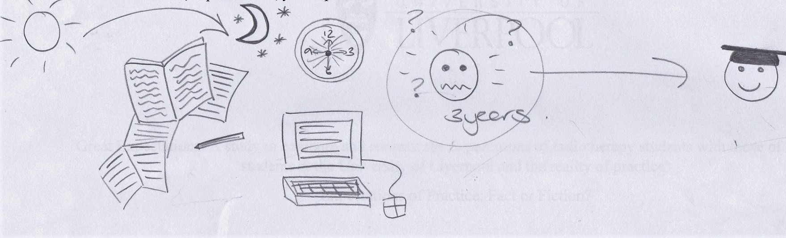
Consensus-Analysis
Radiotherapy RT1 09 (first questionnaire)
Notes:
Centre picture suggests they are unsure if they will achieve the end goal of graduating as the graduation picture is set apart from the other images used.
Initial image would suggest this person feels that they need to work on their academic assignments etc. all day and night.

Slide 12
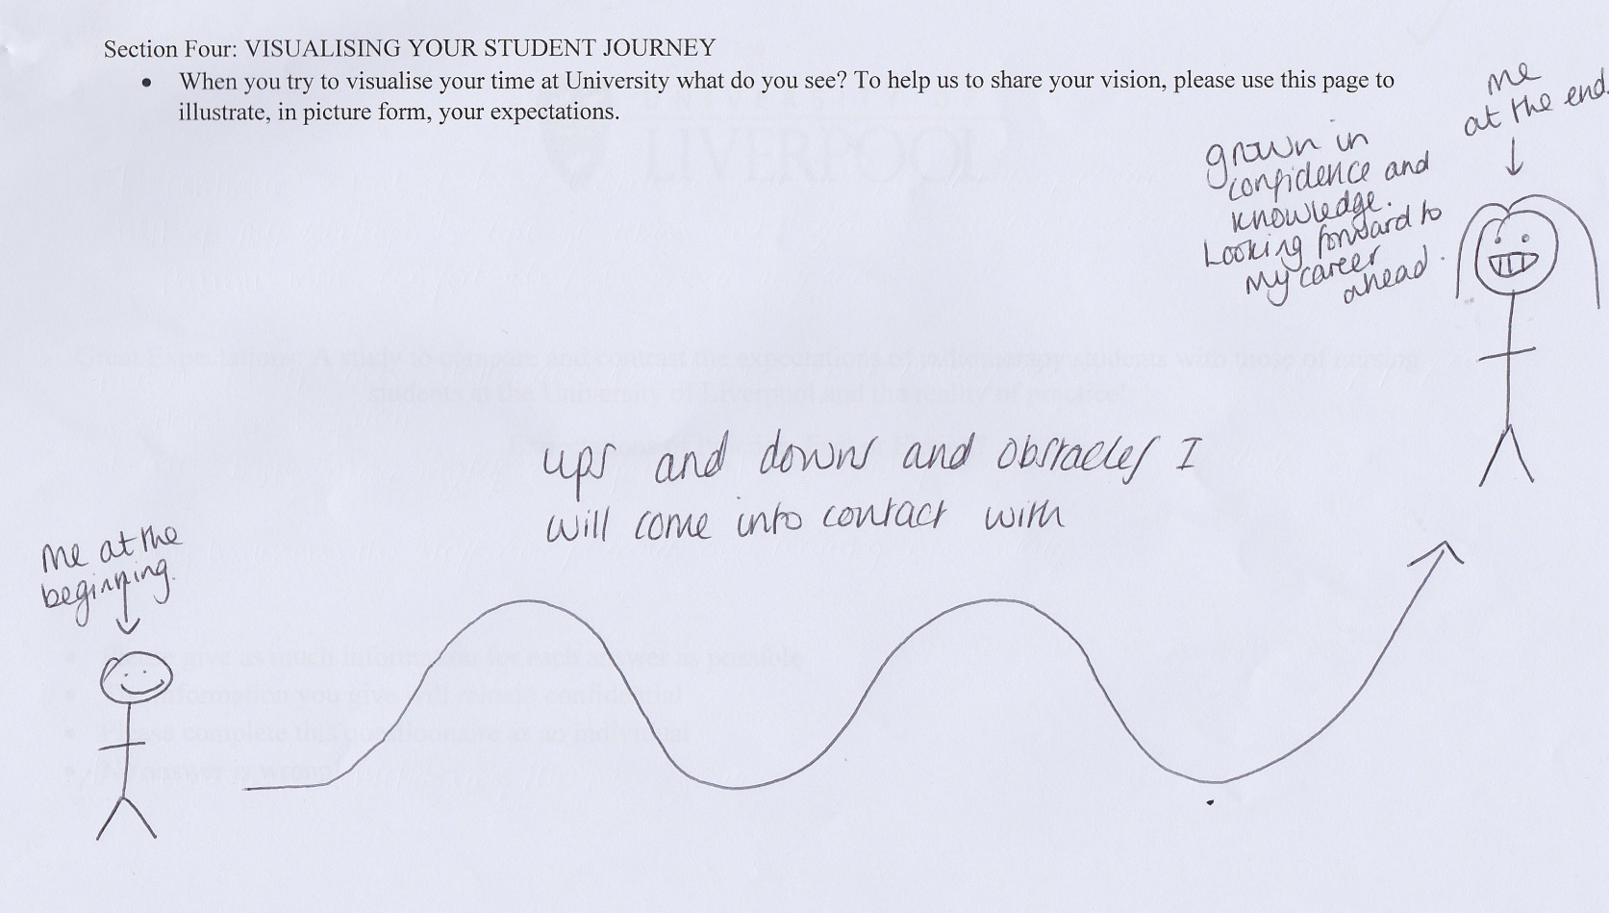
Consensus-Analysis
Nursing N1 08 (first questionnaire)
Notes:
Centre picture suggests they are unsure if they will achieve the end goal of graduating as th4e graduation picture is set apart from the other images used.
Initial image would suggest this person feels that they need to work on their academic assignments etc. all day and night.

Slide 13
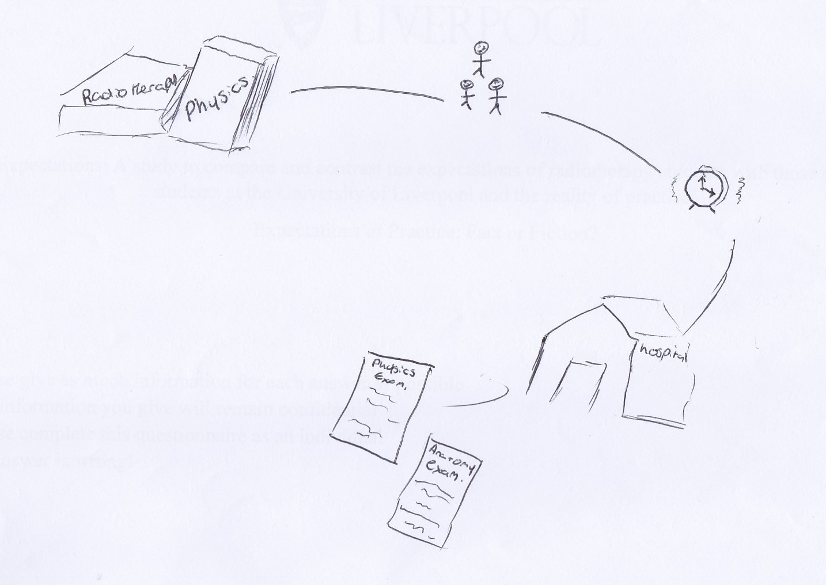
Analysis-interpretation challenges
Radiotherapy RT 1 18 (first questionnaire)
Notes:
The images mention ‘physics’ twice which could suggest that this person is lacking confidence in their abilities in this area.
Images suggest a journey which included academic work and placement but does include any image related to socialising. This could suggest that this person may not have a good work/life balance.

Slide 14
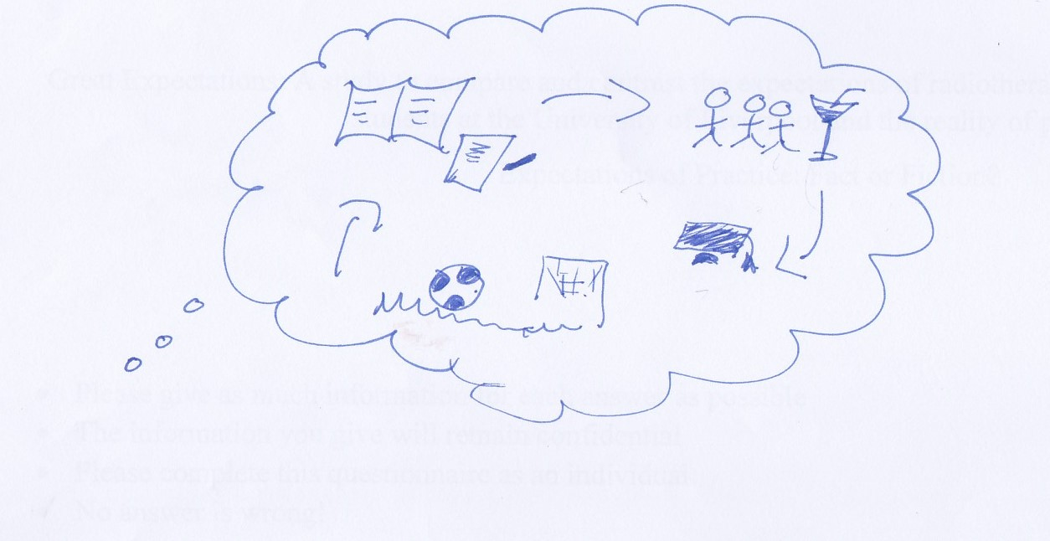
Analysis-interpretation challenges
Radiotherapy RT 1 08 (first questionnaire)
Notes:
Size of images is consistent potentially suggesting confidence in all steps required to complete programme.
Picture is suggestive of a person who is aware of what is required to complete the programme

Slide 15
How did we reach consensus?
Individually reported our interpretation of each picture
Discussion…. and more discussion….
Agreed to not comment on what was not in the pictures
Took forward what we all agreed on

Slide 16
Initial interpretations
Questionnaire one
  less detailed pictures and an apparent lack of confidence
Questionnaire two
  more detailed showing an increase in knowledge and confidence

Slide 17
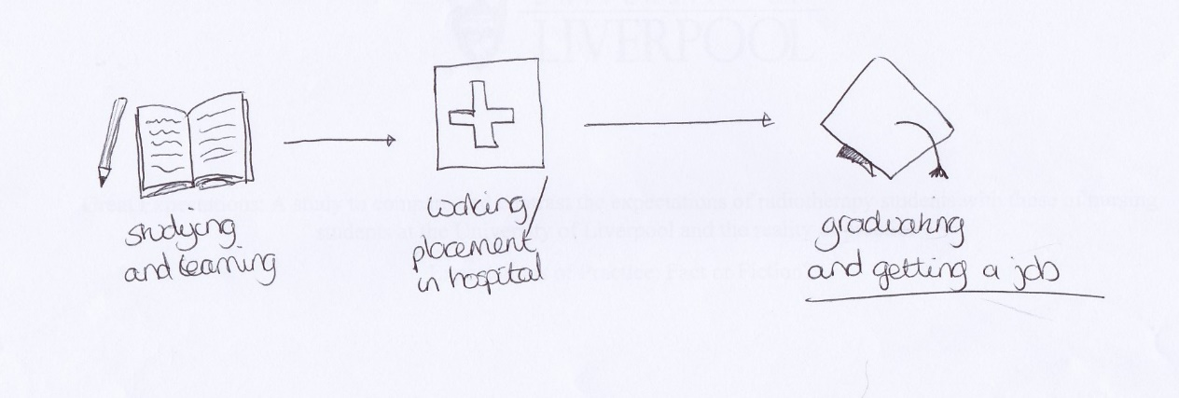
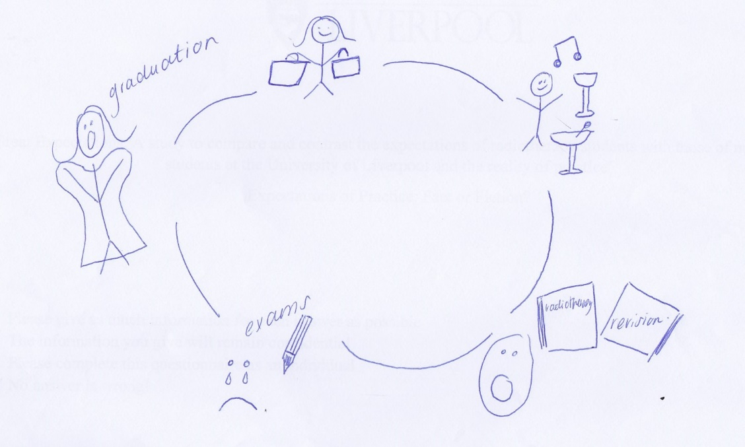
Questionnaire 1
Therapeutic Radiographers
Radiotherapy RT1 15 (first questionnaire)
Radiotherapy RT1 11 (first questionnaire)
Notes:
Simple and straight forward

Slide 18
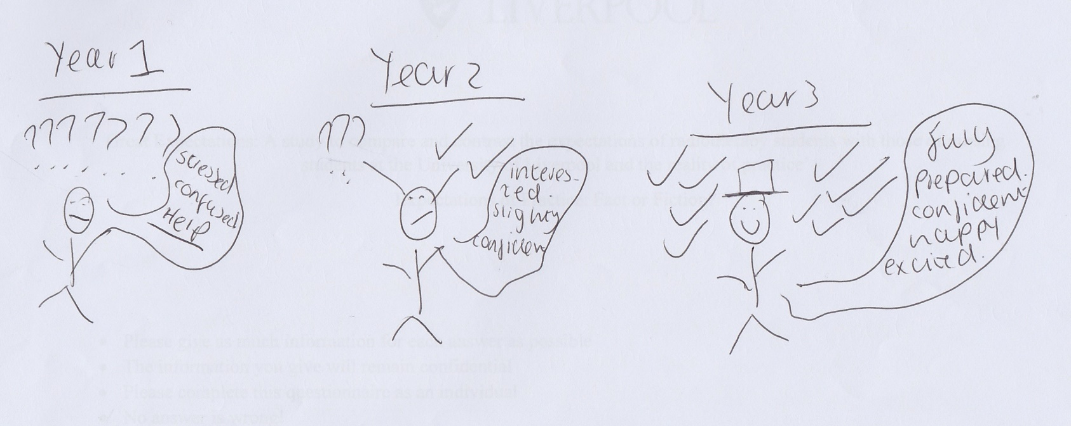
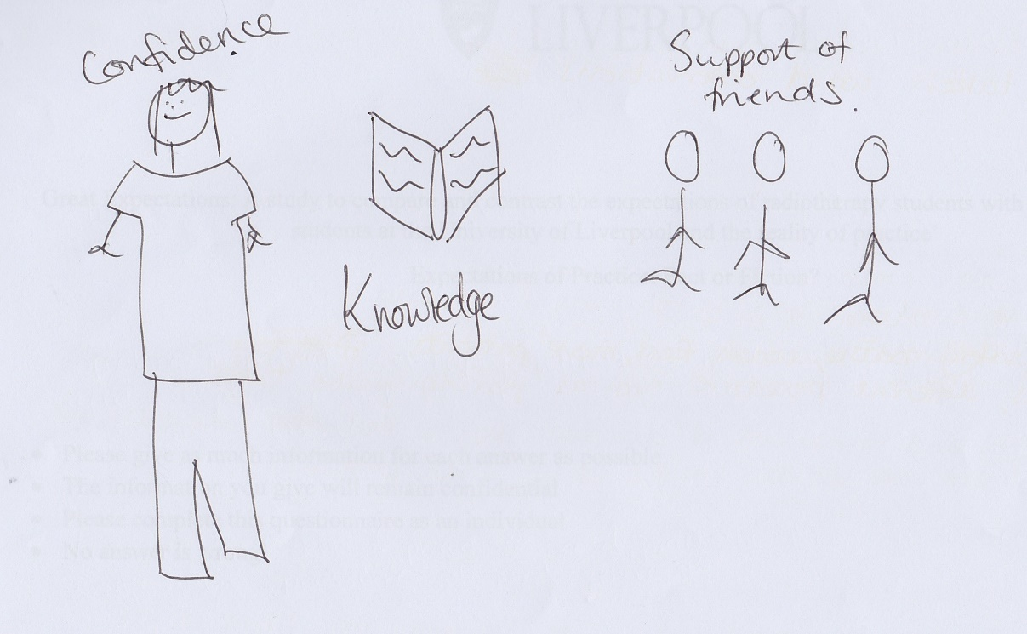
Questionnaire 1
Nursing
Nursing N1 04
(first questionnaire)
Nursing N1 01 (first questionnaire)
Notes:
Simply and straight forward, less detail. Not sure what is ahead of them

Slide 19
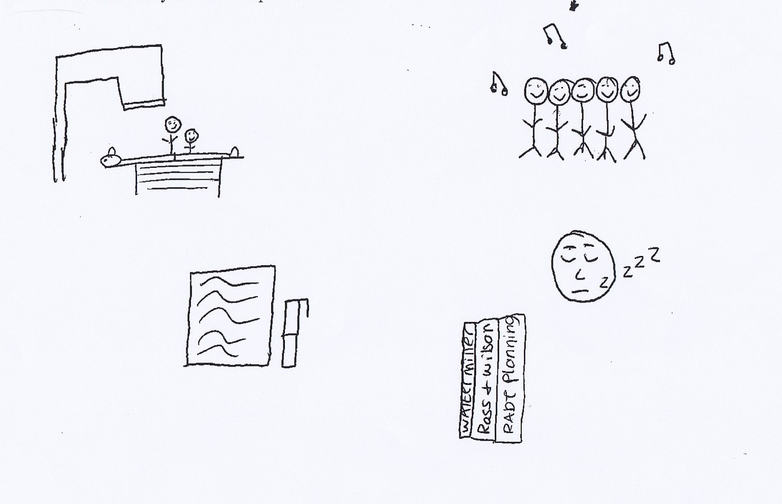
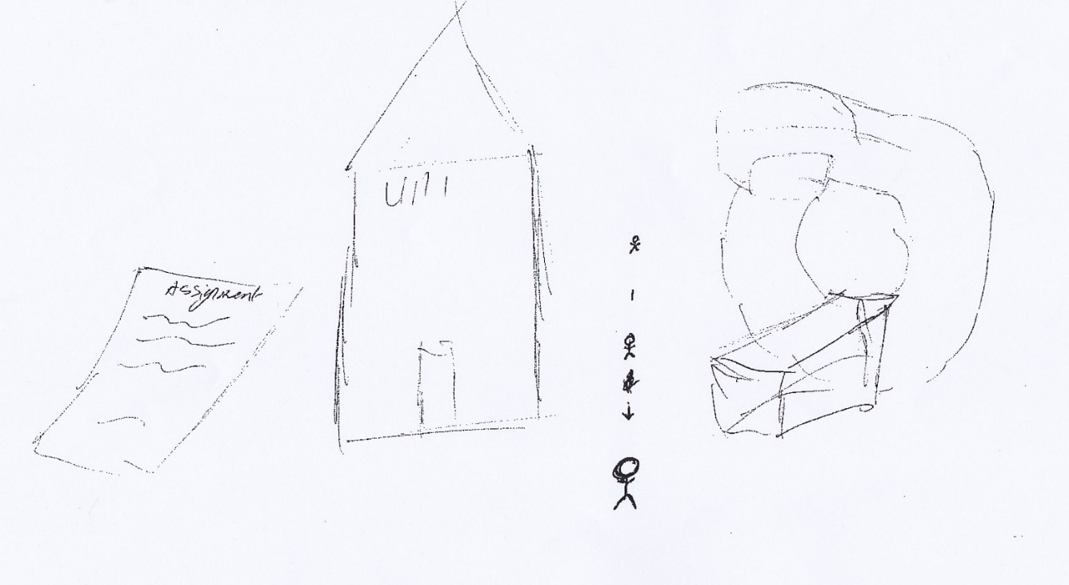
Questionnaire 2
Therapeutic Radiographers
Radiotherapy RT2 18 (second questionnaire)
Radiotherapy RT2 19 (second questionnaire)
Notes:
Equipment stress this

Slide 20
Maturing of Themes…………

Slide 21
Nursing Emergent Themes Questionnaire 1
Confidence
A confidence that they will achieve, graduate and gain clinical skills
A journey
A journey ahead that may be tough, may be an up hill journey
Profession: NURSE
Proud to be a professional nurse
What the journey will contain
Evidence that some expected a lot of work
For some a long way off
Feelings
A range of feelings expressed: stress/anxiety/concern, shyness, fear, ‘help me’
Sleep
Academic work/ Lectures
Social
Placement/ clinical skills

Slide 22
Nursing pictures Questionnaire 1
NF30

Slide 23
Radiotherapy Emergent Themes Questionnaire 1
Expectation of hard work
…in both University and placement
The future
Looking beyond the programme
Confidence
Variety-some were confident of completing whilst others not at all confident
Work/life balance-recognising importance of work/life balance
Confident of completing
Not confident of completing
Journey
Components of the journey
Social, academic, placement ?sleep
Time pressures
Concern about Exam/revision

Slide 24
Radiotherapy pictures from questionnaire 1
RT109 & RT 111
Notes:
Examples for these themes

Slide 25
Nursing Emergent Themes Questionnaire 2
Overcoming hurdles of year 1
completion of programme
Reality of becoming a nurse
Growth/ Increased confidence
gaining skills and knowledge
Poor work/life balance
Only time for placement, study and sleep
Its hard work
Sleep/tiredness
’Level of happiness/contentment/enthusiasm
Some able to manage workload successfully
Overcoming hurdles of year 1
Completion of year1
No (social) life

Slide 26
Nursing pictures from questionnaire 2

Slide 27
Radiotherapy Emergent Themes Questionnaire 2
Personal Development
High academic workload
,
Workload
This workload is tiring/
exhausting
Work/life balance
Some students are managing a effective work/life balance
Increase in confidence
I have been doing…
studying and placement
Positivity
Increase in knowledge and skills

Slide 28
Radiotherapy pictures from questionnaire 2

Slide 29
Methodology: Initial summary
Found themes from traditional text data
Developed a method of analysing the pictorial data
Identified several themes from both professions

Slide 30
What's next?
Further testing of agreed methodology:
    Different student cohorts
    Link questionnaire 1 to questionnaire 2
    Gather pictures with narrative for comparison.

Slide 31
Thank you for listening
Any questions?
Please contact Cath Gordon cgordon@liverpool.ac.uk
Or Cathy Fletcher c.fletcher@liverpool.ac.uk

Slide 32
References
Bagnoli, A. (2012) ‘Beyond the Standard Interview: The use of graphic elicitation and art-based methods’, in Goodwin, J. (ed.) Bibliographic research: Vol. 4. London: Sage, p. 210.
Deacon, S.A. (2006) Creativity within qualitative research on families: new ideas for old methods in: Emergent Methods in Social Research. Thousand Oaks, CA: Sage.
Clover, B. (2011) Huge fall in nurses dropping out of nursing courses. Available at: https://www.nursingtimes.net/whats-new-in-nursing/news-topics/nursing-education/huge-fall-in-nurses-dropping-out-of-nursing-courses/5035504.article (Accessed: 26 June 2017).
Gauntlett, D. (2007) Creative explorations: New approaches to identities and audiences. London: Routledge.
Jewell S. (2012) Therapeutic Radiography Attrition Update paper. Society and College of Radiographers, 2012.
Merrifield, N. (2015) Review identifies vital need to find out why student nurses drop out. Available at: https://www.nursingtimes.net/roles/nurse-educators/review-identifies-vital-need-to-find-out-why-student-nurses-drop-out/5083209.article (Accessed: 26 June 2017).
Patton, M. Q. (1997) Utilization-focused evaluation. Thousand Oaks, CA: Sage

