Slide 1
Effect of gravity on the dispersion and wave localisation in gyroscopic elastic systems
A.Kandiah, I.S. Jones, N.V. Movchan, A.B. Movchan
Supplementary data

Slide 2
Figure 16
The circular trajectories of an infinite chiral chain for the wave number $k=0$ corresponding to standing waves; the ‘+’ mode is associated with counterclockwise motion of the nodal points and the ‘-’ mode is associated with the clockwise motion of the nodes.

Slide 3
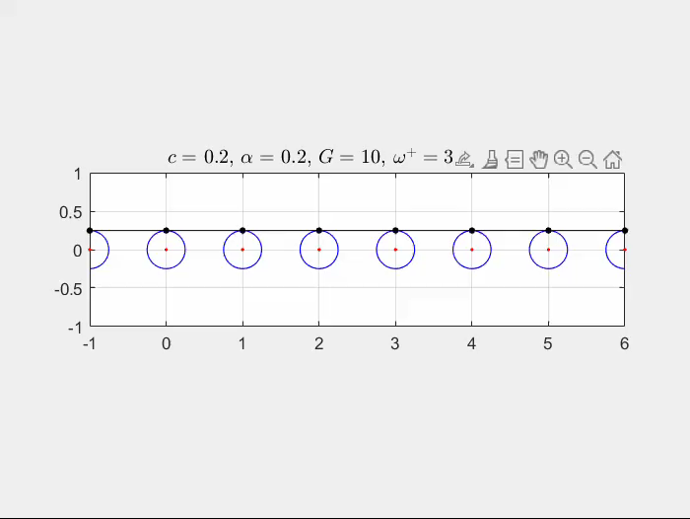
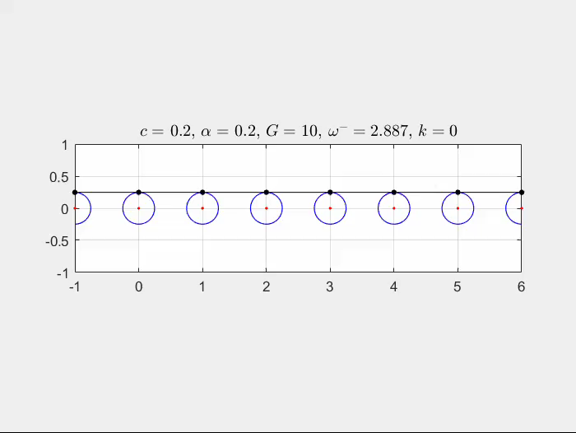


$ω^{+}$ mode
Figure 16
$ω^{−}$ mode

Slide 4
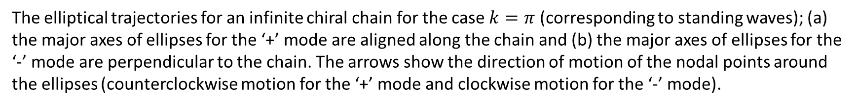
Figure 17
The elliptical trajectories for an infinite chiral chain for the case $k=π$ (corresponding to standing waves); (a) the major axes of ellipses for the ‘+’ mode are aligned along the chain and (b) the major axes of ellipses for the ‘-’ mode are perpendicular to the chain. The arrows show the direction of motion of the nodal points around the ellipses (counterclockwise motion for the ‘+’ mode and clockwise motion for the ‘-’ mode).

Slide 5
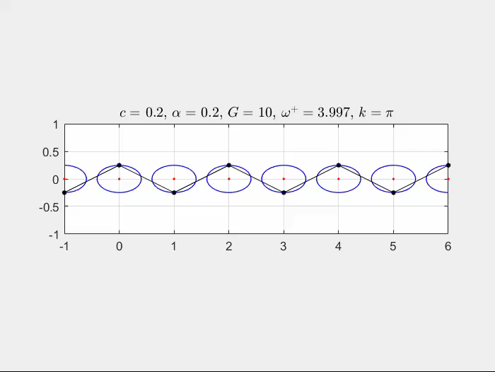
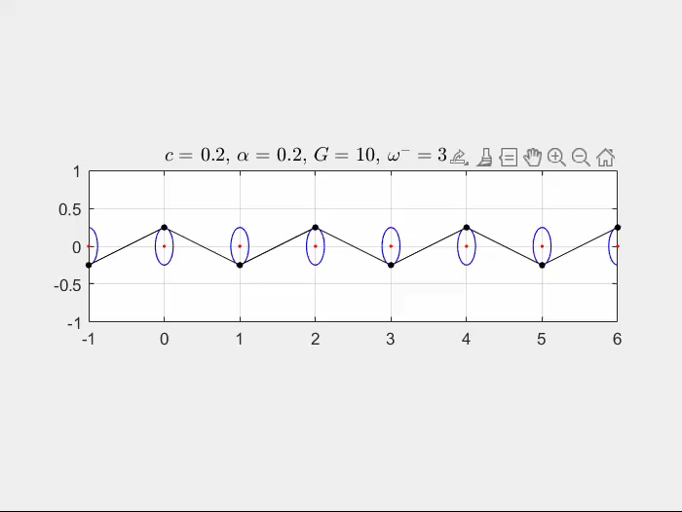
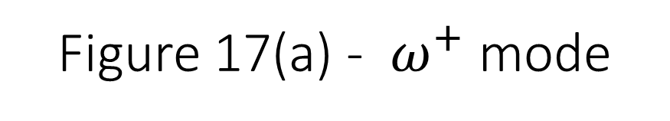
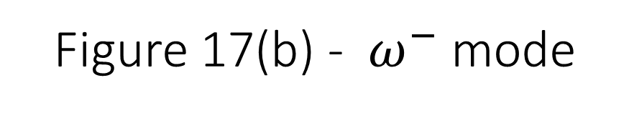
Figure 17(a) - $ω^{+}$ mode
Figure 17(b) - $ω^{−}$ mode

Slide 6
Figure 18
The mode shapes for an infinite chiral chain for $k=π/2$; (a) the ‘+’ mode and (b) the ‘-’ mode. The arrows show the direction of motion of the nodal points around the ellipses (counterclockwise motion for the ‘+’ mode and clockwise motion for the ‘-’ mode).

Slide 7
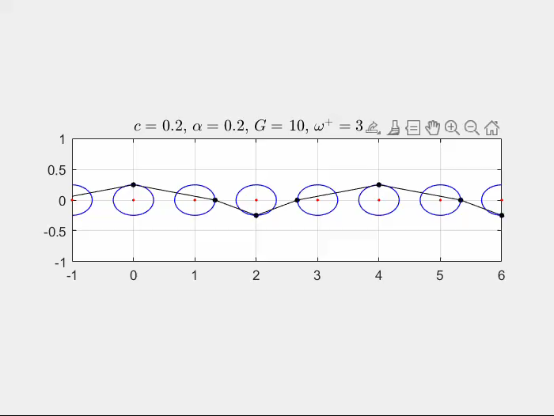
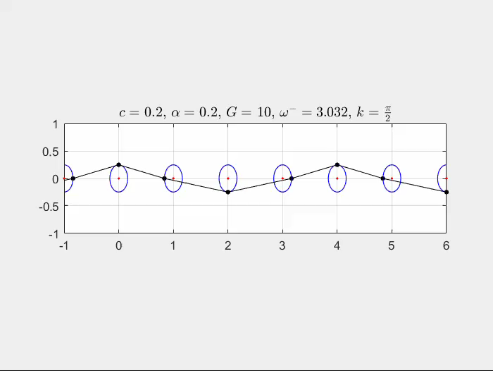
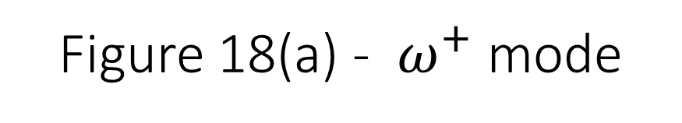
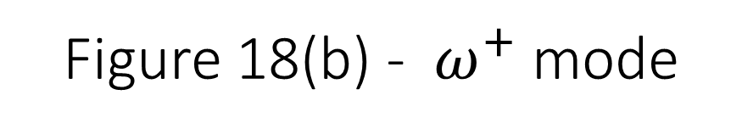
Figure 18(a) - $ω^{+}$ mode
Figure 18(b) - $ω^{+}$ mode

Slide 8
Figure 20
Elliptical trajectories for a chiral chain with $c=0.6$, $α=0.4$ and a range of values of the forcing frequencies associated with the dispersion regions for $G=1$ and $G=3$.

Slide 9
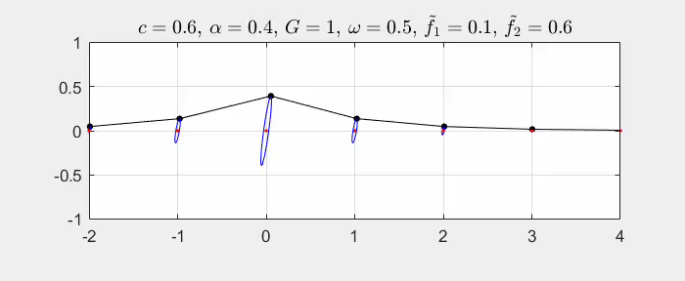
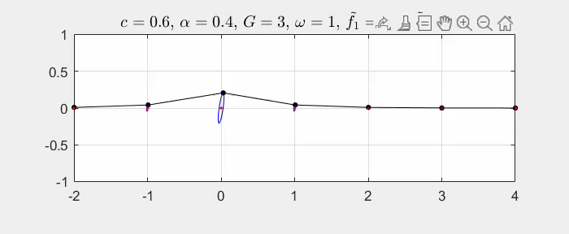
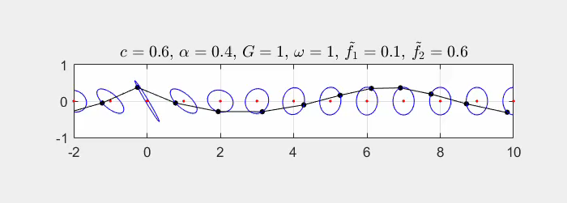
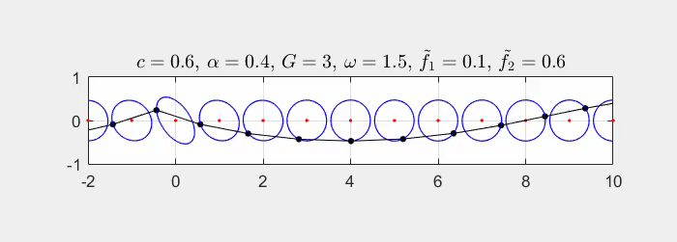


$$G=1$$
$$G=3$$

Slide 10
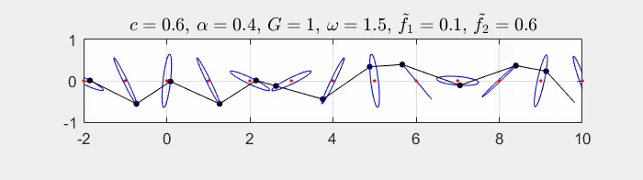
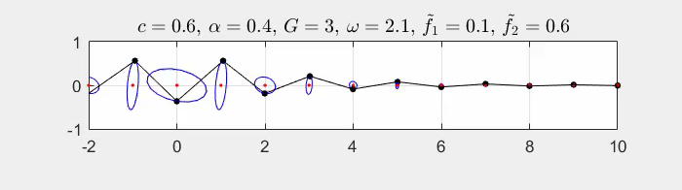
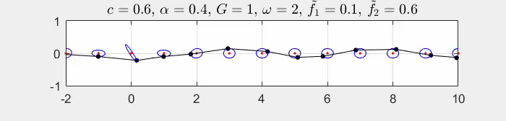
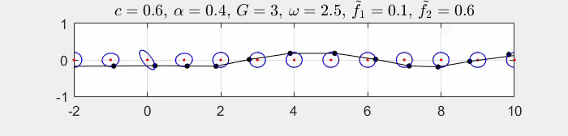
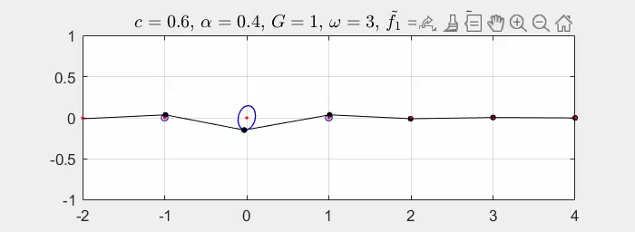
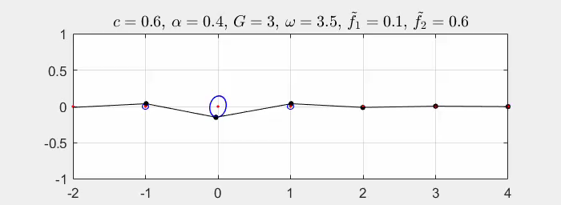


$$G=1$$
$$G=3$$

Slide 11
Figure 23
The trajectories of an infinite chiral chain for $c=0$, $α=0.7$ and $G=1$. (a) $Ω = 1$; (b) $Ω = 11.56$ and $M = −0.706$.

Slide 12
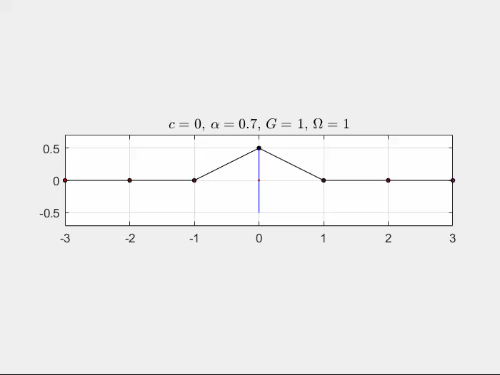
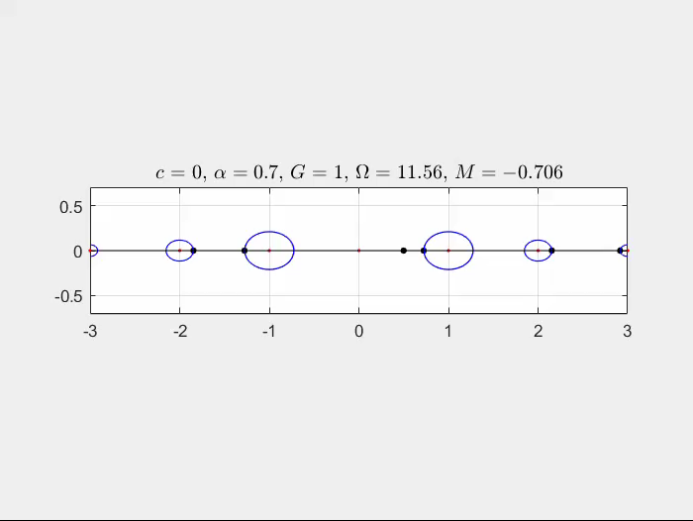
Figure 23(a)
Figure 23(b)

