Slide 1
Dentistry in the UK and Ireland
 | Faculty of Health & Life Sciences
Professor Barry F. A. Quinn
Chair in Restorative Dentistry & Dental Education
Academic Lead/Head of Restorative Dentistry

Slide 2
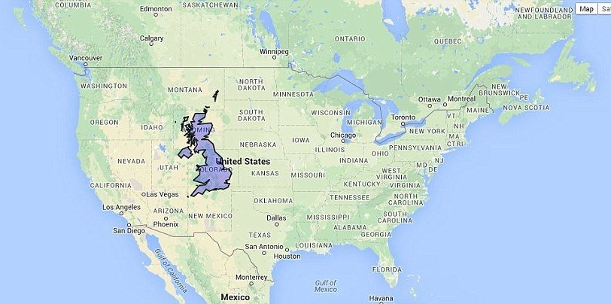
United Kingdom—England, Northern Ireland, Scotland, and Wales
68 million

Slide 3
The National Health Service (NHS) in the United Kingdom is a publicly
funded healthcare system that provides medical services and treatment
to the residents of the UK.
It was established in 1948 and is one of the largest and most comprehensive healthcare systems in the world.
The NHS plays a vital role in providing healthcare services, and its
principles are based on the idea that healthcare should be available to all,
regardless of an individual's financial means.
Free at the point of contact.

Slide 4
Task
Discuss for two minutes with your neighbour,
the challenges of providing free health care

Slide 5
Key features and components of the NHS in the UK include:
Free at the Point of Care:
One of the core principles of the NHS is that healthcare services are provided
free of charge at the point of use. Patients do not have to pay out of pocket when receiving
medical treatment, whether it's a general practitioner (GP) appointment, a hospital stay,
or a surgical procedure.
Comprehensive Services:
The NHS offers a wide range of healthcare services, including general medical care,
hospital services, emergency care, mental health services, dental care, and more.
General Practitioners (GPs):
GPs serve as the primary point of contact for patients in the NHS. They provide a range of
medical services, including diagnosis, treatment, and referrals to specialists when necessary.

Slide 6
Hospitals:
NHS hospitals are publicly funded and provide a variety of inpatient and outpatient
services. This includes general hospitals, teaching hospitals, and specialized hospitals
for specific conditions and treatments.
Specialized Care:
The NHS offers specialized care through various services, such as maternity care,
paediatric care, cancer care, and services for individuals with chronic conditions.
Mental Health Services:
The NHS provides mental health services, including access to psychiatrists, psychologists,
and community-based mental health care teams.

Slide 7
Dental and Optical Care:
Dental services are available through the NHS, although some treatments may involve
charges. Additionally, the NHS provides eye care services, including eye examinations
and some vision correction services.
National Oversight:
The NHS is overseen by the Department of Health and Social Care at the national level. This department sets policies and guidelines, allocates funding, and ensures the overall performance and efficiency of the NHS.
Quality and Safety:
The NHS places a strong emphasis on quality and safety, with organizations such as the National Institute for Health and Care Excellence (NICE) providing clinical guidelines and standards.

Slide 8
Funding:
The NHS is funded primarily through taxation. It is funded from general taxation revenue, National Insurance contributions, and other sources of government revenue. The NHS budget is allocated to various regions within the UK to ensure equitable access to healthcare.

Slide 9
Organisation of Education United Kingdom—England, Northern Ireland, Scotland, and Wales
Primary
Typically covers children aged 5 to 11, Key Stages 1 and 2
Secondary
Secondary education covers Key Stages 3 and 4 (ages 11-16)
General Certificate of Secondary Education (GCSE) exams at the end of Key Stage 4. Usually 8-10 subjects
A-level qualifications at age 18 usually 3-4 subjects
Tertiary (University)
Bachelor of Dental Surgery 5 year degree

Slide 10
Dentistry in the UK is organized through a
combination of public and private healthcare systems.
It is divided into several key components, each of which
plays a distinct role in providing dental care to the population.
Here's an overview of how dentistry is organized in the UK:
The UK and Ireland have similar organisational structure but differences in payment

Slide 11
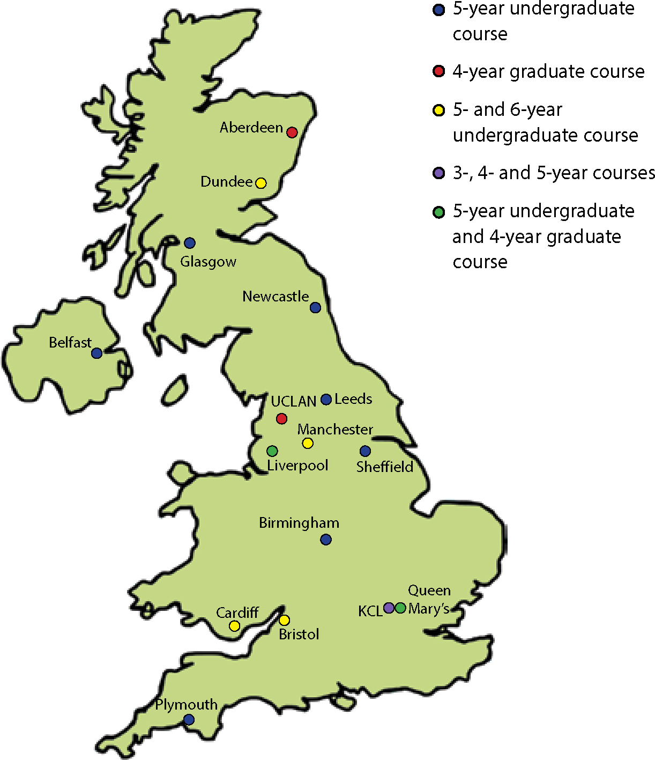
16 Dental Schools in UK
Many schools operate a “hub and spoke” with
outreach centres to under dentist areas
2 postgraduate schools
UCL Eastman and Edinburgh

Slide 12
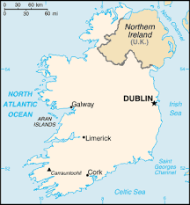
2 Dental Schools in Rep Ireland
Dublin and Cork have an agreement
with Canada

Slide 13
Standard Entry Dentistry 5yrs
Graduate Entry Dentistry 4yrs
Dentistry with a Preliminary Year 6yrs
Fees in England £9250 per year
Fees in Ireland- €3,000 per year
No Fees in Scotland

Slide 14
Task
Discuss for two minutes with your neighbour,
Is Healthcare and Education a human right or a priviledge to be paid for?

Slide 15
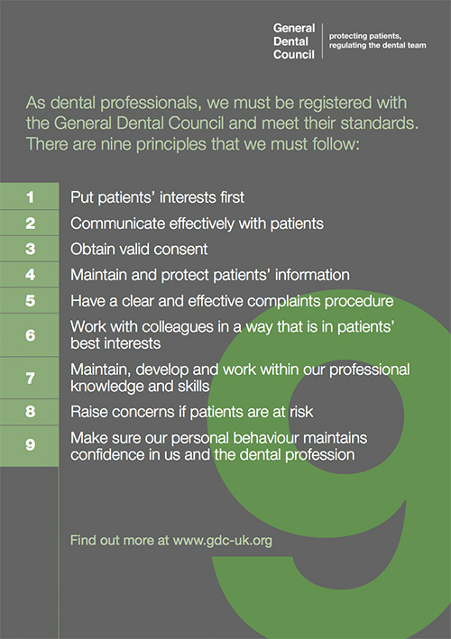

Slide 16
1.Dentists:
Dental Hygienists:
Dental Therapists:
Dental Nurses:
Orthodontic Therapists:
6.Clinical Dental Technicians:
7.Dental Technicians:
7 Registrable members of the Dental Team in UK

Slide 17
The future is female!
Number of registrants in UK October 2023
Registration Type Male Female Gender Unknown Total
Dentist 21315 23690 2 45007
Orthodontic Therapist 40 975 0 1015
Dental Therapist 644 5163 0 5807
Dental Hygienist 700 8772 0 9472
Dental Technician 3581 1470 0 5051
Dental Nurse 957 59593 0 60550
Clinical Dental Technician 365 60 0 425

Slide 18
13 Registrable Specialties in the UK
Dental and Maxillofacial Radiology,
Dental Public Health,
Endodontics,
Oral and Maxillofacial Pathology,
Oral Medicine,
Oral Microbiology,
Oral Surgery,
Orthodontics,
Paediatric Dentistry,
Periodontology,
Prosthodontics,
Restorative Dentistry,
Special Care Dentistry.
Training is usually 3-5 years
Oral and Maxillofacial Surgery is a
medical specialty in the UK

Slide 19
Dental Care is Free in UK Dental Schools!
Curricula must follow General Dental Council Guidance but delivery may vary
At the University of Liverpool Science is longitudinally integrated into the programme
Students see patients in year 1 to 5 year degree
They develop from health promotion to more advanced disease care
On qualifying most will work in salaried positions for our National Health Service for 1-2yrs.
They work in offices/practices 4 days and 1 day they receive education on many issues from
practice management to clinical care, business skills and patient management.

Slide 20
Royal Colleges

Slide 21
Royal Colleges
Accreditation of postgraduate/specialty training centres
Qualifications to enter the specialty register
Continuing Professional Development

Slide 22
National Health Service (NHS) Dentistry:
NHS dental services provide publicly funded dental care to residents in the UK.
Patients can access NHS dental treatment through NHS dentists who work in
NHS practices or through a limited number of private dentists who provide
NHS services.
NHS dental treatment is subsidized, with patients paying set fees for certain
treatments, and some individuals may be eligible for free dental care, depending
on their age, income, or specific health conditions.
NHS dentists follow a fee structure and treatment bands that determine the cost
of various dental procedures.
Private Dentistry:
Many dental practices in the UK are privately operated, and patients can choose
to receive dental care through private dentists .Private dental treatment is not
subsidized by the NHS, and patients are responsible for covering the full cost of their
care.
Mixed Practices:
Some dental practices operate on a mixed model, offering both NHS and private dental care.

Slide 23
Specialist Referrals:
In cases where patients require specialized dental treatment (e.g., orthodontics,
oral surgery, endodontics), general dentists may refer patients to dental specialists.
Dental Hospitals:
Dental hospitals are specialized healthcare facilities that provide more complex and
advanced dental treatments, as well as training for dental professionals.
Dental Schools:
Dental schools in the UK offer undergraduate and postgraduate dental education and
training. They also provide dental care services through teaching clinics where dental
students gain hands-on experience under the supervision of experienced faculty members.

Slide 24
Task
Discuss for two minutes with your neighbour,
Discuss funding models for oral health discuss the challenges & opportunities

Slide 25
Questions?
Notes:
Based at the heart of one of the UK’s most dynamic cities, the University drives the city’s knowledge economy through close collaboration with fellow universities, industry and the NHS. The city’s research base alone is engaged in delivering £470 million of research activity per year alongside worldwide partners and the University plays a huge part in the city region’s economic development organisations, holding key positions in the Local Enterprise Partnership, the Mayor’s Knowledge Quarter Development Zone Board and Daresbury Science Park, to name just a few.

Slide 26
barry.quinn@liverpool.ac.uk
Professor Barry F.A. Quinn
NTF PhD MSc BDS LDS MRD FDS FFD FHEA FFGDP FDTFEd FNCUP
Chair in Restorative Dentistry & Dental Education

